Slide 1
2025 Ancillary Service Methodology
Discussion
Ancillary Services & Operations Analytics
ERCOT

Slide 2
Stakeholder Discussion Timeline
July 23, 2024 – WMWG
July 24, 2024 – PDCWG
August 14, 2024 – PDCWG (Proposed)
August 15, 2024 – OWG (Proposed)
August 30, 2024 – WMWG (Proposed)
September 09, 2024 – ROS
September 11, 2024 – WMS
September 25, 2024 – TAC
October 10, 2024 – BoD
Nov or Dec 2024 – PUC

Slide 3
Discussion Scope for Today
This presentation will discuss the various approaches ERCOT is considering to determine Ancillary Service (A/S) quantities for 2025.
  ERCOT is not considering any changes in the methodologies used to compute Responsive Reserve Service, ERCOT Contingency Reserve Service, and Non-Spinning Reserve Service requirements for 2025.
  NERC’s preliminary BAL-003 Interconnection Frequency Response Obligation (IFRO) assessment for ERCOT for the 2025 Operating Year (OY) has not yet been published. Therefore, this analysis used the minimum RRS-PFR limit of 1,185 MW for 2024.
  ERCOT is considering some changes in the methodology used to compute the Regulation Service for 2025.
The Ancillary Service (A/S) quantities for 2025 contained in this presentation are based on the methodology that was approved in December 2023. The quantities for 2025 reflect moving forward the historic data on which these are based, unless otherwise noted.

Slide 4
Regulation Service

Slide 5
Regulation Service Methodology
ERCOT is considering some changes in the methodology used to compute the minimum Regulation Service requirements in 2025.
The preliminary Regulation quantities for January 2025 through June 2025 in subsequent slides have been computed using current methodology (2022 and 2024 five-minute net load variability), updated Wind Adjustment tables and the updated Solar Adjustment tables.

Slide 6
Adjustments for Regulation Methodology
ERCOT has been considering the idea of switching to an intra-hour netload forecast error based quantity computation methodology.
  This approach would essentially set regulation quantities based on the error in the net load forecast that GTBD/SCED uses.
  The changes in GTBD to use dynamic PSRR thresholds impact the net load forecast error value (in theory these will help lower the net load forecast error).
  Since these changes were implemented in June 2023, an approach like this will be better considered after this change stabilizes.
ERCOT is also conducting analysis for Large Flexible Load (LFL) to determine if any other adjustment should be considered for regulation impacts.

Slide 7
Regulation Up/Down Methodology 2025
 | 2024 Methodology | 2025 Methodology (proposed)
Data Input | 5-min Netload Ramp (2-yr) Historical Reg Deployment (2-yr) | 5-min SCED Netload Forecast Error (2- yr)
Calculation Method | Max(95th of 5-min Netload Ramp, 95th of Historical Reg Deployment) | 95th of 5-min SCED Netload Forecast Error
Wind/Solar Adjustment | GE Table - Increased netload variability/ramp per 1,000 MW installed wind/solar capacity increase | New GE Table - Increased wind/solar forecast error per 1,000 MW installed capacity increase
FRRS Component | 95th of historical FRRS Deployment (2-yr) | No Change
ACE Integral Component | Average of ACE Integral Change (2-yr) | No Change
Load Adjustment (LFL Ramps) | Not considered | TBD

Slide 8
Recap – Dynamic PSRR Threshold in GTBD
ERCOT started to apply a dynamic PSRR threshold in GTBD calculation on 6/12/2023
PSRR thresholds change with 4 pre-defined day periods - Night, Sunrise, Sunset and Other
ERCOT started with a threshold of 80MW/min for Sunrise and Sunset periods on 6/12 and subsequently increased it to 100MW/min on 6/15
ERCOT plans to update the thresholds and the definition of day periods seasonally* (4 times a year)
Night
* Seasons will be defined by shift in solar ramping patterns

Slide 9
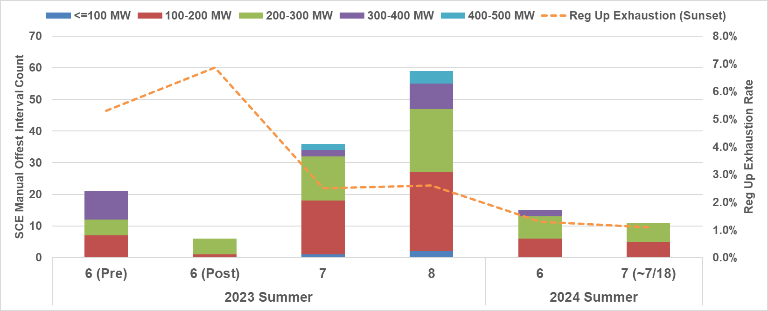
SCED Manual Offset and Reg-Up Exhaustion
Sunset hours: HE 19 - 21
Notes:
FME: Frequency Measurable Event

Slide 10
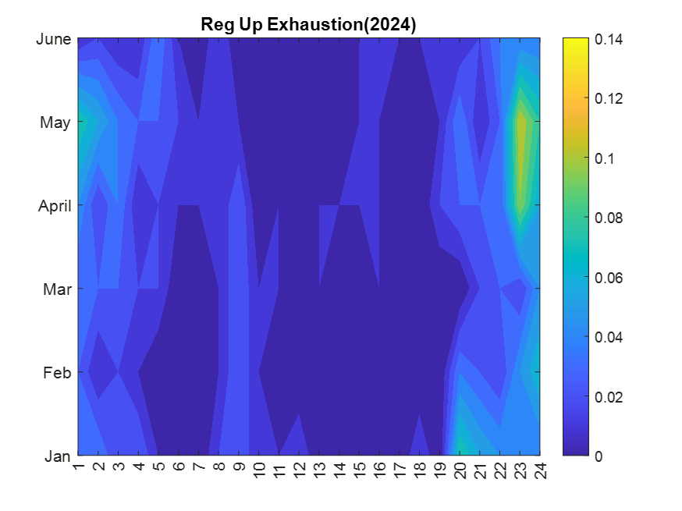
Regulation Exhaustion
2024 Avg: 1.85%
2023 Avg: 1.37%
2024 Avg: 3.84%
2023 Avg: 3.24%

Slide 11
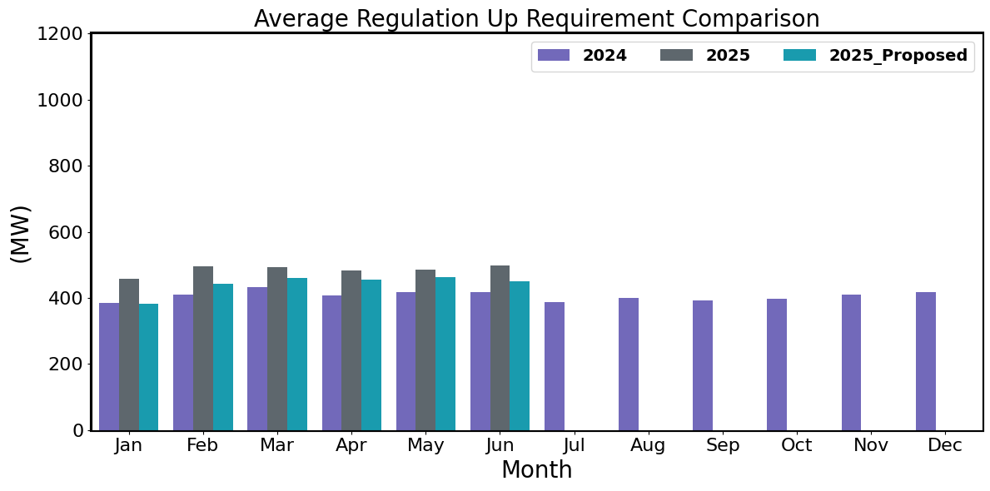
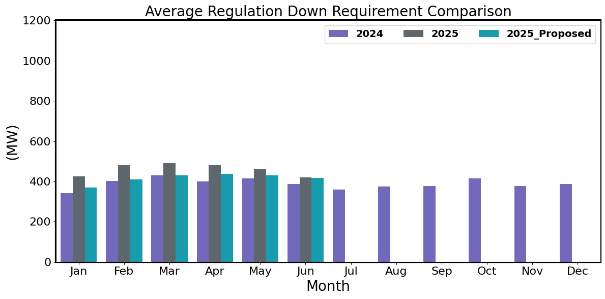
Hourly Average Regulation Comparison
Reg-Up 2025:
On avg. 74 MW increase from prev. year
Largest increase is in Feb by 87 MW
Reg-Up 2025 (Proposed):
On avg. 31 MW increase from prev. year
Largest increase is in Apr by 48 MW
Reg-Down 2025:
On avg. 64 MW increase from prev. year
Largest increase is in Jan by 83 MW
Reg-Down 2025 (Proposed):
On avg. 20 MW increase from prev. year
Largest increase is in Apr by 39 MW

Slide 12
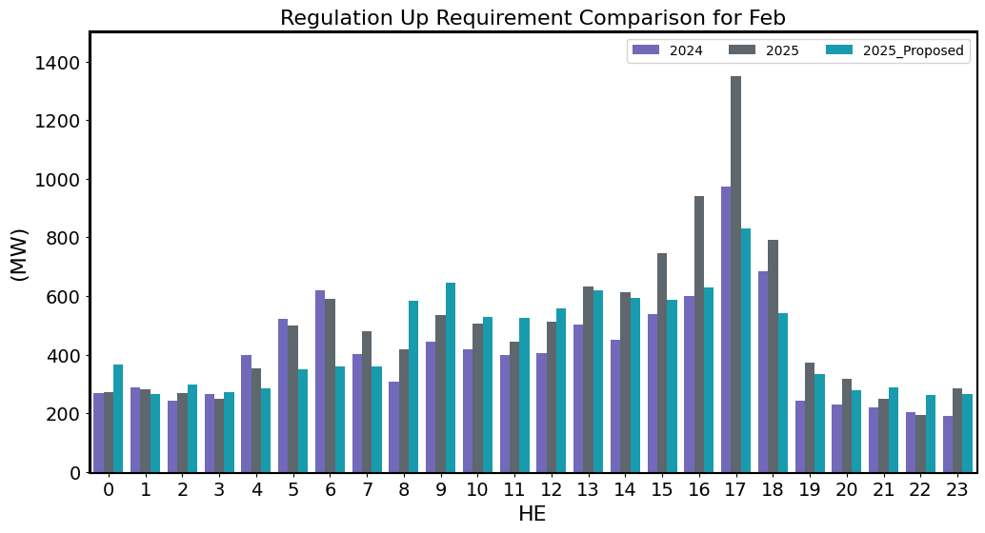
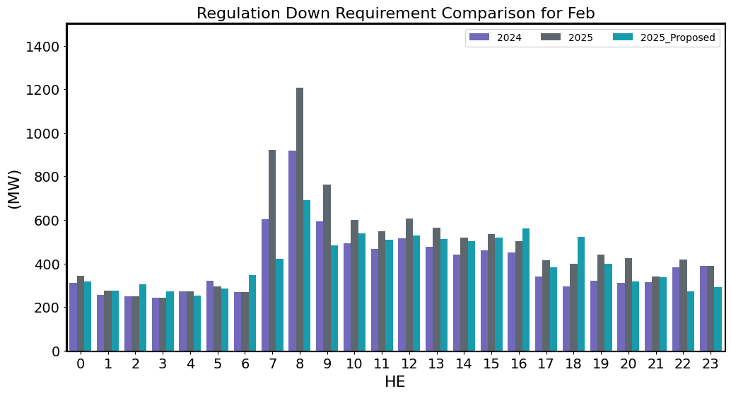
Regulation Comparison February
2025 Reg-Up:
Range: 194 – 1,350 MW;
Avg: 496 MW (87 MW increase from prev. year)
2025 Reg-Up (Proposed):
Range: 261 – 832 MW;
Avg: 443 MW (34 MW increase from prev. year)
2025 Reg-Down:
Range: 241 – 1,208 MW;
Avg: 481 MW (77 MW increase from prev. year)
2025 Reg-Down (Proposed):
Range: 253 – 689 MW;
Avg: 410 MW (6 MW increase from prev. year)

Slide 13
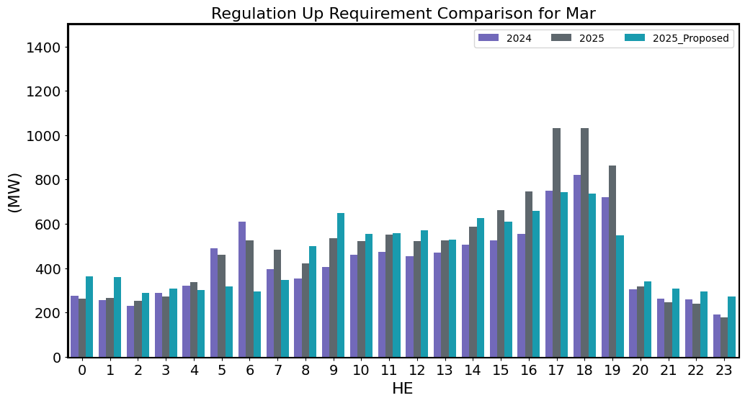
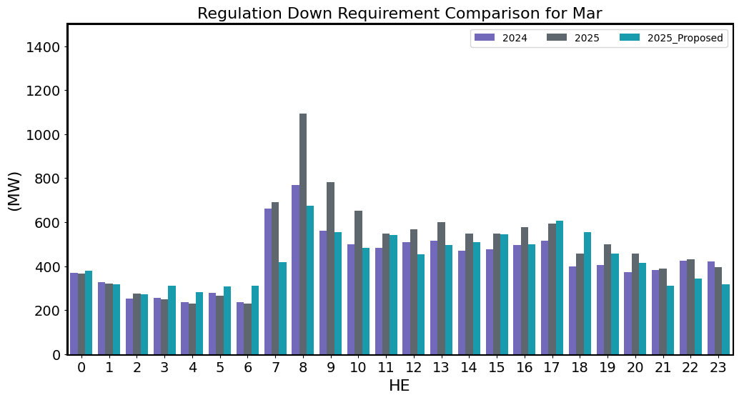
Regulation Comparison March
2025 Reg-Up:
Range: 179 – 1,032 MW;
Avg: 493 MW (61 MW increase from prev. year)
2025 Reg-Up (Proposed):
Range: 271 – 742 MW;
Avg: 461 MW (29 MW increase from prev. year)
2025 Reg-Down:
Range: 231 – 1,093 MW;
Avg: 490 MW (60 MW increase from prev. year)
2025 Reg-Down (Proposed):
Range: 273 – 674 MW;
Avg: 431 MW (1 MW increase from prev. year)

Slide 14
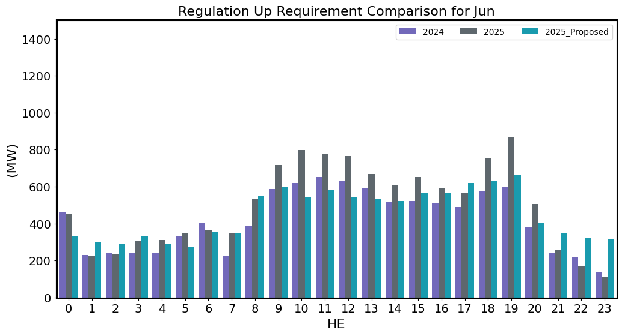
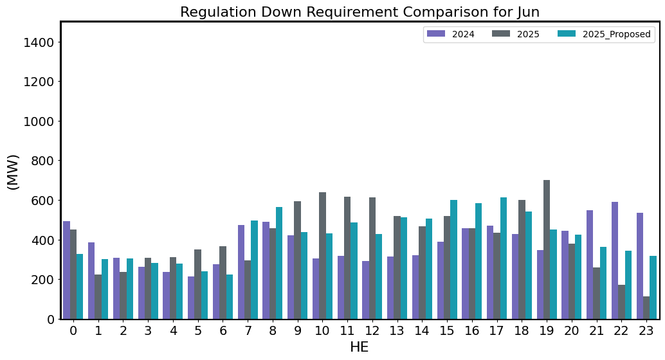
Regulation Comparison June
2025 Reg-Up:
Range: 113 – 865 MW;
Avg: 497 MW (79 MW increase from prev. year)
2025 Reg-Up (Proposed):
Range: 273 – 663 MW;
Avg: 451 MW (33 MW increase from prev. year)
2025 Reg-Down:
Range: 113 – 699 MW;
Avg: 420 MW (32 MW increase from prev. year)
2025 Reg-Down (Proposed):
Range: 223 – 612 MW;
Avg: 419 MW (31 MW increase from prev. year)

Slide 15
Responsive Reserve Service

Slide 16
Responsive Reserve Service (RRS) Methodology
NERC’s preliminary BAL-003 Interconnection Frequency Response Obligation (IFRO) assessment for ERCOT for the 2025 Operating Year (OY) has not yet been published. Therefore, this analysis used the minimum RRS-PFR limit of 1,185 MW for 2024.
The preliminary RRS quantities for January 2025 through June 2025 in subsequent slides have been computed using 2023 and 2024 system inertia conditions and 2024 RRS table.
  The RRS table tracks RRS requirements for different inertia conditions. This table uses a minimum RRS-PFR limit of 1,185 MW for 2024, and the table will be updated for 2025.

Slide 17
2025 RRS Table
Scenario | 1 | 2 | 3 | 4 | 5 | 6 | 7 | 8 | 9 | 10 | 11 | 12
LR/PFR | 2.35:1 | 2.2:1 | 2.06:1 | 1.94:1 | 1.83:1 | 1.74:1 | 1.65:1 | 1.58:1 | 1.51:1 | 1.44:1 | 1.39:1 | 1.33:1
Inertia (GW∙s) | 130 | 140 | 150 | 160 | 170 | 180 | 190 | 200 | 210 | 220 | 230 | 240
PFR Req. (no LR) (MW) | 5,960 | 5,563 | 5,200 | 4,892 | 4,622 | 4,329 | 4,114 | 3,920 | 3,744 | 3,522 | 3,314 | 3,139
*RRS Curr IFRO (MW) | 3,293 | 3,234 | 3,178 | 3,128 | 3,086 | 2,998 | 2,960 | 2,916 | 2,880 | 2,808 | 2,716 | 2,654
**RRS Upd IFRO (MW) | - | - | - | - | - | - | - | - | - | - | - | -
Scenario | 13 | 14 | 15 | 16 | 17 | 18 | 19 | 20 | 21 | 22 | 23 | 24 | 25
LR/PFR | 1.28:1 | 1.24:1 | 1.19:1 | 1.15:1 | 1.12:1 | 1.08:1 | 1.04:1 | 1.01:1 | 1:1 | 1:1 | 1:1 | 1:1 | 1:1
Inertia (GW∙s) | 250 | 260 | 270 | 280 | 290 | 300 | 310 | 320 | 330 | 340 | 350 | 360 | 370
PFR Req. (no LR) (MW) | 3,004 | 2,890 | 2,784 | 2,686 | 2,595 | 2,510 | 2,421 | 2,353 | 2,290 | 2,230 | 2,173 | 2,119 | 2,068
*RRS Curr IFRO (MW) | 2,606 | 2,560 | 2,529 | 2,491 | 2,444 | 2,412 | 2,373 | 2,342 | 2,290 | 2,230 | 2,173 | 2,119 | 2,068
**RRS Upd IFRO (MW) | - | - | - | - | - | - | - | - | - | - | - | - | -
*RRS quantity is calculated for RCC of 2,805 with limit of 60% limit on LRs and min RRS-PFR limit of 1,185 MW.
**The 2025 IFRO assessment has not yet been reported back from NERC, preventing the calculation of RRS quantity.
***Red font in table above identifies study scenario where RRS needed < 2,300 MW. RRS requirement during these is based on the applicable floor.
****Generation mix (CCs, Gas, SC, Coal, Steam) providing 1,150 MW of PFR has been aligned with actual historic system operations.
Inertia < 250 GW·s: 30% Coal + 70% Rest. Inertia ≥ 250 GW·s: 15% Coal + 85% Rest

Slide 18
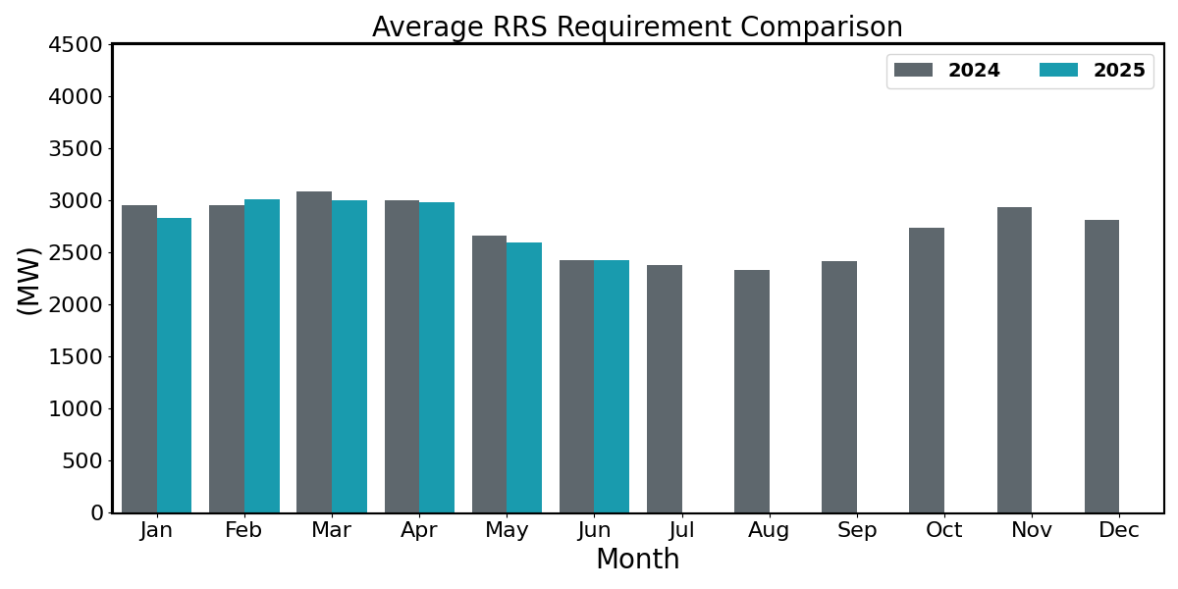
Hourly Average RRS Comparison
2025 RRS:
On avg. 84 MW increase from prev. year
Largest increase is in Feb by 57 MW
Largest decrease is in Jan by 118 MW
*2025 RRS quantities are calculated using the 2024 minimum RRS-PFR limits (to be updated).

Slide 19
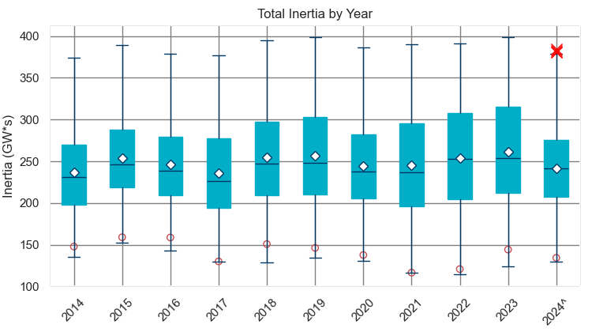
Total Inertia (2014 – 2024.06)
The average inertia in 2023 was comparable to 2022, but currently 2024 is trending lower than in 2022.
[Total inertia for 2014 - 2024.06]

Slide 20
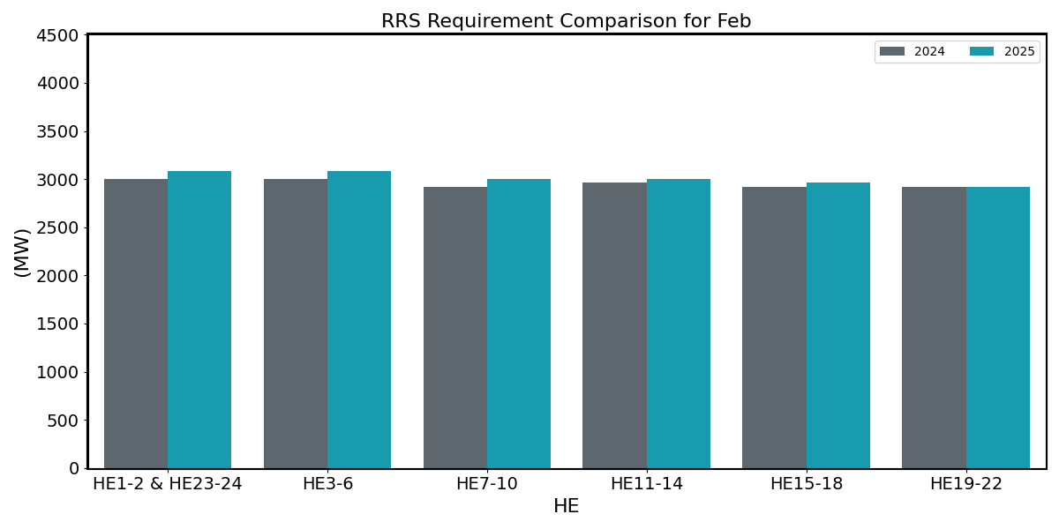
RRS Comparison February
2025 RRS:
Range: 2,916 – 3,086 MW;
Avg: 3,007 MW (56 MW increase from prev. year)
*2025 RRS quantities are calculated using the 2024 minimum RRS-PFR limits (to be updated).

Slide 21
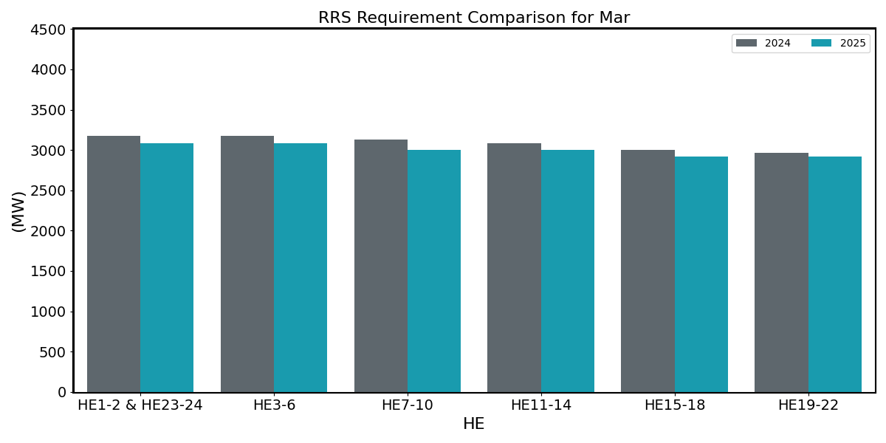
RRS Comparison March
2025 RRS:
Range: 2,916 – 3,086 MW;
Avg: 3,000 MW (88 MW decrease from prev. year)
*2025 RRS quantities are calculated using the 2024 minimum RRS-PFR limits (to be updated).

Slide 22
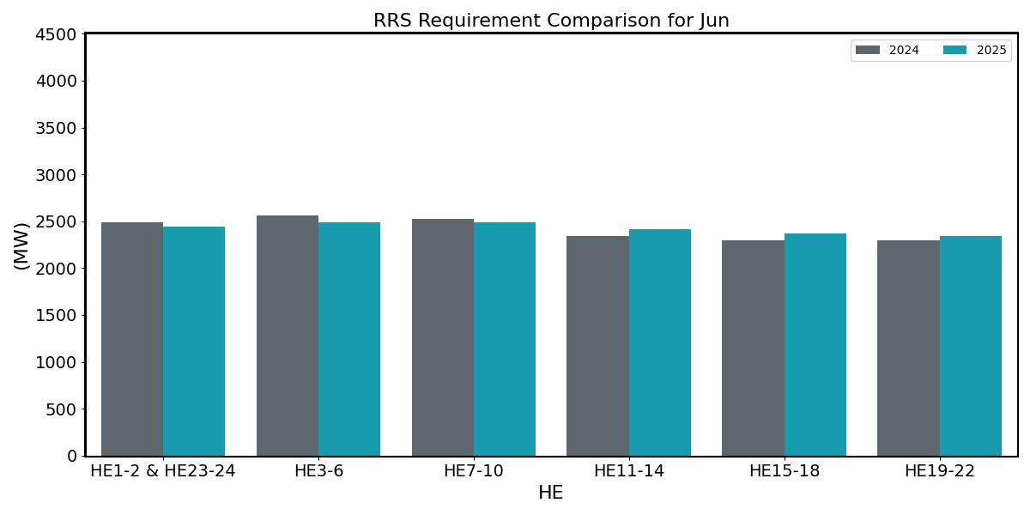
RRS Comparison June
2025 RRS:
Range: 2,342 – 2,491 MW;
Avg: 2,426 MW (6 MW increase from prev. year)
*2025 RRS quantities are calculated using the 2024 minimum RRS-PFR limits (to be updated).

Slide 23
ERCOT Contingency Reserve
Service

Slide 24
ECRS Methodology
ERCOT is not considering any change to the methodology used to compute the minimum ECRS requirements in 2025. ECRS requirements are computed as the sum of capacity needed to recover frequency following a large unit trip and capacity needed to support net load forecast errors during sustained net load ramps.
The preliminary ECRS quantities for January 2025 through June 2025 in subsequent slides have been computed using current methodology (2023 and 2024 Intra-Hour Net load and Net load Forecast, 2023 and 2024 system inertia conditions) and updated Intra-hour Solar Over-Forecast Error Adjustment table.
  Intra-hour Solar Over-Forecast Error Adjustment Table tracks estimated increase in solar over forecast error per 1000 MW increase in installed solar capacity

Slide 25
ECRS Deployment (06/2023 – 06/2024)
Year | Average ECRS Deployed | Deployment Duration | Number of Events | Reason for Deployment
2023 | 23.50% | 1.14 Hrs | 31 | Available capacity not sufficient for projected Net Load
 | 27.10% | 0.09 Hrs | 11 | Frequency below 59.91Hz
2024 | 28.50% | 1.33 Hrs | 5 | Available capacity not sufficient for projected Net Load
 | 36.07% | 0.09 Hrs | 5 | Frequency below 59.91Hz

Slide 26
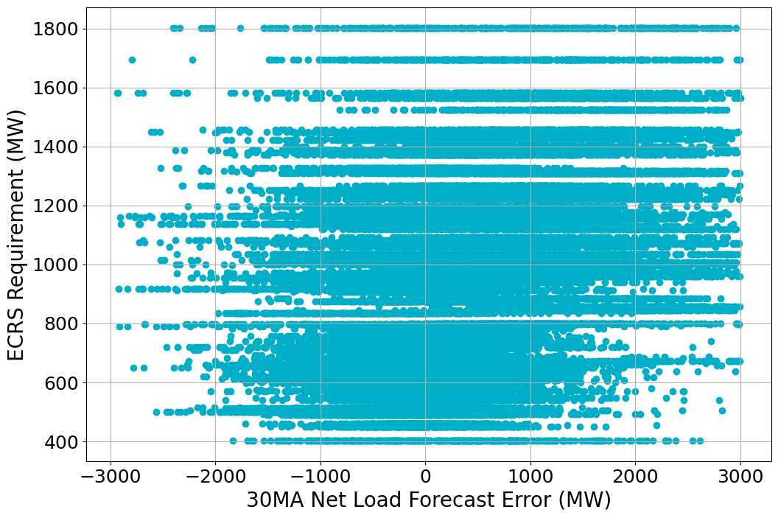
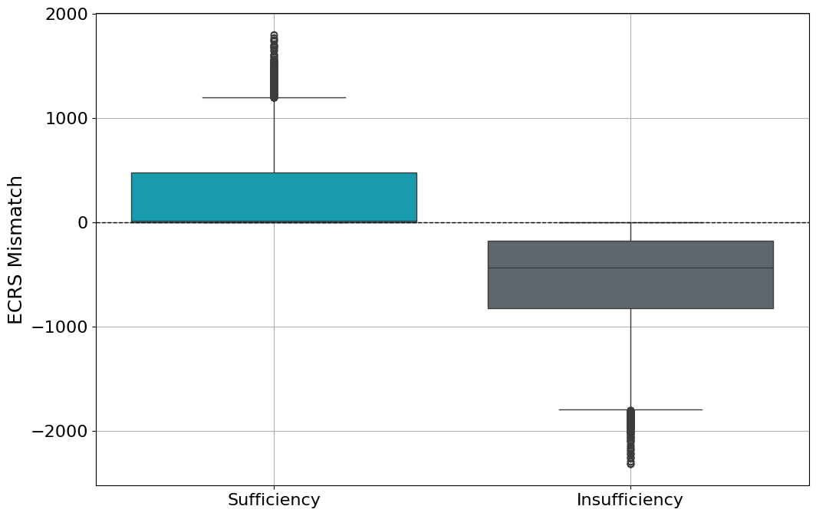
Adequacy of ECRS Quantities in 2024
Between Jan 1, 2024 and June 30, 2024,
  10.5% of the time the 30 Minute Ahead (MA) net load forecast error based ECRS was insufficient to cover the 30MA risk
  ECRS Requirement = Ramping part of ECRS + Solar Adjustment
  ECRS Mismatch = ECRS Requirement – 30MA NLFE*
*NLFE: Net Load Forecast Error

Slide 27
Hourly Average ECRS Comparison
2025 ECRS:
On avg. 190 MW increase from prev. year
Largest increase is in May by 433 MW

Slide 28
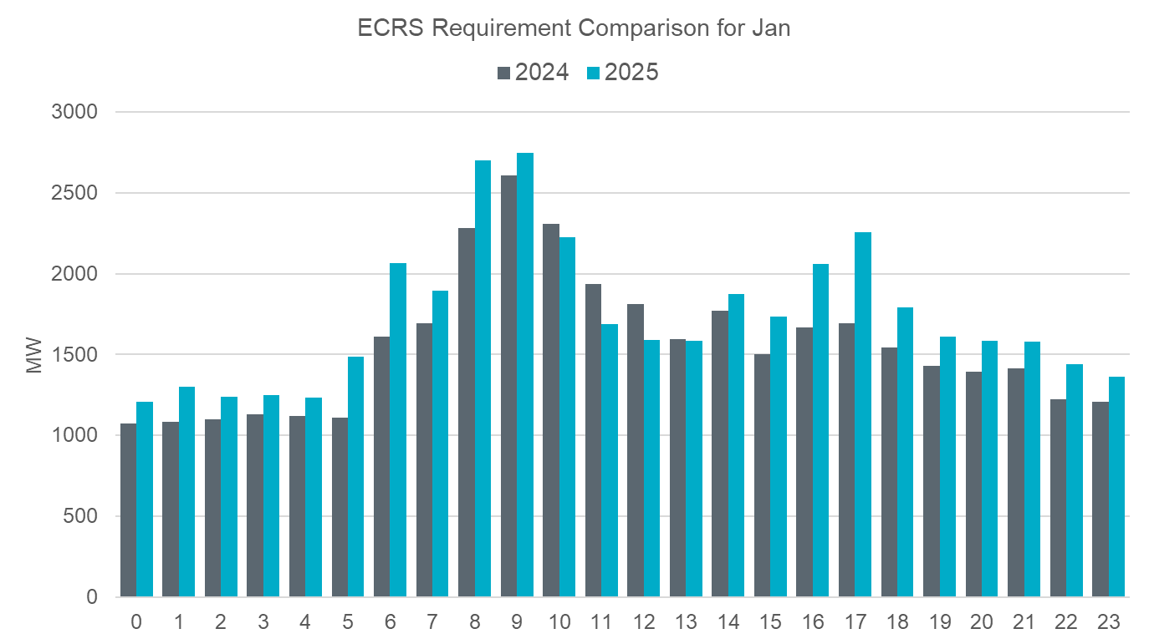
ECRS Comparison January
2025 ECRS:
Range: 1,207 – 2,749 MW;
Avg: 1,729 MW (175 MW increase from prev. year)

Slide 29
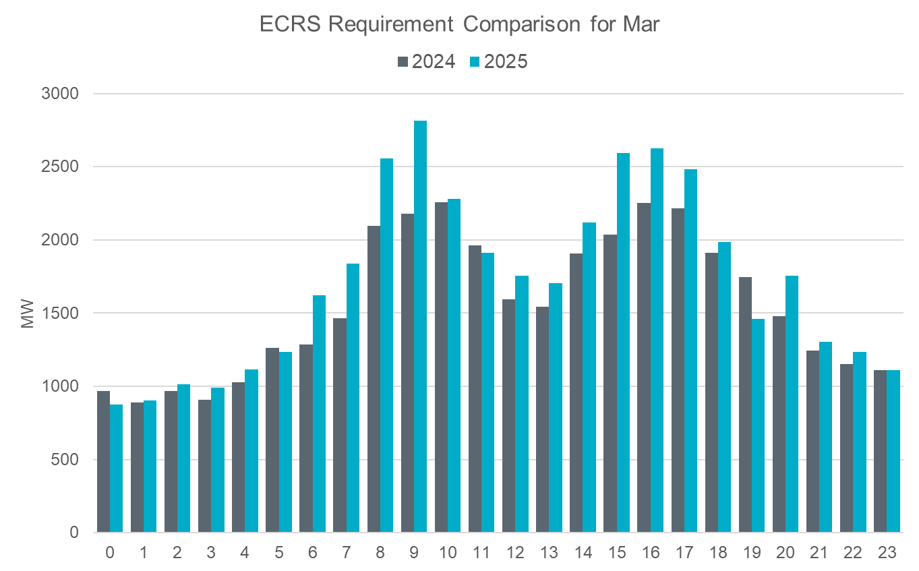
ECRS Comparison March
2025 ECRS:
Range: 875 – 2,812 MW;
Avg: 1,720 MW (159 MW increase from prev. year)

Slide 30
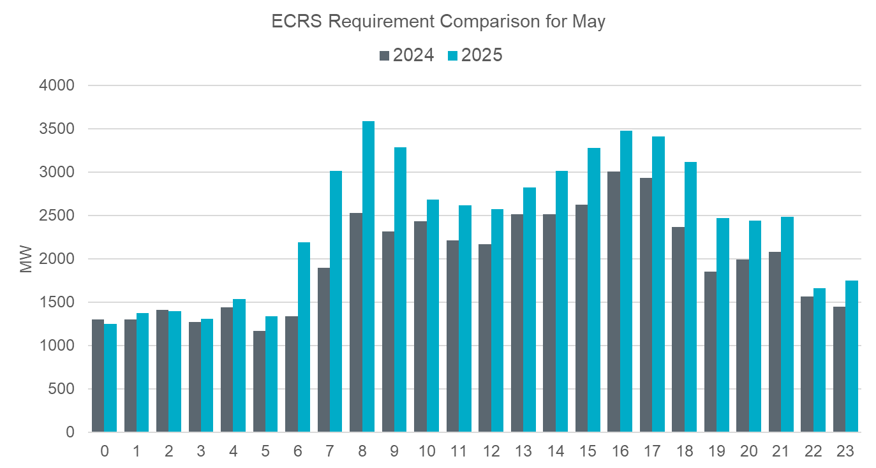
ECRS Comparison May
2025 ECRS:
Range: 1,251 – 3,591 MW;
Avg: 2,421 MW (433 MW increase from prev. year)

Slide 31
Non-Spinning Reserve Service

Slide 32
Non-Spinning Reserve Methodology
ERCOT is not considering any change to the methodology used to compute the minimum Non-Spin requirements in 2025. Non-Spin quantities in 2025 will be computed using 75th to 95th percentile of 6 Hours Ahead (HA) hourly average net load forecast error to compute Non-Spin quantities.
The preliminary Non-Spin quantities for January 2025 through June 2025 in subsequent slides have been computed using current methodology (2022, 2023 and 2024 Net load and Net load Forecast), updated Wind Over-Forecast Error Adjustment table and the updated Solar Over-Forecast Error Adjustment table.
  Wind and Solar Over-Forecast Error Adjustment Table track estimated increase in wind over forecast error per 1000 MW increase in installed wind and solar capacity, respectively.

Slide 33
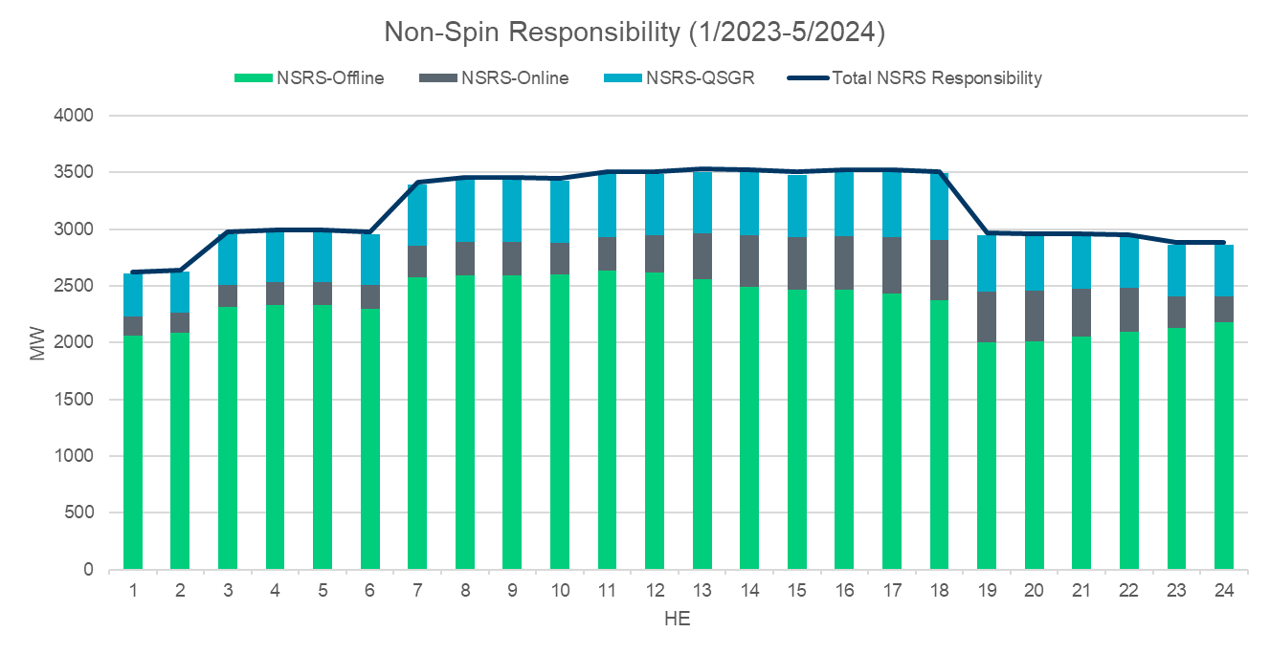
NSRS Deployment (01/2023 – 06/2024)
Year | Average MW Deployed | Deployment Duration | Number of Events
2023 | 629 | 2.07 Hrs | 44
2024 | 1,087 | 4.09 Hrs | 8

Slide 34
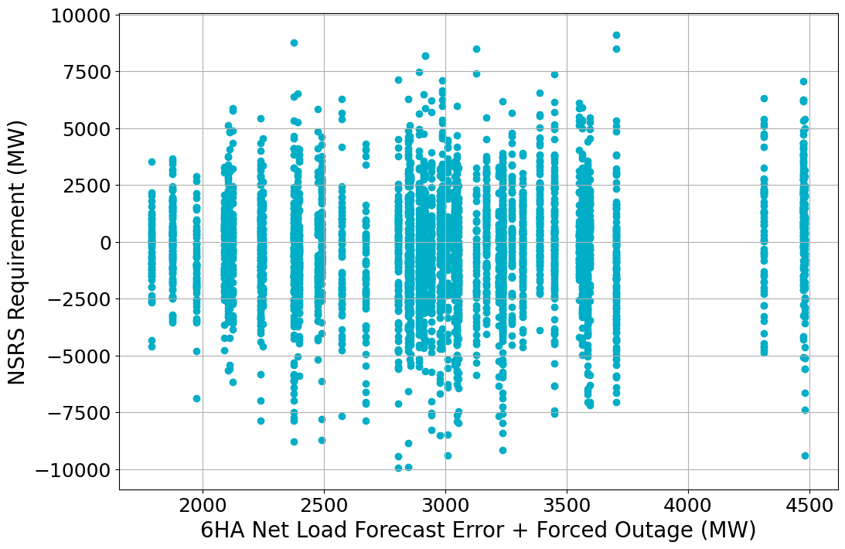
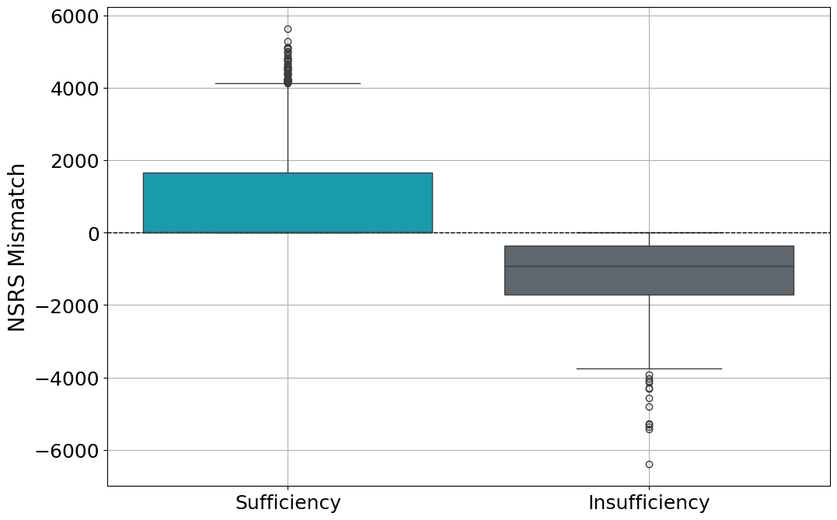
Adequacy of Non-Spin Quantities in 2024
Between Jan 1, 2024 and June 30, 2024,
  8.1% of the time the 6 Hour Ahead (HA) net load forecast error based Non-Spin was insufficient to cover the 6HA risk
  NSRS Mismatch = NSRS Requirement – (6HA NLFE* + Forced Outage)
*NLFE: Net Load Forecast Error

Slide 35
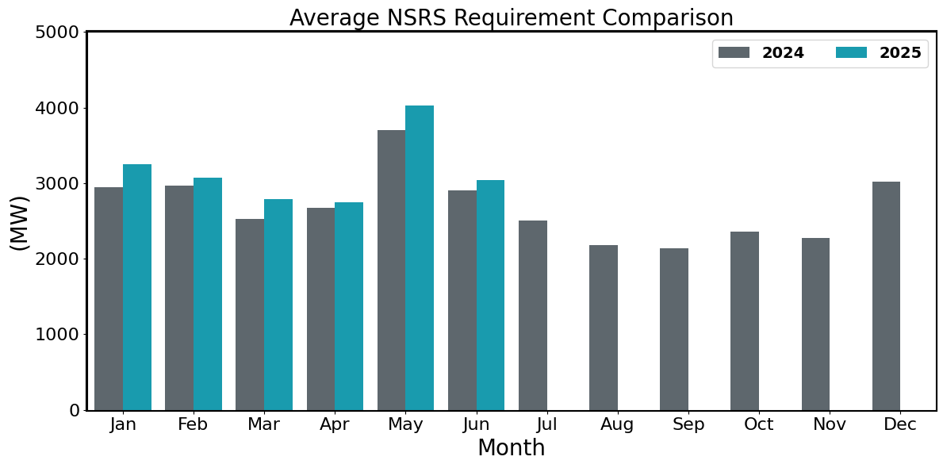
Hourly Average Non-Spin Comparison
2025 NSRS:
On avg. 203 MW increase from prev. year
Largest increase is in May by 327 MW

Slide 36
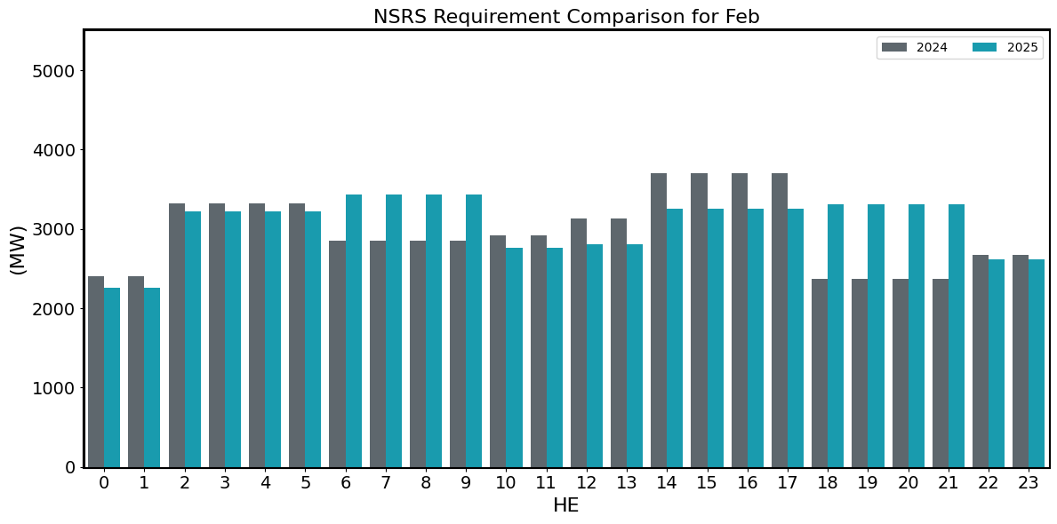
Non-Spin Comparison February
2025 NSRS:
Range: 2,260 – 3,438 MW;
Avg: 3,075 MW (107 MW increase from prev. year)

Slide 37
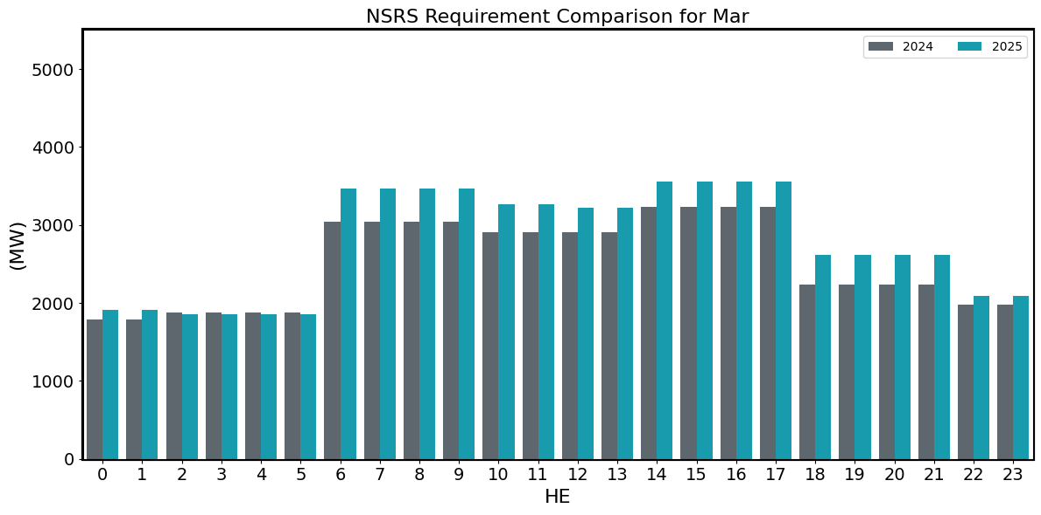
Non-Spin Comparison March
2025 NSRS:
Range: 1,859 – 3,561 MW;
Avg: 2,791 MW (262 MW increase from prev. year)

Slide 38
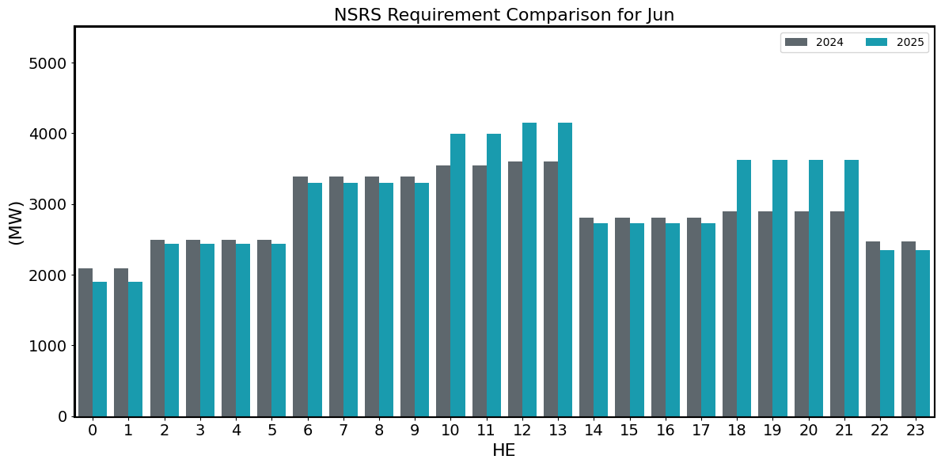
Non-Spin Comparison June
2025 NSRS:
Range: 1,900 – 4,145 MW;
Avg: 3,045 MW (139 MW increase from prev. year)

Slide 39
Summary
Based on the analysis ERCOT has conducted thus far,
  ERCOT is not considering any changes in the methodologies used to compute Responsive Reserve Service, ERCOT Contingency Reserve Service, and Non-Spinning Reserve Service requirements for 2025.
  ERCOT is considering changes in the methodology used to compute the Regulation Service for 2025.
The proposed timeline for this review is included alongside.
Similar to last year, to make the AS Methodology review process more efficient, ERCOT plans to provide all relevant details on the proposed methodology during the July/August working group discussions and provide just a summary of the proposed changes during the September/October discussions.
2025 Methodology Review Timeline
July 23, 2024 – WMWG
July 24, 2024 – PDCWG
August 14, 2024 – PDCWG (Proposed)
August 15, 2024 – OWG (Proposed)
August 30, 2024 – WMWG (Proposed)
September 09, 2024 – ROS
September 11, 2024 – WMS
September 25, 2024 – TAC
October 10, 2024 – BoD
Nov or Dec 2024 – PUC
Interested Stakeholders are requested to attend July and August PDCWG and/or WMWG meetings to provide any feedback on the proposed 2025 AS Methodology.

Slide 40
Suggestions?

Slide 41
APPENDIX

Slide 42
Wind GE Table for Reg-Up
Wind | Jan | Feb | Mar | Apr | May | Jun
H01 | 2.1 | 2.7 | 1.0 | -0.1 | 0.7 | 0.4
H02 | 3.6 | 2.9 | 2.1 | 1.3 | 2.6 | 2.0
H03 | 2.3 | 3.0 | 3.0 | 2.3 | 3.8 | 2.9
H04 | 2.1 | 2.7 | 3.4 | 3.0 | 4.3 | 3.2
H05 | 1.6 | 2.3 | 3.3 | 2.5 | 4.1 | 2.8
H06 | 2.1 | 1.9 | 3.3 | 1.7 | 3.0 | 3.1
H07 | 2.8 | 1.4 | 3.2 | 2.6 | 3.2 | 4.2
H08 | 3.1 | 2.2 | 4.1 | 4.3 | 5.8 | 6.8
H09 | 7.9 | 3.9 | 6.0 | 5.8 | 6.0 | 5.8
H10 | 9.6 | 3.0 | 3.0 | 2.9 | 2.5 | 2.5
H11 | 2.4 | 1.5 | 2.8 | 3.0 | 2.9 | 3.3
H12 | 0.8 | 1.0 | 3.5 | 2.9 | 2.7 | 4.0
H13 | 1.5 | 0.8 | 3.5 | 2.2 | 1.7 | 3.2
H14 | 0.2 | 0.3 | 2.6 | 1.2 | 0.7 | 2.2
H15 | 1.2 | 0.6 | 1.7 | 0.0 | -0.7 | 0.5
H16 | 1.7 | 0.9 | 1.0 | -0.1 | -1.3 | -0.6
H17 | 2.9 | 1.9 | 1.1 | 0.5 | -1.0 | -0.7
H18 | 4.7 | 2.6 | 1.4 | 0.6 | -0.8 | -0.8
H19 | -1.1 | 0.9 | 0.6 | 0.5 | -0.2 | -0.3
H20 | -1.5 | -0.3 | 0.4 | 1.3 | 0.8 | 0.3
H21 | -1.3 | -0.5 | -0.2 | 0.2 | 0.0 | 0.1
H22 | -0.5 | -0.3 | -0.6 | -0.6 | -0.5 | -0.3
H23 | -0.3 | 0.2 | 0.1 | -0.3 | -0.1 | 0.0
H24 | 1.8 | 1.3 | 0.3 | 0.1 | 0.4 | 0.2
Wind | Jan | Feb | Mar | Apr | May | Jun
H01 | 1.5 | 1.2 | 1.1 | 1.5 | 1.5 | 1.4
H02 | 1.2 | 1.1 | 1.1 | 1.4 | 1.6 | 1.3
H03 | 1.2 | 1.1 | 1.1 | 1.4 | 1.4 | 1.4
H04 | 1.3 | 1.2 | 1.2 | 1.4 | 1.4 | 1.3
H05 | 1.4 | 1.2 | 1.1 | 1.3 | 1.4 | 1.2
H06 | 1.5 | 1.1 | 1.1 | 1.5 | 1.4 | 1.2
H07 | 1.4 | 1.2 | 1.1 | 1.4 | 1.6 | 1.3
H08 | 1.4 | 1.0 | 1.2 | 1.5 | 1.6 | 1.8
H09 | 2.1 | 1.7 | 1.8 | 2.0 | 1.6 | 1.1
H10 | 2.0 | 1.1 | 1.3 | 1.5 | 1.3 | 1.1
H11 | 1.5 | 1.2 | 1.2 | 1.7 | 1.7 | 1.3
H12 | 1.3 | 1.1 | 1.3 | 1.8 | 1.5 | 1.3
H13 | 1.4 | 1.1 | 1.3 | 1.7 | 1.3 | 1.1
H14 | 1.3 | 1.2 | 1.2 | 1.7 | 1.4 | 1.3
H15 | 1.4 | 1.2 | 1.3 | 1.8 | 1.4 | 1.1
H16 | 1.4 | 1.2 | 1.3 | 1.8 | 1.5 | 1.2
H17 | 1.5 | 1.2 | 1.3 | 1.5 | 1.5 | 1.3
H18 | 1.8 | 1.4 | 1.4 | 1.7 | 1.5 | 1.3
H19 | 1.0 | 1.1 | 1.4 | 1.8 | 1.5 | 1.4
H20 | 1.1 | 1.0 | 1.2 | 1.8 | 1.6 | 1.4
H21 | 1.1 | 1.0 | 1.0 | 1.4 | 1.5 | 1.2
H22 | 1.1 | 1.0 | 1.0 | 1.5 | 1.3 | 1.1
H23 | 1.2 | 1.1 | 1.1 | 1.3 | 1.6 | 1.2
H24 | 1.3 | 1.2 | 1.1 | 1.5 | 1.5 | 1.3
[Current]
[Proposed]

Slide 43
Solar GE Table for Reg-Up
Solar | Jan | Feb | Mar | Apr | May | Jun
H01 | 0.0 | 0.0 | 0.0 | 0.0 | 0.0 | 0.0
H02 | 0.0 | 0.0 | 0.0 | 0.0 | 0.0 | 0.0
H03 | 0.0 | 0.0 | 0.0 | 0.0 | 0.0 | 0.0
H04 | 0.0 | 0.0 | 0.0 | 0.0 | 0.0 | 0.0
H05 | 0.0 | 0.0 | 0.0 | 0.0 | 0.0 | 0.0
H06 | 0.0 | 0.0 | 0.0 | 0.0 | 0.0 | 0.0
H07 | 0.0 | 0.0 | 0.0 | 0.0 | 0.0 | 0.0
H08 | 94.2 | 78.5 | 85.1 | 76.0 | 74.5 | 55.6
H09 | 81.5 | 81.0 | 64.4 | 67.7 | 85.8 | 74.0
H10 | 103.1 | 120.4 | 84.4 | 81.2 | 89.9 | 123.2
H11 | 116.6 | 112.7 | 113.9 | 102.3 | 128.2 | 157.9
H12 | 138.6 | 115.1 | 105.9 | 121.2 | 125.3 | 162.6
H13 | 116.5 | 125.9 | 121.9 | 133.1 | 131.3 | 151.2
H14 | 133.0 | 134.3 | 115.6 | 126.0 | 136.8 | 150.5
H15 | 124.4 | 145.6 | 130.6 | 118.8 | 142.5 | 141.7
H16 | 147.1 | 155.3 | 128.1 | 121.7 | 137.5 | 130.8
H17 | 204.0 | 176.3 | 136.2 | 132.2 | 152.5 | 133.2
H18 | 202.7 | 197.8 | 161.8 | 134.3 | 132.3 | 132.5
H19 | 92.4 | 153.2 | 165.2 | 160.9 | 143.5 | 155.2
H20 | 68.1 | 77.3 | 131.1 | 167.7 | 149.6 | 165.5
H21 | 75.4 | 72.7 | 69.5 | 86.4 | 103.1 | 125.8
H22 | 0.0 | 0.0 | 0.0 | 0.0 | 0.0 | 0.0
H23 | 0.0 | 0.0 | 0.0 | 0.0 | 0.0 | 0.0
H24 | 0.0 | 0.0 | 0.0 | 0.0 | 0.0 | 0.0
Solar | Jan | Feb | Mar | Apr | May | Jun
H01 | 0.0 | 0.0 | 0.0 | 0.0 | 0.0 | 0.0
H02 | 0.0 | 0.0 | 0.0 | 0.0 | 0.0 | 0.0
H03 | 0.0 | 0.0 | 0.0 | 0.0 | 0.0 | 0.0
H04 | 0.0 | 0.0 | 0.0 | 0.0 | 0.0 | 0.0
H05 | 0.0 | 0.0 | 0.0 | 0.0 | 0.0 | 0.0
H06 | 0.0 | 0.0 | 0.0 | 0.0 | 0.0 | 0.0
H07 | 1.8 | 6.3 | 2.5 | 8.2 | 28.2 | 38.5
H08 | 29.6 | 28.2 | 23.7 | 26.1 | 25.4 | 15.1
H09 | 16.4 | 28.6 | 28.2 | 36.7 | 51.1 | 66.5
H10 | 73.4 | 67.0 | 60.6 | 58.1 | 67.0 | 67.9
H11 | 52.1 | 57.4 | 61.1 | 52.3 | 61.2 | 57.5
H12 | 51.7 | 41.2 | 52.4 | 48.6 | 60.8 | 68.0
H13 | 42.5 | 54.9 | 49.9 | 46.9 | 59.0 | 55.4
H14 | 52.2 | 59.6 | 55.9 | 53.3 | 70.7 | 61.5
H15 | 57.5 | 58.2 | 59.1 | 52.5 | 60.6 | 57.6
H16 | 62.1 | 58.0 | 55.0 | 58.2 | 63.9 | 65.5
H17 | 117.7 | 69.8 | 72.6 | 64.6 | 78.8 | 72.6
H18 | 114.1 | 169.9 | 120.5 | 59.5 | 80.2 | 78.4
H19 | 33.3 | 46.1 | 128.3 | 110.8 | 84.9 | 80.5
H20 | 30.3 | 6.7 | 82.9 | 115.3 | 117.6 | 132.1
H21 | 0.5 | 9.9 | 0.0 | 23.5 | 39.8 | 45.1
H22 | 14.7 | 22.3 | 0.2 | 4.6 | 0.8 | 53.2
H23 | 0.0 | 0.0 | 0.0 | 0.0 | 0.0 | 0.0
H24 | 0.0 | 0.0 | 0.0 | 0.0 | 0.0 | 0.0
[Current]
[Proposed]

Slide 44
Wind GE Table for Reg-Down
Wind | Jan | Feb | Mar | Apr | May | Jun
H01 | 2.2 | 0.7 | 3.2 | 2.2 | 4.0 | 3.0
H02 | -0.3 | 0.3 | 1.1 | 0.6 | 1.0 | 1.0
H03 | -0.3 | 0.0 | -0.5 | -1.1 | -0.7 | -0.1
H04 | -0.4 | -0.3 | -1.0 | -1.4 | -1.6 | -1.4
H05 | -0.2 | 0.3 | -0.5 | -1.2 | -0.9 | -0.7
H06 | 0.0 | 0.2 | 0.0 | -0.6 | 0.1 | -0.1
H07 | 0.1 | -0.5 | -0.4 | -0.6 | 0.0 | -0.4
H08 | -0.1 | -0.8 | -0.4 | -1.0 | -0.5 | -0.7
H09 | -5.3 | -2.5 | -1.1 | -0.8 | -0.3 | 0.2
H10 | -1.9 | -0.1 | 1.7 | 1.6 | 0.7 | 0.3
H11 | 3.4 | 1.9 | 2.1 | 0.9 | 0.2 | 0.0
H12 | 3.5 | 1.6 | 1.0 | -0.2 | -0.1 | -0.2
H13 | 2.4 | 1.2 | 0.6 | -0.1 | 0.4 | 0.1
H14 | 2.0 | 1.7 | 1.2 | 0.8 | 1.5 | 0.8
H15 | 1.4 | 2.1 | 1.7 | 1.5 | 2.6 | 1.9
H16 | 0.3 | 1.9 | 2.3 | 1.9 | 3.4 | 3.0
H17 | 0.4 | 2.1 | 3.8 | 2.8 | 4.5 | 4.3
H18 | 1.0 | 2.0 | 4.4 | 3.7 | 5.2 | 4.6
H19 | 9.4 | 4.0 | 5.0 | 4.5 | 5.7 | 5.0
H20 | 8.0 | 5.5 | 6.2 | 4.5 | 4.1 | 4.8
H21 | 4.6 | 3.6 | 6.5 | 6.6 | 5.2 | 5.1
H22 | 4.9 | 2.5 | 5.6 | 6.9 | 6.4 | 6.6
H23 | 5.1 | 1.7 | 3.7 | 5.4 | 4.4 | 4.8
H24 | 1.6 | 1.5 | 1.8 | 2.9 | 1.8 | 2.9
Wind | Jan | Feb | Mar | Apr | May | Jun
H01 | 1.3 | 1.1 | 1.0 | 1.4 | 1.7 | 1.4
H02 | 1.3 | 1.1 | 1.0 | 1.3 | 1.4 | 1.3
H03 | 1.2 | 1.0 | 0.9 | 1.3 | 1.2 | 1.2
H04 | 1.2 | 1.0 | 1.0 | 1.2 | 1.2 | 1.2
H05 | 1.4 | 1.0 | 1.0 | 1.2 | 1.2 | 1.0
H06 | 1.4 | 1.1 | 1.1 | 1.3 | 1.5 | 1.1
H07 | 1.5 | 1.1 | 1.1 | 1.3 | 1.6 | 1.0
H08 | 1.1 | 1.0 | 0.9 | 1.2 | 1.2 | 1.0
H09 | 1.1 | 1.0 | 1.2 | 1.6 | 1.7 | 1.7
H10 | 1.4 | 1.2 | 1.4 | 2.0 | 1.5 | 1.0
H11 | 1.5 | 1.2 | 1.2 | 1.5 | 1.4 | 1.0
H12 | 1.4 | 1.3 | 1.1 | 1.4 | 1.3 | 0.9
H13 | 1.3 | 1.4 | 1.1 | 1.4 | 1.2 | 0.9
H14 | 1.2 | 1.3 | 1.3 | 1.7 | 1.5 | 1.2
H15 | 1.2 | 1.3 | 1.4 | 1.7 | 1.6 | 1.4
H16 | 1.2 | 1.3 | 1.3 | 1.9 | 1.8 | 1.5
H17 | 1.2 | 1.2 | 1.4 | 1.8 | 1.8 | 1.7
H18 | 1.4 | 1.2 | 1.2 | 2.0 | 2.1 | 1.6
H19 | 1.8 | 1.6 | 1.3 | 1.7 | 1.9 | 1.7
H20 | 1.6 | 1.6 | 1.6 | 1.8 | 1.7 | 1.7
H21 | 1.3 | 1.2 | 1.5 | 2.3 | 1.9 | 1.7
H22 | 1.5 | 1.1 | 1.3 | 2.2 | 1.9 | 1.9
H23 | 1.4 | 1.1 | 1.3 | 1.7 | 1.6 | 1.5
H24 | 1.3 | 1.1 | 1.1 | 1.6 | 1.5 | 1.5
[Current]
[Proposed]

Slide 45
Solar GE Table for Reg-Down
Solar | Jan | Feb | Mar | Apr | May | Jun
H01 | 0.0 | 0.0 | 0.0 | 0.0 | 0.0 | 0.0
H02 | 0.0 | 0.0 | 0.0 | 0.0 | 0.0 | 0.0
H03 | 0.0 | 0.0 | 0.0 | 0.0 | 0.0 | 0.0
H04 | 0.0 | 0.0 | 0.0 | 0.0 | 0.0 | 0.0
H05 | 0.0 | 0.0 | 0.0 | 0.0 | 0.0 | 0.0
H06 | 0.0 | 0.0 | 0.0 | 0.0 | 0.0 | 0.0
H07 | 0.0 | 0.0 | 0.0 | 0.0 | 0.0 | 0.0
H08 | 83.7 | 118.3 | 94.3 | 107.1 | 115.3 | 121.5
H09 | 163.5 | 170.4 | 132.8 | 145.9 | 135.7 | 139.2
H10 | 134.3 | 144.3 | 141.1 | 137.8 | 102.0 | 114.3
H11 | 142.2 | 162.2 | 124.3 | 113.5 | 107.1 | 97.7
H12 | 117.8 | 143.5 | 123.0 | 109.1 | 97.0 | 96.3
H13 | 129.5 | 144.1 | 122.0 | 100.1 | 99.4 | 94.6
H14 | 126.2 | 136.9 | 125.0 | 108.3 | 104.9 | 96.3
H15 | 114.8 | 133.6 | 109.0 | 108.6 | 116.3 | 98.9
H16 | 103.5 | 130.6 | 115.2 | 125.0 | 113.9 | 109.2
H17 | 73.8 | 95.4 | 113.2 | 107.6 | 103.7 | 126.2
H18 | 60.3 | 64.4 | 110.6 | 103.7 | 107.2 | 112.3
H19 | 122.4 | 98.6 | 79.4 | 86.3 | 99.6 | 101.7
H20 | 117.2 | 122.3 | 92.9 | 53.7 | 64.9 | 61.8
H21 | 110.6 | 110.1 | 104.5 | 118.5 | 122.3 | 113.0
H22 | 0.0 | 0.0 | 0.0 | 0.0 | 0.0 | 0.0
H23 | 0.0 | 0.0 | 0.0 | 0.0 | 0.0 | 0.0
H24 | 0.0 | 0.0 | 0.0 | 0.0 | 0.0 | 0.0
Solar | Jan | Feb | Mar | Apr | May | Jun
H01 | 0.0 | 0.0 | 0.0 | 0.0 | 0.0 | 0.0
H02 | 0.0 | 0.0 | 0.0 | 0.0 | 0.0 | 0.0
H03 | 0.0 | 0.0 | 0.0 | 0.0 | 0.0 | 0.0
H04 | 0.0 | 0.0 | 0.0 | 0.0 | 0.0 | 0.0
H05 | 0.0 | 0.0 | 0.0 | 0.0 | 0.0 | 0.0
H06 | 0.0 | 0.0 | 0.0 | 0.0 | 0.0 | 0.0
H07 | 0.2 | 7.0 | 0.1 | 1.1 | 4.9 | 11.1
H08 | 21.6 | 47.2 | 54.7 | 73.8 | 98.2 | 120.6
H09 | 164.5 | 180.6 | 133.4 | 152.4 | 123.6 | 97.8
H10 | 79.2 | 61.2 | 85.7 | 61.0 | 59.9 | 55.3
H11 | 49.9 | 53.8 | 52.2 | 52.2 | 63.4 | 55.0
H12 | 38.8 | 56.7 | 66.0 | 54.0 | 68.9 | 52.7
H13 | 41.6 | 51.9 | 45.9 | 53.6 | 50.3 | 59.9
H14 | 45.3 | 56.5 | 57.7 | 48.3 | 58.6 | 56.0
H15 | 46.3 | 60.0 | 57.8 | 55.3 | 71.0 | 60.8
H16 | 63.8 | 55.9 | 53.3 | 60.4 | 72.7 | 69.9
H17 | 43.3 | 68.3 | 60.2 | 64.7 | 65.4 | 77.0
H18 | 34.1 | 39.9 | 72.1 | 77.2 | 75.7 | 77.9
H19 | 35.3 | 49.5 | 42.6 | 59.9 | 62.6 | 74.5
H20 | 0.3 | 5.1 | 20.6 | 19.6 | 28.1 | 41.1
H21 | 0.1 | 0.1 | 12.5 | 42.8 | 38.6 | 42.8
H22 | 0.4 | 22.3 | 0.2 | 1.7 | 8.2 | 26.8
H23 | 0.0 | 0.0 | 0.0 | 0.0 | 0.0 | 0.0
H24 | 0.0 | 0.0 | 0.0 | 0.0 | 0.0 | 0.0
[Current]
[Proposed]

