Slide 1
Data Collection to Support RIOO’s Transition to Single-Model Representation of ESRs
7/24/2024

Slide 2
Topics
Antitrust admonition
RTC+B background
  New ESR name and telemetry
Data collection via DocuSign
  Who will/won’t receive the request?
Review of Excel template
Key takeaways
Questions
Combo Model
Single Model
RIOO
RIOO
The RIOO ESR Project is the first application within ERCOT to transition to a single-model representation of ESRs

Slide 3
Don’t Bury the Lede
ERCOT will initiate an RFI via DocuSign from 8/6 to 9/6
  A lack of response will result in missing data within RIOO
  All missing data must be provided prior to any additional changes to the ESR
A DocuSign envelope will be sent to the Authorized Representative of REs with ESRs that are:
  Commissioned,
  In the commissioning process, or
  Have an approved Production Load Date
ESRs not yet meeting the criteria above will provide this same data via the standard RIOO user interface

Slide 4
Background
RTC+B and the RIOO ESR Project

Slide 5
RTC+B: Transition to Single-Model Representation of ESRs
A key goal of the RTC+B project is to transition from a combo-model to a single-model representation of ESRs
All ERCOT systems currently represent an ESR as a load/generator pair
RIOO
Model
EMS/MMS
Post-RTC+B go-live, all core systems will utilize the single-model representation for ESRs
RIOO
Model
EMS/MMS
RIOO will be the first application to make this transition

Slide 6
Current State: Combo Model Used in All Systems
Currently, RIOO and all downstream systems represent ESRs as a generator and load pair
RIOO
Model
EMS/MMS
Outputs
Separate submissions must be made to add/update the load or generator
All communications (e.g., ICCP, reporting, etc.) reference either the load or generator
Now through Q3 2024

Slide 7
RIOO ESR Project
This change supports the RTC+B program and precedes other downstream application updates
RIOO
RIOO
Combo Model
Single Model
The goal of the RIOO ESR project is to implement a single-model representation of Energy Storage Resources

Slide 8
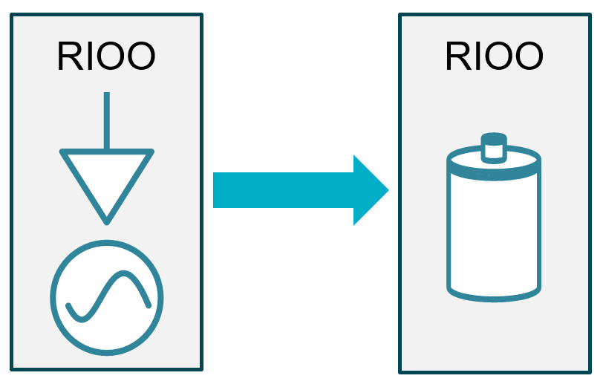
RIOO ESR Project: Milestones
The ESR project enables single-model submissions
The ESR project has two key milestones:
  Application updated to accept single-model submissions for new interconnection requests
    Implementation Date: 7/25/2024
  All in-flight and commissioned ESRs programmatically converted from combo-model to single-model
    Target Date: 9/26/2024
Prior to the ESR conversion, ERCOT will request additional information to support the transformation.

Slide 9
Post RIOO ESR Project: Single Model in RIOO Only
After the RIOO ESR Project, RIOO will no longer represent an ESR as individual loads and generators. Downstream systems will continue to use the combo model.
ERCOT will translate single model submissions into the combo model
RIOO
Model
EMS/MMS
Outputs
Changes to both the charging and discharging sides of the ESR can be done in one submission
Downstream systems will continue to use the combo model
Q3 2024 through Q4 2025

Slide 10
Post RIOO ESR Project: Single Model in RIOO Only
After the RIOO ESR Project, RIOO will no longer represent an ESR as individual loads and generators. Downstream systems will continue to use the combo model.
ERCOT will translate single model submissions into the combo model
RIOO
Model
EMS/MMS
Outputs
Changes to both the charging and discharging sides of the ESR can be done in one submission
Downstream systems will continue to use the combo model
ERCOT will also bring key ESR information into the model to support RTC+B testing
Q3 2024 through Q4 2025

Slide 11
Parallel ESR Telemetry Prior to RTC+B Go-Live
To support testing and ensure readiness, parallel telemetry for combo-model and single-model representations of ESRs will be required prior to RTC+B go-live.
Current
EMS/MMS
Model
To support this new telemetry, QSEs will need the ESR name provided in the prepopulated Excel file (or entered into RIOO when completing the interconnection request)
UNIT1
Telemetry from QSE
CLR1
RTC+B
EMS/MMS
ESR1
Single-model telemetry, including those needed for RTC+B, will be required prior to RTC+B go-live

Slide 12
Post RTC+B: Single Model Used in All Systems
After RTC+B go-live (Q4 2025), all systems will represent an ESR as a single object
RIOO
Model
EMS/MMS
Outputs
ESR1
Telemetry from QSE
~Q4 2025

Slide 13
Data Collection Via DocuSign

Slide 14

Data Collection via DocuSign
ERCOT will use DocuSign to collect the ESR-related information
The DocuSign envelope will be sent to the Authorized Representative of the Resource Entity.

Slide 15
Who Will Receive a Data Request Via DocuSign?
ERCOT requires additional information for each ESR that is, or will soon be, modeled within the Network Operations Model.
On August 6th, ERCOT will send a DocuSign envelope to Resource Entities with ESRs that are:
  Commissioned,
  In the commissioning process, or
  Have an approved Production Load Date

Slide 16
Who Will Not Receive a Data Request Via DocuSign?
ESRs in the earlier stages of the interconnection process will provide the required information via the RIOO application
After the July 25th release, new interconnection requests for ESRs will follow the single-model process
After the September 26th database conversion, in-flight interconnection requests will be transitioned to the single-model process
The single-model ESR information will be provided when substation-level detail is entered in RIOO

Slide 17
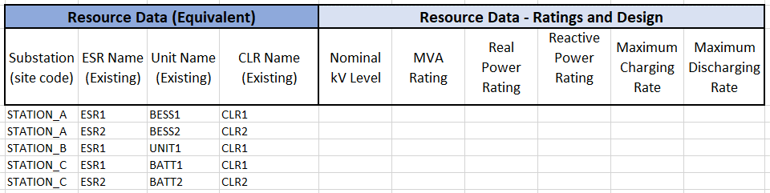
One DocuSign Response Per Resource Entity
One DocuSign envelope will be used to provide responses for all ESRs associated to the RE
Pre-Populated ESR Spreadsheet
All ESRs owned by the Resource Entity
A single attachment will be required with the submission. Pre-populated templates will be posted to the ERCOT MIS.
https://mis.ercot.com/secure/data-products/data-product-details?id=np12-230

Slide 18
DocuSign and Supplemental Workflows

Slide 19
Sample DocuSign Envelope
Only the completed ESR spreadsheet should be attached within the DocuSign envelope

Slide 20
Excel Template Overview

