Slide 1
EAL Change Proposals
Scenario #5 & #5a
Sanchir Dashnyam
ERCOT Market Credit Manager
ERCOT Public
July 24, 2024

Slide 2
Invoice Exposures – Definitions
Invoice exposures – New
M1 days forward invoices + 7 days look back actual invoices
M1 days could range from 10 to 21 days depending on weekends/holidays, MP activity
Invoices exclude M&N securitization invoices, CRR auction invoices, miscellaneous invoices relating to $2B distributed to market for Sec N on 6/21/22
Data is for a period covering 11/21/2021 through 4/30/2024
Excluded CARD invoices
TPEA excludes Uri invoices, PUL uplift
Excluded CARD credits from OUT
TPEA – Invoice exposures = Gap
Negative gap is when invoice exposures exceed TPEA (less than -$10,000)
Positive gap is when TPEA exceeds invoice exposures (more than $10,000)
Independent amounts posted as a result of NPRR1165 are not included in these calculations. IA’s are part of TPES.

Slide 3
Current EAL Formula vs. Scenarios #1, #1a and 1b
Current: EAL _{q} = Max [IEL during the first 40-day period only beginning on the date that the Counter-Party commences activity in ERCOT markets, RFAF * Max {RTLE during the previous lrq days}, RTLF] + DFAF * DALE + Max [RTLCNS, Max {URTA during the previous lrq days}] + OUT _{q} + ILE _{q}
OUT _{q} = OIA _{q} + UDAA _{q} + UFA _{q} + UTA _{q} + CARD*
Scenario #1: EAL t = Max [RFAF * Max { RTNLE during the previous lrt days}, FAF*RTNLF] + DFAF * DALE + Max [RTLCNS NLCD, Max {ULERTA during the previous lrq days}] + OUT (included UDAA)
NLE = Total net liability extrapolated (Last 14 days RTM Initial Statement Average + Last 14 days DAM Initial Statement Average based on RTM Initial OD)*M1. Use same RTM ODs for DAM as well
NLF = net liability forward = 1.5 * NLCD
NLCD = (7 most recent Operating days Real time estimates + 7 most recent DAM ODs day-ahead) if settled data is available use settled else estimates – no price cap
FAF = 21 future / most recent days 7 RTM Prices
ULE = unbilled liability extrapolated (Last 14 days RTM Initial Statement Average + Last 14 days DAM Initial Statement Average based on RTM Initial OD)*M2 - use same RTM ODs for DAM as well
Scenario #1a: EAL = Max [RFAF * Max { RTNLE during the previous lrt days}, FAF*RTNLF] + DFAF * DALE + Max [RTLCNS (RTLCNS + UDAA), Max {ULERTA during the previous lrq days}] + OUT
Scenario #1b EAL t = Max [RFAF * Max { RTNLE during the previous lrt days}, FAF*RTNLF] + DFAF * DALE + Max [RTLCNS NLCD, Max {ULERTA during the previous lrq days}] + OUT
OUT t = OIA + UFA + UTA + CARD* (S1a and S1b excludes UDAA)

Slide 4
Scenarios #2, #3 and #4
Scenario #2*: EAL q = Max [IEL during the first 40-day period only beginning on the date that the Counter-Party commences activity in ERCOT markets, Max{(RFAF * Max {RTLE) during the previous lrq days}, RTLF] + DFAF * DALE + Max [RTLCNS, Max {URTA during the previous lrq days}] + OUT q + ILE q
Scenario #3*: EAL q = Max [IEL during the first 40-day period only beginning on the date that the Counter-Party commences activity in ERCOT markets, RFAF * Max {RTLE during the previous lrq days}, RTLF] + DFAF * DALE + Max [RTLCNS, Max {URTA during the previous lrq days}] + OUT q + ILE q
Two RFAF’s: CP specific RFAF and Global RFAF
CP specific RFAF = Projected Real-Time ICE Forward Average Price / Max RTLE date Historic Real-Time Settled Average Price
Global RFAF is calculated based on existing methodology. Global RFAF is used in MCE calculations.
Scenario #4*: Take Scenario #1a as a basis: EAL = Max [RFAF * Max { RTNLE*FAF during the previous lrt days}, FAF*RTNLF] + DFAF * DALE + Max [RTLCNS (RTLCNS + UDAA), Max {ULERTA during the previous lrq days}] + OUT
Apply FAF against NLE, then take the Max and compare against FAF*NLF. Essentially combine Scenario #2 and Scenario #1
Establish a floor for FAF at 1
Increase MCE for load entities (2 days from 1 day) - FAF Revised

Slide 5
Scenarios #5
Scenario #5*: Take Scenario #4 as a basis: EAL = Max [RFAF * Max { RTNLE*RFAF during the previous lrt days}, FAF*RTNLF] + DFAF * DALE + Max [RTLCNS (RTLCNS + UDAA), Max {ULERTA during the previous lrq days}] + OUT
RFAF_{i} = 21-day future prices / 14 days RTM Prices corresponding to the 14 days in RFAF_{i.} Cap RFAF at 1.5. RFAF is applied against NLE. There is no floor for RFAF. For each RFAF, we are using the corresponding Operating Day (and not Invoice Business Day) RTM settled prices, which match the respective operating Days in the NLE.
Apply FAF against NLF. FAF = 21-day future prices / 7 most recent days RTM Prices corresponding to the 7 days in NLF. Set a floor of 1 for FAF.
Strip out impact of CARD invoices from both invoice exposures and TPEA
For MCE use RFAF (No floor Or Cap) for a minimum of 2 day load.
Scenario #5a*: The same as #5 above, except RFAF has a floor of 1.
Current: EAL _{q} = Max [IEL during the first 40-day period only beginning on the date that the Counter-Party commences activity in ERCOT markets, RFAF * Max {RTLE during the previous lrq days}, RTLF] + DFAF * DALE + Max [RTLCNS, Max {URTA during the previous lrq days}] + OUT _{q} + ILE _{q}
OUT _{q} = OIA _{q} + UDAA _{q} + UFA _{q} + UTA _{q} + CARD*

Slide 6
EAL for Scenarios – market

Slide 7
EAL for Scenarios, market: Scenarios 5 & 5a vs. Current EAL

Slide 8
Negative and Positive Gaps: Market
S5a significantly decreases the negative gap events while increasing positive gaps. However, it is noted that the extent of the increase in positive gap $s and occurrences is not as much as in S4.

Slide 9
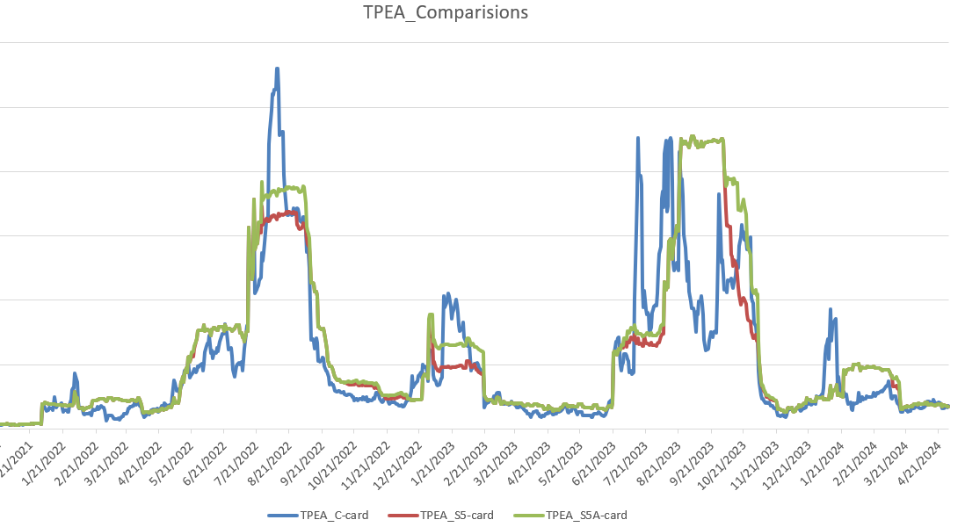
Sample CP – TPEA comparison
S5a resolves the “double top” issue discussed in prior meetings.
It provides more stable or less volatile measurement of exposures tracking actual invoice exposures more closely. RFAF in the existing framework is more volatile and is applied against MaxRTLE while S5a is applying FAF against NLE with a cap and a floor.
Overall, S5a provides slightly higher coverage relative to the existing methodology.
One of the main advantages of S5a is capturing DAM exposures and having a look back period (Scenarios #4 and #5 are further refinements of Scenario #1).

Slide 10
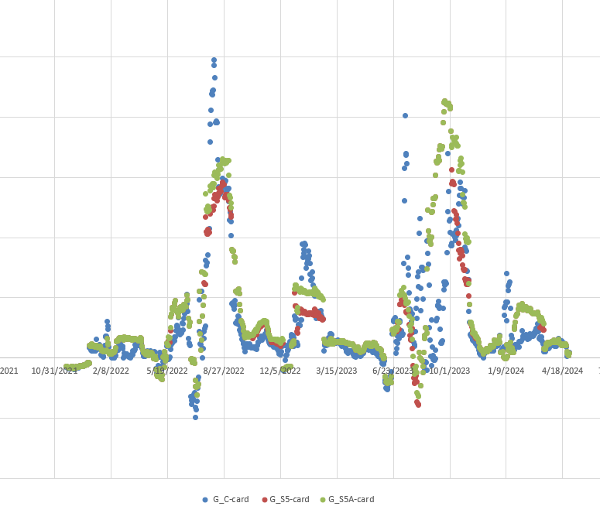
Sample CP – gap events

Slide 11
Negative and Positive Gaps by activity type

Slide 12
Negative and Positive Gaps: Traders

Slide 13
Negative and Positive Gaps during Elliott: Market
S5a significantly decreases the negative gap events and also increases positive gaps. However, the extent of increase in positive gap $s and occurrences is not as much as in S4.

Slide 14
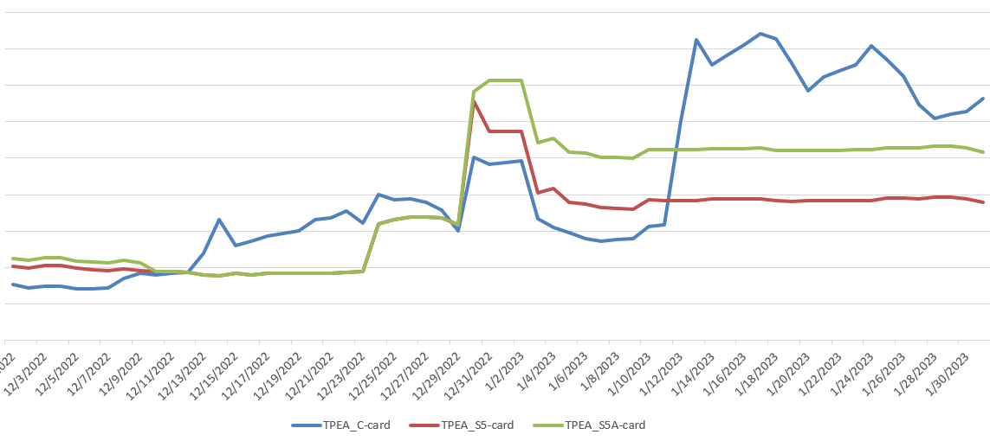
Elliott – sample CP

Slide 15
Negative and Positive Gaps during Elliott by activity type

Slide 16
Negative and Positive Gaps during Elliott: Traders

Slide 17
Next steps: potential improvements – S6
1. Negative gaps. Solution for the increase in negative gaps for trader is increasing MCE. The current MCE for traders is $22,500.
Should we increase MCE based on the level of activity? For example, greater of RTM or DA volume – make it dependent on the volume.
increase across the board by X times?
2. Positive gaps. Implement a seasonal look back adjustment. For example: end of summer – on Sep 15 cut the look back period to 20 days instead of 40 days and re-instate the 40 day look back on May 15. This could lower the positive gaps.

