Slide 1
Monthly Review of Reliability Unit Commitment Market Impacts – June 2024
Wholesale Market Working Group
ERCOT Staff

Slide 2
RUC Resource-Hours
June 2024 | Total | Opt-Out | Non-Opt-Out
Instructed Resource-Hours
Total Count | 88.0 | 15.0 | 73.0
Effective Resource-Hours*
Total Count | 83.5 | 11.0 | 72.5
Average Megawatts (MW) for Effective Resource Hours
Average LSL | 48.4 | 60.0 | 46.6
Average LDL | 53.5 | 98.2 | 46.8
Average BP | 59.7 | 144.9 | 46.8
Average HSL | 167.5 | 200.0 | 162.6
* The difference between “Instructed” and “Effective” values is a result of Resources starting up, shutting down, receiving partial hour instructions, or otherwise not being dispatchable by SCED.

Slide 3
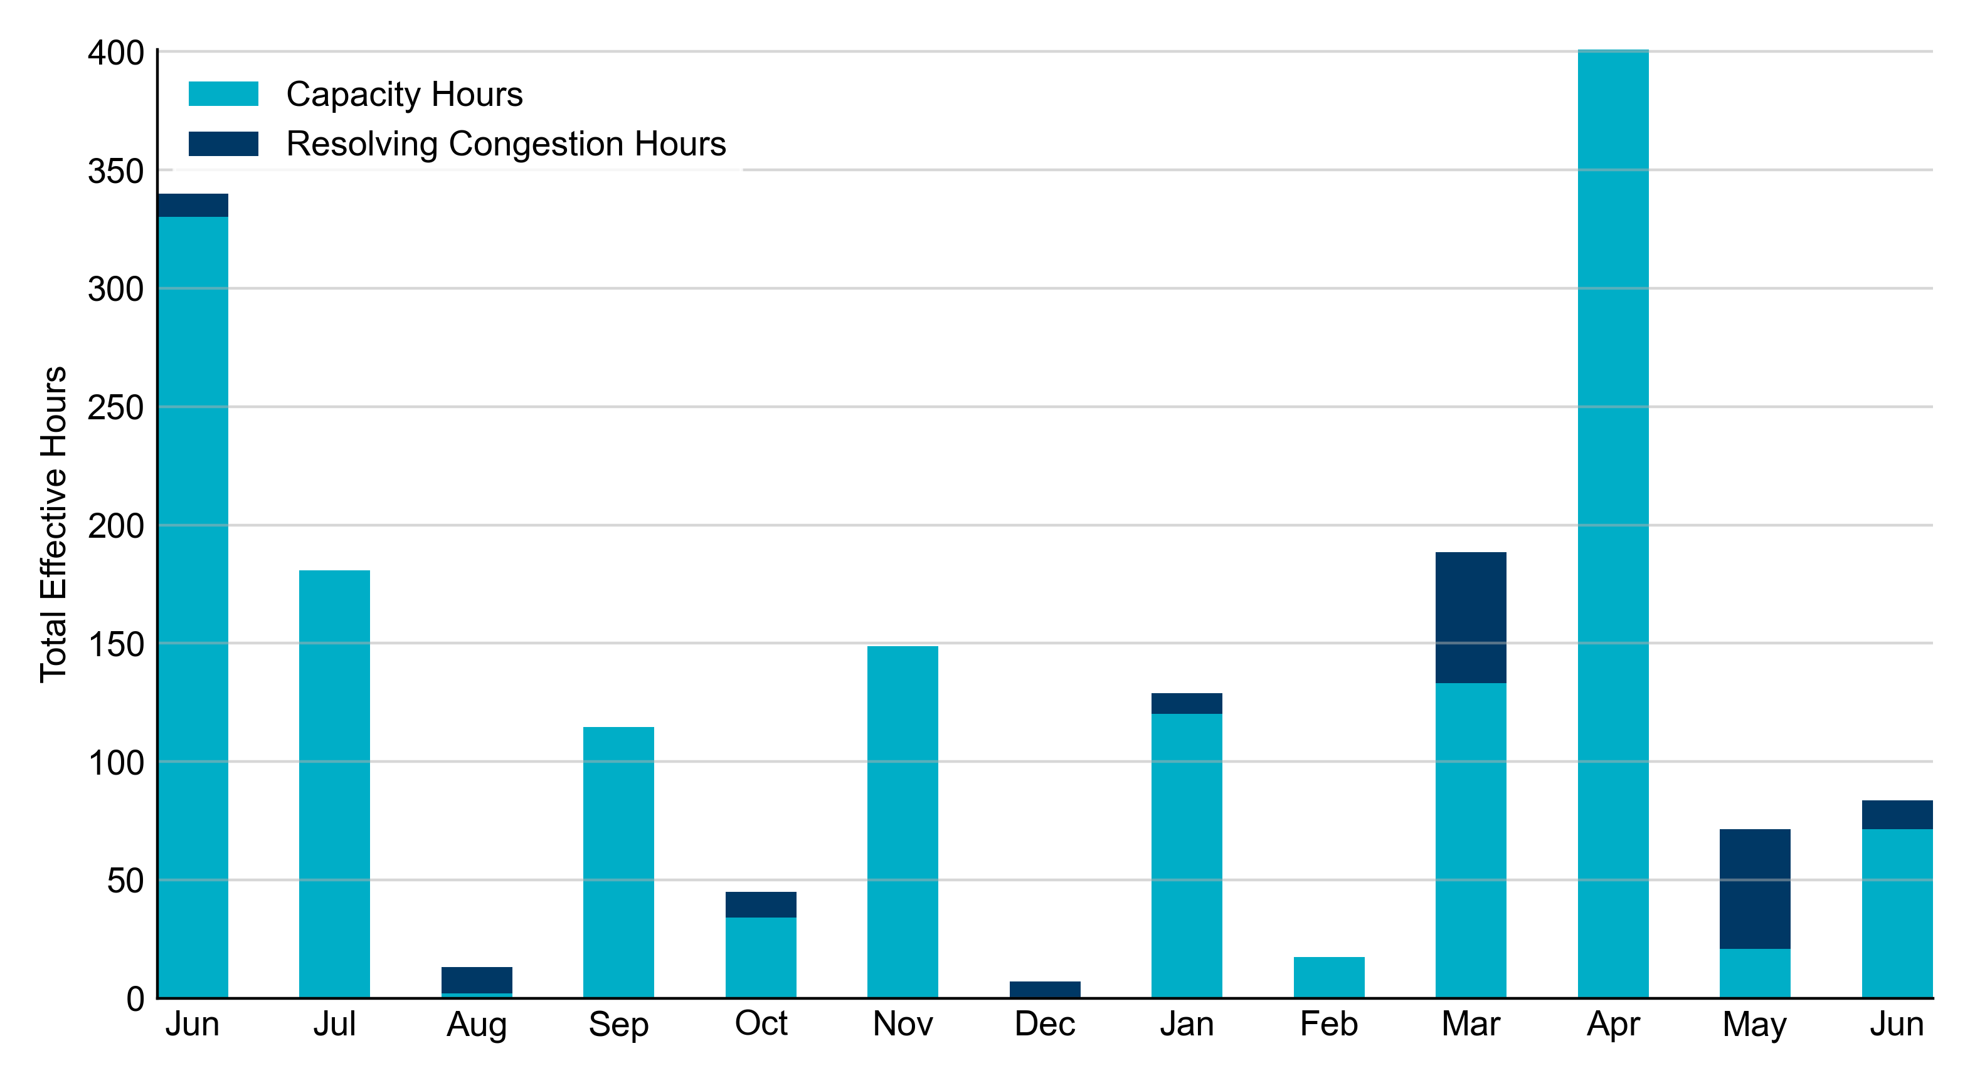
RUC Instruction Reasons: Last 13 Months
RUC in June 2024 was primarily to ensure sufficient capacity and resolve congestion.

Slide 4
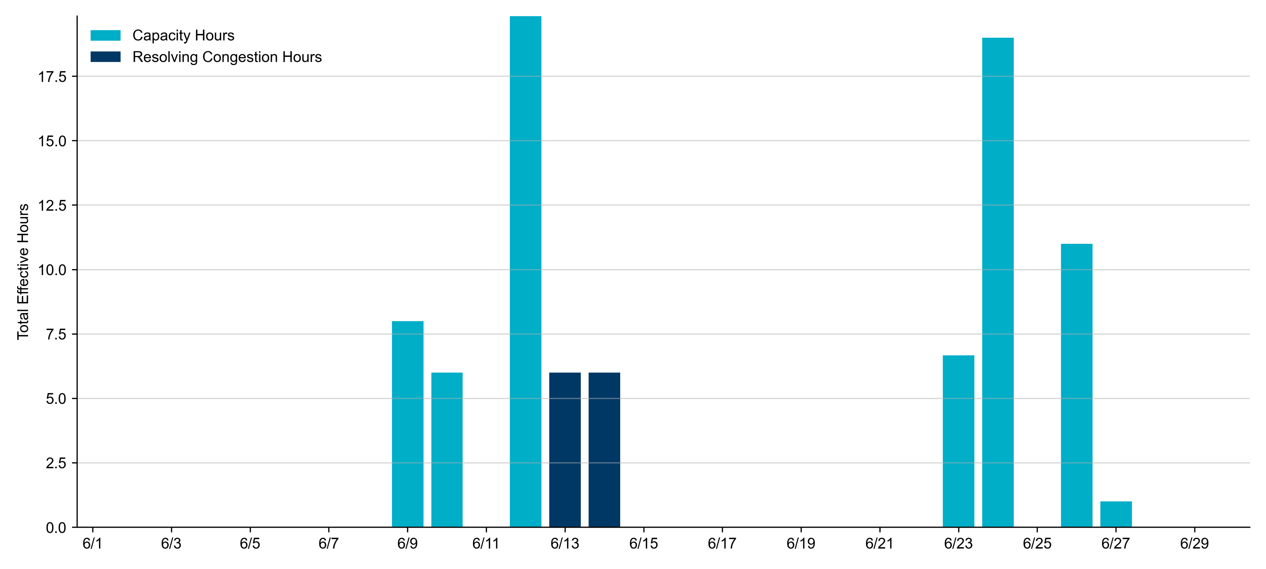
RUC Instruction Reasons in June 2024
83.5 RUC effective Resource-hours.
  71.5 hours (85.63%) for capacity.
  12.0 hours (14.37%) for congestion.

Slide 5
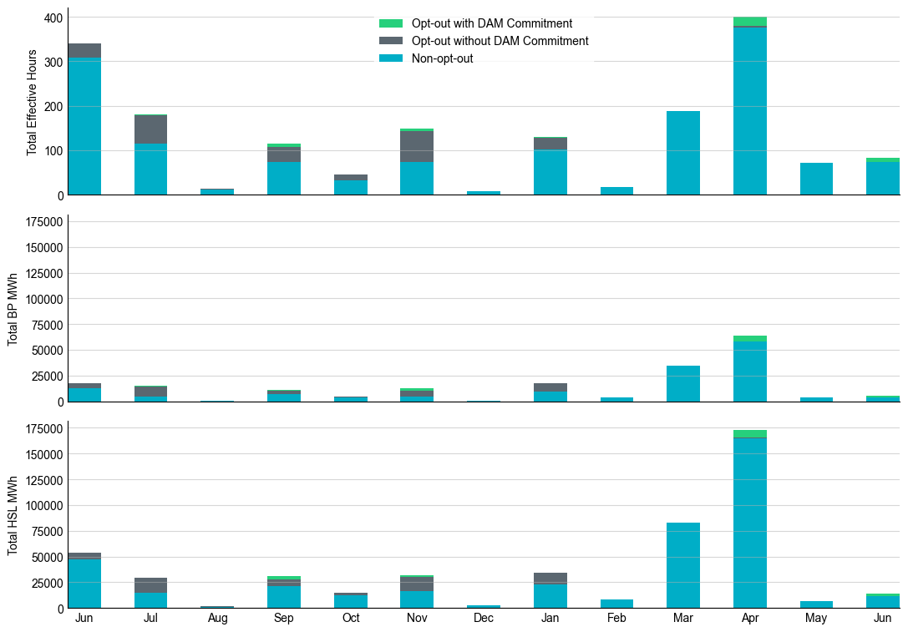
Non-opt-out and Opt-out Totals: Last 13 Months
June 2024 had a total of 72.5 non-opt-out effective Resource-hours (86.83%) and 11.0 opt-out effective Resource-hours (13.17%).

Slide 6
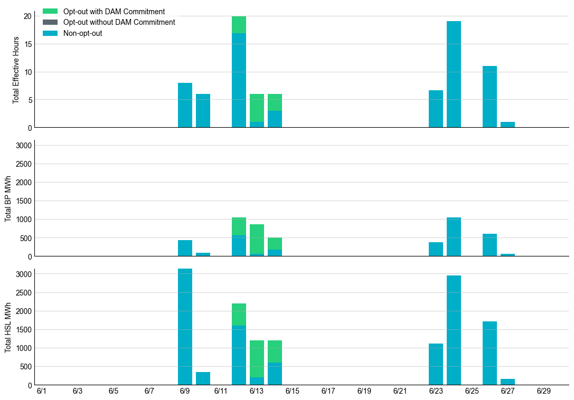
Non-opt-out and Opt-out Totals: June 2024

Slide 7
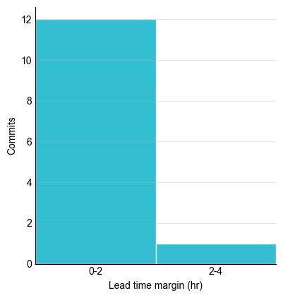
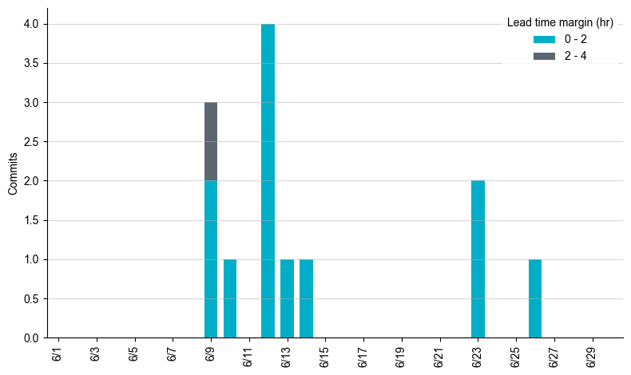
RUC Lead Time Margin: June 2024
Most RUC commitment windows had a lead time margin at or below 2 hours.
Lead time refers to the length of time between a RUC instruction and the start of the commitment window.
Lead time margin is the difference between lead time and the Resource’s startup time.
In cases where a Resource is committed for multiple back-to-back time blocks, lead time margin is calculated from the first instruction.

Slide 8
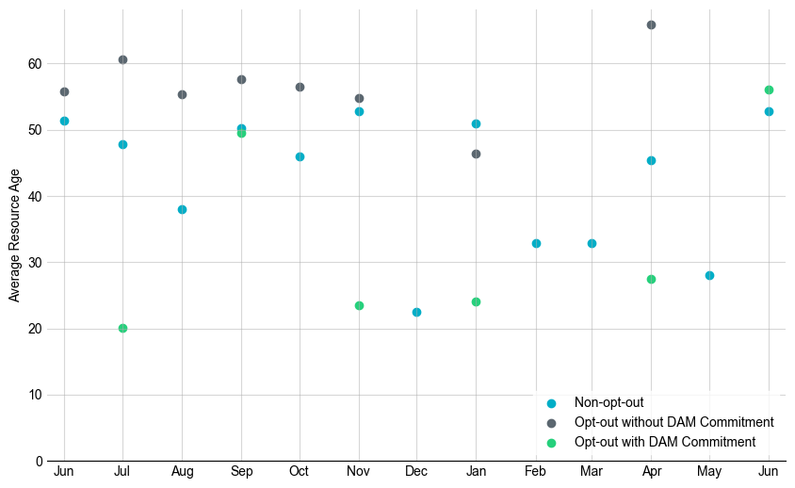
Average Resource Age: Last 13 Months
In June 2024, the average age of RUC-committed Resources was 52.8 years for non-opt-out Resource-hours and 56.1 for opt-out with DAM commitment.
Note: For Resource configurations with multiple physical generators, the age of the oldest generator is used.

Slide 9
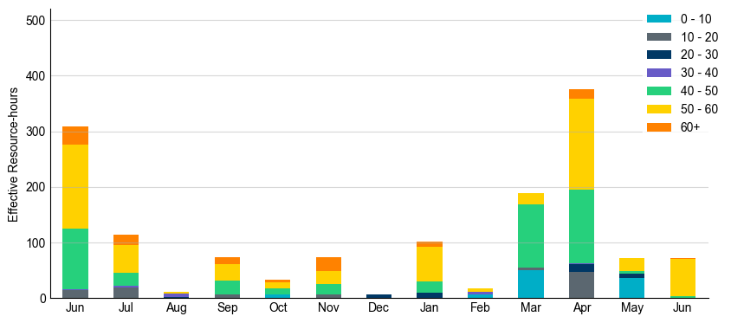
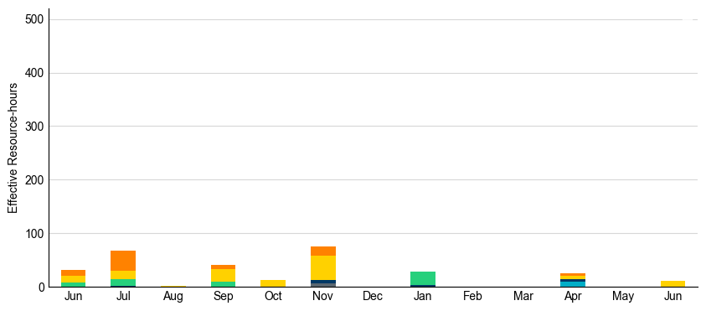
Age Category: Last 13 Months
Most RUC-committed Resources in June 2024 were older than 50 years old.
Non-opt-out
Opt-out

Slide 10
RUC-Instructed Resource Dispatch above LDL
June 2024
There were no effective Resource-hours in which Resources that did not successfully opt out were dispatched above their LDL in June 2024.
Additionally, there were no Exceptional Fuel Cost submissions for any RUC-committed Resources in June 2024.
*Note: Numbers may not sum exactly due to rounding.

Slide 11
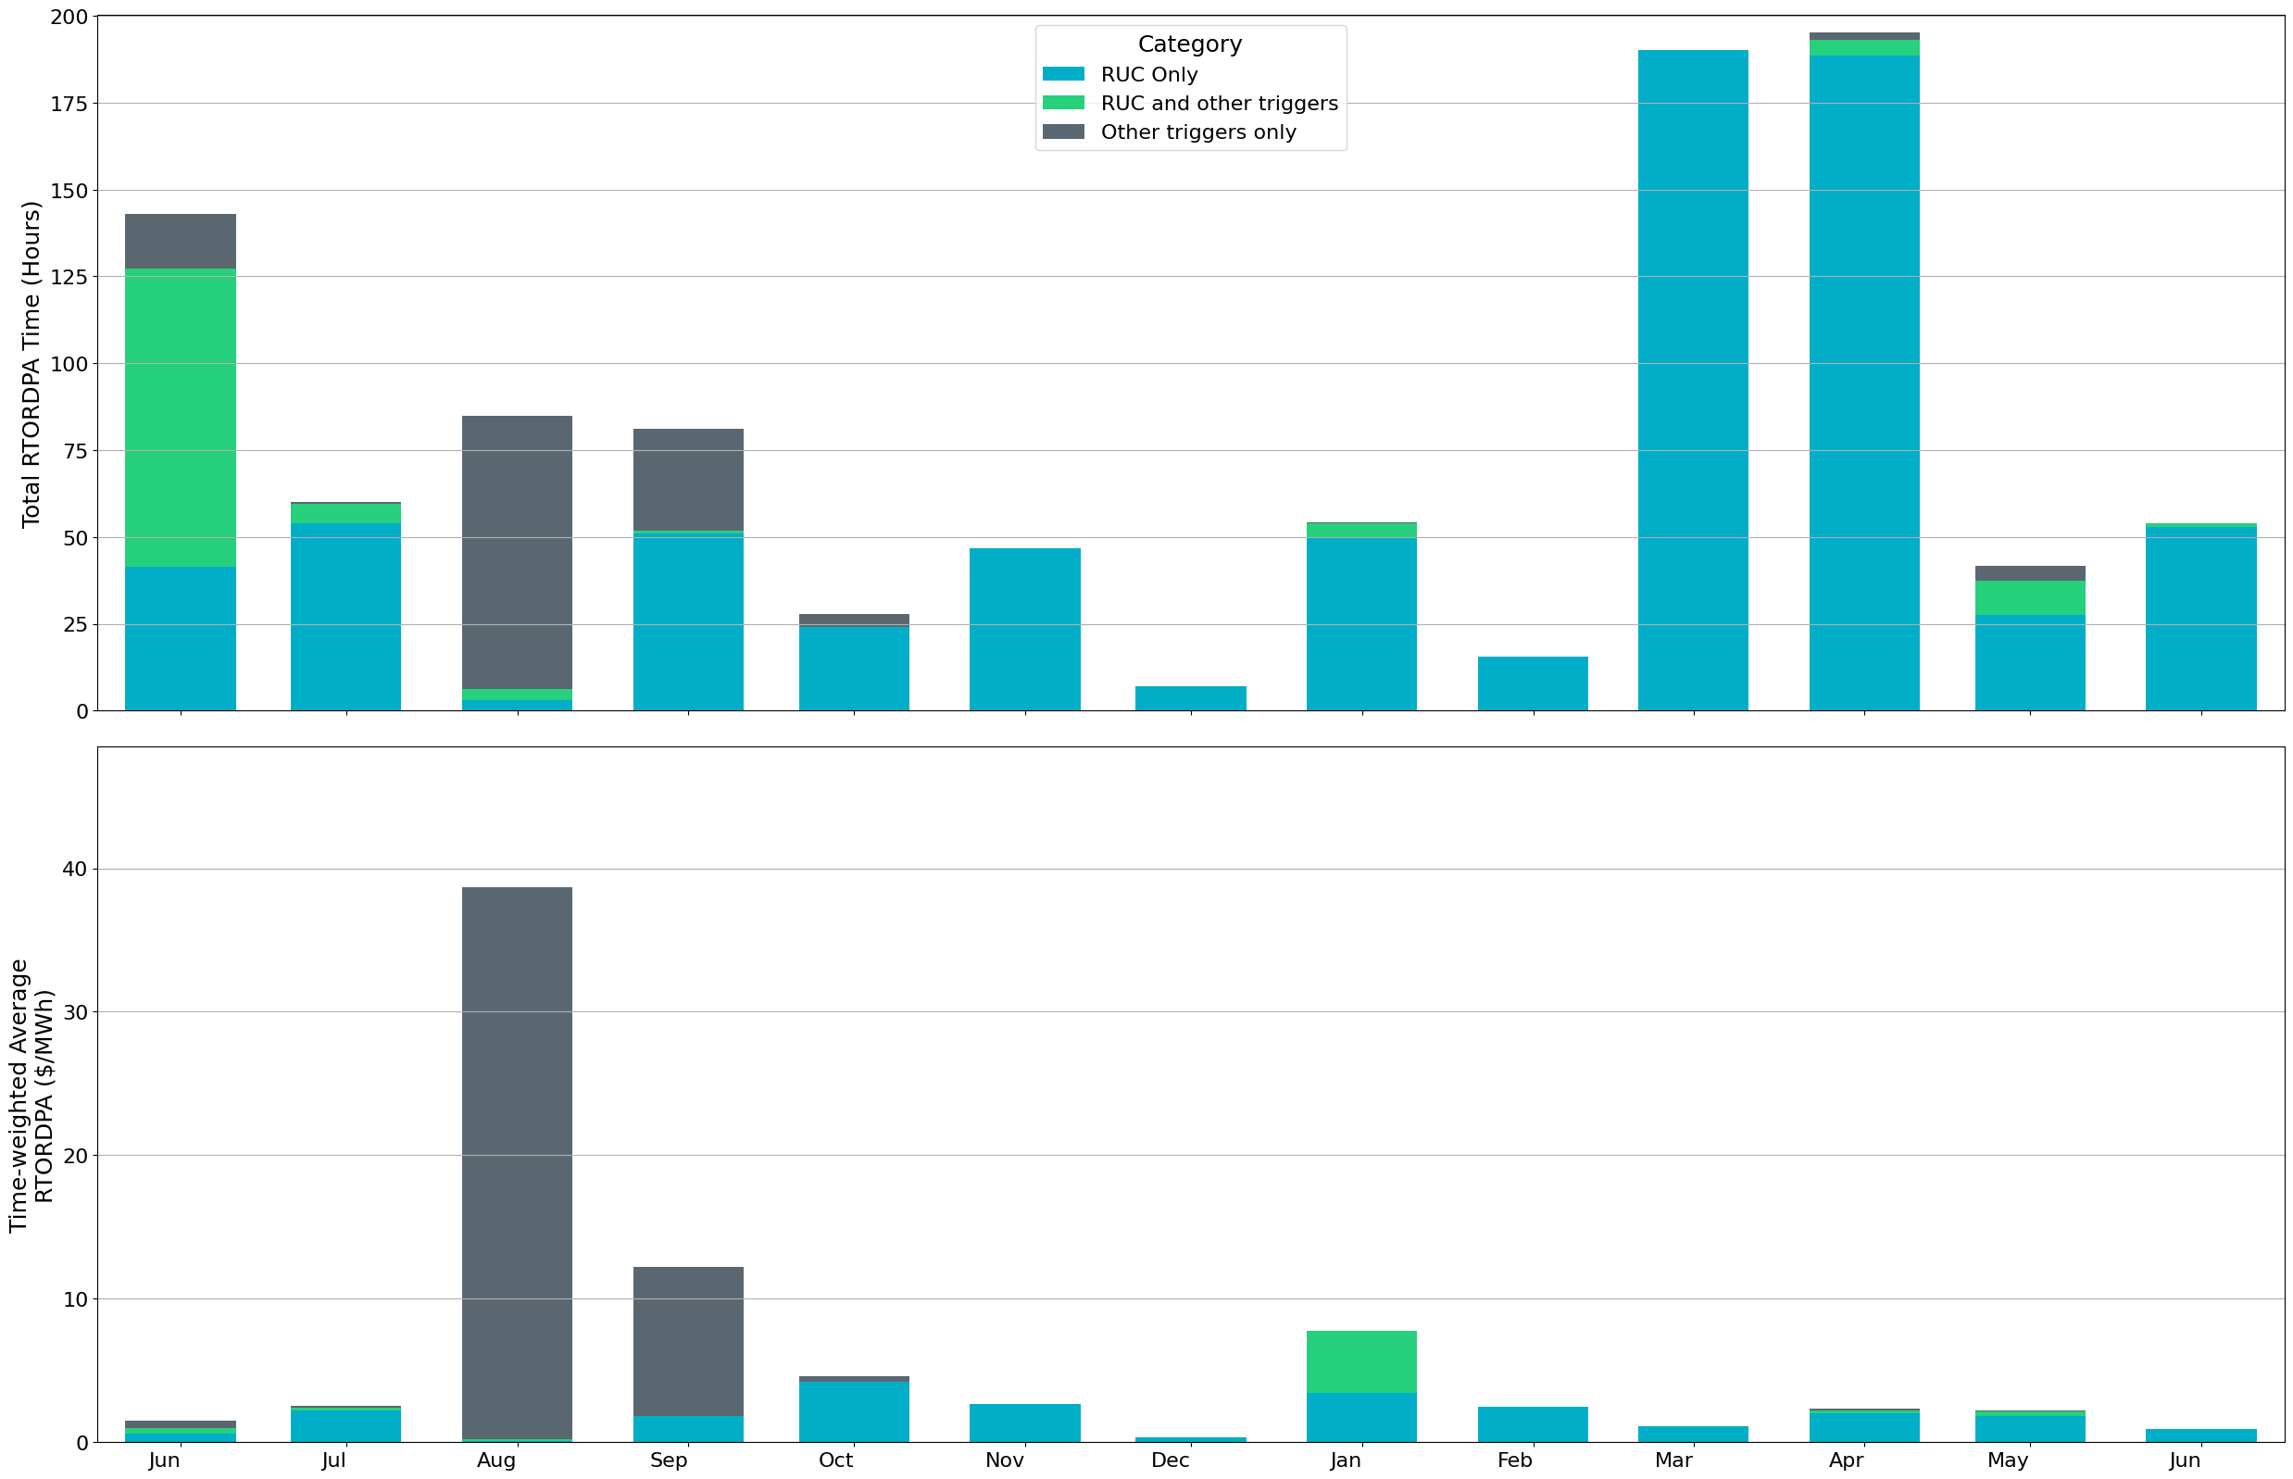
Reliability Deployment Price Adder: Last 13 Months
June 2024 had a total of 54 RTORDPA hours with an average value of $0.38/MWh.
These graphs show RTORDPA instances by reliability action: 'RUC Only' for instances triggered solely by Reliability Unit Commitment, 'RUC and other triggers' for instances with RUC and additional triggers, and 'Other triggers only' for instances with non-RUC triggers. The daily average RTORDPA is calculated using the total duration across all categories. See ERCOT protocol section 6.5.7.3.1 for details.

Slide 12
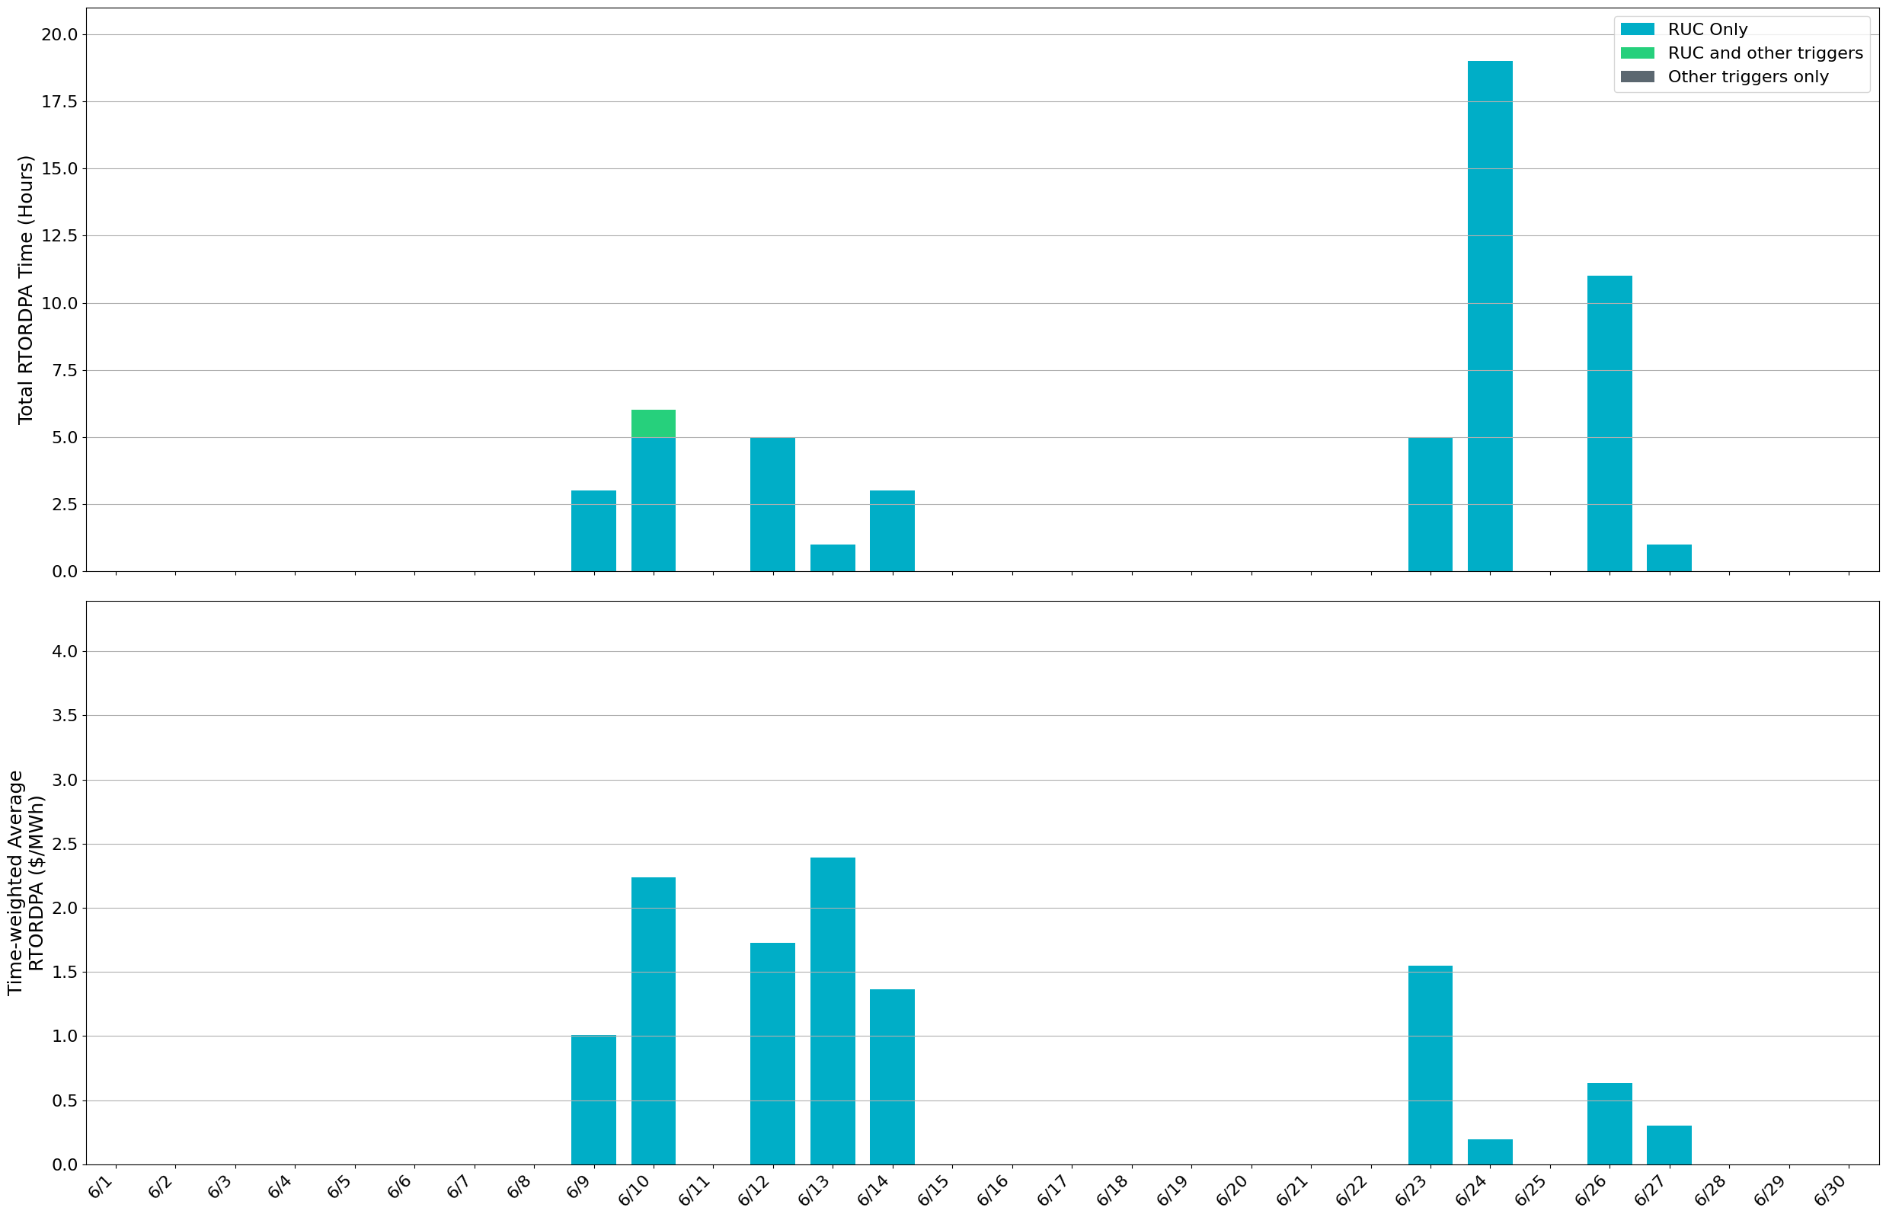
Reliability Deployment Price Adder: June 2024
OD 6/13 had the highest daily time-weighted average RTORDPA of $2.39/MWh.
These graphs show RTORDPA instances by reliability action: 'RUC Only' for instances triggered solely by Reliability Unit Commitment, 'RUC and other triggers' for instances with RUC and additional triggers, and 'Other triggers only' for instances with non-RUC triggers. The daily average RTORDPA is calculated using the total duration across all categories. See ERCOT protocol section 6.5.7.3.1 for details.

Slide 13
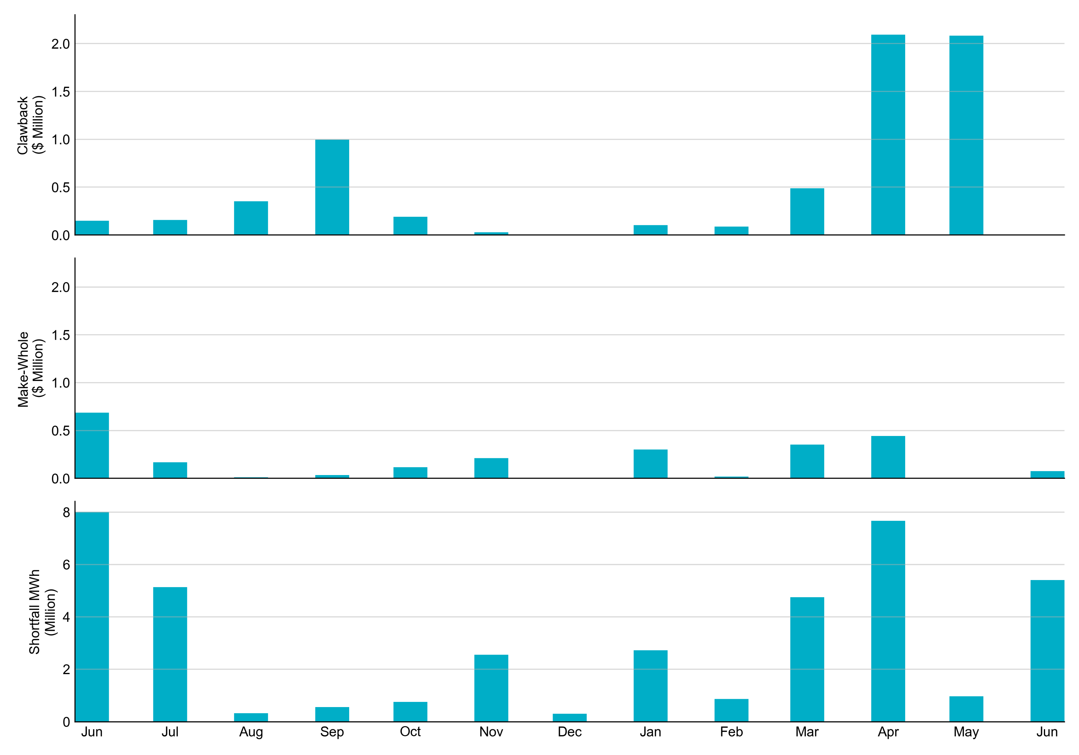
RUC Clawback, Make-Whole, and Shortfall
For June 2024, the total Clawback Charge was $57.93. The total Make-Whole Payment was $77K.
Of the $77K in Make-Whole Payments made in June 2024, $1.89 was uplifted to load due to rounding.
The remaining amount was collected through Capacity-Short Charges.
Data as of June 6th, 2024

Slide 14
RUC Clawback by Settlement Type
Month | Initial Settlement ($) | Final Settlement Change ($) | True-up Settlement Change ($) | Net as of July 7, 2024 ($)
Jun ’23 | 149,347 | 0 | 0 | 149,347
Jul ‘23 | 218,907 | -60,841 | 0 | 158,065
Aug ‘23 | 352,002 | 0 | 0 | 352,002
Sep ‘23 | 997,843 | 0 | 0 | 997,843
Oct ‘23 | 190,721 | 0 | 0 | 190,721
Nov ‘23 | 29,684 | 0 | 0 | 29,684
Dec ‘23 | 0 | 0 | 0 | 0
Jan ‘24 | 107,176 | -4,657 | - | -
Feb ‘24 | 88,220 | 0 | - | -
Mar ‘24 | 487,193 | 0 | - | -
Apr ‘24 | 2,092,224 | 0 | - | -
May ‘24 | 2,084,416 | - | - | -
June ‘24 | 58 | - | - | -
Negative dollars represent a payment from ERCOT to a market participant
“-” indicates settlement has yet to be completed.
Net figures may differ slightly due to rounding.

Slide 15
RUC Make-Whole by Settlement Type
Month | Initial Settlement ($) | Final Settlement Change ($) | True-up Settlement Change ($) | Net as of July 7, 2024 ($)
Jun ‘23 | -600,652 | 0 | -86,170 | -686,821
Jul ‘23 | -161,994 | -4,996 | -855 | -167,845
Aug ‘23 | -12,090 | 0 | 0 | -12,090
Sep ‘23 | -35,168 | 0 | 0 | -35,168
Oct ‘23 | -72,477 | -43,063 | 0 | -115,541
Nov ‘23 | -194,731 | 0 | -17,934 | -212,665
Dec ‘23 | -5,316 | 0 | 0 | -5,316
Jan ‘24 | -253,466 | -79,942 | - | -
Feb ‘24 | -19,673 | 0 | - | -
Mar ‘24 | -353,562 | 0 | - | -
Apr ‘24 | -443,178 | 0 | - | -
May ‘24 | -2,957 | - | - | -
June ‘24 | -76,670 | - | - | -
Negative dollars represent a payment from ERCOT to a market participant
“-” indicates settlement has yet to be completed.
Net figures may differ slightly due to rounding.

