Slide 1
Concept – Distribution Transformer Concept
Joel Koepke

Slide 2
Goals
Provide Background
Discuss ERCOT Proposed Concept
Solicit Feedback

Slide 3
Background

Slide 4
Background: Transitioning to Simplified Modeling of DGR and DESRs
TSP Station
Old-Style
Transmission Network
New-Style
Transmission Network
DGR Station
TSP Station
Single substation with load and generator modeled at transmission voltages
CIM Load
CIM Load
Line
Multiple substations with load and generator modeled at distribution voltages

Slide 5
ERCOT Proposal

Slide 6
ERCOT Proposal – Addition of Distribution Transformer Class
ERCOT proposes the creation of an optional CIM class which contains key information on distribution transformers
Operations Model
Associated
A single load and multiple distribution generators can be associated to the new class

Slide 7
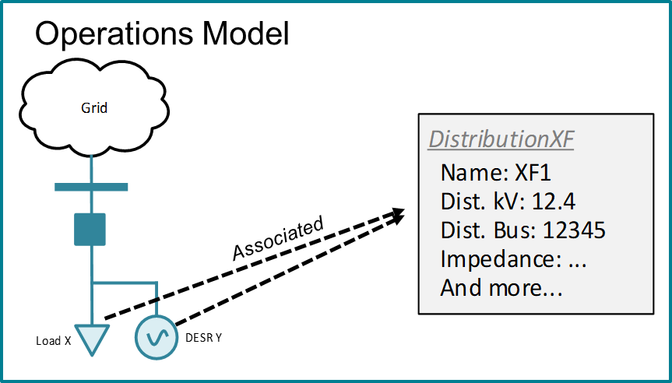
ERCOT Proposal – Modification of Topology Processor
During topology processing, the Distribution Transformer will be converted to a transformer and a distribution-level bus will be created
Planning Model
Topology Processor
The distribution transformer is created…
…and connected to a new distribution bus…
…with the associated load and generator.
The associated load and generation will be moved to the distribution bus

Slide 8
Current Approach: SODG
SODGs are not included in Operations topology but are added to new transmission-level buses in Planning cases via script.
Field
Model
Operations
Planning
SODGs are “mapped” to loads and are not topologically connected
Real-time applications do not meaningfully utilize SODG information
ERCOT adds SODGs to Planning cases at transmission-level via script

Slide 9
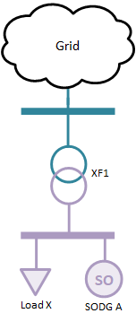
Proposed Approach: SODG With Distribution Transformer
SODGs are not included in Operations topology but are added to new distribution-level buses in Planning cases via script.
Field
Model
Operations
Planning
No Change
SODGs are “mapped” to loads and are not topologically connected
No change to real-time applications
Transformer and distribution bus created with load and SODG connected.

Slide 10
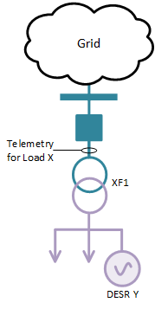
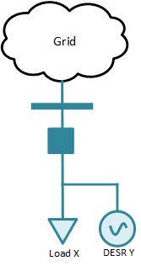

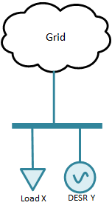
Current Approach: DGR/DESR
DGRs are fully modeled in Operations and are on the same transmission-level bus as the associated load within Planning cases.
Field
Model
Operations
Planning
DGR=True
DGR=True
DGRs are topologically connected to the CIM load
Real-time applications do not incorporate DGR telemetry
Load and DGR on same planning bus at transmission-level voltage
DGR=True

Slide 11
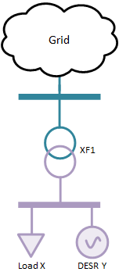

Proposed Approach: DGR/DESR With Distribution Transformer
DGRs remain fully modeled in Operations but are added to new distribution-level buses in the Planning cases via script.
Field
Model
Operations
Planning
No Change
DGRs are topologically connected to the CIM load
Real-time applications do not incorporate DGR telemetry
Transformer and distribution bus created with load and DGR connected.

Slide 12
Supplemental Slides

Slide 13
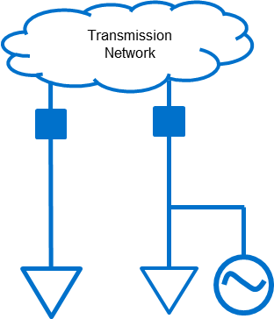
Background: ERCOT State Estimator Enhancements
Capital project completed in early 2022 to modify the treatment of DGR/DESR in the State Estimator
Before Project
After Project
Without code changes the DGR output would be double-counted
3MW
Estimated flows are correct…
Calculated
10MW
Calculated
10MW
7MW
…because DGR telemetry is ignored by the SE
telemetry
telemetry
10MW
7MW
telemetry
telemetry
DGR output already captured in load telemetry
DGR

