Slide 1
Project Update
July 18, 2024
Troy Anderson
ERCOT Portfolio Management

Slide 2
Project Update Agenda
  Recent / Upcoming Project Highlights
  2024 Release Targets
  Major Projects
  Additional Project Status Information
  Priority/Rank Recommendations for Revision Requests with Impacts
    NPRR1217 – Remove Verbal Dispatch Instruction (VDI) Requirement for Deployment and Recall of Load Resources and Emergency Response Service (ERS) Resources
  Technology Working Group (TWG)
    Next meeting is 7/25/2024
  Aging Revision Request Project Review
Location of Revision Request Project Information: http://www.ercot.com/services/projects

Slide 3
Recent / Upcoming Project Highlights
2024 June Release – R6 – 6/27/2024 Complete
  NPRR962 – Publish Approved DC Tie Schedules
  NPRR1090 – ERS Winter Storm Uri Lessons Learned Changes and Other ERS Items
  NPRR1121 – Add a Posting Requirement to the Exceptional Fuel Cost Submission Process
  NPRR1139 – Adjustments to Capacity Shortfall Ratio Share for IRRs
  NPRR1149 – Implementation of Systematic Ancillary Service Failed Quantity Charges
  NPRR1186 – Implement consideration of ESR SOC in ERCOT tools and studies
  NPRR1196 – Correction of NCLR Ancillary Service Failed Quantity Calcs under NPRR1149
2024 July Release – R7 – 7/25/2024 In Flight
  NPRR1002 – BESTF-5 ESR Single Model Registration and Charging Restrictions in Emergency Conditions
  RRGRR023 – Related to NPRR1002
2024 August Release – R8 – 8/22/2024 In Flight
  NPRR1058 – Resource Offer Modernization
  NPRR1131 – Controllable Load Resource Participation in Non-Spin
  SCR821 – Voltage Set Point Target Information for DGR or DESR
Note: Projected Go-Live dates are subject to change.
Please watch for market notices as the effective dates approach.

Slide 4
2024 Release Targets – Approved NPRRs / SCRs / xGRRs
R1
R3
R5
January 1/25 | February 2/22 | March 3/28 | April 4/25 | May 5/30 | June 6/27
NPRR1092(b) PGRR098(a) ESR Telemetry Public API Enhancements | NPRR1132(a) RRGRR032 NOGRR249(b) NPRR1184(a) NPRR1026(b) NPRR1172(a) | NPRR1040 NOGRR247(a) NPRR1165 NPRR989(a) NPRR1038 NOGRR204(a) |  | SCR819 NPRR1111 Securitization Default Charge Supporting Data | NPRR1149 NPRR1186 NPRR1196 NPRR1121 NPRR1090 NPRR962 NPRR1139
R2
R4
R6
ü
ü
ü
ü
ü
ü
ü
ü
ü
ü
E
E
E
ü
ü
ü
ü
ü
ü
ü
ü
ü
ü
ü
ü
ü
ü
ü
1/1
3/11
Various effective dates
2/1
2/26
4/1
6/1
2/16
3/1
ü
R7
R9
July 7/25 | August 8/22 | September 9/26 | October 10/24 | TX SET 5.0 11/10 | December 12/11-12/12
NPRR1002 RRGRR023 | NPRR1058 NPRR1131 SCR821 Forecast Presentation Platform (CDR rpts) SCR813 | OBDRR040 Forecast Presentation Platform (CDR rpts) | NPRR1183 | NPRR1095 SCR817 SCR823 RMGRR172 RMGRR168 RMGRR179 | PGRR088 PGRR094 NPRR1023
R8
R10
R11
E
E
P
E
I
E
E
E
E
E
E
NS
NS
P
TBD
Moving to future year
Go-live dates can differ from Protocol effective dates – Please refer to market notices for more details
APPENDIX
Red Text: New additions and target release changes
Strike-Through Text: Previous target release
(a), (b), etc.: Multiple phase release
Project Status Codes
NS = Not Started
I = Initiation
P = Planning
E = Execution
H = On Hold
NPRR989(a) – ESR tech. req.
NPRR1026(b) – SLF – Reporting
NPRR1092(b) – Limit RUC Opt-Out
NPRR1132(a) – RIOO portion
NPRR1172(a) – Phase 1 elements
NPRR1184(a) – Interest calcs
NOGRR204(a) – ESR tech req
NOGRR247(a) – UFLS changes
NOGRR249(b) – MIS posting
PGRR098(a) – Section 4.1.1.8
Release targets are subject to change

Slide 5
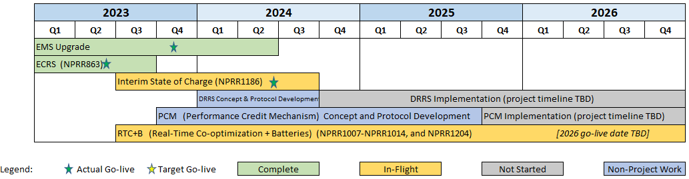
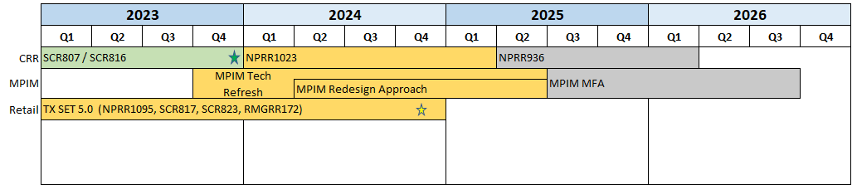
Major Projects
Other Project Highlights

Slide 6
Additional Project Status Information
RR | Description | Proj Phase | Additional Detail
NPRR1006 | Update RT On-Line Reliability Deployment Price Adder Inputs to Match Actual Data | On Hold | Unable to work these into the project queue without negatively impacting RTC+B Investigating potential to work RIOO portion of NPRR1077 earlier
NPRR1077 | Extension of Self-Limiting Facility Concept to Settlement Only Generators (SOGs) and Telemetry Requirements for SOGs | Not Started
NPRR1091 | Changes to Address Market Impacts of Additional Non-Spin Procurement | Not Started
Red Text: New additions and updates

Slide 7
Priority / Rank Recommendations for Revision Requests with Impacts
Recommendations for…
Revision Request | Description | Priority | Rank | Comments
NPRR1217 | Remove Verbal Dispatch Instruction (VDI) Requirement for Deployment and Recall of Load Resources and Emergency Response Service (ERS) Resources | 2024 | 4100 | $10k-$20k, 1-2 months Impacted System(s): Reporting Candidate for O&M project ERCOT would like to implement by end of 2024
PPL Rank Information
Next available 2024 Rank in Business Strategy = 4100
Next available 2025 Rank in Business Strategy = 4530
Next available 2026 Rank in Business Strategy = 4710
Next available Rank in Regulatory = 390

Slide 8
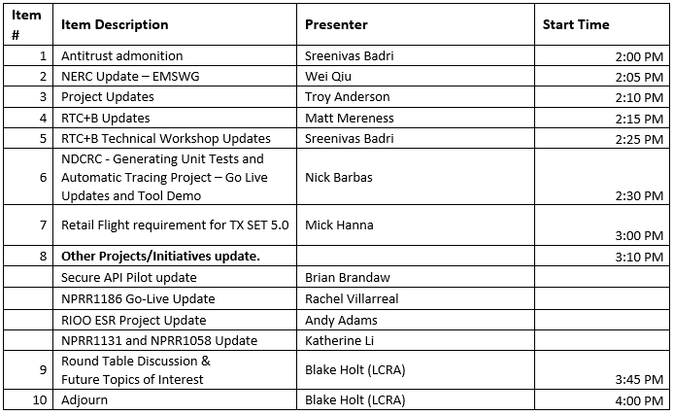
Technology Working Group (TWG)
Agenda for TWG meeting held on 6/26/2024:
Next TWG scheduled for 7/25/2024

Slide 9
Aging Revision Request Project Review
Continuing “Aging Revision Request” discussion
Data Analysis on slide 10
Latest details of each recommendation category on slides 11-16
Reminder of how to remove a previously approved RR on slide 17
Updated draft Gantt on slides 18-20
TBD | NPRRs: 484,825(b),826,829,841,857,879,885,904,918,930,936,941,945,963,965,975,987,989,995,1004,1006,1007,1019,1020(b),1029,1030,1032,1034,1038, 1057,1077,1091,1098,1105,1128 SCRs: 805,810,818 PGRRs: 076,091,099,103 Other: OBDRR009,OBDRR017,RRGRR028

Slide 10
Aging Revision Request Review at PRS – Stats
Progress of Aging RR review by month
The drop in the total count from June to July is due to:
  SCR799 project started
  SCR821 O&M effort underway
  NPRR1183 project started
Other Status Changes
  2024 start targets
    NPRR965
    NPRR1004
    NPRR1128
  Early 2025 start target – SCR825
  Post-RTC
    NPRR1006
    NPRR1077
    SCR810
See following slides for details
Category | March PRS | May PRS | June PRS | July PRS
1 – Proceed as Planned | 13 | 13 | 15 | 16
3 – No Action | 14 | 14 | 15 | 14
4 – Candidate for Revision / Removal | 2 | 2 | 2 | 2
5 – Post-RTC+B | 9 | 19 | 20 | 23
6 – Market Input Needed | 28 | 14 | 9 | 3
Total | 66 | 62 | 61 | 58

Slide 11
1 – Proceed as Planned
Revised ERCOT recommendation
Target Start | Revision Request | Approval Date | RR Name | Project Status | Budget Range | Duration Range | ERCOT Recommendation
Q3 2024 | NPRR1004 | Aug-2020 | Load Distribution Factor Process Update | Not Started | $45k-$65k | 5-7 months | 1 - Proceed as planned
Q3 2024 | NPRR1128 | Jan-2023 | Allow FFR Procurement up to FFR Limit Without Proration | Not Started | $30k - $50k | 3 - 5 months | 1 - Proceed as planned
Q3 2024 | NPRR1145 | May-2023 | Use of State Estimator-Calculated ERCOT-Wide TLFs in Lieu of Seasonal Base Case ERCOT-Wide TLFs for Settlement | Not Started | $50k - $80k | 3 - 6 months | 1 - Proceed as planned
Q3 2024 | PGRR088 | Jun-2021 | Include Financial Security Amt in Monthly Generator Interconnection Status Report | Not Started | $20k- $40k | 3 - 5 months | 1 - Proceed as planned
Q3 2024 | PGRR094 | Oct-2021 | Clarify Notification Requirement for Generator Construction Commencement or Completion | Not Started | $10k - $20k | 1 - 2 months | 1 - Proceed as planned
Q4 2024 | PGRR076 | Aug-2020 | Improvements to GINR Process | Not Started | $50k-$75k | 6-9 months | 1 - Proceed as planned
Q4 2024 | SCR805 | Dec-2019 | Provide Early Access to Certain 60-Day Reports to TSPs Upon Request | Not Started | $40k-$60k | 4-6 months | 1 - Proceed as planned
Q4 2024 | NPRR965 | Dec-2019 | GREDP Shutdown Exemption | Not Started | $10k-$20k | 3-5 months | 1 - Proceed as planned
Q4 2024 | NPRR1035 | Oct-2020 | DC Tie Schedules Protected Information Expiry and Posting | Not Started | $20k-$40k | 3-5 months | 1 - Proceed as planned
Q4 2024 | NPRR1208 | Apr-2024 | Creation of Invoice Report | Not Started | $40k - $60k | 4 - 6 months | 1 - Proceed as planned
Q1 2025 | NPRR936 | Oct-2019 | CRR Account Holder Limits | Not Started | $150k-$250k | 8-10 months | 1 - Proceed as planned
Q1 2025 | NPRR1184 | Nov-2023 | Update to Procedures for Managing Interest on Cash Collateral | Not Started | $100k - $150k | 6 - 9 months | 1 - Proceed as planned
Q2 2025 | SCR825 | Apr-2024 | ERCOT Voice Communications Aggregation | Not Started | $150k-$250k | 7 - 10 months | 1 - Proceed as planned
Q3 2025 | NOGRR226 | Jan-2023 | Addition of Supplemental UFLS Stages | Not Started | $40k - $60k | 3 - 5 months | 1 - Proceed as planned
Q3 2025 | NOGRR247 | Oct-2023 | Change UFLS Stages and Load Relief Amounts | Not Started | <$10k | 1 - 2 months | 1 - Proceed as planned
Q4 2025 | SCR818b | Apr-2022 | Changes to Incorporate GIC Modeling Data into Existing Modeling Applications | Not Started | $300k - $500k | 9 - 12 months | 1 - Proceed as planned
Items singled out by PRS as candidates to be considered in parallel with RTC+B

Slide 12
3 – No Action Needed
Target Start | Revision Request | Approval Date | RR Name | Project Status | Budget Range | Duration Range | ERCOT Recommendation
6/1/2024 | NPRR945 | Dec-2020 | Net Metering Requirements | Not Started | $10k-$20k | 3-4 months | 3 - No action
 | NPRR829 | Oct-2017 | Incorporate Real-Time Non-Modeled Telemetered Net Generation by Load Zone into the Estimate of RTL | On Hold | $200k-$300k | 5-10 months | 3 - No action
 | NPRR841 | Feb-2018 | RT Adjustments to Day-Ahead Make Whole Payments due to A/S Infeasibility Charges | Not Started | $60k-$80k | 4-6 months | 3 - No action
 | NPRR857 | Oct-2018 | Creation of Direct Current Tie Operator Market Participant Role | Not Started | $500k-$700k | 12-18 months | 3 - No action (Southern Spirit)
 | NPRR885 | Jun-2019 | Must-Run Alternative (MRA) Details and Revisions Resulting from PUCT Project No_ 46369, Rulemaking Relating to RMR Service | On Hold | $500k - $700k | 8 - 12 months | 3 - No action
 | NPRR963 | Feb-2020 | Base Point Deviation Settlement and Deployment Performance Metrics for Energy Storage Resources (Combo Model) | On Hold | $150k-$200k | 8-12 months | 3 - No action
 | NPRR975 | Jun-2020 | Load Forecast Model Transparency | Not Started | $75k-$100k | 6-9 months | 3 - No action
 | NPRR995 | Aug-2021 | RTF-6 Create Definition and Terms for Settlement Only Energy Storage | Not Started | $800k-$1.2M | 20-30 months | 3 – No action
 | NPRR1030 | Aug-2020 | Modify Allocator for CRR Auction Revenue Distribution | Not Started | $175k-$225k | 8-12 months | 3 - No action
 | NPRR1034 | Feb-2021 | Frequency-Based Limits on DC Tie Imports or Exports | Not Started | $50k-$70k | 5-7 months | 3 - No action (Southern Spirit)
 | NPRR1054 | Feb-2021 | Removal of Oklaunion Exemption Language | Not Started | $10k-$15k | 3-4 months | 3 - No action
 | NPRR1098 | Mar-2022 | DC Tie Reactive Power Capability Requirements | Not Started | $10k - $20k | 3 - 5 months | 3 - No action (Southern Spirit)
 | NPRR1216 | TBD | Implementation of Emergency Pricing Program | Pending PRS Approval | $125k-$175k | 5-7 months | 3 - No action
 | PGRR103 | Oct-2023 | Establish Time Limit for Generator Commissioning Following Approval to Synchronize | Not Started | $40k-$60k | 4 - 6 months | 3 - No action

Slide 13
4 – Candidate for Revision / Removal
Target Start | Revision Request | Approval Date | RR Name | Project Status | Budget Range | Duration Range | ERCOT Recommendation
 | NPRR1029 | Dec-2020 | BESTF-6 DC-Coupled Resources | Not Started | $800k-$1.2M | 16-24 months | 4 - Candidate for revision/removal
 | NPRR1020b | Aug-2020 | Allow Some Integrated Energy Storage Designs to Calculate Internal Loads - Data Agg | Not Started | $175k-$225k | 8-12 months | 4 - Candidate for revision/removal

Slide 14
5 – Post-RTC+B (page 1)
Target Start | Revision Request | Approval Date | RR Name | Project Status | Budget Range | Duration Range | ERCOT Recommendation
 | NOGRR215 | Oct-2023 | Limit Use of Remedial Action Schemes | Not Started | $1.0M - $1.5M | 12 - 18 months | 5 - Post-RTC+B
 | NPRR1140 | Nov-2022 | Recovering Fuel Costs for Generation Above LSL During RUC-Committed Hours | Not Started | $20k - $30k | 3 - 4 months | 5 - Post-RTC+B
 | NPRR904 | Aug-2019 | Revisions to Real-Time On-Line Reliability Deployment Price Adder for ERCOT-Directed Actions Related to DC Ties | On Hold | $200k-$300k | 6-9 months | 5 - Post-RTC+B
 | OBDRR009 | Aug-2019 | ORDC OBD Revisions for ERCOT-Directed Actions Related to DC Ties | On Hold | $30k-$50k | 4-6 months | 5 - Post-RTC+B
 | NPRR918 | Oct-2019 | Validation for PTP Obligations with Links to an Option | Not Started | $30k-$50k | 4-6 months | 5 - Post-RTC+B
 | NPRR941 | Dec-2019 | Create a Lower Rio Grande Valley Hub | Not Started | $250k-$350k | 6-8 months | 5 - Post-RTC+B
 | NPRR826 | Feb-2020 | Mitigated Offer Caps for RMR Resources | Not Started | $100k-$200k | 6-8 months | 5 - Post-RTC+B
 | NPRR1182 | Oct-2023 | Inclusion of Controllable Load Resources and Energy Storage Resources in the CCT Process | Not Started | $60k - $90k | 5 - 7 months | 5 - Post-RTC+B
 | NPRR825 | Dec-2017 | Require ERCOT to Issue a DC Tie Curtailment Notice Prior to Curtailing any DC Tie Load | Not Started | $200k-$300k | 8-12 months | 5 - Post-RTC+B
 | NPRR930 | Oct-2019 | Process Pricing and Cost Recovery for Delayed Resource Outages | On Hold | $100k-$200k | 5-7 months | 5 - Post-RTC+B
 | NPRR987 | Jun-2020 | BESTF-3 ESR Contribution to PRC and Real-Time On-Line Reserve Capacity Calculations | On Hold | $150k-$200k | 6-9 months | 5 - Post-RTC+B
 | NPRR1019 | Jun-2020 | Pricing and Settlement Changes for SWGRs Instructed to Switch to ERCOT | On Hold | $100k-$140k | 5-7 months | 5 - Post-RTC+B
 | NPRR1032 | Dec-2020 | Consideration of Physical Limits of DC Ties in RUC Optimization and Settlements | Not Started | $100k-$150k | 5-8 months | 5 - Post-RTC+B
 | NPRR1057 | Apr-2021 | Modification to Real-Time Hub Price Formulas for Fully De-Energized Hubs | Not Started | $20k - $30k | 3 - 5 months | 5 - Post-RTC+B
 | NPRR1105 | Dec-2021 | Option to Deploy Distribution Voltage Reduction Measures Prior to EEA - Phase 2 | Not Started | $80k - $120k | 6 - 9 months | 5 - Post-RTC+B

Slide 15
5 – Post-RTC+B (page 2)
Target Start | Revision Request | Approval Date | RR Name | Project Status | Budget Range | Duration Range | ERCOT Recommendation
 | NPRR879 | Dec-2018 | SCED Base Point, Base Point Deviation, and Performance Evaluation Changes for IRRs that Carry Ancillary Services | Not Started | $200k-$250k | 6-9 months | 5 - Post-RTC+B
 | NPRR1091 | Dec-2021 | Changes to Address Market Impacts of Additional Non-Spin Procurement | Not Started | $120k - $160k | 7 - 10 months | 5 - Post-RTC+B
 | NPRR1171 | Oct-2023 | Requirements for DGRs and DESRs on Circuits Subject to Load Shedding | Not Started | $350k - $550k | 9 - 12 months | 5 - Post-RTC+B
 | NPRR1213 | Apr-2024 | Allow DGRs and DESRs on Circuits Subject to Load Shed to Provide ECRS | Not Started | $350k-$450k | 8 - 12 months | 5 - Post-RTC+B
 | NPRR1201 | Feb-2024 | Limitations on Resettlement Timeline and Default Uplift Exposure Adjustments | Not Started | $40k - $70k | 4 - 6 months | 5 - Post-RTC+B
 | NPRR1006 | Jun-2020 | Update Real-Time On-Line Reliability Deployment Price Adder Inputs to Match Actual Data | On Hold | $140k-$180k | 6-9 months | 5 - Post-RTC+B
 | SCR810 | Aug-2020 | EMS System Change to Count DC Ties towards the 2% Constraint Activation Criterion | Not Started | $15k-$25k | 3-5 months | 5 - Post-RTC+B
 | NPRR1077 | Dec-2021 | Extension of Self-Limiting Facility Concept to Settlement Only Generators (SOGs) and Telemetry Requirements for SOGs | Not Started | $100k - $160k | 7 - 10 months | 5 - Post-RTC+B
Items singled out by PRS as candidates to be considered in parallel with RTC+B
Revised ERCOT recommendation

Slide 16
6 – Market Input Needed
Target Start | Revision Request | Approval Date | RR Name | Project Status | Budget Range | Duration Range | ERCOT Recommendation
 | RRGRR028 | Aug-2021 | Transformer Impedance Clarifications | Not Started | $100k - $150k | 7 - 10 months | 6 - Market input needed
 | NPRR1172 | Feb-2024 | Fuel Adder Definition, Mitigated Offer Caps, and RUC Clawback | Not Started | $65k - $85k | 4 - 7 months | 6 - Market input needed
 | PGRR091 | Aug-2021 | FIS Application Completion 60-Day Limit | Not Started | $15k - $30k | 3 - 5 months | 6 - Market input needed

Slide 17
Aging Revision Request Project Review
Reminder: If PRS determines that one or more aging Revision Requests are candidates for removal, the process is to file a “new RR” to strike it
The “new RR” would go through the stakeholder process like any other RR
There are several historical examples of this from 2015:
  NPRR721 – Removal of Language related to NPRR455
  NPRR722 – Removal of Language related to NPRR181
  NPRR724 – Removal of Language related to NPRR493
  NPRR727 – Removal of Language related to NPRR327
  NPRR728 – Removal of Language related to NPRR484 and NPRR554
TBD | NPRRs: 484,825(b),826,829,841,857,879,885,904,918,930,936,941,945,963,965,975,987,989,995,1004,1006,1007,1019,1020(b),1029,1030,1032,1034,1038, 1057,1058,1077,1091,1098,1105,1128,1131 SCRs: 799,805,810,818 PGRRs: 066,076,088,091,094,099,103 Other: OBDRR009,OBDRR017,RRGRR028

Slide 18
Aging Revision Request Project Review
2030 Start Targets should be considered “TBD”

Slide 19
Aging Revision Request Project Review
2030 Start Targets should be considered “TBD”

Slide 20
Aging Revision Request Project Review
2030 Start Targets should be considered “TBD”

