Slide 1
ESR Mitigation
Recommendation Impacts
Market Analysis & Validation
CMWG
July 2024

Slide 2
Recap: ESR Mitigation
ERCOT and CMWG have been reviewing the concept of a ‘Just-in-time’ mitigation framework with a Mitigated Offer Cap (MOC) derived as a function of a Resource’s shift factor and the shadow price cap of a given constraint when the resource has been flagged for mitigation by the Competitive Constraint Test (CCT).
Subsequent slides include proposed additional refinements and supportive analysis for discussion.
  Addition of System Lambda from Step 1 into MOC calculation
  Clarity around how MOC will be applied to multiple constraints

Slide 3
Additional Refinements
Previous MOC formula did not account for System Lambda
  Could lead to potential over-mitigation when System Lambda is high
  Propose to use System Lambda from SCED Step 1, also known as the Reference System Lambda
  Similar to approach contemplated for MOC of RMRs under NPRR 826
Where a ESR has been flagged for mitigation and more than one constraint exists, ERCOT proposes to use the lowest absolute value of constraint contributions
Additional refinements meant to support a balanced approach which avoids risk of over-mitigation

Slide 4
Revised Mitigation Proposal
Just-in-time
  We consider the constraints an ESR can help by at least -0.2 (those that have a more negative shift factor).
  We find the lowest highest contribution factor (-1 * max constraint shadow price * shift factor).
  The ESR MOC is lowered from the SWCAP to the min max contribution factor plus the SCED Step 1 System Lambda, or Reference System Lambda, minus one cent.
Note that these MOC changes can only impact SCED results if the ESR is flagged in the SCED CCT process.

Slide 5
System Lambda Need
In hypothetical example:
  System Lambda = $3,000/MWh
  Resource has a significant helping shift factor on a non-competitive constraint
Mitigated Offer Cap (MOC) should include the system-wide scarcity pricing.

Slide 6
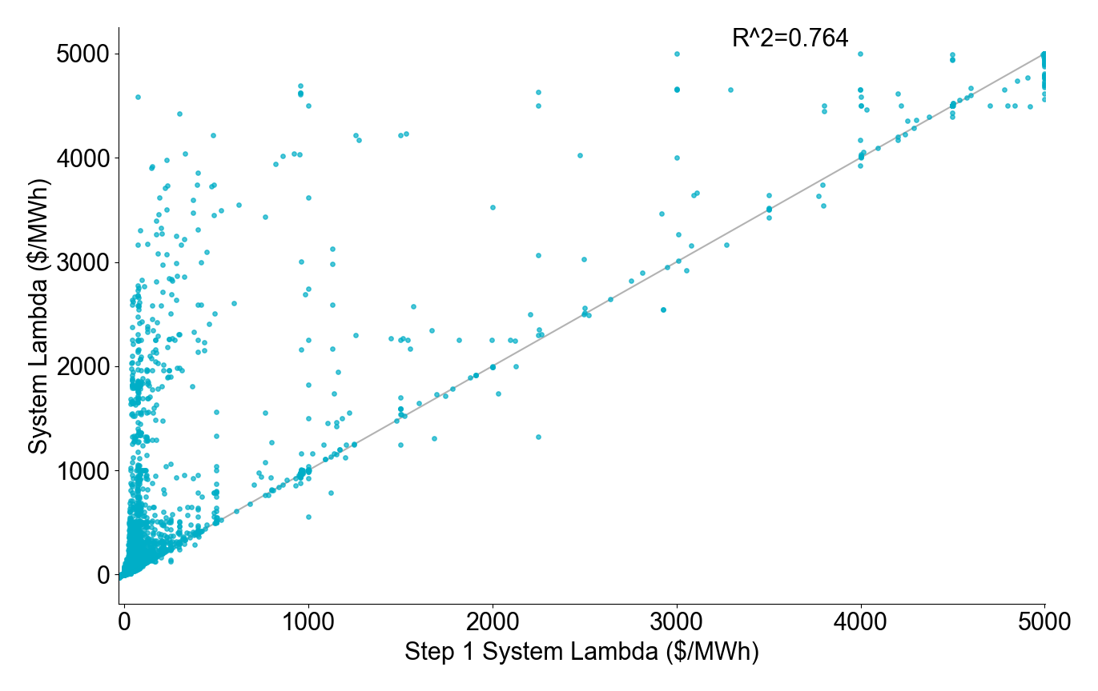
There is a strong correlation between the Step 1 System Lambda and System Lambda (Step 2)

Slide 7
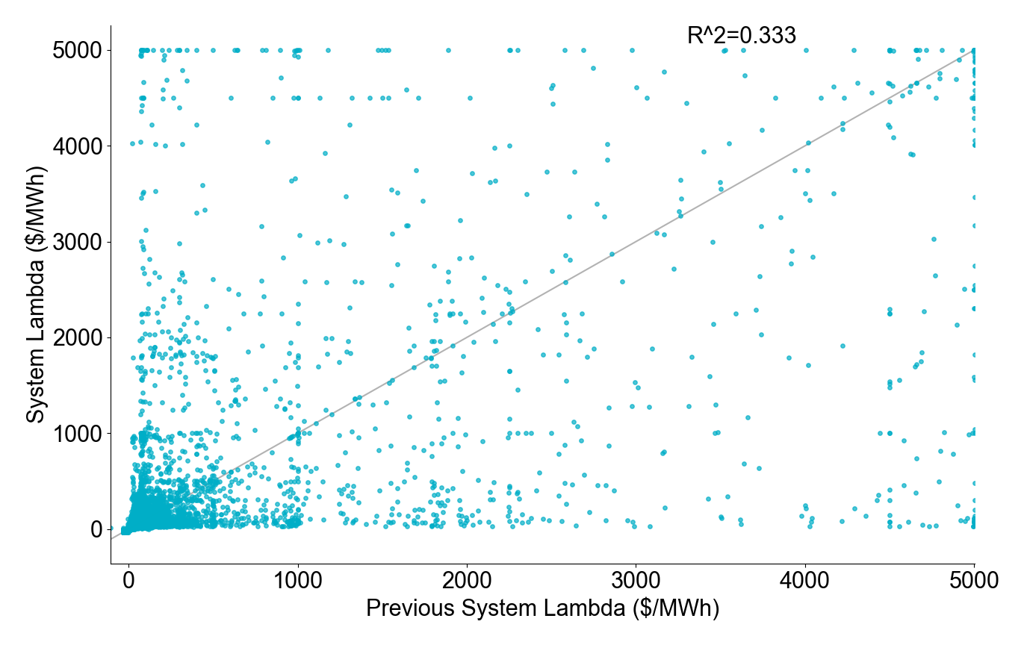
The System Lambda from the previous SCED run provides a much weaker estimate of System Lambda

Slide 8
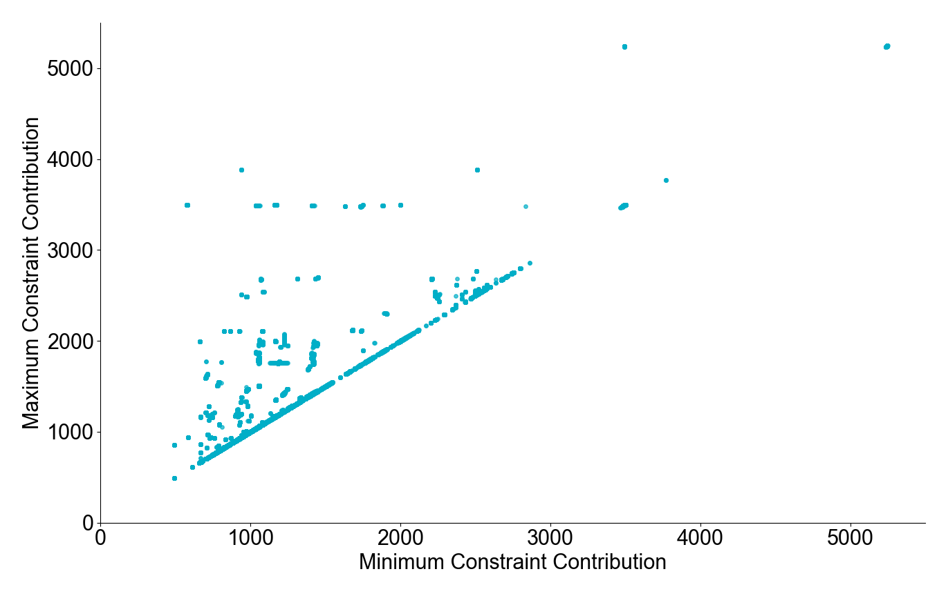
Most intervals are unaffected when we take the minimum vs maximum constraint contribution

Slide 9
Analysis Methodology
The table shows how often each mitigation strategy would impact SCED
  An interval is considered “impacted” if the dispatch differs by at least 0.1 MW between the original EOC and the EOC mitigated by the different proposals using the production LMP for both. This will tell us how often SCED would be impacted but would not show the correct dispatch.
  We could only determine the actual MW dispatch difference by rerunning SCED.
The case studies involve SCED reruns

Slide 10
Mitigation impacts
Proposal | Unique SCED intervals | Unique Resources | Resource-intervals | Mitigated over 1 hour | Greatest daily mitigation (hours)
Previous Just-in-time | 358 | 14 | 581 | 12 | 2.4
Just-in-time | 284 | 11 | 439 | 5 | 2.6
Notes:
An interval is considered “impacted” if the dispatch differs by at least 0.1 MW between the original EOC and the EOC mitigated by the different proposals using the production LMP for both. If we were to rerun, the difference in that specific resource may or may not exist, but there would be an impact to the objective function.
We could not tell the actual dispatch amount difference without rerunning SCED.
‘Mitgated over 1 hour’ looks at whether there is at least 1 hour of mitigation within a 2-hour period. There is a limit of 1 instance per resource per day.

Slide 11
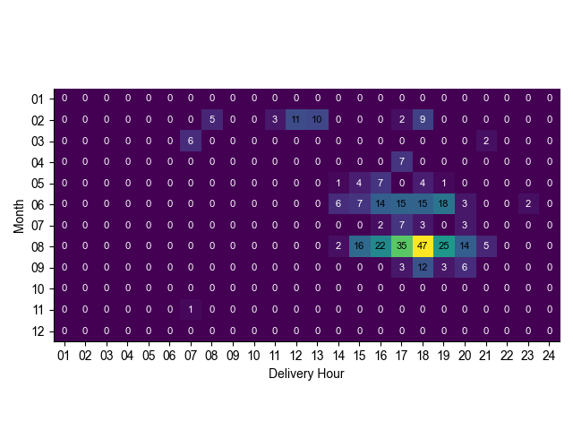
Affected intervals by month and delivery hour

Slide 12
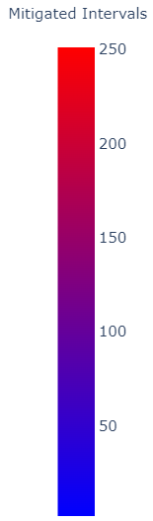
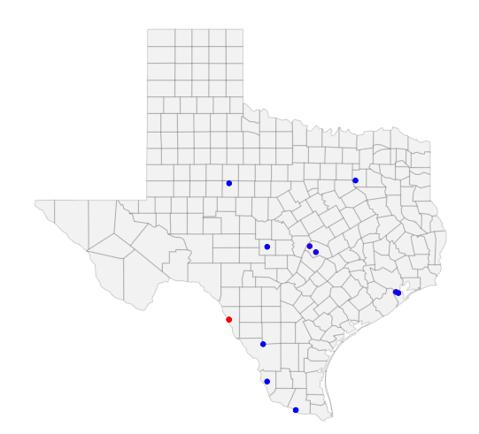
Mitigated intervals

Slide 13
Case Study: SCED interval 2023-03-25 20:05
BRP_PBL1_UNIT1 (and BRP_PBL2_UNIT1)
CROSSETT_BES1 (and CROSSETT_BES2)
CATARINA_BESS

Slide 14
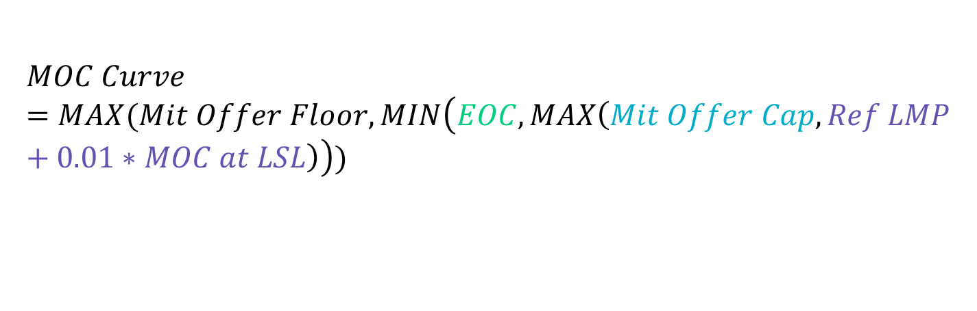
Mitigation in SCED
$$MOC Curve=MAX(Mit Offer Floor,MIN\left(EOC, MAX\left(Mit Offer Cap, Ref LMP+0.01∗MOC at LSL\right)\right))$$
The mitigated offer cap will only be applicable if it is greater than the reference LMP. It will cap the energy offer curve at this value.

Slide 15
Mitigation Case Study: BRP_PBL1_UNIT1
Mitigated Offer Cap = 910.26 = 681.8 + 228.46
  -0.243 shift factor on constraint with a max shadow price of $2,800/MWh
  $228.46 Reference System Lambda
Notes:
Dispatch increases to help relieve congestion

Slide 16
Mitigation Case Study: CROSSETT_BES1
No mitigation. No constraints met -0.2 threshold.
Notes:
Curve is unchanged

Slide 17
Mitigation Case Study: CATARINA_BESS
Mitigated Offer Cap = 1,188.55 = 960.10 + 228.46
  -0.274 shift factor on constraint with a max shadow price of $3,500/MWh
  $228.46 Reference System Lambda
Notes:
Dispatch remains unchanged. LMP increases from 233 to 263 ($/MWh) due to co-optimization between this resource and BRP_PBL1_UNIT1

Slide 18
Case study comparison: SBE2ASH8 TURTLECK_WCRYS_1 impact
 | Original | Just-in-time
Shadow Price ($/MW) | 2,800 | 2,118.22
Violation (MW) | 0.93 | 0

Slide 19
Takeaways
Just-in-time
  This strategy mitigates resources when the ability to abuse market power due to local market conditions exists. This is the goal of mitigation in ERCOT.
  There was only one instance in 2023 when a resource was mitigated over 2 hours in a day using this strategy.

Slide 20
Discussion

