Slide 1
Supplemental Information
Retail Electric Market
August 2024 – August 2025

Slide 2
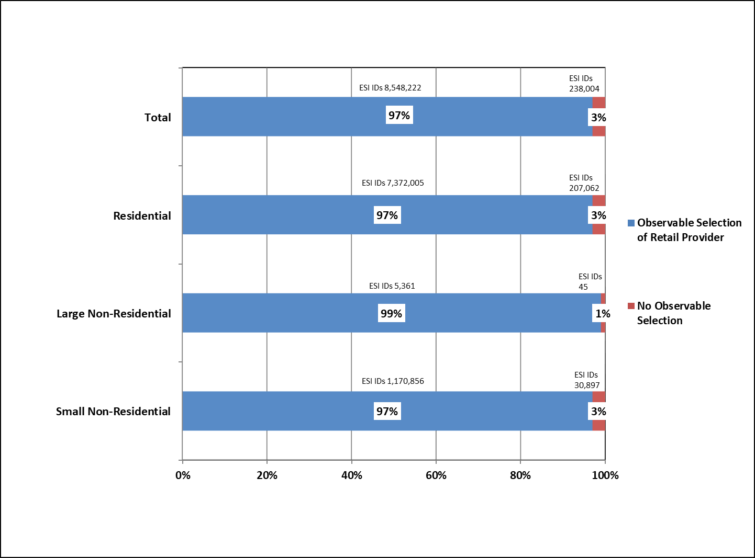
Observable Selection of Electric Provider
Notes:
The percentage of ESI IDs represented in blue with an “Observed Selection” Includes:
- ESI IDs created after the start of full Retail Competition in 2002
- ESI IDs that have had at least one change to the initially established default Rep of Record relationship since the start of Retail Competition in 2002
The percentage of ESI IDs represented in red without an “Observed Selection” includes:
- ESI IDs that have never had a change to the initially established default Rep of Record relationship since the start of Retail Competition in 2002
These statistics are based on the data available in ERCOT’s retail registration system

Slide 3
Observable Selection of Electric Provider - Definition
The percentage of ESI IDs represented in blue with an “Observed Selection” Includes:
ESI IDs created after the start of full Retail Competition in 2002
ESI IDs that have had at least one change to the initially established default Rep of Record relationship since the start of Retail Competition in 2002
The percentage of ESI IDs represented in red without an “Observed Selection” includes:
ESI IDs that have never had a change to the initially established default Rep of Record relationship since the start of Retail Competition in 2002
These statistics are based on the data available in ERCOT’s retail registration system

Slide 4
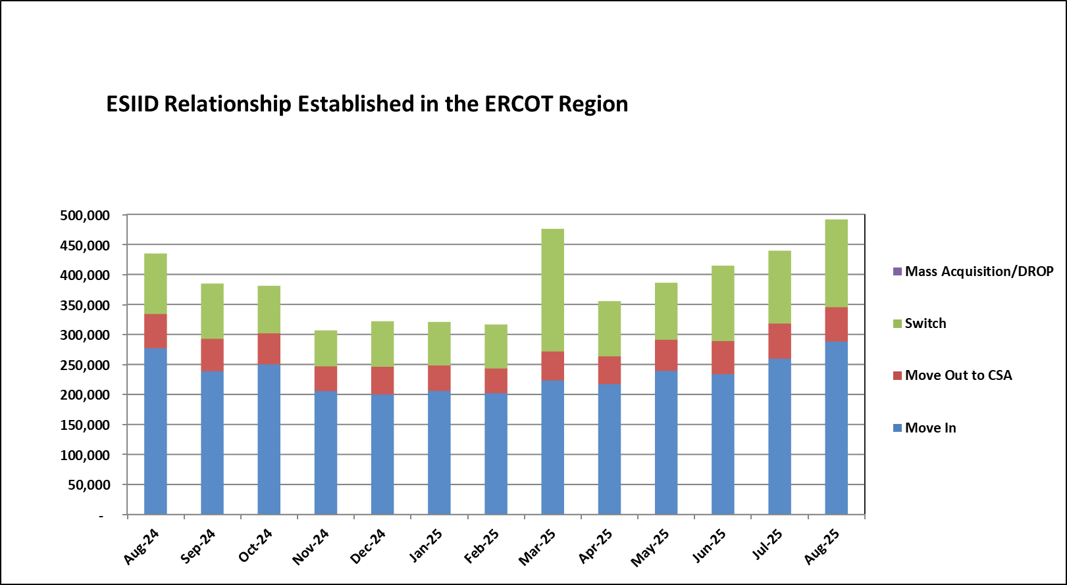
Competitive Retail Market Activity
Notes:
Move Out to CSA represents the initiation of a service period with a retailer having an existing Continuous Service Agreement at a premise. This is often used in landlord/tenant scenarios.
*Total for August 2024 – August 2025 = 5,029,638
*Average per Month = 386,895
*Total for 2025 = 3,200,556

