Slide 1
NPRR1131 – Controllable Load Resource Participation in Non-Spin
NPRR1058 Resource Offer Modernization
June 26, 2024

Slide 2
NPRR1131 – Controllable Load Resource Participation in Non-Spin
Objectives
Changes CLR participation in Non-Spin from Off-Line to On-Line Non-Spin.
Along with OBDRR040 - ORDC Changes Related to NPRR1131
Consistent with On-Line treatment, this NPRR also sets a bid floor of $75/ MWh for CLR capacity providing Non-Spin, equivalent to the offer floor for a Generation Resource providing On-Line Non-Spin
Adds the requirement that if the Qualified Scheduling Entity (QSE) also assigns Responsive Reserve (RRS) and/or Regulation Up Service (Reg-Up) to a CLR that has been assigned Non-Spin, there will be a bid floor for the sum of the RRS, Reg-Up, and Non-Spin Ancillary Service Resource Responsibilities of $75 per MWh
Project is in Planning/Execution Phase
Requirement and design are in progress
Tentative Go live – August 22, 2024

Slide 3
NPRR1058 – Resource Offer Modernization
Objectives
Allow all Resources to update their offers in Real-Time to reflect their current costs.
For any Operating Hour, a QSE
may submit or change Energy Offer Curve for a Resource
may submit or change RTM Energy Bid
at any time prior to SCED execution, and SCED will use the latest Energy Offer Curve or RTM Bid available in the system at the time of SCED execution and ERCOT will notify the QSE any invalid Energy Offer Curve or RTM Energy Bid was rejected.
The QSE must provide a freeform reason at the time of the submission of the EOC if submitted after the end of the Adjustment Period
For the percentages FIP and FOP within an Energy Offer Curve, submissions and updates must be received by ERCOT’s systems in the Adjustment Period.
Changes will be in
XSD
Market Manager UI
Backward compatible
Project is in Planning/Execution Phase
Requirement and design are in progress
Tentative Go live – August 2024
MOTE Testing Expectations
Changes will be available in MOTE for MPs testing – tentatively planned for 08/02/2024 (will confirm the date in July TWG meeting)
Perform submission of Energy Offer Curve and RTM Energy Bid up to Real Time
Market Manager UI
API

Slide 4
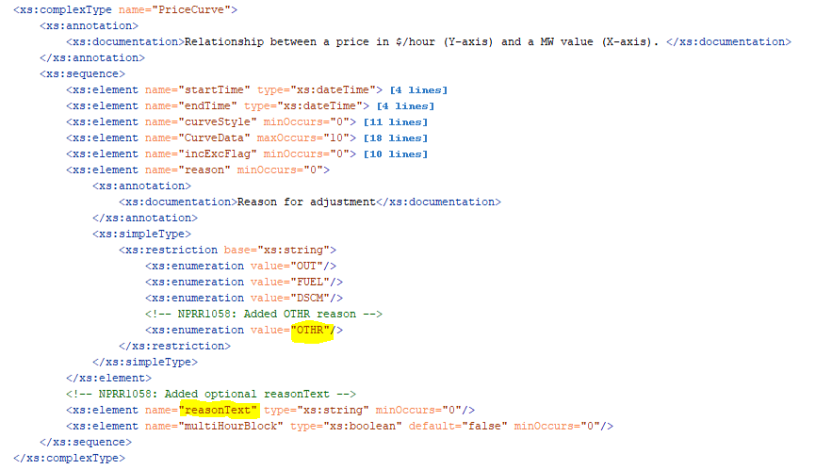
NPRR1058 – Resource Offer Modernization
XSD Changes

Slide 5
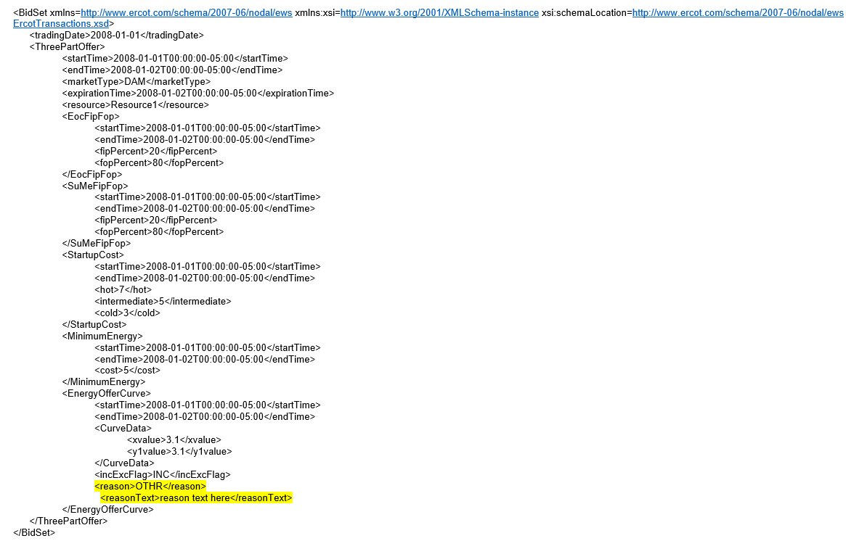
NPRR1058 – Resource Offer Modernization
XSD Changes – A Sample

Slide 6
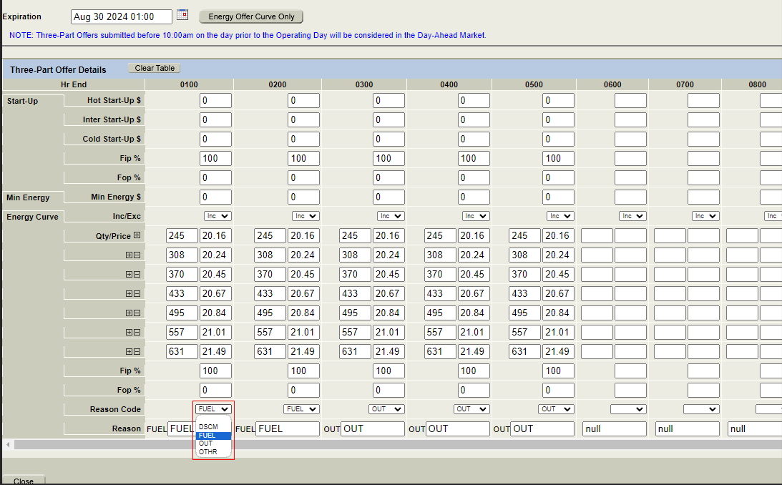
NPRR1058 – Resource Offer Modernization
MMS UI Changes

Slide 7
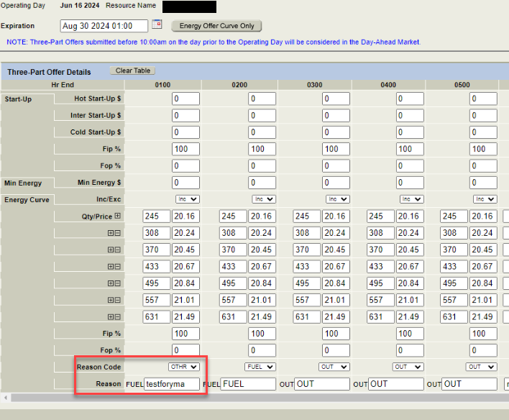
NPRR1058 – Resource Offer Modernization
MMS UI Changes

