Slide 1
2024 Long-Term Load Forecast with HB5066 Impacts
Sam Morris & Kate Lamb
Load Forecasting & Analysis

Slide 2
Agenda
Scope of Long-Term Load Forecast
HB5066 Explanation
TDSP Survey
Waterfall Method/Peak Hour Shifts
Summer and Winter Peaks
2023 Weather Year Comparison

Slide 3
Forecast Scope
Our official forecast created using 15 historical weather years, economic drivers, calendar information, and historical load
The 2024 Long-Term Load Forecast, which was published in January 2024, is comprised of: Base (econometric model) forecast, Roof-top PV forecast, Electric Vehicle forecast, Large Flexible Load forecast, and New Large Loads with a signed Contract with their TSP or DSP as of 10, 2023
For this presentation, ERCOT has included the following additional load forecast impacts:
- Additional New Large Loads with a signed Contract with their TSP or DSP as of MM, 2024
- Additional New Large Loads without a signed Contract with their TSP or DSP, but with a TSP or DSP Officer Letter (“Executive Letter”)

Slide 4
HB5066
”5066 attempts to spur a bolder, more proactive approach that better syncs the transmission planning and construction process with the dynamic needs of Texas customers by requiring ERCOT, the Public Utility Commission of Texas, and utilities to plan the grid more proactively based on the information utilities have about load growth in their area.” - 88(R) HB 5066 - Committee Report (Substituted) version - Bill Analysis (texas.gov)

Slide 5
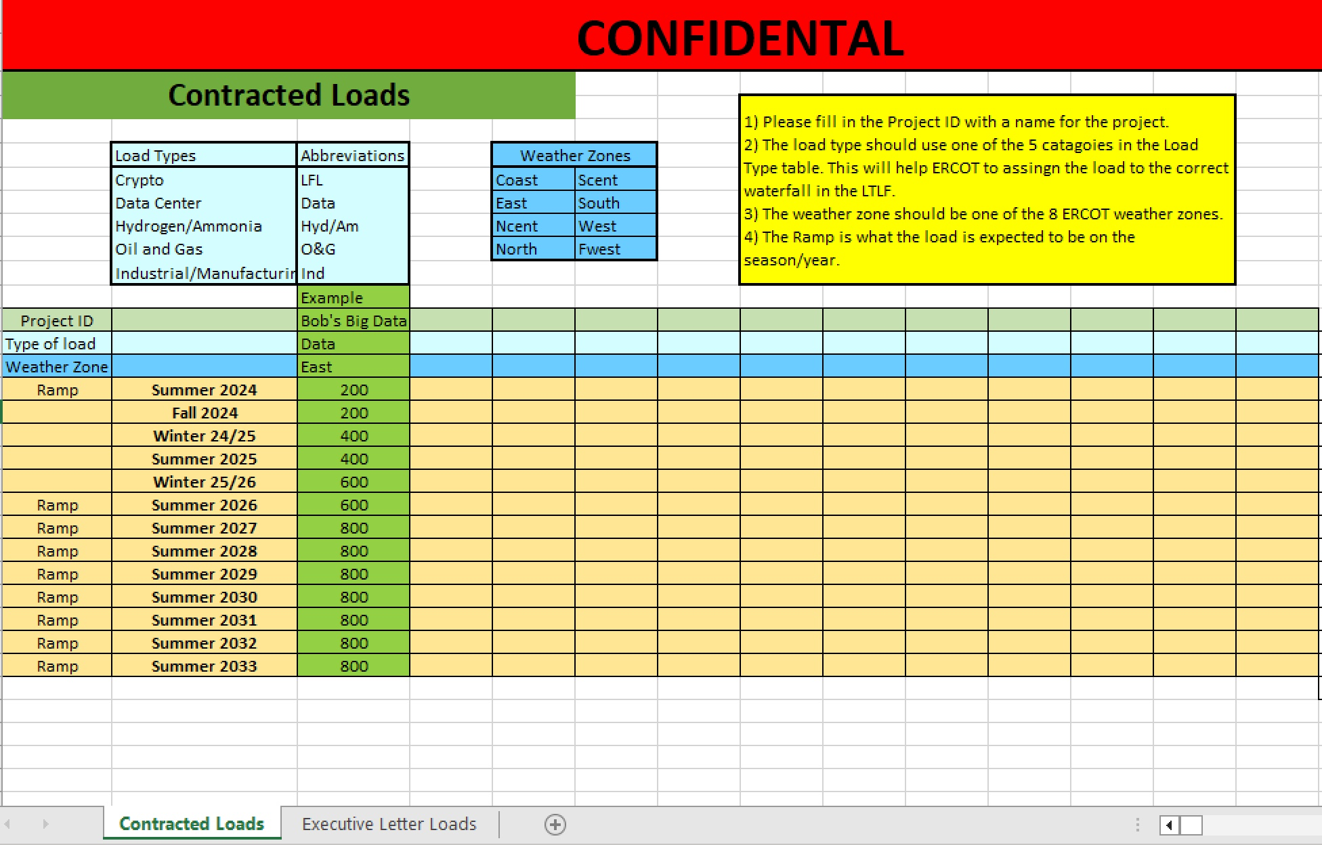
TDSP Survey

Slide 6
Waterfall Methodology

Slide 7
Waterfall Methodology
Net Forecast = Base Forecast + EV Forecast + LFL Forecast – PV Forecast
Benefits:
Gives us the ability to provide forecasts for many scenarios
Reconstitution to avoid double counting load

Slide 8
How it works
15 Weather Year Forecasts per Weather Zone
Rank by Year and Month
Sort by Rank
Averaged across Weather Years
Map to a moderate Weather Year
*Individual Weather Year Forecasts can be used for weather scenarios like LTSA, LTRA, MORA, and other weather studies.
Year | Month | Day | Hour | Rank | Forecast based on 2011’s Weather
2024 | 1 | 13 | 20 | 1 | 16,159
2024 | 1 | 13 | 19 | 2 | 16,140
2024 | 1 | 13 | 11 | 3 | 16,055
2024 | 1 | 12 | 9 | 4 | 15,993
2024 | 1 | 12 | 8 | 5 | 15,979

Slide 9
Peak Hour Shifts

Slide 10
Summer Peak Hour Shift
 | Coast | East | Fwest | NCENT | North | SCENT | South | West | ERCOT
2024 | 17 | 17 | 22 | 17 | 22 | 17 | 15 | 17 | 17
2025 | 17 | 17 | 22 | 17 | 22 | 22 | 15 | 17 | 17
2026 | 17 | 17 | 22 | 17 | 22 | 22 | 15 | 17 | 17
2027 | 17 | 17 | 22 | 17 | 22 | 22 | 15 | 17 | 17
2028 | 18 | 17 | 22 | 19 | 22 | 22 | 17 | 18 | 22
2029 | 18 | 17 | 22 | 19 | 22 | 22 | 17 | 18 | 22
2030 | 18 | 17 | 22 | 19 | 22 | 22 | 17 | 18 | 22

Slide 11
Summer CP Forecast

Slide 12
2030 Peak with Executive Letters

Slide 13
Winter CP Forecast

Slide 15
2023 Weather Year Scenario

Slide 16
 | 2024 Forecast published January 2024 for Summer 2024 | 2023 Forecast published January 2023 for Summer 2024 | 2023 WY Forecast Scenario for Summer 2024
Base 50/50 | 83,332 | 84,329 | 86,165
LFLs 100% | 2,891 | 700 | 2,891
Additional PV | -1,061 | -705 | -1,061
P90 Percentage Adder | 4,009 | 4,009 | 4,009
Total | 85,162 | 84,324 | 87,995
Total with P90 Adder | 89,171 | 88,333 | 92,004

Slide 17
Questions?

