Slide 1
Project Update
June 13, 2024
Troy Anderson
ERCOT Portfolio Management

Slide 2
Project Update Agenda
Recent / Upcoming Project Highlights
2024 Release Targets
Major Projects
Additional Project Status Information
Priority/Rank Recommendations for Revision Requests with Impacts
NPRR1216 – Implementation of Emergency Pricing Program
Technology Working Group (TWG)
Next meeting is 6/26/2024
Aging Revision Request Project Review
Next Month: IA Statistics?
Location of Revision Request Project Information: http://www.ercot.com/services/projects

Slide 3
Recent / Upcoming Project Highlights
2024 May Release – R5 – 5/30/2024 Complete
SCR819 – Improving IRR Control to Manage GTC Stability Limits
NPRR1111 – Related to SCR819, Improving IRR Control to Manage GTC Stability Limits
2024 June Off-Cycle Release – 6/1/2024 Complete
NPRR1103 – Securitization Phase 2b
Default Charge Supporting Data
2024 June Release – R6 – 6/27/2024 In Flight
NPRR962 – Publish Approved DC Tie Schedules
NPRR1090 – ERS Winter Storm Uri Lessons Learned Changes and Other ERS Items
NPRR1121 – Add a Posting Requirement to the Exceptional Fuel Cost Submission Process
NPRR1139 – Adjustments to Capacity Shortfall Ratio Share for IRRs
NPRR1149 – Implementation of Systematic Ancillary Service Failed Quantity Charges
NPRR1186 – Implement consideration of ESR SOC in ERCOT tools and studies
NPRR1196 – Correction of NCLR Ancillary Service Failed Quantity Calcs under NPRR1149
2024 May Release – R7 – 7/25/2024 In Flight
NPRR1002 – BESTF-5 ESR Single Model Registration and Charging Restrictions in Emergency Conditions
RRGRR023 – Related to NPRR1002
Note: Projected Go-Live dates are subject to change. Please watch for market notices as the effective dates approach.

Slide 4
2024 Release Targets – Approved NPRRs / SCRs / xGRRs
R1
R3
R5
January 1/25 | February 2/22 | March 3/28 | April 4/25 | May 5/30 | June 6/27
NPRR1092(b) PGRR098(a) ESR Telemetry Public API Enhancements | NPRR1132(a) RRGRR032 NOGRR249(b) NPRR1184(a) NPRR1026(b) NPRR1172(a) | NPRR1040 NOGRR247(a) NPRR1165 NPRR989(a) NPRR1038 NOGRR204(a) |  | SCR819 NPRR1111 Securitization Default Charge Supporting Data | NPRR1149 NPRR1186 NPRR1196 NPRR1121 NPRR1090 NPRR962 SCR819 NPRR1111 NPRR1139
R2
R4
R6
ü
ü
ü
ü
ü
ü
ü
ü
ü
ü
P
P
P
NS
E
ü
ü
ü
ü
ü
ü
ü
ü
E
E
E
E
E
E
E
1/1
3/11
Various effective dates
2/1
2/26
4/1
6/1
2/16
3/1
ü
R7
R9
July 7/25 | August 8/22 | September 9/26 | October 10/24 | TX SET 5.0 11/10 | December 12/11-12/12
NPRR1002 RRGRR023 | NPRR1058 NPRR1131 NPRR1139 SCR813 SCR821 Forecast Presentation Platform (CDR rpts) | NPRR1131 OBDRR040 | NPRR1183 | NPRR1095 SCR817 SCR823 RMGRR172 RMGRR168 RMGRR179 | PGRR088 PGRR094 NPRR1023
R8
R10
R11
E
E
P
NS
E
E
E
E
E
E
NS
NS
P
To R6
TBD
Go-live dates can differ from Protocol effective dates – Please refer to market notices for more details
APPENDIX
Red Text: New additions and target release changes
Strike-Through Text: Previous target release
(a), (b), etc.: Multiple phase release
Project Status Codes
NS = Not Started
I = Initiation
P = Planning
E = Execution
H = On Hold
NPRR989(a) – ESR tech. req.
NPRR1026(b) – SLF – Reporting
NPRR1092(b) – Limit RUC Opt-Out
NPRR1132(a) – RIOO portion
NPRR1172(a) – Phase 1 elements
NPRR1184(a) – Interest calcs
NOGRR204(a) – ESR tech req
NOGRR247(a) – UFLS changes
NOGRR249(b) – MIS posting
PGRR098(a) – Section 4.1.1.8
Release targets are subject to change

Slide 5
Major Projects
Other Project Highlights

Slide 6
Additional Project Status Information
RR | Description | Proj Phase | Additional Detail
NPRR1004 | Load Distribution Factor Process Update | Not Started | These items are being assessed for implementation windows in the near term
NPRR1006 | Update RT On-Line Reliability Deployment Price Adder Inputs to Match Actual Data | On Hold
NPRR1077 | Extension of Self-Limiting Facility Concept to Settlement Only Generators (SOGs) and Telemetry Requirements for SOGs | Not Started
NPRR1091 | Changes to Address Market Impacts of Additional Non-Spin Procurement | Not Started
NPRR1128 | Allow FFR Procurement up to FFR Limit Without Proration | Not Started
Red Text: New additions and updates

Slide 7
Priority / Rank Recommendations for Revision Requests with Impacts
Recommendations for…
Revision Request | Description | Priority | Rank | Comments
NPRR1216 | Implementation of Emergency Pricing Program | 2024 | 380 | $175k-$250k, 9-12 months Impacted System(s): S&B, MMS, Reporting, Integration, Registration, ERCOT.com 2 phases expected – See Comments in IA for more information REGULATORY
PPL Rank Information
Next available 2024 Rank in Business Strategy = 4100
Next available 2025 Rank in Business Strategy = 4530
Next available 2026 Rank in Business Strategy = 4710
Next available Rank in Regulatory = 380

Slide 8
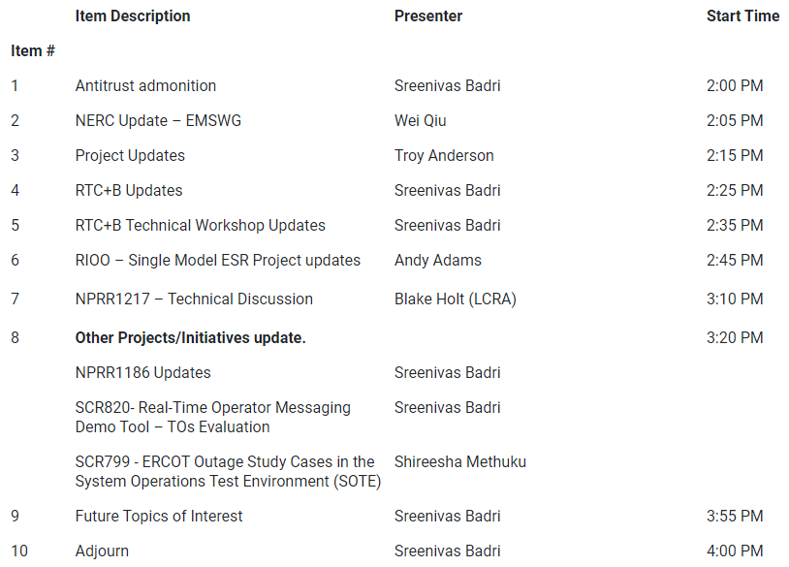
Technology Working Group (TWG)
Agenda for TWG meeting held on 5/29/2024:
Next TWG scheduled for 6/26/2024

Slide 9
Aging Revision Request Project Review
Continuing “Aging Revision Request” discussion
Data Analysis on slide 10
Latest details of each recommendation category on slides 11-16
Reminder of how to remove a previously approved RR on slide 17
Updated draft Gantt on slides 18-20
TBD | NPRRs: 484,825(b),826,829,841,857,879,885,904,918,930,936,941,945,963,965,975,987,989,995,1004,1006,1007,1019,1020(b),1029,1030,1032,1034,1038, 1057,1077,1091,1098,1105,1128 SCRs: 805,810,818 PGRRs: 076,091,099,103 Other: OBDRR009,OBDRR017,RRGRR028

Slide 10
Aging Revision Request Review at PRS – Stats
Progress of Aging RR review by month
The drop in the total count from May to June is due to:
NPRR1058 combined with the in-flight NPRR1131 project
Other Changes
Southern Spirit items moved to “No Action” category until a target start date is determined
PGRR088 and PGRR094 targeted for December 2024 go-live
Recommending NPRR879 move to “Post-RTC+B”
PGRR103 moved to “No Action”
See following slides for items in each category
Category | March PRS | May PRS | June PRS
1 – Proceed as Planned | 13 | 13 | 15
2 – Southern Spirit | 3 | 3
3 – No Action | 11 | 11 | 15
4 – Candidate for Revision / Removal | 2 | 2 | 2
5 – Post-RTC+B | 9 | 19 | 20
6 – Market Input Needed | 28 | 14 | 9
Total | 66 | 62 | 61

Slide 11
1 – Proceed as Planned
Target Start | Revision Request | Approval Date | RR Name | Project Status | Budget Range | Duration Range | ERCOT Recommendation
TBD | SCR821 | Jan-2023 | Voltage Set Point Target Information for DGR or DESR | Not Started | $25k - $50k | 3 - 5 months | 1 - Proceed as planned
6/1/2024 | NPRR1183 | Oct-2023 | ECEII Definition Clarification and Updates to Posting Rules for Certain Docs w/o ECEII | Not Started | $50k - $75k | 4 - 6 months | 1 - Proceed as planned
7/1/2024 | SCR799 | Jun-2019 | ERCOT Outage Study Cases in SOTE | Not Started | $150k-$250k | 5-7 months | 1 - Proceed as planned
Q3 2024 | NPRR1145 | May-2023 | Use of State Estimator-Calculated ERCOT-Wide TLFs in Lieu of Seasonal Base Case ERCOT-Wide TLFs for Settlement | Not Started | $50k - $80k | 3 - 6 months | 1 - Proceed as planned
10/1/2024 | PGRR076 | Aug-2020 | Improvements to GINR Process | Not Started | $50k-$75k | 6-9 months | 1 - Proceed as planned
10/1/2024 | SCR805 | Dec-2019 | Provide Early Access to Certain 60-Day Reports to TSPs Upon Request | Not Started | $40k-$60k | 4-6 months | 1 - Proceed as planned
10/1/2024 | NPRR1035 | Oct-2020 | DC Tie Schedules Protected Information Expiry and Posting | Not Started | $20k-$40k | 3-5 months | 1 - Proceed as planned
10/1/2024 | NPRR1208 | Apr-2024 | Creation of Invoice Report | Not Started | $40k - $60k | 4 - 6 months | 1 - Proceed as planned
3/1/2025 | NPRR936 | Oct-2019 | CRR Account Holder Limits | Not Started | $150k-$250k | 8-10 months | 1 - Proceed as planned
3/1/2025 | NPRR1184 | Nov-2023 | Update to Procedures for Managing Interest on Cash Collateral | Not Started | $100k - $150k | 6 - 9 months | 1 - Proceed as planned
12/1/2025 | SCR818b | Apr-2022 | Changes to Incorporate GIC Modeling Data into Existing Modeling Applications | Not Started | $300k - $500k | 9 - 12 months | 1 - Proceed as planned
7/1/2025 | NOGRR226 | Jan-2023 | Addition of Supplemental UFLS Stages | Not Started | $40k - $60k | 3 - 5 months | 1 - Proceed as planned
7/1/2025 | NOGRR247 | Oct-2023 | Change UFLS Stages and Load Relief Amounts | Not Started | <$10k | 1 - 2 months | 1 - Proceed as planned
Q3 2024 | PGRR088 | Jun-2021 | Include Financial Security Amt in Monthly Generator Interconnection Status Report | Not Started | $20k- $40k | 3 - 5 months | 1 - Proceed as planned
Q3 2024 | PGRR094 | Oct-2021 | Clarify Notification Requirement for Generator Construction Commencement or Completion | Not Started | $10k - $20k | 1 - 2 months | 1 - Proceed as planned
Revised ERCOT recommendation

Slide 12
3 – No Action Needed
Target Start | Revision Request | Approval Date | RR Name | Project Status | Budget Range | Duration Range | ERCOT Recommendation
6/1/2024 | NPRR945 | Dec-2020 | Net Metering Requirements | Not Started | $10k-$20k | 3-4 months | 3 - No action
1/1/2027 | SCR825 | Apr-2024 | ERCOT Voice Communications Aggregation | Not Started | $150k-$250k | 7 - 10 months | 3 - No action
 | NPRR829 | Oct-2017 | Incorporate Real-Time Non-Modeled Telemetered Net Generation by Load Zone into the Estimate of RTL | On Hold | $200k-$300k | 5-10 months | 3 - No action
 | NPRR841 | Feb-2018 | RT Adjustments to Day-Ahead Make Whole Payments due to A/S Infeasibility Charges | Not Started | $60k-$80k | 4-6 months | 3 - No action
 | NPRR857 | Oct-2018 | Creation of Direct Current Tie Operator Market Participant Role | Not Started | $500k-$700k | 12-18 months | 3 - No action (Southern Spirit)
 | NPRR885 | Jun-2019 | Must-Run Alternative (MRA) Details and Revisions Resulting from PUCT Project No_ 46369, Rulemaking Relating to RMR Service | On Hold | $500k - $700k | 8 - 12 months | 3 - No action
 | NPRR963 | Feb-2020 | Base Point Deviation Settlement and Deployment Performance Metrics for Energy Storage Resources (Combo Model) | On Hold | $150k-$200k | 8-12 months | 3 - No action
 | NPRR975 | Jun-2020 | Load Forecast Model Transparency | Not Started | $75k-$100k | 6-9 months | 3 - No action
 | NPRR995 | Aug-2021 | RTF-6 Create Definition and Terms for Settlement Only Energy Storage | Not Started | $800k-$1.2M | 20-30 months | 3 – No action
 | NPRR1030 | Aug-2020 | Modify Allocator for CRR Auction Revenue Distribution | Not Started | $175k-$225k | 8-12 months | 3 - No action
 | NPRR1034 | Feb-2021 | Frequency-Based Limits on DC Tie Imports or Exports | Not Started | $50k-$70k | 5-7 months | 3 - No action (Southern Spirit)
 | NPRR1054 | Feb-2021 | Removal of Oklaunion Exemption Language | Not Started | $10k-$15k | 3-4 months | 3 - No action
 | NPRR1098 | Mar-2022 | DC Tie Reactive Power Capability Requirements | Not Started | $10k - $20k | 3 - 5 months | 3 - No action (Southern Spirit)
 | NPRR1216 | TBD | Implementation of Emergency Pricing Program | Pending PRS Approval | $125k-$175k | 5-7 months | 3 - No action
 | PGRR103 | Oct-2023 | Establish Time Limit for Generator Commissioning Following Approval to Synchronize | Not Started | $40k-$60k | 4 - 6 months | 3 - No action

Slide 13
4 – Candidate for Revision / Removal
Target Start | Revision Request | Approval Date | RR Name | Project Status | Budget Range | Duration Range | ERCOT Recommendation
 | NPRR1029 | Dec-2020 | BESTF-6 DC-Coupled Resources | Not Started | $800k-$1.2M | 16-24 months | 4 - Candidate for revision/removal
 | NPRR1020b | Aug-2020 | Allow Some Integrated Energy Storage Designs to Calculate Internal Loads - Data Agg | Not Started | $175k-$225k | 8-12 months | 4 - Candidate for revision/removal

Slide 14
5 – Post-RTC+B (page 1)
Target Start | Revision Request | Approval Date | RR Name | Project Status | Budget Range | Duration Range | ERCOT Recommendation
 | NOGRR215 | Oct-2023 | Limit Use of Remedial Action Schemes | Not Started | $1.0M - $1.5M | 12 - 18 months | 5 - Post-RTC+B
 | NPRR1140 | Nov-2022 | Recovering Fuel Costs for Generation Above LSL During RUC-Committed Hours | Not Started | $20k - $30k | 3 - 4 months | 5 - Post-RTC+B
 | NPRR904 | Aug-2019 | Revisions to Real-Time On-Line Reliability Deployment Price Adder for ERCOT-Directed Actions Related to DC Ties | On Hold | $200k-$300k | 6-9 months | 5 - Post-RTC+B
 | OBDRR009 | Aug-2019 | ORDC OBD Revisions for ERCOT-Directed Actions Related to DC Ties | On Hold | $30k-$50k | 4-6 months | 5 - Post-RTC+B
 | NPRR918 | Oct-2019 | Validation for PTP Obligations with Links to an Option | Not Started | $30k-$50k | 4-6 months | 5 - Post-RTC+B
 | NPRR941 | Dec-2019 | Create a Lower Rio Grande Valley Hub | Not Started | $250k-$350k | 6-8 months | 5 - Post-RTC+B
 | NPRR826 | Feb-2020 | Mitigated Offer Caps for RMR Resources | Not Started | $100k-$200k | 6-8 months | 5 - Post-RTC+B
 | NPRR1182 | Oct-2023 | Inclusion of Controllable Load Resources and Energy Storage Resources in the CCT Process | Not Started | $60k - $90k | 5 - 7 months | 5 - Post-RTC+B
 | NPRR825 | Dec-2017 | Require ERCOT to Issue a DC Tie Curtailment Notice Prior to Curtailing any DC Tie Load | Not Started | $200k-$300k | 8-12 months | 5 - Post-RTC+B
 | NPRR930 | Oct-2019 | Process Pricing and Cost Recovery for Delayed Resource Outages | On Hold | $100k-$200k | 5-7 months | 5 - Post-RTC+B
 | NPRR987 | Jun-2020 | BESTF-3 ESR Contribution to PRC and Real-Time On-Line Reserve Capacity Calculations | On Hold | $150k-$200k | 6-9 months | 5 - Post-RTC+B
 | NPRR1019 | Jun-2020 | Pricing and Settlement Changes for SWGRs Instructed to Switch to ERCOT | On Hold | $100k-$140k | 5-7 months | 5 - Post-RTC+B
 | NPRR1032 | Dec-2020 | Consideration of Physical Limits of DC Ties in RUC Optimization and Settlements | Not Started | $100k-$150k | 5-8 months | 5 - Post-RTC+B
 | NPRR1057 | Apr-2021 | Modification to Real-Time Hub Price Formulas for Fully De-Energized Hubs | Not Started | $20k - $30k | 3 - 5 months | 5 - Post-RTC+B
 | NPRR1105 | Dec-2021 | Option to Deploy Distribution Voltage Reduction Measures Prior to EEA - Phase 2 | Not Started | $80k - $120k | 6 - 9 months | 5 - Post-RTC+B

Slide 15
5 – Post-RTC+B (page 2)
Target Start | Revision Request | Approval Date | RR Name | Project Status | Budget Range | Duration Range | ERCOT Recommendation
 | NPRR879 | Dec-2018 | SCED Base Point, Base Point Deviation, and Performance Evaluation Changes for IRRs that Carry Ancillary Services | Not Started | $200k-$250k | 6-9 months | 5 - Post-RTC+B
 | NPRR1091 | Dec-2021 | Changes to Address Market Impacts of Additional Non-Spin Procurement | Not Started | $120k - $160k | 7 - 10 months | 5 - Post-RTC+B
 | NPRR1171 | Oct-2023 | Requirements for DGRs and DESRs on Circuits Subject to Load Shedding | Not Started | $350k - $550k | 9 - 12 months | 5 - Post-RTC+B
 | NPRR1213 | Apr-2024 | Allow DGRs and DESRs on Circuits Subject to Load Shed to Provide ECRS | Not Started | $350k-$450k | 8 - 12 months | 5 - Post-RTC+B
 | NPRR1201 | Feb-2024 | Limitations on Resettlement Timeline and Default Uplift Exposure Adjustments | Not Started | $40k - $70k | 4 - 6 months | 5 - Post-RTC+B
Items singled out by PRS as candidates to be considered in parallel with RTC+B
Revised ERCOT recommendation

Slide 16
6 – Market Input Needed
Target Start | Revision Request | Approval Date | RR Name | Project Status | Budget Range | Duration Range | ERCOT Recommendation
 | NPRR1004 | Aug-2020 | Load Distribution Factor Process Update | Not Started | $45k-$65k | 5-7 months | 6 - Market input needed
 | NPRR965 | Dec-2019 | GREDP Shutdown Exemption | Not Started | $10k-$20k | 3-5 months | 6 - Market input needed
 | NPRR1006 | Jun-2020 | Update Real-Time On-Line Reliability Deployment Price Adder Inputs to Match Actual Data | On Hold | $140k-$180k | 6-9 months | 6 - Market input needed
 | SCR810 | Aug-2020 | EMS System Change to Count DC Ties towards the 2% Constraint Activation Criterion | Not Started | $15k-$25k | 3-5 months | 6 - Market input needed
 | RRGRR028 | Aug-2021 | Transformer Impedance Clarifications | Not Started | $100k - $150k | 7 - 10 months | 6 - Market input needed
 | NPRR1128 | Jan-2023 | Allow FFR Procurement up to FFR Limit Without Proration | Not Started | $30k - $50k | 3 - 5 months | 6 - Market input needed
 | NPRR1172 | Feb-2024 | Fuel Adder Definition, Mitigated Offer Caps, and RUC Clawback | Not Started | $65k - $85k | 4 - 7 months | 6 - Market input needed
 | PGRR091 | Aug-2021 | FIS Application Completion 60-Day Limit | Not Started | $15k - $30k | 3 - 5 months | 6 - Market input needed
 | NPRR1077 | Dec-2021 | Extension of Self-Limiting Facility Concept to Settlement Only Generators (SOGs) and Telemetry Requirements for SOGs | Not Started | $100k - $160k | 7 - 10 months | 6 - Market input needed
Items singled out by PRS as candidates to be considered in parallel with RTC+B

Slide 17
Aging Revision Request Project Review
Reminder: If PRS determines that one or more aging Revision Requests are candidates for removal, the process is to file a “new RR” to strike it
The “new RR” would go through the stakeholder process like any other RR
There are several historical examples of this from 2015:
NPRR721 – Removal of Language related to NPRR455
NPRR722 – Removal of Language related to NPRR181
NPRR724 – Removal of Language related to NPRR493
NPRR727 – Removal of Language related to NPRR327
NPRR728 – Removal of Language related to NPRR484 and NPRR554
TBD | NPRRs: 484,825(b),826,829,841,857,879,885,904,918,930,936,941,945,963,965,975,987,989,995,1004,1006,1007,1019,1020(b),1029,1030,1032,1034,1038, 1057,1058,1077,1091,1098,1105,1128,1131 SCRs: 799,805,810,818 PGRRs: 066,076,088,091,094,099,103 Other: OBDRR009,OBDRR017,RRGRR028

Slide 18
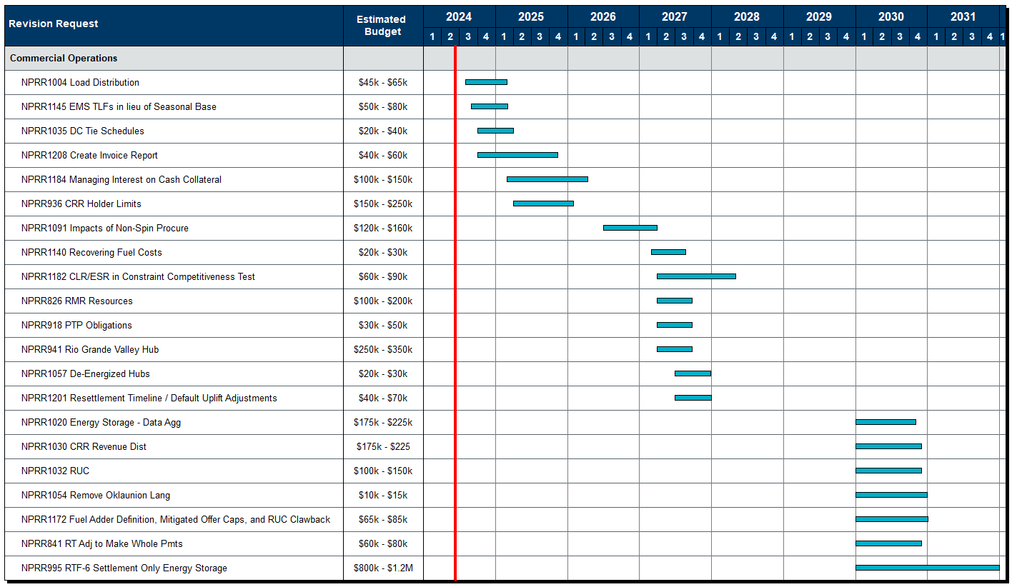
Aging Revision Request Project Review

Slide 19
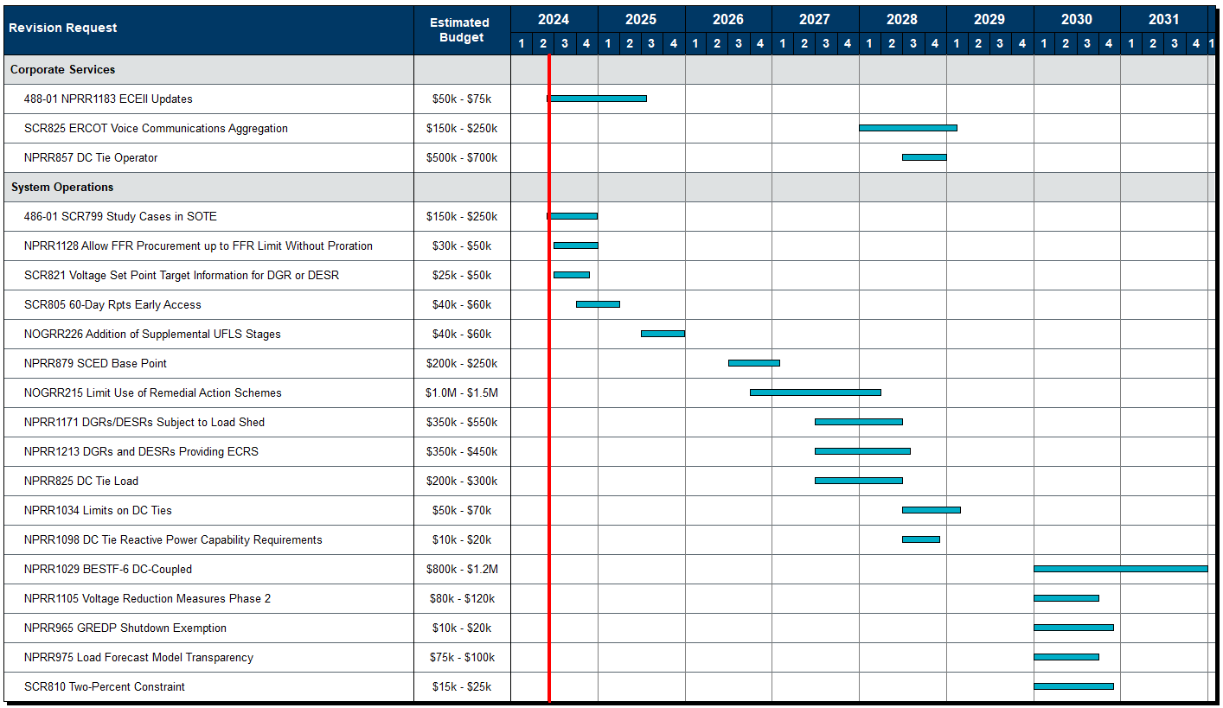
Aging Revision Request Project Review

Slide 20
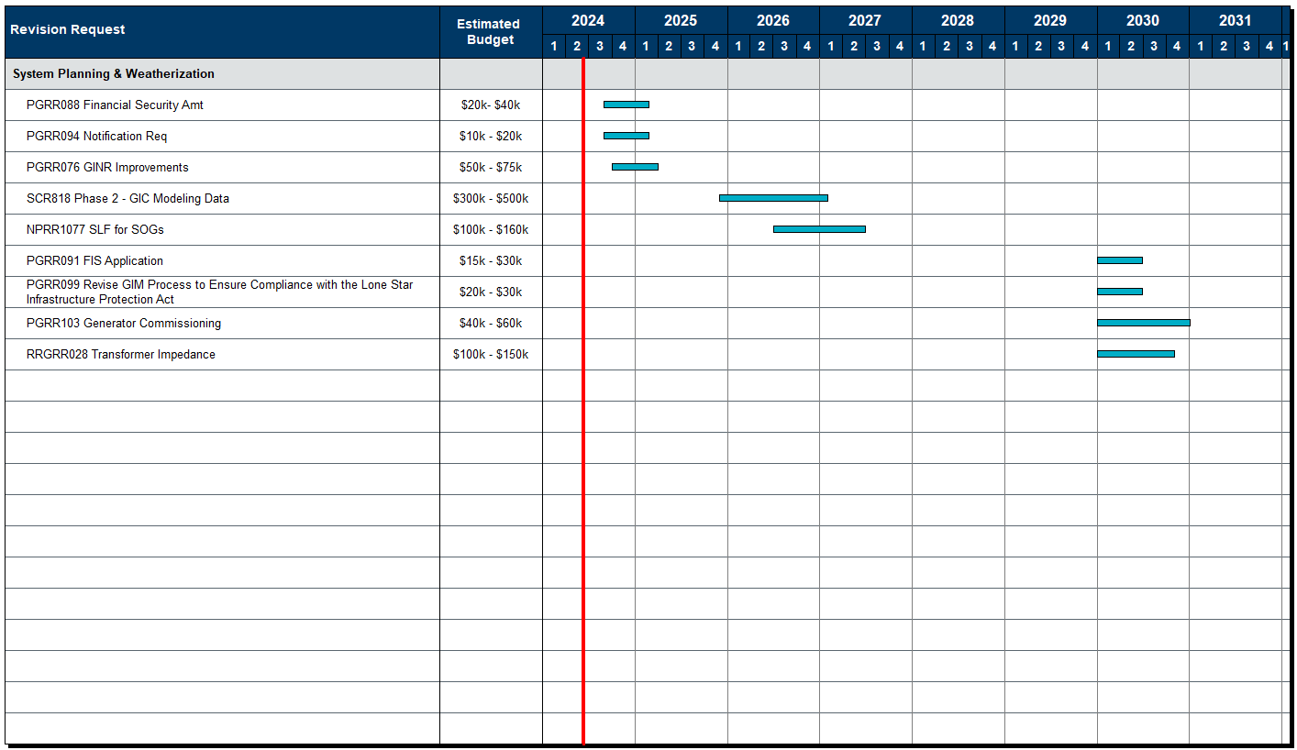
Aging Revision Request Project Review

