Slide 1
NDCRC – Automatic Tracing and Unit Tests
Nick Barbas
June 26, 2024

Slide 2
NDCRC – Automatic Tracing and Unit Tests
Objectives
Replace the current working pattern of QSEs requesting permission for generator unit testing to proceed (AVR/PSS/Reactive/etc.) and ERCOT approving or rejecting the request via email
ERCOT shift supervisors receive anywhere from 50 to 100 requests per day through email and track the status in an excel spreadsheet
Replace existing workflow with an enhancement to the NDCRC application allowing a QSE user to submit the same type of request using a simple web form
After go-live ERCOT will approve or reject testing requests from within the NDCRC application and QSEs will be expected to make future requests through the app rather than emailing shiftsupv@ercot.com
Expected Benefits
Requests to test will be persisted to a database (secure storage)
Application UI will enable both QSE and ERCOT users to easily filter and review previous requests and their statuses without having to search an inbox
ERCOT approvals and rejections of test requests will generate real-time email notifications to submitter which can be used to more dynamically orchestrate testing activity based on current conditions
Project is in Execution Phase
Planned go live for production – July 25th, 2024
NDCRC user interface changes and demo planned for today
Exploring the possibility of a soft launch where requests can be made through both NDCRC and email until market is comfortable using the application to submit them exclusively

Slide 3
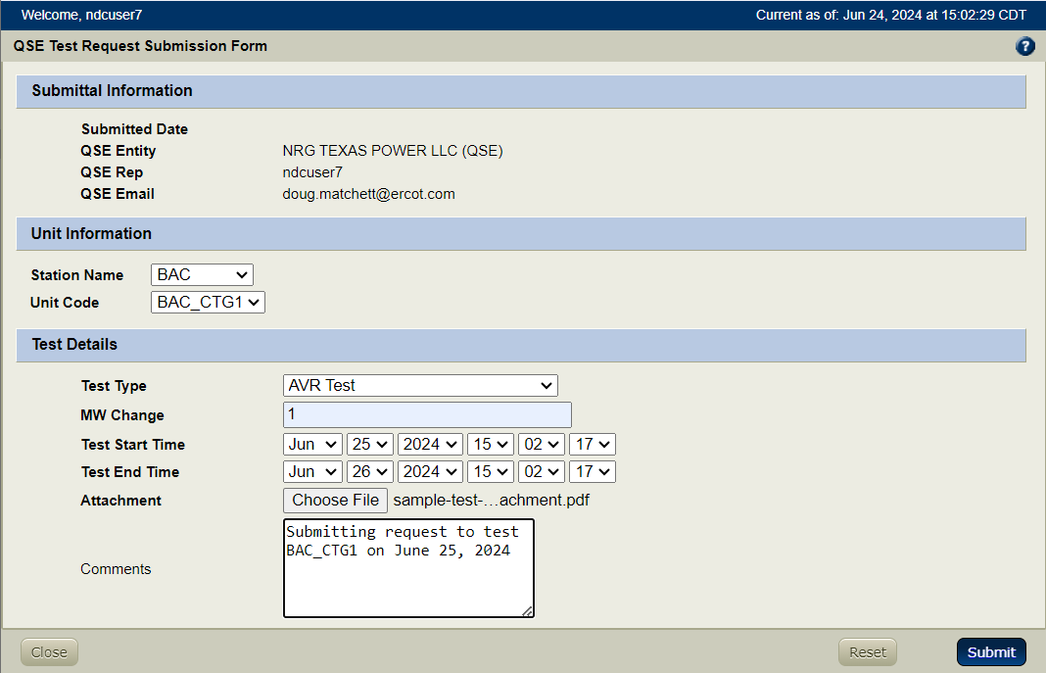
NDCRC – Automatic Tracing and Unit Tests
Process Flow
QSE navigates to NDCRC (https://mis.ercot.com/ndcrc/Home.do) and chooses their certificate when prompted
QSE clicks on “QSE Test Request” tab and presses the “Create New Test Request” button to open the web form pictured below
ERCOT operators will tentatively approve the submitted request, expecting the QSE to return and check the status is still approved on the day it’s scheduled to begin

Slide 4
NDCRC – Automatic Tracing and Unit Tests
NDCRC Applications changes – Demo

