Slide 1
Status of CONE, Reliability Standard, and VOLL Studies
Pete Warnken
Resource Adequacy
Supply Analysis Working Group
June 26, 2024

Slide 2
CONE Study Status
CONE study status report filed with the PUCT on June 6, 2024
https://interchange.puc.texas.gov/Documents/54584_64_1400659.PDF
Discussion on the CONE study provided during the June 13 PUCT Open Meeting; requested feedback on the dispatchable reference technology selection (GE LM6000PC) and cadence for future CONE study updates
Final report and CONE model completed
Completing briefings with the Commission on the Study this week
The PUCT report filing and ercot.com posting date (report and model) will be determined after the briefings

Slide 3
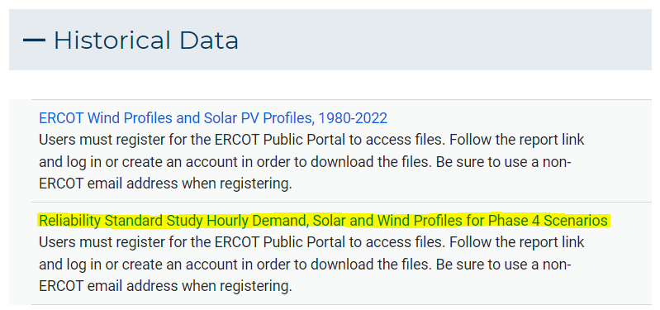
Reliability Standard
Reliability Standard “Proposal for Publication” approved at the June 13th PUCT Open Meeting, available at:
https://interchange.puc.texas.gov/search/documents/?controlNumber=54584&itemNumber=67
Comment deadline is July 15, 2024
Some stakeholders have requested certain SERVM model data files for the Phase 4 Monte Carlo simulations; for more information, see ERCOT’s Market Notice, available at:
https://www.ercot.com/services/comm/mkt_notices/W-B062024-01
Link located at the bottom of the Resource Adequacy webpage (Account creation is needed to download the files)

Slide 4
Value of Lost Load (VOLL) Study
VOLL Survey closed in May
Brattle project team conducting survey data checks and developing VOLL estimation models
Preliminary VOLL value based on survey data is expected in mid to late July

