Slide 1
Existing Process to Include Emissions Costs in VC
RCWG
ERCOT Staff
June 25, 2024

Slide 2
Current Emissions Index Prices
Originally determined while EPA’s Clean Air Interstate Rule (CAIR) was effective (March 2011).
Index prices selected based on annual trading programs rather than seasonal programs.
The goal in 2011 was to calculate costs of NO_{x} and SO₂ that were applicable throughout the year.
The Cross-State Air Pollution Rule (CSAPR) replaced EPA’s 2005 CAIR on January 1, 2015, but prices used by ERCOT remain as Cross-State annual indices through today.
Seasonal emissions cost calculations may require a new VCMRR as more changes are needed for the VC Manual.

Slide 3
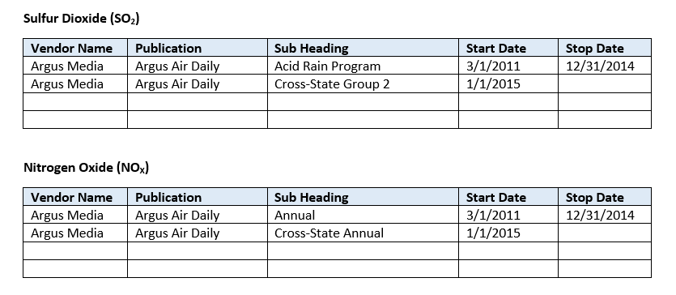
Current Emissions Index Prices
Over the last several years, few trades are taking place due to ongoing uncertainty over EPA’s Good Neighbor Plan implementation.

Slide 4
Appendix: Emissions Costs Calculations

Slide 5
Emissions Cost in Startup O&M
Equation 4: Equation for Calculation of Verifiable Startup Emission Costs¹
Verifiable Startup Emission Cost ($/Start) = RAFCRS * ∑Emission Rate i * Emission Cost Index i
Where RAFCRS = Quantity of approved startup fuel consumed by Resource (including fuel used to shutdown Resource (MMBtu/Start)
Emission Rate i = Quantity of emission i emitted by resource (lbs/MMBtu)
Emission Cost Index i = Published cost index of emission i ($/lb)
i = Index for each emittent approved for inclusion in Startup Cost
Inputs: NO_{X} Annual Index Price: $3/short ton
SO₂ Annual Index Price: $2/short ton
Sample Startup Fuel Consumption (RAFCRS): 3,000 MMBtu/Start
Sample Startup NO_{X} produced: 0.15 lb/MMBtu
Sample Startup SO₂ produced: 0.0006 lb/MMBtu
Emissions Cost = $3,000 * [(0.15 * $3)/2000 + (0.0006 * $2)/2000]
Emissions Cost = $3,000 * [0.000225 + 0.0000006]
Emissions Cost = $0.6768 per start
¹ Appendix 5: Specification of Relevant Equations

Slide 6
Emissions Cost in O&M at LSL
Equation 5: Equation for Calculation of Verifiable Minimum-Energy Emission Costs¹
Verifiable Minimum-Energy Emission Costs ($/MWh) = [AHR] * ∑Emission Rate i * Emission Cost Index i
Where AHR = Average heat rate at Minimum Energy (MMBtu/Hr)
Emission Rate i = Quantity of emission i emitted by resource (lbs/MMBtu)
Emission Cost Index i = Published cost index of emission i
i = Index of each emittent approved for inclusion in Minimum-Energy Cost
Inputs: NO_{X} Annual Index Price: $3/short ton
SO₂ Annual Index Price: $2/short ton
Sample Avg Heat Rate at LSL: 10 MMBtu/MWh
Sample NO_{X} produced at LSL: 0.12 lb/MMBtu
Sample Startup SO₂ produced: 0.0006 lb/MMBtu
Emissions Cost = 10 * [(0.12 * $3)/2000 + (0.0006 * $2)/2000]
Emissions Cost = 10 * [0.00018 + 0.0000006]
Emissions Cost = $0.001806 per MWh
¹ Appendix 5: Specification of Relevant Equations

Slide 7
Next Steps
Questions?

