Slide 1
ERCOT Updates
Joel Koepke
6/18/2024

Slide 2
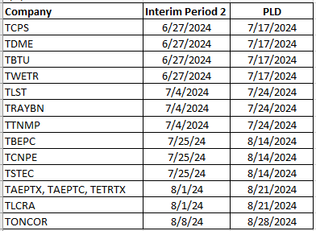
Topics
Voiceovers
Manual Contingency Review
Potential Master-QSE-Information Report
Project Updates
ICCP Handbook ROS Action Item
Review DPC Slide from BOD meeting
NPRR1234 – Identifying Large Loads
Other Business
Manual Contingency Review Timeline

Slide 3
Project Updates
Active/Upcoming Projects
Upgrade to NMMS RHEL Operating System
Upgrades the OS of additional NMMS systems
No changes in MAGE functionality
Upgrade NMMS Application to CIM16 and SCR813 Implementation
Scope
Upgrades the NMMS database schema to CIM16
Upgrades XML models and incremental files to CIM16
Adds coordination confirmation prompt when jointly-rated equipment is modified
“Planning” phase nearing completion
Vetted project dates to be available in early August

Slide 4
ICCP Handbook - Background
At the April and May 2019 ROS meetings, it was requested that NDSWG review the the ICCP Handbook
Determine what is binding/non-binding
Determine the proper repository for the binding language
Update references to ICCP Handbook to new repository
April Notes
May Notes

Slide 5
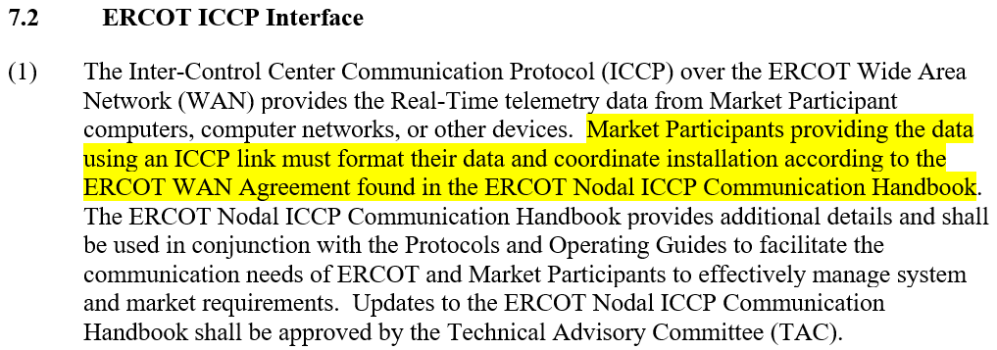
ICCP Handbook – Issues
ERCOT Nodal ICCP Communication Handbook may have language that should be binding
At least one binding document, the Nodal Operating Guides, refers to the non-binding Handbook in a “binding fashion” (e.g. “must”)
Nodal Operating Guides

Slide 6
ICCP Handbook – Potential Action
ERCOT proposes that the ICCP Handbook be added as an attachment to the Nodal Operating Guides
Why?
Addresses the ROS action item
Eliminates potential ambiguity on the bindingness of the Handbook
Standardizes the modification process
Utilizes the Revision Request approval process
Allows for increased stakeholder input

Slide 7
ICCP Handbook – Potential Next Steps
Ultimately, ERCOT would submit a Nodal Operating Guide Revision Request to add the Handbook as an attachment
Potential Next Steps:
Contemplate the proposal and gather any concerns
Review Handbook for low hanging changes
Clarifications
Ensure explicit callouts for examples or guidance
“Shalls” to “shoulds”

Slide 8
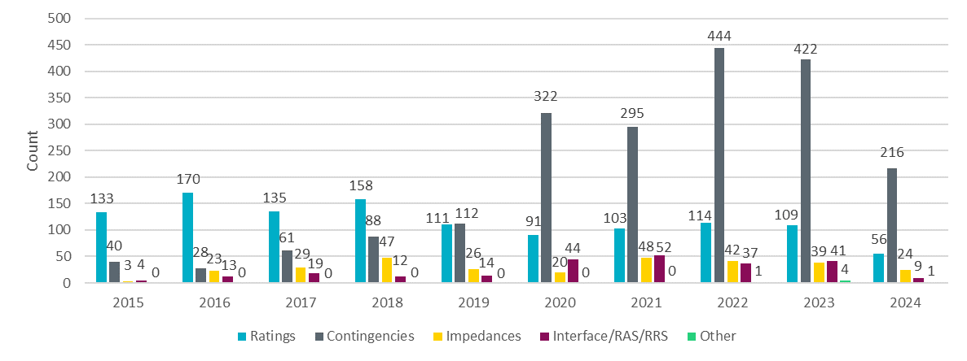
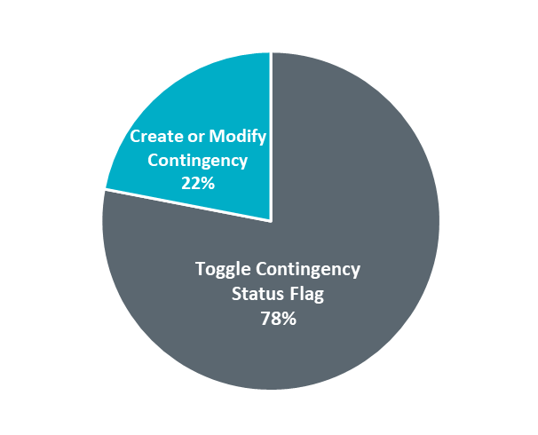
Downstream Production Changes (DPC)
The Downstream Production Change process allows TDPSs and ERCOT to request changes to the currently in-use Production model without loading a new model. Only pre-approved types of changes are considered.
Downstream Production Changes: 2015 – May 2024
In 2020, ERCOT formalized processes for transitory contingency definitions needed during construction phases of projects thus causing an increase in DPCs.
The majority of contingency-related DPCs request changes to the enabled/disabled status of contingency definitions as construction phases conclude.
Types of contingency-related DPCs

Slide 9
NPRR1234 Modeling of Loads 25MW or Greater

Slide 10
Modeling of Loads 25 MW or Greater – Additional Details
TSPs will need to identify a load point or collection of load points serving a site with a historical, requested, or expected peak Demand 25 MW or greater in the ERCOT Network Operations Model.
RE will need to identify a load point or collection of load points serving a behind the meter load (excluding aux load) with a historical, requested, or expected peak Demand 25 MW or greater in the Resource Registration Data.
Load points serving sites 25-75 MW may include additional customers <25 MW.
For each load point identified, the TSP/RE must also provide the primary end-use activity from a list of broad categories.
The goal of these requirements is to allow ERCOT to improve its load forecasts and to provide real-time visibility to system operators.

Slide 11
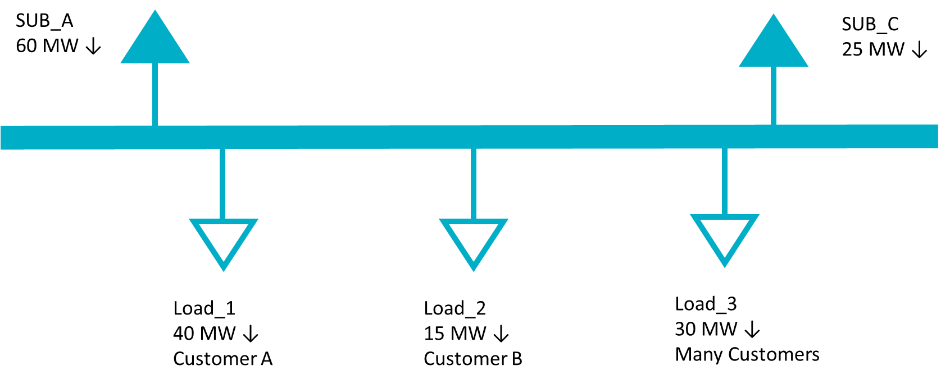
Modeling of Loads 25 MW or Greater – Conceptual Examples
Example 1
A single customer and/or site with a historical peak Demand of 25 MW or larger served from a single load point in the Network Operations Model.
In the example below, a substation serves 85 MW of customer load. Load_1 serves a single facility with a peak Demand of 40 MW and does not include any other customer load. Load_2 represents a single, smaller customer and Load_3 includes many customers across multiple sites, none of whom are 25 MW or greater individually.
TSP Actions
Identify Load_1 as a 25 MW or greater facility in the ERCOT Network Operations Model
Identify the primary end use category of Load_1 from a pre-defined list.
Load_2 does not need to be identified since it is less than 25 MW.
Load_3 does not need to be identified because it is composed of many customers and facilities.

Slide 12
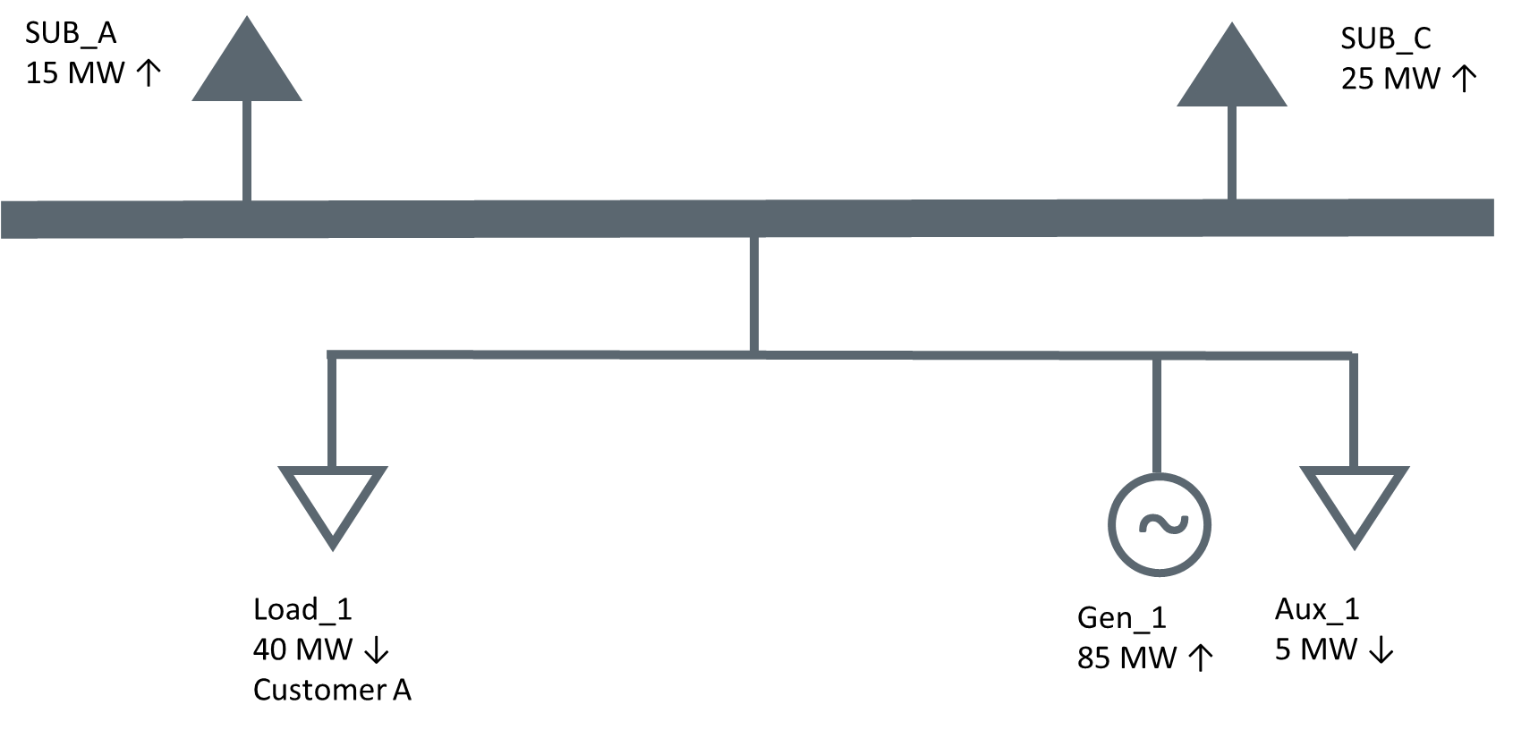
Modeling of Loads 25 MW or Greater – Conceptual Examples
Example 2
A single customer and/or site with a historical peak Demand of 25 MW or larger located with a Generation Resource served from a single load point in the Network Operations Model.
In this example, the same Load_1 from the previous example is served behind the meter of a Generation Resource. The generator also has 5 MW of Aux load.
RE Actions
Identify Load_1 as associated with a 25 MW or greater facility in its Resource Registration Data.
Identify the primary end use category of Load_1 from a pre-defined list.
The Aux load should not be identified as a 25 MW or greater facility.

Slide 13
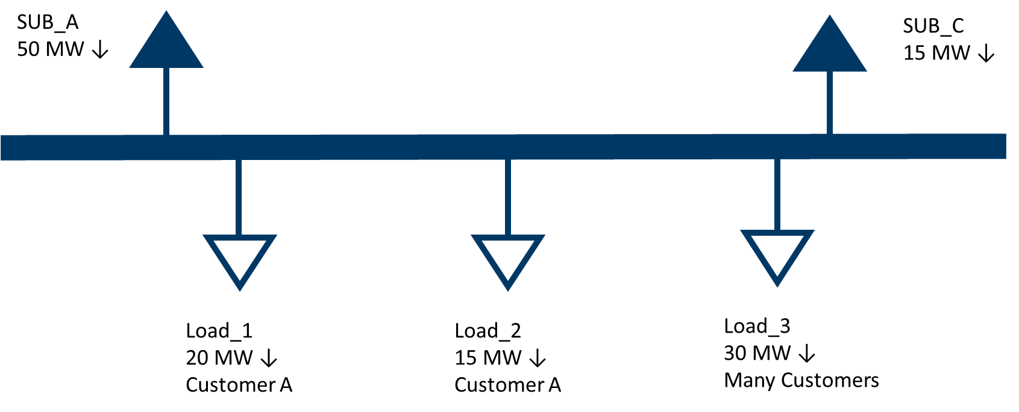
Modeling of Loads 25 MW or Greater – Conceptual Examples
Example 3
A single customer and/or site with a historical peak Demand of 25 MW or larger served from a multiple load points in the Network Operations Model.
In the example below, a substation serves 65 MW of customer load. Load_1 and Load_2 correspond to a single site with a peak Demand of 35 MW. Load_3 includes many customers across a multiple sites, none of whom are 25 MW or greater individually.
TSP Actions
Identify Load_1 AND Load_2 as associated with a 25 MW or greater site in the ERCOT Network Operations Model. Even though neither point individually exceeds 25 MW, both should be included because the correspond to a single site.
Identify the primary end use category of Load_1 and Load_2 from a pre-defined list.
Load_3 does not need to be identified because it is composed of many customers and sites.

Slide 14
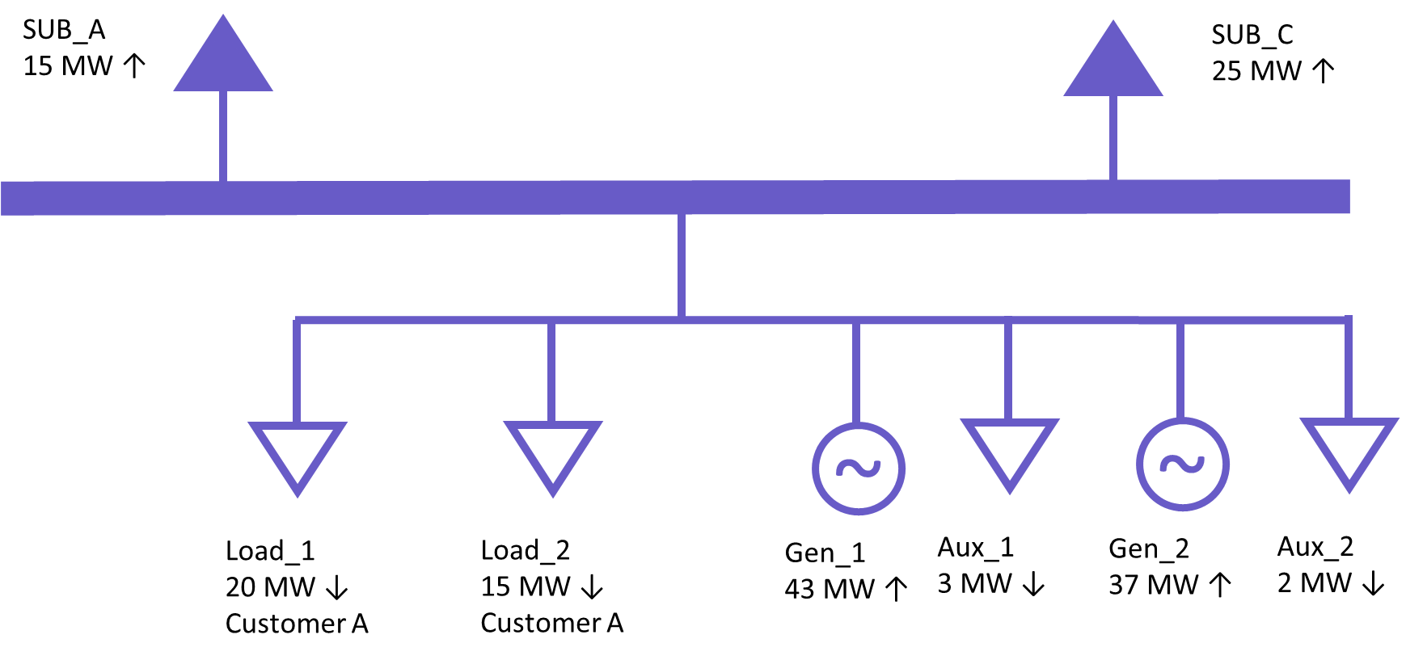
Modeling of Loads 25 MW or Greater – Conceptual Examples
Example 4
A single customer and/or site with a historical peak Demand of 25 MW or larger located with a Generation Resource served from multiple load points in the Network Operations Model.
In this example, the same Load_1 and Load_2 from the previous example are served behind the meter of a Generation Resource. The generator also has 5 MW of Aux load.
RE Actions
Identify Load_1 AND Load_2 as associated with a 25 MW or greater facility in the Resource Registration data. Even though neither point individually exceeds 25 MW, both should be included because the total load, excluding aux load, behind the POI exceeds 25 MW.
Identify the primary end use category of Load_1 and Load_2 from a pre-defined list.
The Aux loads should not be identified as part of a 25 MW or greater facility.

Slide 15
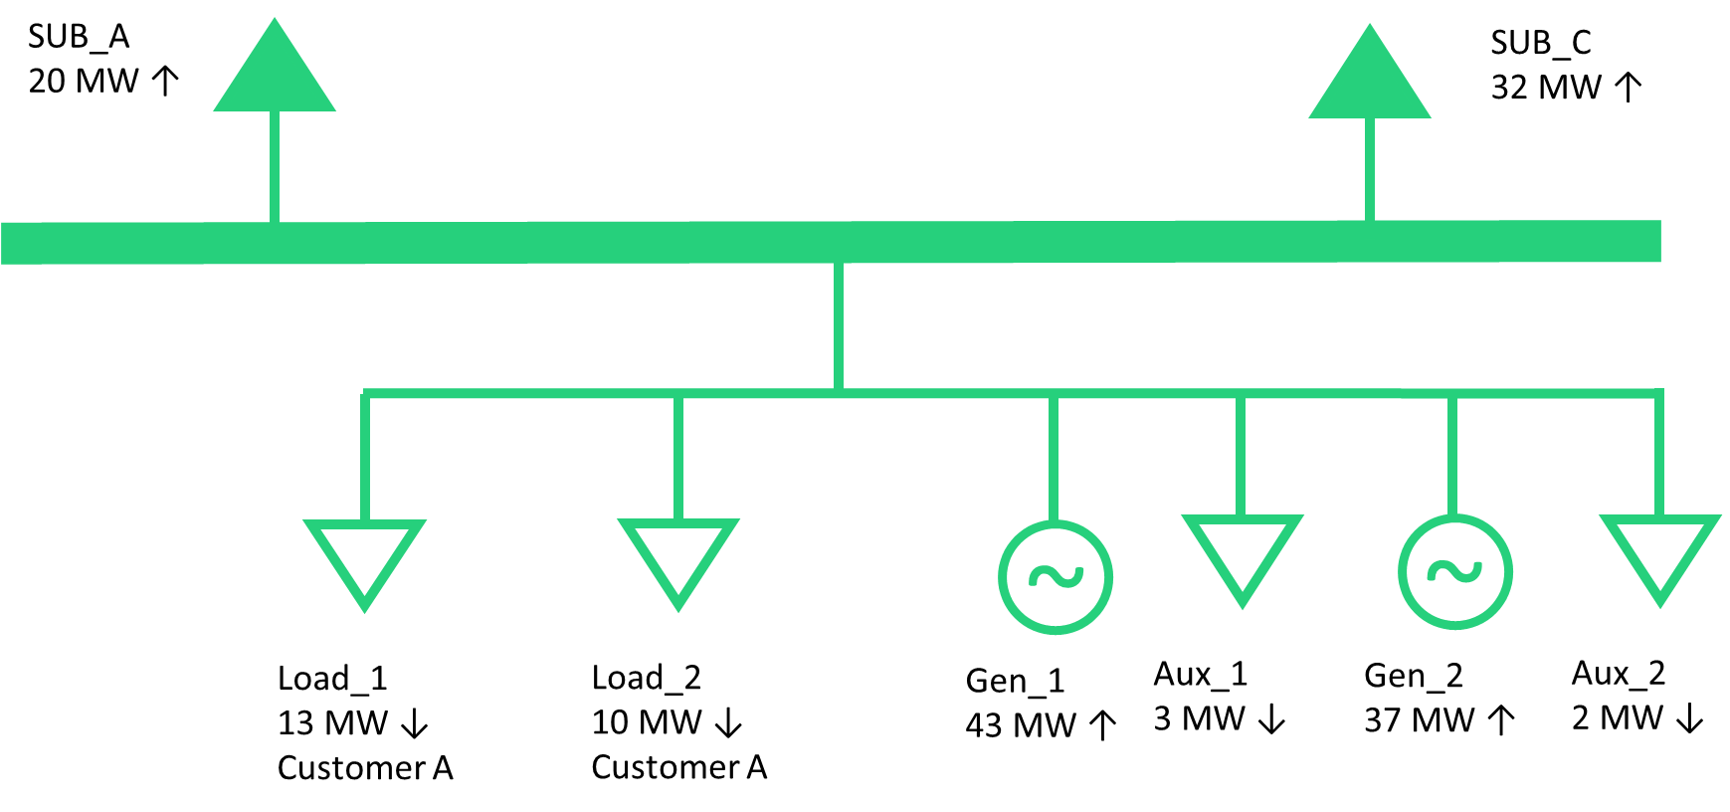
Modeling of Loads 25 MW or Greater – Conceptual Examples
Example 5
A single customer and/or site with a historical peak Demand of 22 MW located with a Generation Resource served from multiple load points in the Network Operations Model.
In this example, the same Load_1 and Load_2 from the previous example are served behind the meter of a Generation Resource. The total peak Demand of these two load points is 22 MW. The generator also has 5 MW of Aux load.
RE Actions
No loads need to be identified as associated with a 25 MW or greater facility in the Resource Registration data. Even though the total load behind the POI exceeds 25 MW, the non-aux load peak Demand is less than 25 MW.

Slide 16
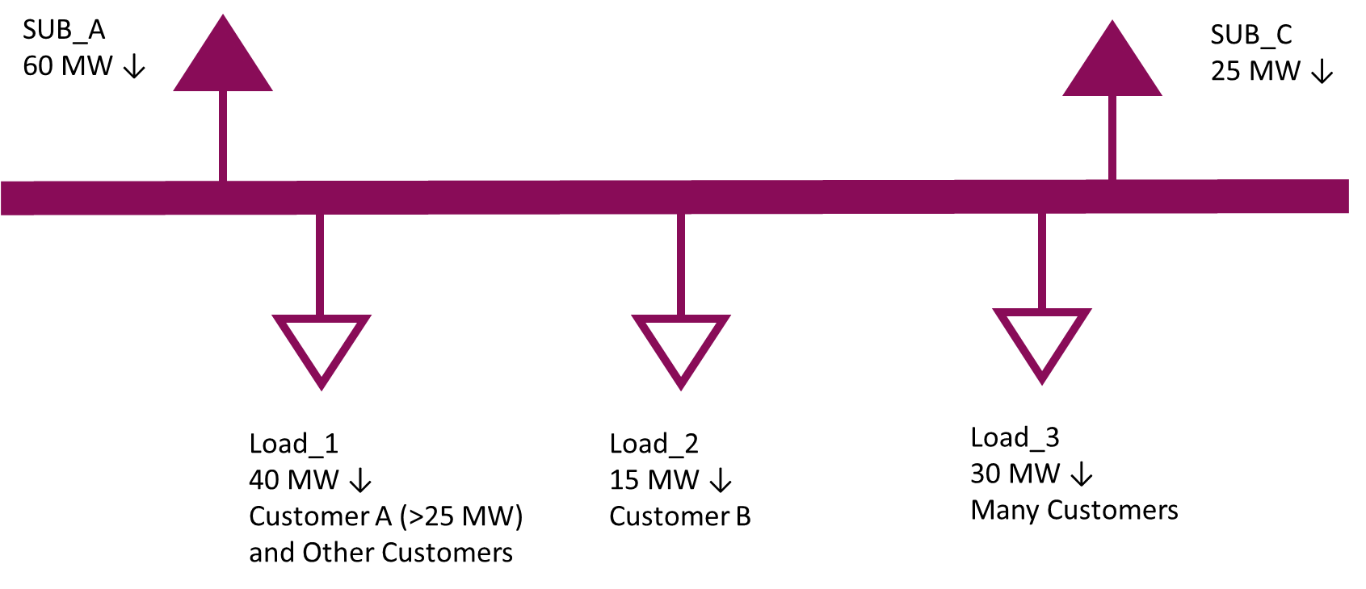
Modeling of Loads 25 MW or Greater – Conceptual Examples
Example 6
A single customer and/or site with a historical peak Demand of 25 MW or larger served from a single load point in the Network Operations Model that includes other customers.
In the example below, a substation serves 85 MW of customer load. Load_1 serves a site with a peak Demand greater than 25 MW and other, smaller customers. Load_2 represents a single, smaller customer and Load_3 includes many customers across multiple sites, none of whom are 25 MW or greater individually.
TSP Actions
Identify Load_1 as associated with a 25 MW or greater facility in the ERCOT Network Operations Model.
Identify the primary end use category of the largest customer behind Load_1 from a pre-defined list.
Load_2 does not need to be identified since it is less than 25 MW.
Load_3 does not need to be identified because it is composed of many customers and facilities.

Slide 17
Loads 25 MW or Greater - Draft End Use Classifications
Oil and Gas Production, Processing, and Transmission
Oil and Chemical Refining
Steel Manufacturing
Cryptocurrency Mining
Data Center (non-Cryptocurrency)
Hydrogen and Electrofuel Production
Other Industrial

Slide 18
Other Business

