Slide 1
RTC+B Task Force
Update
Matt Mereness
TAC
June 24, 2024

Slide 2
Outline
Program update: RTC+B Program Update from June Board T&S
Potential Market Trial Sequence
Reminder of RTCBTF Review Cycle
Current Issues for RTCBTF

Slide 3
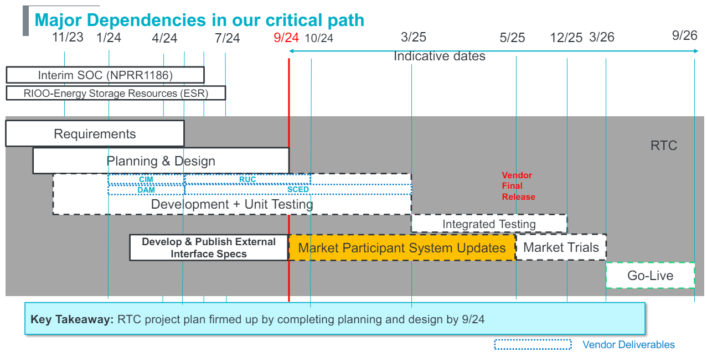
RTC+B Program Update
(excerpt from April Board T&S RTC Update)

Slide 4
Sequence and Potential Dates for Market Trials
(dates subject to change while in Planning phase)
May 2025
June 2025
July 2025
Aug 2025
Sep 2025
Oct 2025
Nov 2025
Dec 2025
QSE Attestation
9 months before Trials
Each activity will have a public-facing Scorecard and exit Criteria
3-4 months
2 months
1 month
DRAFT
RTC QSE Submission Testing
(Submit COP, RT AS Offers,
DAM Virtual AS, Outages for ESRs)
Open-loop RTC SCED
(QSE offers, SCED non-binding award/dispatch)
Closed-loop SCED/LFC
(QSE RTC offers and telemetry to support closed-loop frequency control test 2-3 tests of 2-4 hour durations)
Transition to Go-Live
Upon completion of testing, confirmation of ERCOT and market readiness for Go-Live.
RTC QSE Telemetry Check-out (QSEs add/verify new telemetry points for UDSP, New ramp rates, ESR telemetry)
QSE Telemetry Tests
(Individual QSE to follow UDSP and support new ramp rate and ESR telemetry)
Day-Ahead Market
(Non-binding DAM using QSE offers for at least 2 tests)
Current draft of the earliest possible dates for Market Trials and Go-Live that have been shared through TWG and the RTC+B Workshops, in support of Market Participants readiness at RTCBTF.
Actual Market Trials and Go-Live milestones are to be determined and will be communicated no later than 9/30/24.
1-2 months
Updated 2024-05-22

Slide 5
Plans for Meetings and Review Cycles
Reminder of RTC+B Program Scope
  RTC Key Principles were approved to lay foundation of NPRR1007-1013
    Consolidated Key Principles: https://www.ercot.com/files/docs/2020/04/01/RTC_Key_Principle_Quick_Reference.docx
    Library of Key Principles: https://www.ercot.com/mktrules/puctDirectives/rtCoOptimization
  Battery Key Topic Concepts approved to lay foundation of NPRR1014
    https://www.ercot.com/mktrules/keypriorities/bes
  RTC State-of-Charge accounting in NPRR1204
Objective is to present concepts or issues that need to be resolved for an effective implementation.
  Coordinating timelines for interface requirements and testing,
  Providing the forum for any analysis or policy decisions (such as parameter values)
  Coordinating market readiness and cutover activities,
  Review draft Revision Requests or other artifacts necessary to successfully implement the program within the identified timeframes, and discussing other details as needed.
Lessons learned from RTCTF to avoid being delayed in decisions:
  Meeting #1: Initial concept presented by ERCOT staff
  Meeting #2: Comments and alternatives presented by MPs
  Meeting #3: RTCTF consensus achieved or escalated to TAC for a vote to decide the matter.

Slide 6
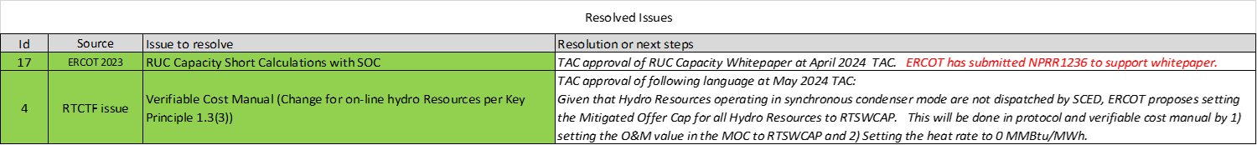
Current RTCBTF Issues List
Link to issues on RTCBTF home page

Slide 7
Upcoming RTC+B Clarification NPRRs
RTC+B NPRR next steps:
  RUC Capacity Short NPRR1236 is going to July PRS Meeting
  Verifiable Cost Hydro MOC will be part of clarifying NPRR
ERCOT is developing at least 2 clarifying NPRRs with target of July drafts:
  Clarification NPRR after completing business requirements (eg, drift in baseline since 2019, discrepancies and/or small gaps found during business requirement development)
  Clarification NPRR as an extension of NPRR1014 Single Model to clarify single model language in other areas of protocols.
  Note- All changes are intended to be “as designed” clarifications, aligned with Key Principles, and have no system impacts.
Current plan is to share initial drafts with RTCBTF, and then ERCOT will formally file as NPRRs to allow vetting of comments via existing PRS/TAC process and supported by RTCBTF to thoroughly review.

Slide 8
Reviewed at June RTCBTF
Issue 3 - Framework for periodic analysis comparing RTC and the current ORDC design
  ERCOT updated the publicly available RTC Excel tool and will be posted to RTCBTF home page
  Next RTCBTF meeting lay out date estimates for development of tool capabilities.
Issue 20 - Review of the Energy and AS Offer Caps in the context of Current Policy
  Review last month’s presentation and see if any questions (none)
Issue 9-10 - Market Readiness and Technical Workshops
  Reviewed outline of market trials sequence and objectives (seeking Market Feedback)
  Reviewed telemetry changes shared at RTC+B Technical Workshops
  Asked MPs what is needed to continue to develop their changes.
Issue 18 - Review of the AS Demand Curves in the context of current policy
  ERCOT Operations provided feedback on questions from prior RTCBTF meetings

Slide 9
RTCBTF Next steps
Wrapped up limited series of RTC+B Technical Workshops (April-June 2024)
  Target audience, vendors and IT development/implementation staff (sent to RTCBTF and TWG)
    RTC+B Technical Workshop - April 18, 2024: 1:00 PM – 4:00 PM :
    Overview of ICCP Telemetry/EMS SCADA/AGC changes & ICCP Configurations for parallel testing.
    RTC+B Technical Workshop - May 6, 2024: 1:00 PM – 4:00 PM :
    Finalize approach on ICCP configuration approaches for parallel testing and transition.
    RTC+B Technical Workshop - May 15, 2024: 1:00 PM – 4:00 PM :
    Market Interfaces design specifications (submissions - External API/Market Manager, notifications, and reports)
    RTC+B Technical Workshop - June 6, 2024: 1:00 PM – 4:00 PM :
    Reserved for further discussions if needed and Q&A session.
  Based on the feedback from these workshops, ERCOT will finalize ICCP/Market Interface design specifications and publish draft versions to the ERCOT website by end of June.
  This engagement will help QSEs and their vendors start planning their RTC+B systems design and implementation early to align with ERCOT’s RTC+B project implementation timelines which is critical for ERCOT to deliver this project successfully and on time.
  Discussions and artifacts will be highlighted and shared at regular RTCBTF meetings.
July 17th - Next RTCBTF
  Feedback on Market Trials Plan from MPs and review of QSE Attestation
Questions?

