Slide 1
RTC+B Market Trials
Approach and Assumptions
Matt Mereness
RTCBTF
June 14, 2024

Slide 2
Approach and Assumptions
ERCOT has been considering a progression of market trial activities to mitigate the reliability risk of cutover to the RTC+B systems
ERCOT used the following assumptions to help shape the approach to market trials:
  Closed Loop LFC Test required- Multiple closed loop LFC tests will be needed to ensure reliable and successful frequency control which includes transitioning from portfolio to resource specific basepoint and regulation signaling, and testing the QSEs can effectively follow the UDSP signal (combination of basepoint and regulation signal).
  This is not a nodal implementation- Rather this is a hybrid of normal project implementation and 2010 Nodal Implementation:
    Nodal was complete replacement of all systems and needed end-to-end testing of all functionality with MPs- this included parallel platforms of all systems in a market facing environment (EMS, MMS, OS, NMMS, CRR, S&B, Credit, and new integration)
    RTC+B is an incremental functional upgrade to existing systems and existing integration end points
      ERCOT is standing up new MMS, OS, and EMS in parallel market trials, but not Settlements, Credit, Extracts, MIS, Dashboards, etc
      ERCOT will provide subset “Current Day Reports” for new data reports, such as Real-Time AS prices
  ERCOT is assuming some incremental parallel testing to align with production data, but not extended simulations (example, not performing continuous Nodal 6-month LMPs)
    Price formation analysis will be based on re-running historical Operating Days in RTC+B study tools (discuss seek market feedback at end of presentation).
Detailed Market Trials Handbooks will be released 3 months prior to each trial phase.

Slide 3
Sequence and Potential Dates for Market Trials
(dates subject to change while in Planning phase)
May 2025
June 2025
July 2025
Aug 2025
Sep 2025
Oct 2025
Nov 2025
Dec 2025
QSE Attestation
9 months before Trials
Each activity will have a public-facing Scorecard and exit Criteria
3-4 months
2 months
1 month
DRAFT
RTC QSE Submission Testing
(Submit COP, RT AS Offers,
DAM Virtual AS, Outages for ESRs)
Open-loop RTC SCED
(QSE offers, SCED non-binding award/dispatch)
Closed-loop SCED/LFC
(QSE RTC offers and telemetry to support closed-loop frequency control test 2-3 tests of 2-4 hour durations)
Transition to Go-Live
Upon completion of testing, confirmation of ERCOT and market readiness for Go-Live.
RTC QSE Telemetry Check-out (QSEs add/verify new telemetry points for UDSP, New ramp rates, ESR telemetry)
QSE Telemetry Tests
(Individual QSE to follow UDSP and support new ramp rate and ESR telemetry)
Day-Ahead Market
(Non-binding DAM using QSE offers for at least 2 tests)
Current draft of the earliest possible dates for Market Trials and Go-Live that have been shared through TWG and the RTC+B Workshops, in support of Market Participants readiness at RTCBTF.
Actual Market Trials and Go-Live milestones are to be determined and will be communicated no later than 9/30/24.
1-2 months
Updated 2024-05-22

Slide 4
Today’s presentation outlines Objectives from Draft Market Trials Planning Document posted with meeting

Slide 5
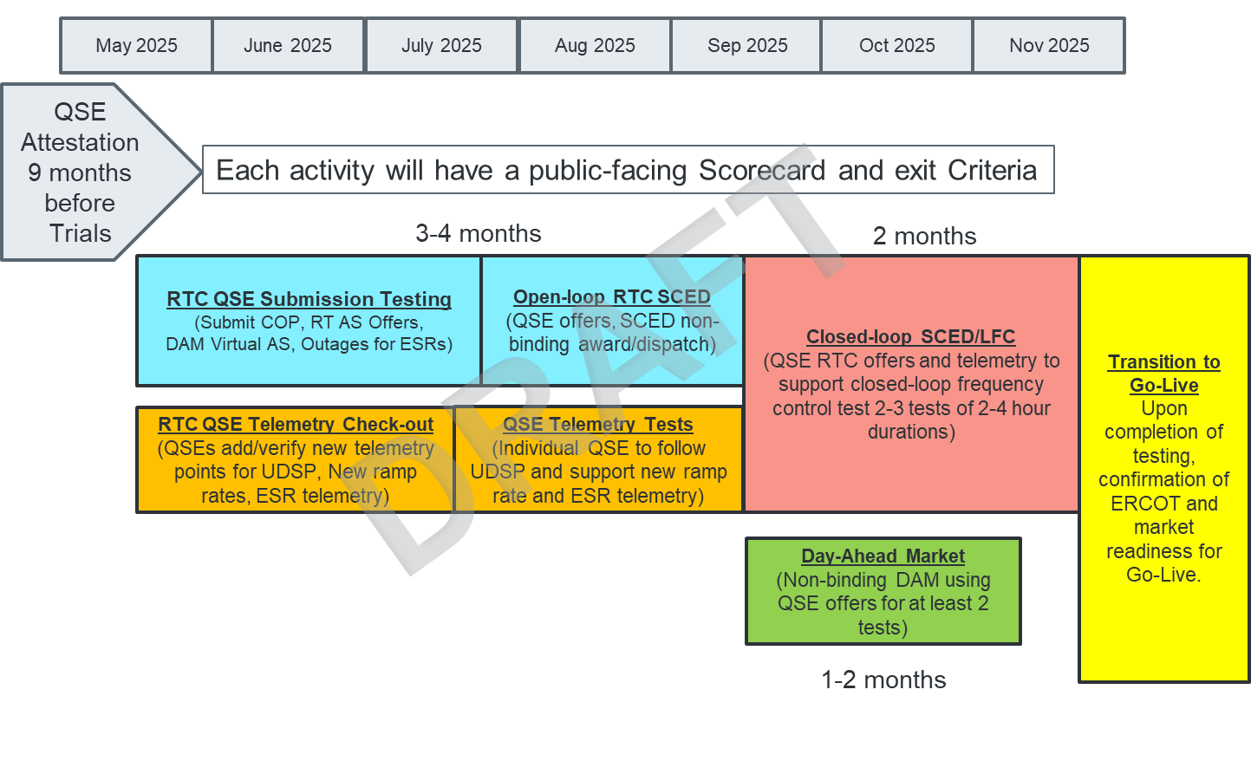
Activity 1- QSE Attestation
ERCOT Request of QSE Attestation:
QSEs with Resources will identify Accountable Executive
Accountable Executive will attest the QSE is aware of and committed to developing the necessary systems changes to be ready to engage the RTC+B Market Trials activities (potentially as early as May 2025) and will support required testing leading up to Go-Live.
Note- ERCOT would request this attestation after releasing the key interface specifications and at least 9 months prior to initiating market trials (likely in July 2024 timeframe).
1

Slide 6
Activity 2- QSE Market Submission Testing Objectives
ERCOT will deploy RTC+B Code into a market facing trials environment
  MMS-API, MMS-UI, OS-API, OS-UI
  This test will be similar to MOTE testing, limited to receiving data from QSE
QSE will test their market submissions for defined transactions (including COP, RT AS Offers, RT Energy Offers, DAM AS Only Offers, 3 Part Supply Offers)
ERCOT will maintain scorecard of QSE participation as defined in Handbook. Goal is for 95% of QSEs to demonstrate successful submissions, and have mitigation plans in place for remaining 5% to address in next trial phase.
2

Slide 7
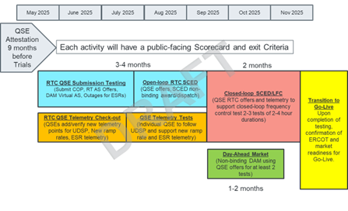
Activity 3- QSE Telemetry Point Checkout Objectives
ERCOT will deploy RTC+B Code into a market facing trials environment
  EMS SCADA/ICCP
  This test window is for QSEs to set-up new telemetry points
  QSEs will not follow telemetry points in this phase
QSE will add telemetry points for EMS/ICCP system interface with ERCOT (UDSP, New Ramp Rates, and ESR Telemetry)
ERCOT will maintain scorecard of QSE participation as defined in Handbook. Goal is for 98% of QSEs to demonstrate successful submissions, and mitigation plans in place for remaining 2% to address in next trial phase.
3

Slide 8
Activity 4- QSE Telemetry Following Dispatch Tests Objectives
ERCOT will deploy RTC+B Code into a market facing trials environment
  EMS SCADA/ICCP, RLC, LFC
  This test window is for coordinating individual ERCOT/QSEs tests for following new UDSP telemetry points.
ERCOT will coordinate individual QSE testing for subset of resources to follow UDSP signal.
QSE will have ability to support live-production-quality telemetry for existing and added telemetry points (UDSP, New Ramp Rates, and ESR Telemetry)
  Note this dual-entry is needed to support reasonable OpenLoop-RTC-SCED that will be receiving new telemetry from QSE and pushing out telemetry the QSE, but not be followed except during individual QSE testing.
ERCOT will maintain scorecard of QSE participation as defined in Handbook. Goal is for 98% of QSEs to demonstrate successful submissions, and mitigation plans in place for remaining 2% to address in next trial phase.
4

Slide 9
Activity 5- Open Loop RTC SCED Objectives
ERCOT will deploy RTC+B Code into a market facing trials environment
  RTC-SCED, MMS-UI, MMS-API, EMS, SCADA, RLC, LFC
  Three CDR Reports: RTC LMPs, RTC AS prices, and SCED Binding Constraints
QSE will build upon prior tests and begin supporting “parallel production” telemetry and entering market submissions to support RTC SCED for windows of time to observe, but not follow, non-binding RTC energy and A/S awards and dispatch.
ERCOT will maintain scorecard of QSE participation as defined in Handbook. Goal is for 100% of QSEs to demonstrate successful submissions and support new and existing telemetry reflective of actual production, and mitigation plans in place for any outliers.
5

Slide 10
Activity 6- Closed Loop RTC SCED/LFC Objectives
ERCOT will support RTC+B functionality in market facing environment in a manner that is equivalent to production level systems and support.
  RTC-SCED, MMS-UI, MMS-API, EMS, SCADA, RLC, LFC
  Three CDR Reports: RTC LMPs, RTC AS prices, and SCED Binding Constraints
QSE will support RTC+B functionality in a manner that is equivalent to production level systems and support.
ERCOT and QSE will conduct multiple live-production tests of RTC-SCED and Load Frequency Control to ensure effective RTC-SCED dispatch and Frequency Control prior to go-live.
Dispatch during the tests will be binding to manage the reliable operations of the grid.
Settlement during these tests will be performed with the current Settlement systems and leveraging Emergency Base point or Testing logic to ensure all QSEs are paid for energy dispatched during tests.
ERCOT will maintain scorecard of QSE participation as defined in Handbook. Goal is for 100% of QSEs to demonstrate successful submissions and telemetry, and mitigation plans in place for any outliers.
6

Slide 11
Activity 7- Day-Ahead Market Objectives
ERCOT will deploy Day-Ahead Market into a market facing environment
  RTC-DAM, MMS-UI, MMS-API
  MMS-UI and MMS-API will support publishing awards to QSEs
  CDR Reports: DAM AS Obligations, DAM AS Demand Curves, DAM Awards, DAM LMPs, DAM AS prices
QSE will test their market submissions for defined transaction (AS Self-Arrangement, DAM AS Only Offers, in addition to normal DAM submissions)
ERCOT will execute and publish at least two Day-Ahead Markets
Does DAM participation need to be required? RTC DAM is essentially voluntary and includes much broader QSE population (traders and load-only QSEs).
7

Slide 12
ERCOT interested in feedback
Over next month ERCOT is interested in feedback:
Open to feedback on all 7 activities, especially any reliability risks not addressed by the trial activities, durations or frequencies.
Specific questions ERCOT asks:
  What windows and frequency of requiring QSE production-like offers for the Open Loop SCED is best cost/beneficial (ie for dual entry by QSEs)?
    Example, 8 hours/day twice per week for 2 months?
  Any argument to make DAM participation a required activity or more iterations?
  Metrics for required testing will focus on QSEs with Resources, unless DAM becomes required.
  Understanding that while ERCOT will not be able to provide settlement invoices and extracts, that sample/generic versions will be provided from ERCOT test environment during iTest.
Higher level question- Market ideas on the priority of education/deep-dives to help QSEs in their development and readiness?
Final comments and questions?
Feedback and detailed discussion at July RTCBTF meeting.

