Slide 1
Project 2020-02
Modifications to PRC-024 (Generator Ride-through)
PRC-024-4 and PRC-029-1
June 14, 2024
Xiaoyu (Shawn) Wang, Chair (Enel North America)
Husam Al-Hadidi, Vice Chair (Manitoba Hydro)
Jamie Calderon, NERC Standards Developer

Slide 2
Project 2020-02 Drafting Team- SAR and Standards
Drafting Team Roster
 | Name | Entity
Chair | Xiaoyu (Shawn) Wang | Enel North America
Vice Chair | Husam Al-Hadidi | Manitoba Hydro
Members | Ebrahim Rahimi | California ISO
 | John B. Anderson | Xcel Energy
 | Johnny C. Carlisle | Southern Company Services, Inc.
 | Robert J. O’Keefe | American Electric Power
 | Rajat Majumder | Invenergy
 | Alex Pollock | RES
 | Ebrahim Rahimi | California ISO
 | Fabio Rodriguez | Duke Energy
 | Kenneth Silver | 8minute Solar Energy
 | Ovidiu Vasilachi | Independent Electricity System Operator (IESO)
 | John Zong | Electric Power Engineers
NERC Staff | Jamie Calderon | North American Electric Reliability Corporation

Slide 3
Project 2020-02 SAR1
Title: Revision of relevant Reliability Standards to include applicability of transmission-connected dynamic reactive resources
Date Submitted: Feb 24, 2020 (Revised on February 3, 2022)
Notes:
Matt start

Slide 4
Project 2020-02 SAR2
Title: Generator Ride-Through Standard (PRC-024-03 Replacement)
Date Submitted: April 28, 2022 (revised March 31, 2023)
Industry Need:
Based on the ERO Enterprise analyzing over 10 disturbances reports highlighting key findings and recommendations
A widespread loss of generating resources – solar PV, wind, synchronous generation, and battery energy storage systems (BESS)
Multiple IBR experience abnormally tripping, ceasing current injection, or reducing power output with control interactions.
The unexpected loss of widespread generating assets poses a significant risk to BPS reliability.
The existing PRC-024-3 is an equipment settings standard focused solely on voltage and frequency protection and is inadequate to address the IBR performance issues
The proposed standards project will address this known reliability risk with a more suitable performance-based standard that ensures generating resource ride-through performance for expected or planned BPS disturbances
Notes:
Matt start

Slide 5
Project 2020-02 SDT Approach
Modify PRC-024-3 to retain the Reliability Standard as a protection-based standard with applicability to only synchronous generators and synchronous condensers.
Create a new Reliability Standard (PRC-029-1) to address inverter-based resource (IBR) disturbance ride-through performance criteria.
Coincide with ride-through requirements of IEEE standards but structure to follow language from FERC Order No. 901, which states that “NERC has the discretion to consider during its standards development process whether and how to reference IEEE standards in the new or modified Reliability Standards.”

Slide 6
Project 2020-02 after 1st Comment Period
The comment period and initial ballot for the first draft: 3/27/2024 – 4/27/2024
The first draft failed the initial ballot and received ~200 pages of comments from different stakeholders
The drafting team went through a series of meetings to address all the comments in May and early June, including an in-person meeting and dedicated meetings with specific stakeholders, e.g. EPRI
PRC-029 has been extensively updated by revising or adding clarifications to the previous requirement languages, as per the comments from the stakeholders
See details in the next couple of slides

Slide 7
Project 2020-02 Draft Language PRC-029-1
Functional Entities (4.1)
The functional entity responsible for assuring acceptable ride-through performance of IBR is the Generator Owner (GO) and Transmission Owner (TO).
Facilities (4.2)
Applicability Facilities includes:
BES inverter-based resources
A collection of individual solar photovoltaic (PV), Type 3 and Type 4 wind turbines, battery energy storage system (BESS), or fuel cells that operate as a single plant/resource. In case of offshore wind plants connecting via a dedicated VSC-HVDC, the inverter-based resource includes the VSC-HVDC system.
Consistent with FERC Order No. 901, IBR performance is based on the overall IBR plant
Requirements do not apply to individual inverter units or measurements taken at individual inverter unit terminals
Utilize the disturbance monitoring equipment requirements established under the proposed PRC-028-1
Notes:
Matt end

Slide 8
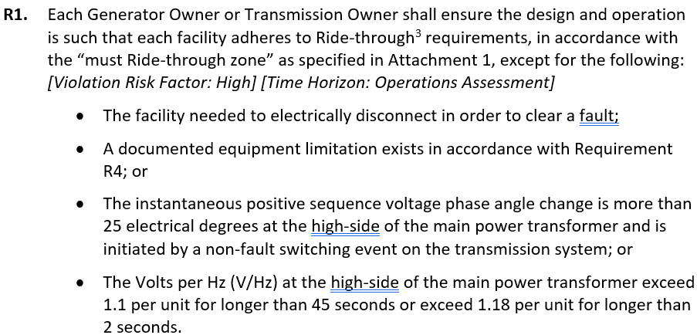
Project 2020-02 Draft Language PRC-029-1
Notes:
Matt end

Slide 9
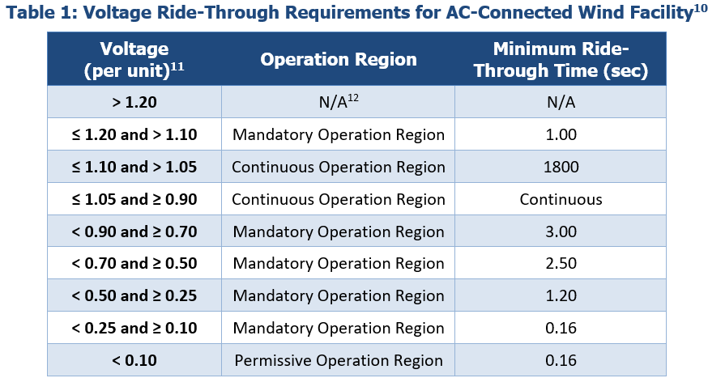
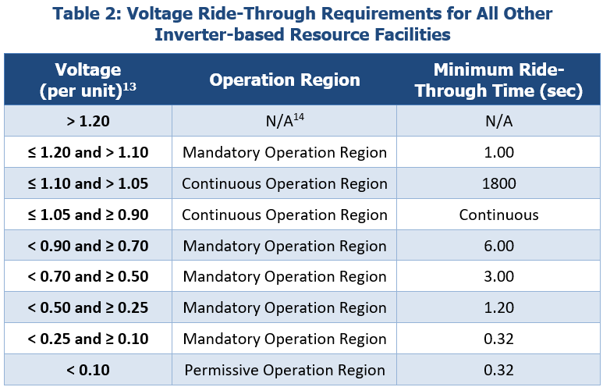
Project 2020-02 Draft Language PRC-029-1
AC-Connected Wind IBR
None AC-Connected Wind IBR
Notes:
Matt end

Slide 10
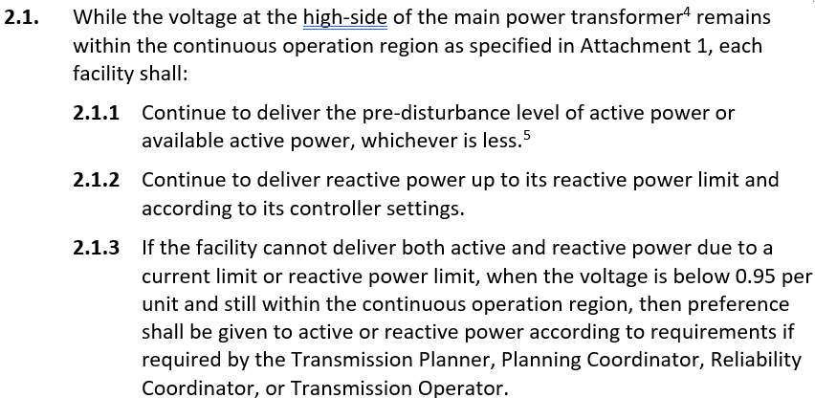
Project 2020-02 Summary of PRC-029-1
Notes:
Matt end

Slide 11
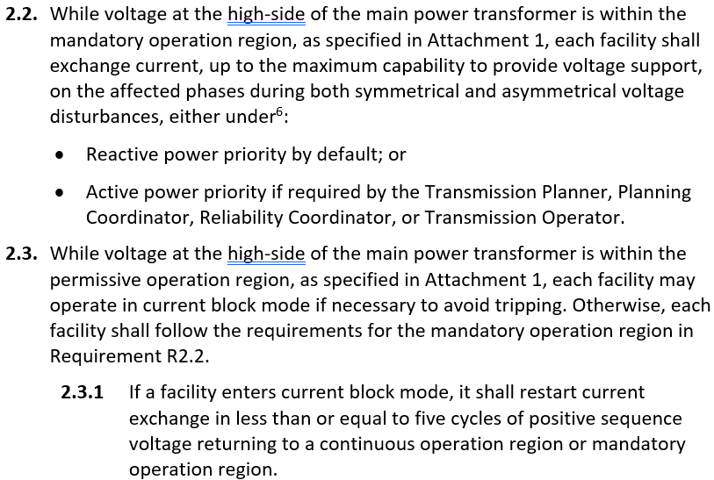
Project 2020-02 Summary of PRC-029-1
Notes:
Matt end

Slide 12
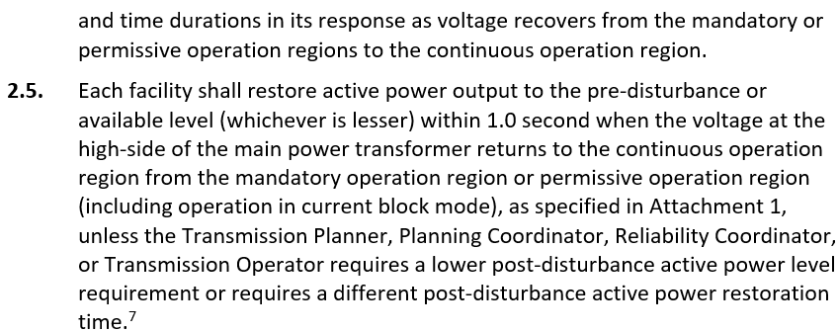
Project 2020-02 Summary of PRC-029-1
Notes:
Matt end

Slide 13
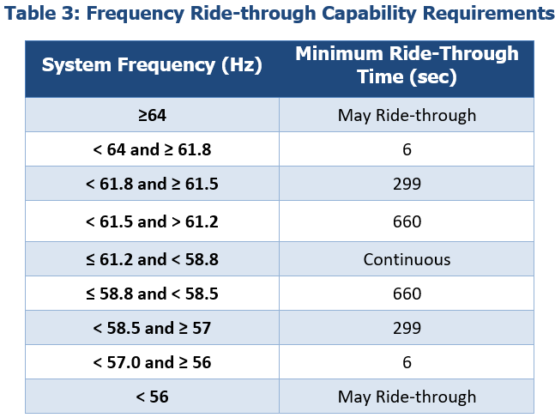
Project 2020-02 Summary of PRC-029-1
Notes:
Matt end

Slide 14
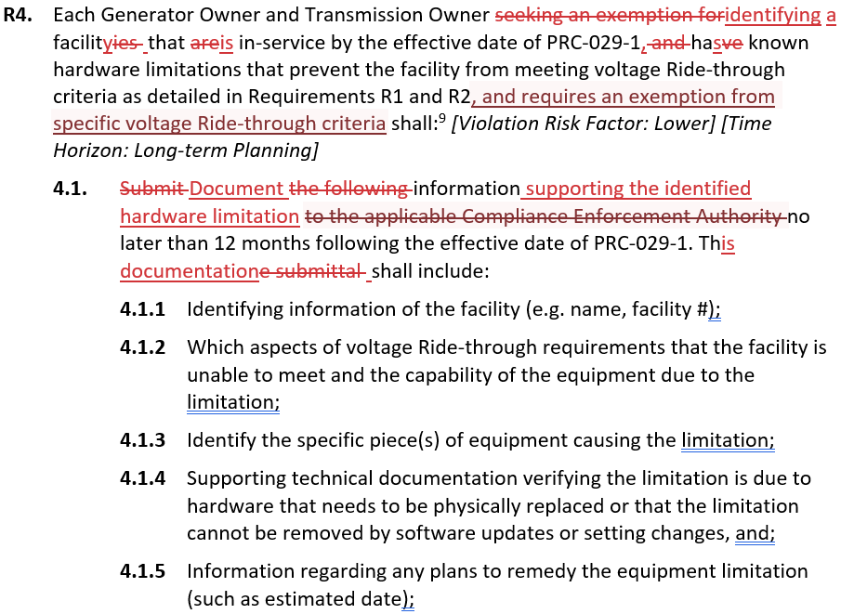
Project 2020-02 Summary of PRC-029-1
Notes:
Matt end

Slide 15
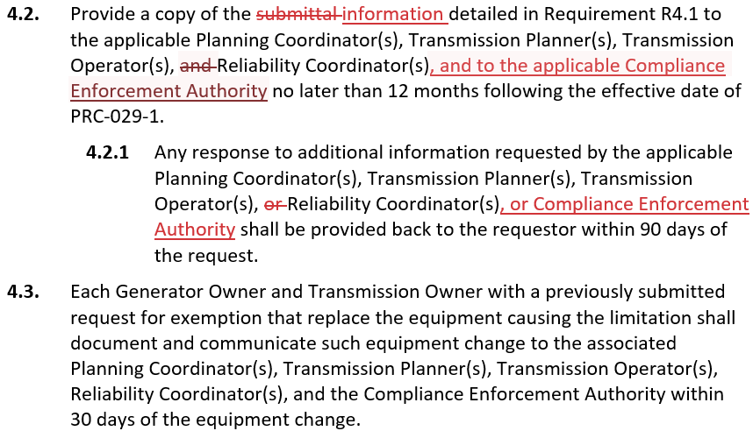
Project 2020-02 Summary of PRC-029-1
Notes:
Matt end

Slide 16
Project 2020-02 Next Steps
Relevant information
Project page
Planned Ballot dates
15 day formal comment period and additional ballot
June 15th 2024 to July 19nd 2024
Contact information
Jamie Calderon: Jamie.Calderon@nerc.net
Xiaoyu (Shawn) Wang: xiaoyu.wang@enel.com
Husam Al-Hadidi: halhadidi@hydro.mb.ca
Notes:
August board

Slide 17
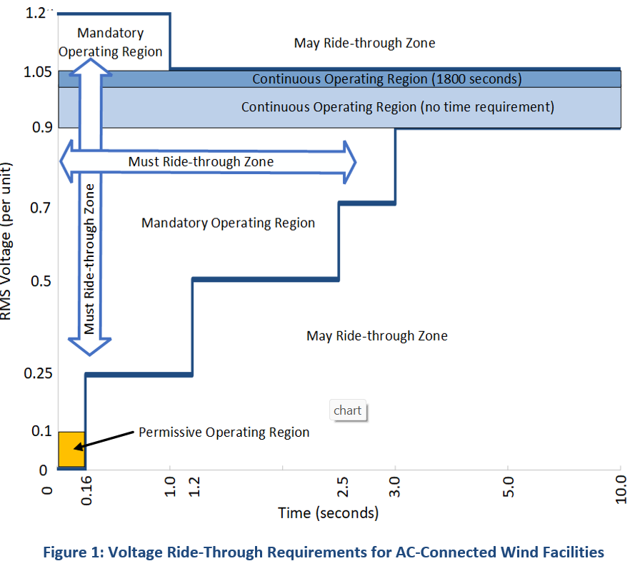
Project 2020-02

Slide 18
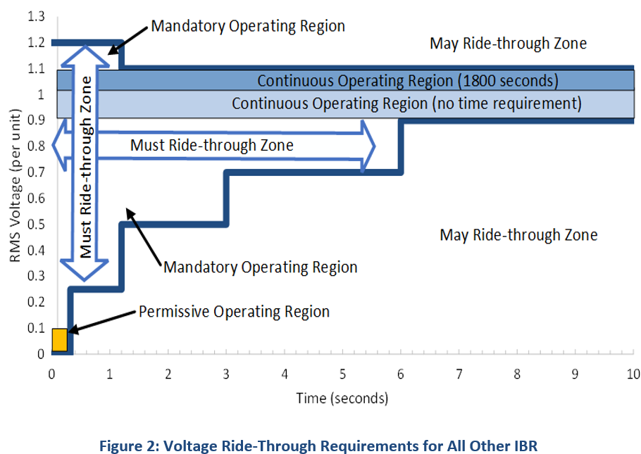
Project 2020-02

Slide 19
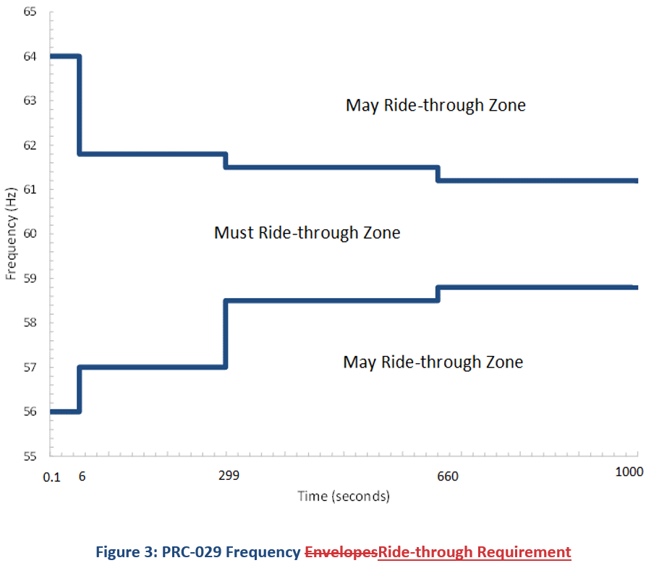
Project 2020-02

