Slide 1
ERCOT IBRTF: NERC and Other Industry Updates
Julia Matevosyan
Chief Engineer
ESIG
06/14/2024

Slide 2
MISO: IEEE 2800-2022 Adoption
FERC has approved MISO’s tariff redlines from the first round of IEEE 2800-2022 implementation, which call out the clauses of IEEE 2800

Slide 3
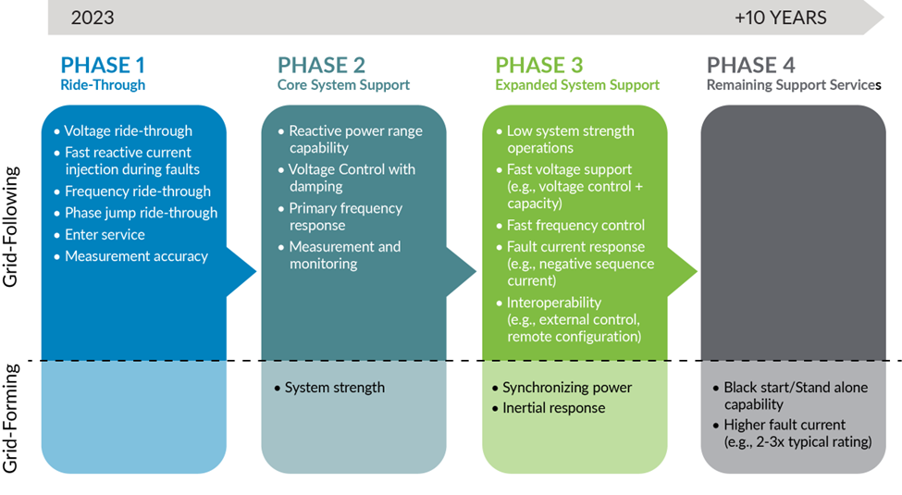
Adoption Priorities – MISO
Planned for 2024
Attributes Roadmap Publication: https://cdn.misoenergy.org/2023%20Attributes%20Roadmap631174.pdf

Slide 4
MISO: GFM Capabilities and Performance for BESS
The evolving energy landscape requires MISO and the industry to adopt available grid-forming control technologies to support MISO’s Reliability Imperative and grid stability as the fleet transitions.
MISO posted an initial draft whitepaper outlining a proposal to adopt some GFM capabilities and performance for BESS.
MISO’s proposal closely follows the NERC Whitepaper: Grid Forming Functional Specifications for BPS-Connected Battery Energy Storage Systems, while also incorporating concepts from AEMO and UNIFI, among other sources to streamline industry-vetted approaches as appropriate.
MISO stakeholders are invited to share formal feedback by June 28th, following June 4th Interconnection Process WG meeting.
MISO intends to finalize GFM BESS requirements in Nov 2024, with an implementation applicable to future projects.
Notes:
In 2021, MISO’s Renewable Integration Impact Assessment (RIIA) described a range of localized and regional grid stability challenges that could materialize as renewable penetration levels increase, absent solutions to support stability. RIIA indicated that transient voltage stability in weak grid areas may be the first stability issue encountered (30% energy served by renewables milestone).
RIIA projected that voltage stability issues could represent the largest capital cost to mitigate, when considering the range of potential stability issues. The RIIA analysis was a multi-year effort, largely performed before GFM IBR models were widely available and therefore the technology was not considered as a solution.

Slide 5
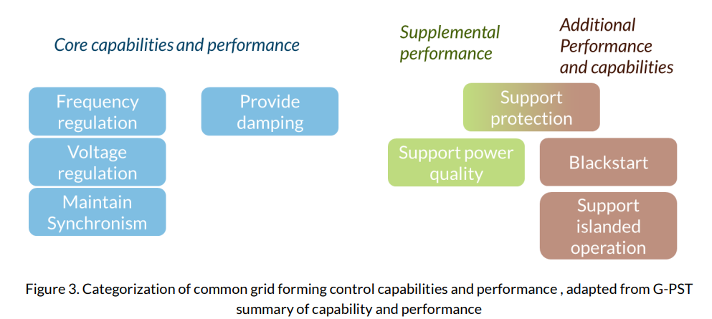
MISO: GFM Capabilities and Performance for BESS
MISO requirements are a subset of currently available GFM BESS capabilities referred to as “core capabilities” by the AEMO and can be enacted through inverter software changes only.
Oscillation damping and performance characteristics are more complex to define or may introduce study complexity. Rather than requiring these at this time MISO shares guidance on recommended performance.
Categorization of common grid forming control capabilities and performance , adapted by MISO from G-PST summary of capability and performance

Slide 6
MISO: GFM Capabilities and Performance for BESS
Four simulation test procedures and success criteria are described:
the loss of last synchronous machine test,
phase jump test,
rate of change of frequency test, and
short circuit ratio ramp down with fault test.
These tests rely on two simple EMT test-setups which are also specified.
To support MISO’s simulation test requirements, MISO proposed guidance for model quality, data exchange, and process elements.

Slide 7
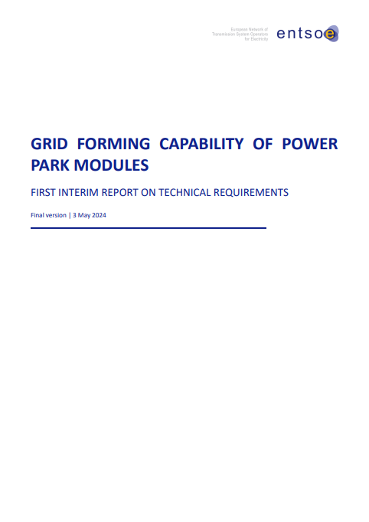
ENTSO-E GFM Capability of Power Park Modules
On 12/19/23, the Agency for the Cooperation of Energy Regulators (ACER) recommended amending the Network Connection Code requirements for generators (RfG Regulation).
It includes non-exhaustive Grid-Forming (GFM) requirements for Power Park Modules (PPM).
To facilitate its application and address stakeholders’ concerns about harmonization, an Implementation Guidance Document (IGD) proposing exhaustive GFM requirements will be released after the publication of the updated regulation, expected in 2025, following a dedicated process.
ENTSO-E published Grid Forming Capability of Power Park Modules First Interim Report that provides recommendations on the exhaustive technical GFM reequipments for PPM
A range of parameters has been proposed accompanied with a proposal for compliance testing of GFM capable PPMs.

Slide 8
ESIG GFM Landscape Page
ESIG created a set of webpages is continuation of the Grid-Forming Technology in Energy Systems Integration Report and tracks progress on grid-forming technology development and deployment including installed projects, specifications, modeling, and studies on the technology’s benefits.
https://www.esig.energy/working-users-groups/reliability/grid-forming/gfm-landscape/

Slide 9
Key Goals and Outcomes from i2X FIRST
To facilitate understanding and adoption of new and recently updated standards relevant for existing and newly interconnecting wind, solar and battery storage plants
The Forum will convene the industry stakeholders to enable practical and more harmonized implementation of these interconnection standards.
The presentation portion of the meeting will be recorded and posted, and presentation slides will be shared.
Additionally, the leadership team will produce a summary of each meeting capturing:
Recommended best practices,
Challenges and
Gaps that require future work.
Notes:
[DOE]

Slide 10
Upcoming i2X FIRST Meetings
June 25th, 2024, 11 a.m.- 1 p.m. ET:
July 30th, 2024, 11 a.m.- 1 p.m. ET:
August 20th, 2024, 11 a.m.- 1 p.m. ET:
September 24th, 2024, 11 a.m.- 1 p.m. ET:
October 24th, 2024 hybrid full day event during ESIG Fall Workshop, Providence, Rhode Island
November 26th, 2024, 11 a.m.- 1 p.m. ET:
December 17th, 2024, 11 a.m.- 1 p.m. ET:
January 28th 2025, 11 a.m.- 1 p.m. ET:
February 25th 2025
March 20th, 2025 hybrid full day event during ESIG Spring Workshop, Austin, Texas
Sign up for all future i2X FIRST Meetings here: https://www.zoomgov.com/meeting/register/vJItceuorTsiErIC-HInpPbWuTUtrYQAuoM#/registration
Follow DOE i2X FIRST website: https://www.energy.gov/eere/i2x/i2x-forum-implementation-reliability-standards-transmission-first for meeting materials & recordings and for future meeting details & agendas

Slide 11
Julia Matevosyan
julia@esig.energy

