Slide 1
RTC+B Task Force
Update
Matt Mereness
RTCBTF
June 14, 2024

Slide 2
Outline
Brief Program update: RTC+B Program Update from April Board T&S
Reminder of RTCBTF Review Cycle
Review of Issues List
Upcoming RTC+B Clarification NPRRs
Today’s Issues List for Discussion:
  Issue 3 - Framework for periodic analysis comparing RTC and the current ORDC design
  Issue 20 - Review of the Energy and AS Offer Caps in the context of Current Policy
  Issue 9-10 - Market Readiness and Technical Workshops
  Issue 18 - Placeholder for MPs discussion of AS Demand Curves

Slide 3
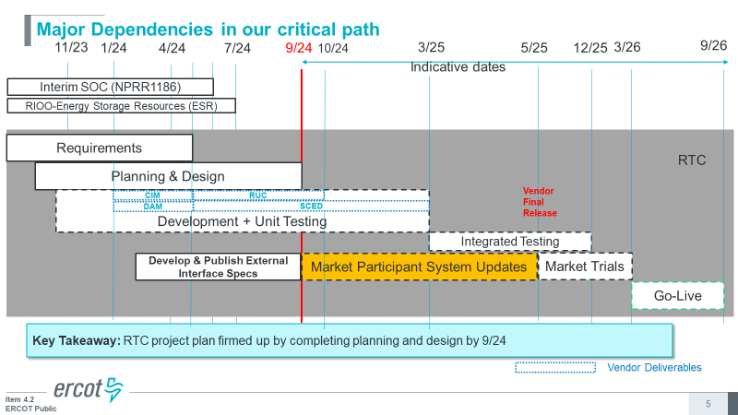
RTC+B Program Update
(excerpt from June Board T&S RTC Update)

Slide 4
Sequence and Potential Dates for Market Trials
(dates subject to change while in Planning phase)
May 2025
June 2025
July 2025
Aug 2025
Sep 2025
Oct 2025
Nov 2025
Dec 2025
QSE Attestation
9 months before Trials
Each activity will have a public-facing Scorecard and exit Criteria
3-4 months
2 months
1 month
DRAFT
RTC QSE Submission Testing
(Submit COP, RT AS Offers,
DAM Virtual AS, Outages for ESRs)
Open-loop RTC SCED
(QSE offers, SCED non-binding award/dispatch)
Closed-loop SCED/LFC
(QSE RTC offers and telemetry to support closed-loop frequency control test 2-3 tests of 2-4 hour durations)
Transition to Go-Live
Upon completion of testing, confirmation of ERCOT and market readiness for Go-Live.
RTC QSE Telemetry Check-out (QSEs add/verify new telemetry points for UDSP, New ramp rates, ESR telemetry)
QSE Telemetry Tests
(Individual QSE to follow UDSP and support new ramp rate and ESR telemetry)
Day-Ahead Market
(Non-binding DAM using QSE offers for at least 2 tests)
Current draft of the earliest possible dates for Market Trials and Go-Live that have been shared through TWG and the RTC+B Workshops, in support of Market Participants readiness at RTCBTF.
Actual Market Trials and Go-Live milestones are to be determined and will be communicated no later than 9/30/24.
1-2 months
Updated 2024-05-22

Slide 5
Plans for Meetings and Review Cycles
Reminder of RTC+B Program Scope
  RTC Key Principles were approved to lay foundation of NPRR1007-1013
    Consolidated Key Principles: https://www.ercot.com/files/docs/2020/04/01/RTC_Key_Principle_Quick_Reference.docx
    Library of Key Principles: https://www.ercot.com/mktrules/puctDirectives/rtCoOptimization
  Battery Key Topic Concepts approved to lay foundation of NPRR1014
    https://www.ercot.com/mktrules/keypriorities/bes
  RTC State-of-Charge accounting in NPRR1204
Objective is to present concepts or issues that need to be resolved for an effective implementation.
  Coordinating timelines for interface requirements and testing,
  Providing the forum for any analysis or policy decisions (such as parameter values)
  Coordinating market readiness and cutover activities,
  Review draft Revision Requests or other artifacts necessary to successfully implement the program within the identified timeframes, and discussing other details as needed.
Lessons learned from RTCTF to avoid being delayed in decisions:
  Meeting #1: Initial concept presented by ERCOT staff
  Meeting #2: Comments and alternatives presented by MPs
  Meeting #3: RTCTF consensus achieved or escalated to TAC for a vote to decide the matter.

Slide 6
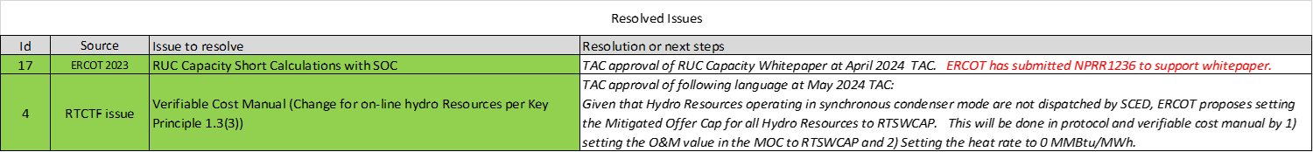
Current RTCBTF Issues List
Link to issues on RTCBTF home page

Slide 7
Upcoming RTC+B Clarification NPRRs
RTC+B NPRR next steps:
  RUC Capacity Short NPRR1236 is going to July PRS Meeting
  Verifiable Cost Hydro MOC will be part of clarifying NPRR
ERCOT is developing at least 2 clarifying NPRRs with target of July drafts:
  Clarification NPRR after completing business requirements (eg, drift in baseline since 2019, discrepancies and/or small gaps found during business requirement development)
  Clarification NPRR as an extension of NPRR1014 Single Model to clarify single model language in other areas of protocols.
  Note- All changes are intended to be “as designed” clarifications, aligned with Key Principles, and have no system impacts.
Current plan is to share initial drafts with RTCBTF, and then ERCOT will formally file as NPRRs to allow vetting of comments via existing PRS process and supported by RTCBTF to thoroughly review.

Slide 8
Proceed with rest of meeting
Issue 3 - Framework for periodic analysis comparing RTC and the current ORDC design
  ERCOT has updated the publicly available RTC Excel tool and will be posted to RTCBTF home page
  Solicit any further comments from MPs (beyond Luminant feedback from last meeting)?
Issue 20 - Review of the Energy and AS Offer Caps in the context of Current Policy
  Review last month’s presentation and see if any questions.
Issue 9-10 - Market Readiness and Technical Workshops
  Walk-though outline of market trials sequence and objectives
  Walk-though of telemetry changes shared at RTC+B Technical Workshop
Issue 18 - Review of the AS Demand Curves in the context of current policy
  ERCOT Operations to provide some feedback on questions from prior RTCBTF meetings
Potentially end by 1pm
Next meeting in-person/WebEx on Wednesday July 17, 2024

