Slide 1
Weatherization Considerations for New ERCOT Generation Resources
David Kezell
Director, Weatherization and Inspection
Resource Integration Working Group Meeting
ERCOT Public
June 12, 2024

Slide 2
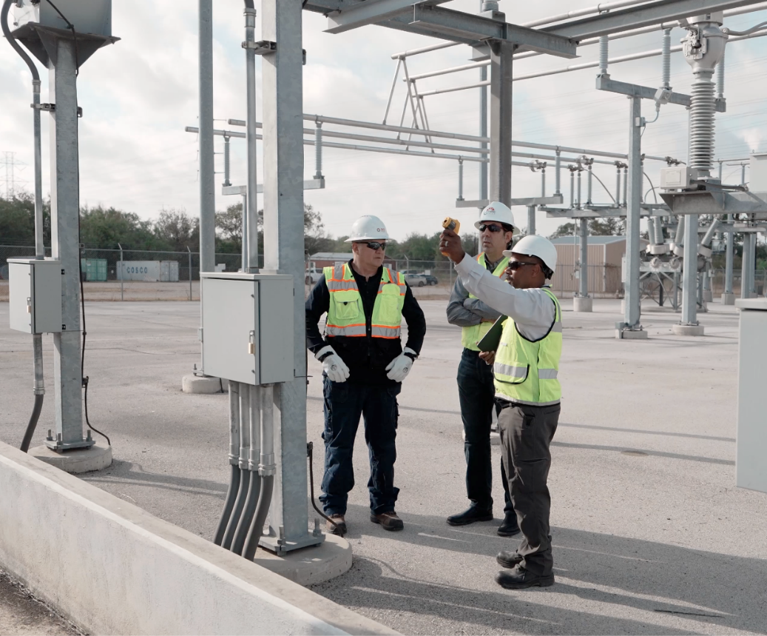
Mandatory Weatherization in Texas
Winter Storm Uri in February, 2021 precipitated a number of new laws. SB3 from the 2021 legislative session required that weatherization rules be established by the Public Utilities Commission of Texas for the electric industry and by the Texas Railroad Commission for the natural gas industry.
In October 2021 the PUCT adopted Phase I of their Weather Emergency Preparedness (16 TAC § 25.55), rule followed by Phase II in September 2022.
The rule requires various preparatory measures to be taken prior to the winter and summer seasons and that those measures be maintained.
Declarations of Weather Preparedness are required to be submitted semi-annually.
New or repowered resources must submit a declaration prior to the resource commissioning date established in the interconnection process.

Slide 3
16 TAC §25.55 Rule Requirements
Market Participants (MPs) are responsible to:
  Establish and maintain weather preparation measures for both winter and summer seasons reasonably expected to ensure sustained operation at weather-zone specific conditions
  Make notarized declarations of preparedness for both winter and summer
  Create a list of all cold- and hot-weather-critical components
  Train appropriate personnel, etc.
ERCOT is responsible to:
  Deliver biannual reports that address whether each GE and TSP has submitted a declaration
  Develop winter and summer inspection checklists for resources and TSPs
  Inspect to determine compliance (every resource 1x/3yr, 10% of TSP facilities 1x/3yr)
  Provide inspection reports and establish cure periods for deficiencies, etc.

Slide 4
Requirement to Submit Declarations of Preparedness
16 TAC 25.55(c)(3)(C) . . . For any new or repowered resource, a generation entity must submit the appropriate declaration of preparedness prior to the resource commissioning date established in the ERCOT interconnection process for resources.
Checklist Part 3 of the commissioning process requires this step to be completed, see ERCOT New Generator Commissioning Checklist.
For Resource Entities requesting to commission a Generation Resource(s) or Energy Storage Resource(s) during the winter months (December through February), the declaration of winter weather preparedness required by Public Utility Commission of Texas (PUCT) Substantive Rule 25.55 parts (c)(3)(C) and (c)(3)(A), has been submitted to ERCOT addressing the new resource(s) either on Declaration of Weather Preparedness (DoWP) # (if submitted between November 1 and December 1) or on Weatherization Support Case (WSUP) # (if submitted between December 2 and the end of February).
For Resource Entities requesting to commission a Generation Resource(s) or Energy Storage Resource(s) during the summer months (June through September), the declaration of summer weather preparedness required by Public Utility Commission of Texas (PUCT) Substantive Rule 25.55 parts (c)(3)(C) and (c)(3)(B), has been submitted to ERCOT addressing the new resource(s) either on Declaration of Weather Preparedness (DoWP) # (if submitted between May 1 and June 1) or on Weatherization Support Case (WSUP) # (if submitted between June 2 and the end of September).

Slide 5
Process to Submit First Declaration of Preparedness
For Resource Entities requesting to commission a Generation Resource(s) or Energy Storage Resource(s) during the summer or winter seasons, the declaration of winter weather preparedness is submitted to ERCOT for the new resource(s) in one of two ways:
  1) Using the Declaration of Weather Preparedness open for one month prior to either season (May 1 – Jun 1 or Nov 1 – Dec 1). This will generate a unique DoWP number.
  2) Using the Weatherization Support Case if during either season (Jun 2 thru end of Sep or Dec 2 thru end of Feb). This will generate a unique WSUP number.
  Either way requires working within the portal. Entering the portal requires a specific role to be added to your digital certificate.
Instructions for submitting a Declaration of Weather Preparedness are found on pages 15-21 of the Weatherization and Inspection Market Participant Portal User Guide in the “Weatherization and Inspection Market Participant Portal Training” folder at Summer Weather Readiness (ercot.com).
Instructions for submitting a Weatherization Support Case are found on pages 22-23 of the same User Guide.

Slide 6
Key Takeaways
Effective weatherization of all power facilities is essential to reliability during extreme cold and extreme hot weather conditions and to meet ERCOT’s rapidly growing electricity demand.
The PUCT Weather Emergency Preparedness (16 TAC § 25.55) rule requires that weatherization measures be in place and maintained throughout the summer (Jun – Sep) and winter (Dec – Feb) seasons.
The rule also requires the submission of signed and notarized Declarations of Weather Preparedness prior to the commissioning date and by every June 1st and December 1st thereafter.
More ERCOT weatherization information can be found at https://www.ercot.com/gridinfo/generation/summerready and https://www.ercot.com/gridinfo/generation/winterready. For information specifically regarding the use of the ERCOT portal, please see the “Weatherization & Inspection Market Participant Portal Training” folder within https://www.ercot.com/gridinfo/generation/summerready.

