Slide 1
Resource Integration Topics
Jenifer Fernandes
ERCOT
Resource Integration Working Group
June 12, 2024

Slide 2
Quarterly Stability Assessment (QSA)
Planning Guide 5.9
Next Deadline for QSA
If a GINR is not included in QSA, its Initial Synchronization date will be automatically delayed to the next quarter
All-Inclusive Generation Resource Initial Synchronization Date | Last Day for an IE to meet prerequisites as listed in paragraph (4) below | Completion of Quarterly Stability Assessment
Upcoming January, February, March | Prior August 1 | End of October
Upcoming April, May, June | Prior November 1 | End of January
Upcoming July, August, September | Prior February 1 | End of April
Upcoming October, November, December | Prior May 1 | End of July

Slide 3
Quarterly Stability Assessment (QSA)
Planning Guide 5.9, Quarterly Stability Assessment
Issue’s seen in previous QSA’s
  10 day comment period for FIS
    Needs to be complete before QSA deadline
    TSPs need to plan for it
  Dynamic/PSCAD Model Review
    Dependent on FIS Stability study
    Need to meet PG 6.9 15 to 30 days prior to QSA deadline
PSSE Model Quality Test Required
PSCAD Model Quality Test, Unit Model Validation and Template is required. PSCAD template is required starting August 1st QSA.
TSAT Model Required – If PSSE model is UDM, then TSAT model should be UDM and should include MQT

Slide 4
Commissioning Requests Submission- New Email Address
ERCOT has established a new, dedicated email address for Market Participants to submit new generator Commissioning Checklist for review.
Starting June 10, 2024, all new Commissioning Checklists (Parts 1-3) should be emailed to CommissioningRequests@ercot.com in addition to being submitted to RIOO-IS.
Commissioning Checklists (Parts 1-3) submitted to ResourceIntegrationDepartment@ercot.com after June 21, 2024, will not be processed.
Commissioning Plans should not be emailed for review to the new Commissioning Request email address.

Slide 5
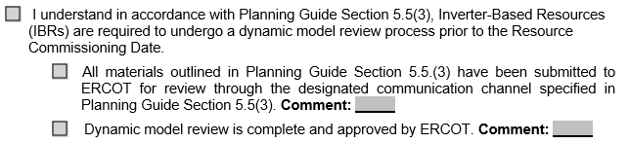
PGRR109 – Dynamic Model Review for Inverter-Based Resources
PGRR109 was implemented on May 1st, 2024. The PGRR requires IBRs to submit the appropriate dynamic models for the “as-built” data and the data submitted for the quarterly stability assessment for ERCOT review prior to the Resource Commissioning Date.
Refer to Planning Guide 5.5 (3) for data and submittal requirements prior to Part 3 Commissioning.
ERCOT New Generator Commissioning Checklist (Part 3) has been updated to include the following RE attestation:

Slide 6
Self Limiting Facility - VSS
NPRR1026 and PGRR081 were approved on 12/08/2020 and implemented on 03/01/2024.
NPRR1026: Nodal Protocol 3.15:
  NP 3.15 (f):For any Generation Resource or Energy Storage Resource (ESR) that is part of a Self-Limiting Facility, the capabilities described in paragraphs (a) and (b) above shall be determined based on the Self-Limiting Facility’s established MW Injection limit and, if applicable, established MW Withdrawal limit.
  NP 3.15.3 (9):If any individual Resource within a Self-Limiting Facility is incapable of meeting its Reactive Power requirement at the POI, the QSE must bring On-Line additional Resource(s) within the Self-Limiting Facility to provide VSS as specified in paragraph (4) of Section 3.15, Voltage Support, while respecting the limit on MW Injection.

Slide 7
Self Limiting Facility - VSS
Example:
  Solar (100MW) + Battery (50 MW), SLF Limit is 100MW. VSS requirement is based on the SLF’s established MW injection limit of 100MW which is 32.9MVAr.
  1. Solar Only Discharging = VSS requirement is 32.9MVAr
  2. Battery Only Discharging = VSS requirement is 32.9MVAr
  3. Battery Only Charging = VSS requirement is 32.9MVAr
  4. Solar + Battery Discharging = VSS requirement is 32.9MVAr

Slide 8
Active RR’s
NPRR1212/PGRR114
  PGRR114 requires that before ERCOT approves Initial Energization for a project that will consume Load other than Wholesale Storage Load (WSL) and that is not behind a Non-Opt-In Entity (NOIE) tie meter, the Distribution Service Provider (DSP) must provide ERCOT with Electric Service Identifier(s) (ESI ID(s)). Ensuring that ESI ID(s) are provided before Initial Energization will avoid the creation of (Unaccounted for Energy) UFE for Initial Settlement.
PGRR112
  Dynamic Data Model and Full Interconnection Study (FIS) Deadline for Quarterly Stability Assessment – Approved at TAC for December 1st, 2024, implementation which affects February 1st, 2025, QSA.

Slide 9
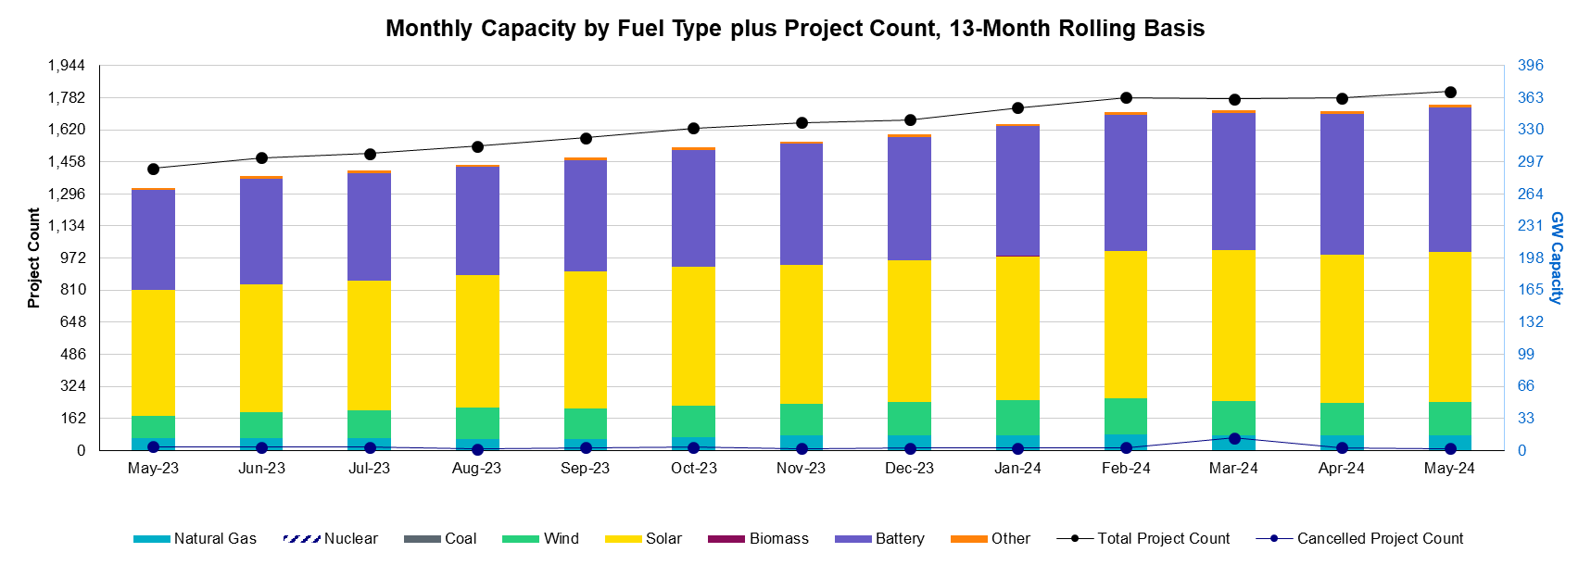
Generation Interconnection Requests
1,813 active generation interconnection requests totaling 355 GW as of May 31st, 2024
(Solar 154 GW, Wind 34 GW, Gas 16 GW, and Battery 149 GW)
(Excludes capacity associated with projects designated as Inactive per Planning Guide Section 5.7.6)

Slide 10
Generation Interconnection Requests
Small Gen- 39 projects Not Model Ready, 41 projects Model Ready

Slide 11
Other contact information
ResourceIntegrationDepartment@ercot.com is distribution list for Resource Integration department
Mailing List
  RESOURCE_INTEGRATION@LISTS.ERCOT.COM

Slide 12

Questions?
Thank you!

