Slide 1
Single Model ESR (Energy Storage Resource) - RIOO
June 12, 2024

Slide 2
ESR (Energy Storage Resource) - RIOO
Single Model ESR
  ESRs are currently being represented in RIOO as combo model by using Conventional Generators and Load Resources. Market Participant users are currently creating two separate projects in RIOO, a Conventional Generator (energy storage) project and a Load Resource project hence the name combo model.
  This will change with ESR-RIOO go live, Market Participant Users will need to create only one project i.e. enter Load (Charging) and Generator (Discharging) info in a single project as single model ESR data.
  ESR Panels and Functionality
  Fuel and technology type on an INR will be driving the ESR panels and functionality display in the UI.
  MP users will need to select Battery/Energy Storage as the Fuel Type/Technology type on an INR to create a single model ESR project.
  INR creation, submission and graduation process will remain the same for ESR and non ESR projects. Single model ESRs will be available in RIOO RS upon graduation, and RE users will be able to make updates via an RSCR.

Slide 3
ESR (Energy Storage Resource) - RIOO
Migration of Combo to Single model ESRs
  ERCOT is developing a process to convert current combo model data to single model.
  Once the conversion is complete, users will see their single model ESR data in RIOO application.
RIOO ESR Release Timelines
  ESR panels and functionality is targeted to go live end of July 2024.
  ESR migration of combo model to single model is targeted to complete by end of September 2024.

Slide 4
ESR (Energy Storage Resource) – RIOO IS Application Demo
RIOO IS Application demo to show the new/modified panels.
Screenshots of new/modified RIOO IS panels are included in rest of the slides for your reference

Slide 5
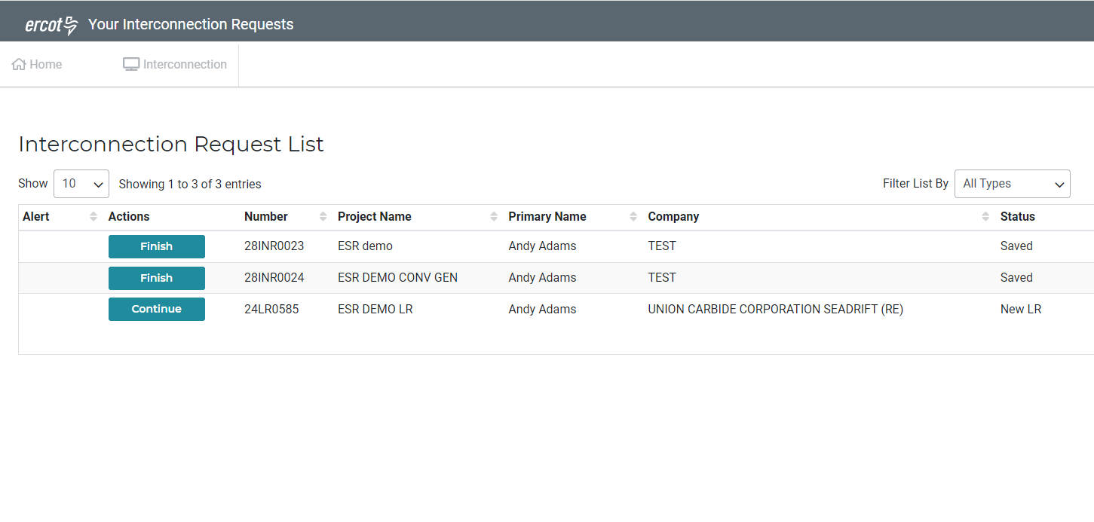
ESR (Energy Storage Resource) – RIOO IS Application Demo

Slide 6
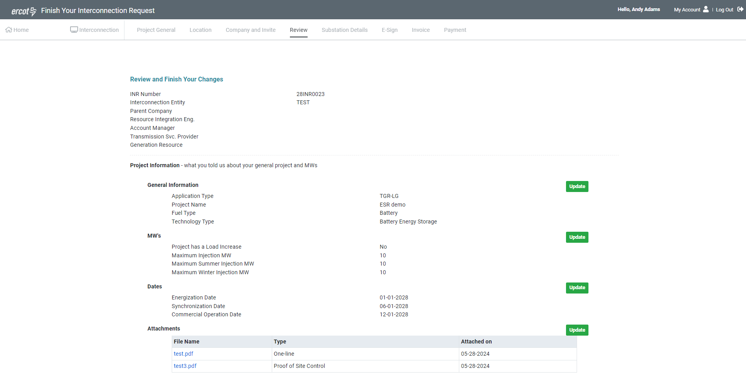
ESR (Energy Storage Resource) – RIOO IS – New/Modified Panels

Slide 7
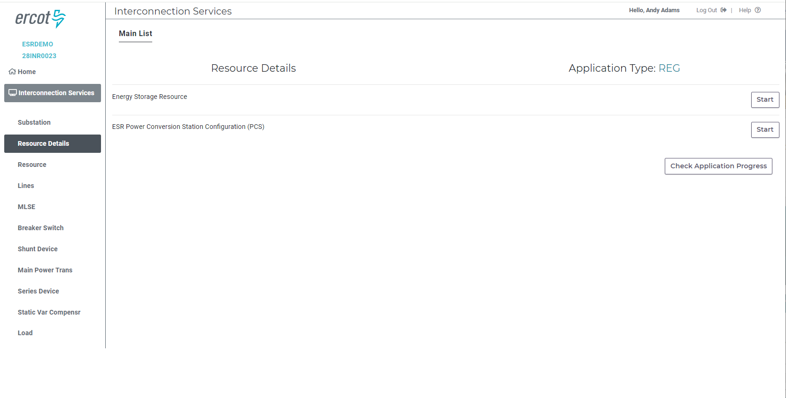
ESR (Energy Storage Resource) – RIOO IS – New/Modified Panels

Slide 8
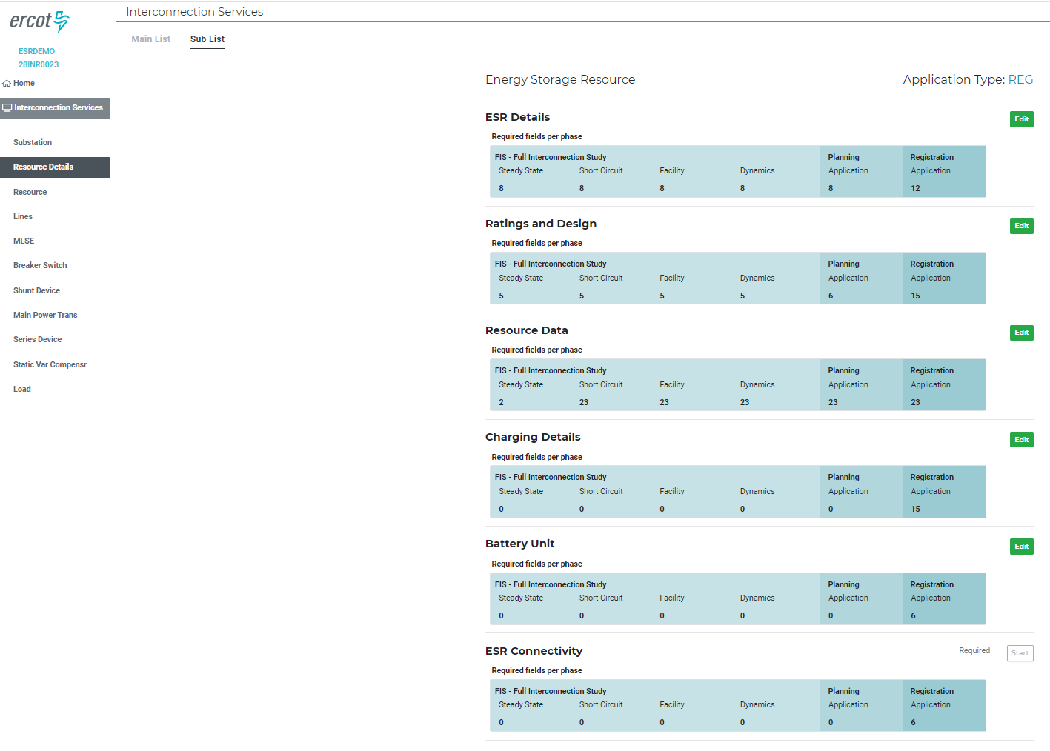
ESR (Energy Storage Resource) – RIOO IS – New/Modified Panels

Slide 9
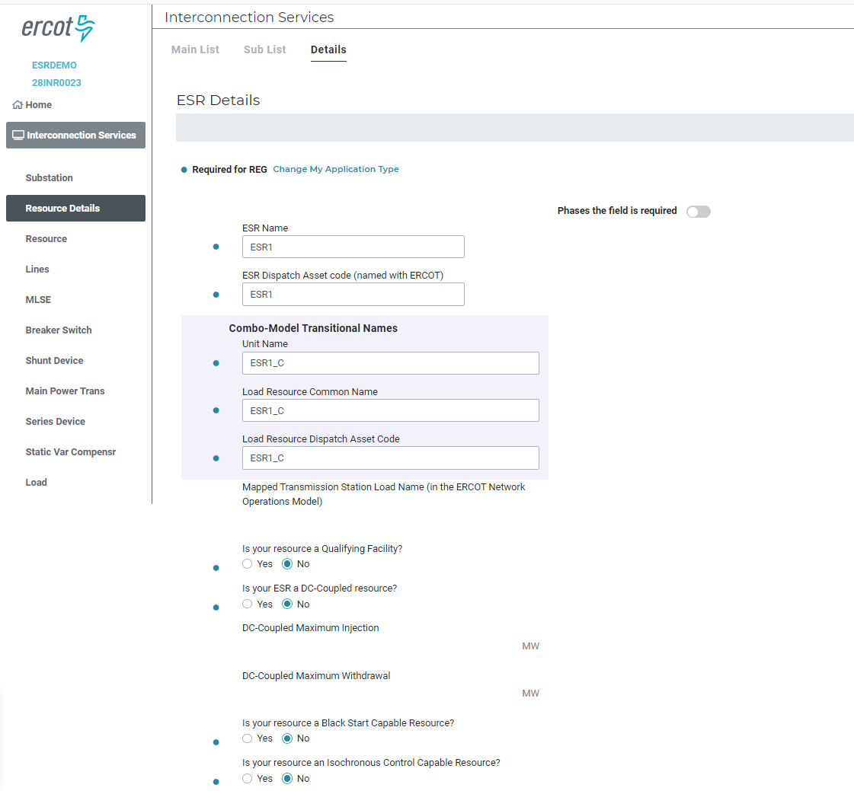
ESR (Energy Storage Resource) – RIOO IS – New/Modified Panels

Slide 10
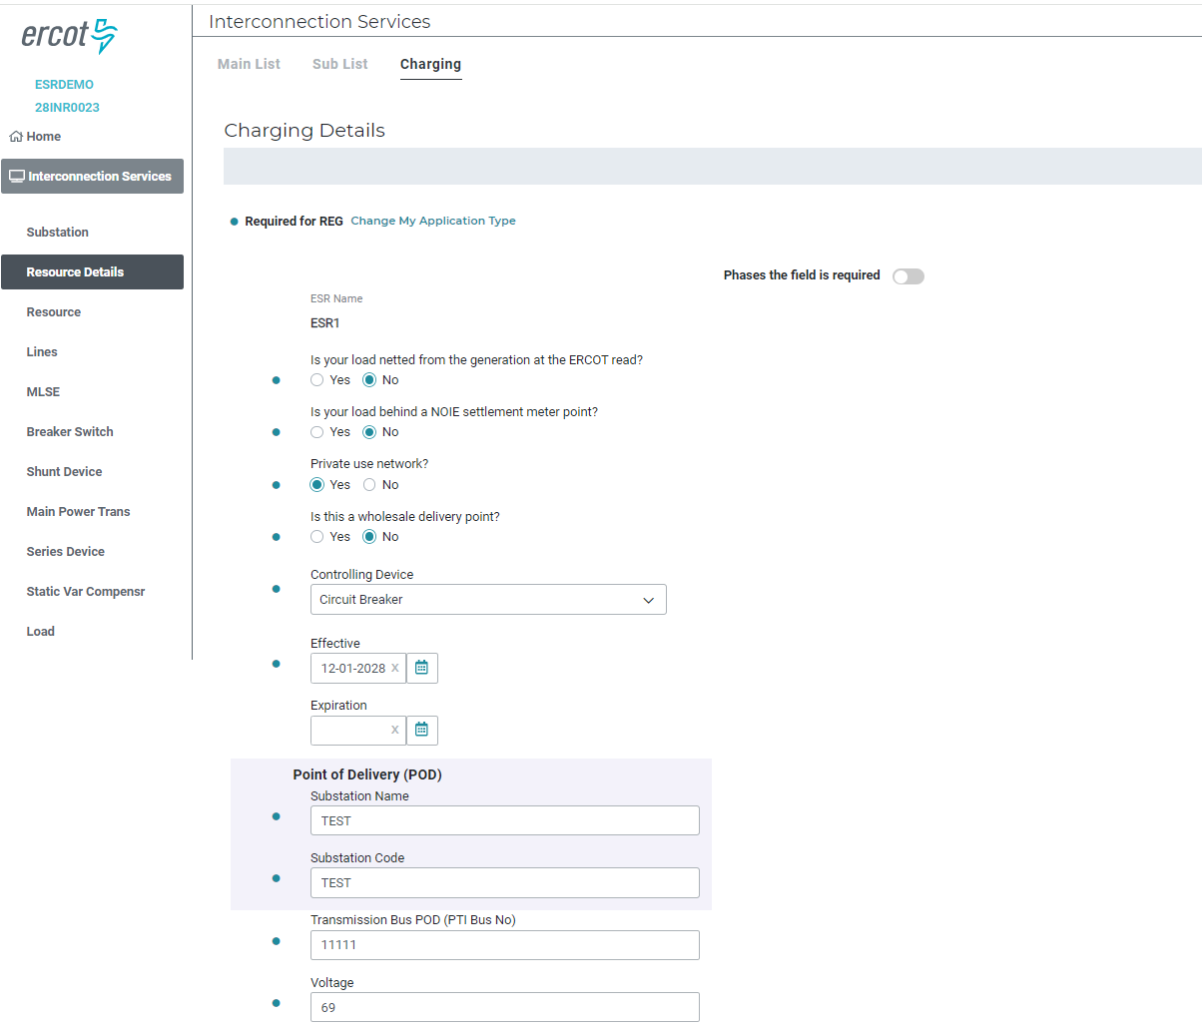
ESR (Energy Storage Resource) – RIOO IS – New/Modified Panels

Slide 11
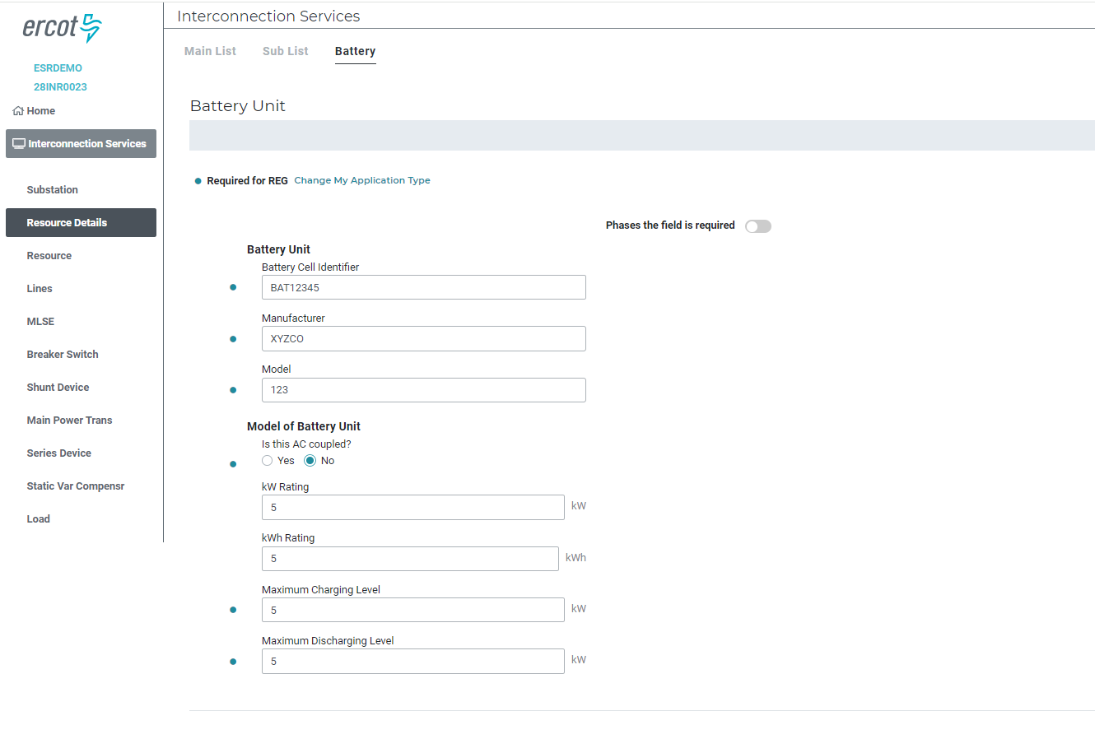
ESR (Energy Storage Resource) – RIOO IS – New/Modified Panels

Slide 12
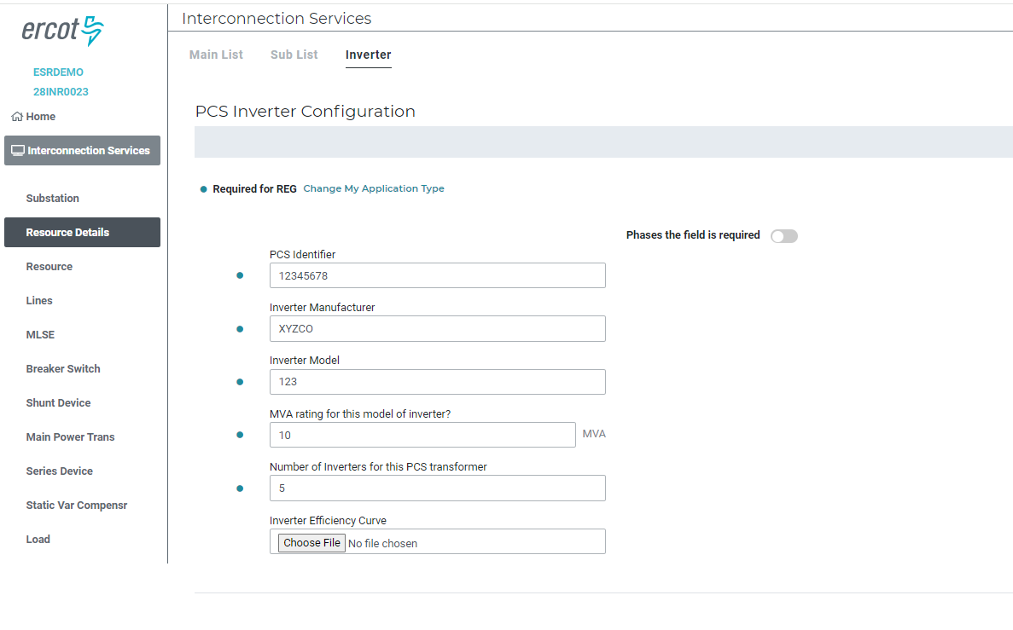
ESR (Energy Storage Resource) – RIOO IS – New/Modified Panels

