Slide 1
RTC+B Technical Workshops
ERCOT Staff
June 06, 2024

Slide 2
RTC+B Technical Workshops
WELCOME
Workshop#4 - Revisit ICCP Telemetry Points, Review EIP External Specifications Document changes and Parallel Operations of Market External Interfaces

Slide 3
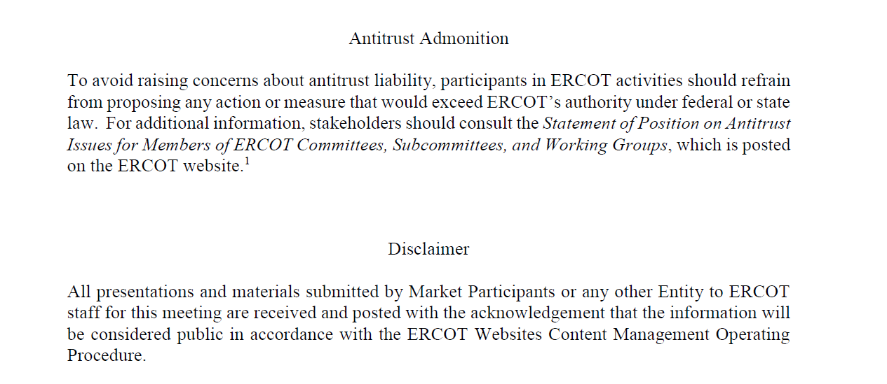
RTC+B Technical Workshops

Slide 4
Agenda
Item # | Item Description | Presenter | Start Time
1 | Antitrust admonition | Sreenivas Badri | 1:00 PM
2 | Recap – First Three Technical Workshops Topics | Sreenivas Badri | 1:05 PM
3 | RTC+B Program Updates and Market Trials Timelines | Matt Mereness | 1:10 PM
4 | RTC+B ICCP Telemetry Points additional changes and Telemetry Points Description | Sreenivas Badri/Abhi Masanna Gari | 1:20 PM
5 | Review RTC+B ICCP Handbook Updates | Kevin McGarrahan | 1:45 PM
6 | Review RTC+B EIP External Interfaces Specifications Document changes | Sreenivas Badri/Susan Jinright | 02:00 PM
 | Break | Break | 2:20 PM
7 | Revisit RTC+B Market External Interfaces Systems Configuration for Parallel Operation | Sreenivas Badri | 2:30 PM
8 | Go over Market Trials – Market Submissions Dual Entry details | Sruthi Hariharan | 2:45 PM
9 | Q&A Session | ERCOT Staff/QSEs/Vendors | 3:00 PM
10 | Next Steps | Sreenivas Badri | 3:50 PM
11 | Adjourn | Sreenivas Badri | 4:00 PM

Slide 5
RTC+B Technical Workshops
Key Objectives
  Help QSEs, and their vendors start planning their RTC+B systems design and implementation early to align with ERCOT’s RTC+B project implementation timelines which is critical for ERCOT to deliver this project successfully and on time.
  Based on the feedback from these workshops, ERCOT will finalize ICCP/Market External Interfaces design specifications and publish draft versions to the ERCOT website.
RTC+B Technical Workshops - Completed
    RTC+B Technical Workshop - April 18, 2024: 1:00 PM – 4:00 PM :
    Overview of ICCP Telemetry/EMS SCADA/AGC changes & ICCP Configurations for parallel testing.
    RTC+B Technical Workshop - May 6, 2024: 1:00 PM – 4:00 PM :
    Finalize approach on ICCP configuration approaches for parallel testing and transition.
    RTC+B Technical Workshop - May 15, 2024: 1:00 PM – 4:00 PM :
    Market Interfaces design specifications (submissions - External API/Market Manager, notifications, and reports)

Slide 6
RTC+B Technical Workshops - Recap
  Workshop#1
    Had detailed discussion on EMS/AGC design on new RTC+B ICCP telemetry points additions and deletions.
    Introduced ICCP Configurations for parallel testing
  Workshop#2
    Went over questions/comments from Workshop#1
    Had further discussion on new RTC+B ICCP telemetry points additions and deletions
    Discussed in detail ICCP Configurations for parallel testing, pros/cons for two options presented
  Workshop#3
    ERCOT selected ICCP Configuration Option#1 for parallel testing which is Add RTC+B telemetry points to current production ICCP system
    Discussed in detail
      New/Modified Market Submissions in RTC+B
      Discussed in detail Market External Interfaces – Market Manager/Outage Scheduler UI changes, API/XSD changes, XML alerts and notices.
      Discussed in detail RTC+B Market External Interfaces Systems Configuration - stand up new parallel External API/EWS Systems for RTC+B Project for dual entry during Market Trials

Slide 7
RTC+B Technical Workshops – Workshop #4
  Focus of today’s meeting
    RTC+B ICCP Telemetry Points description
    Go over ICCP Handbook updates
    Go over EIP External Interfaces Specifications document RTC+B changes
    RTC+B Market External Interfaces Systems Configuration for Parallel Operation
    Market Trials – Dual Entry of Market Submissions
    Q&A Session

Slide 8
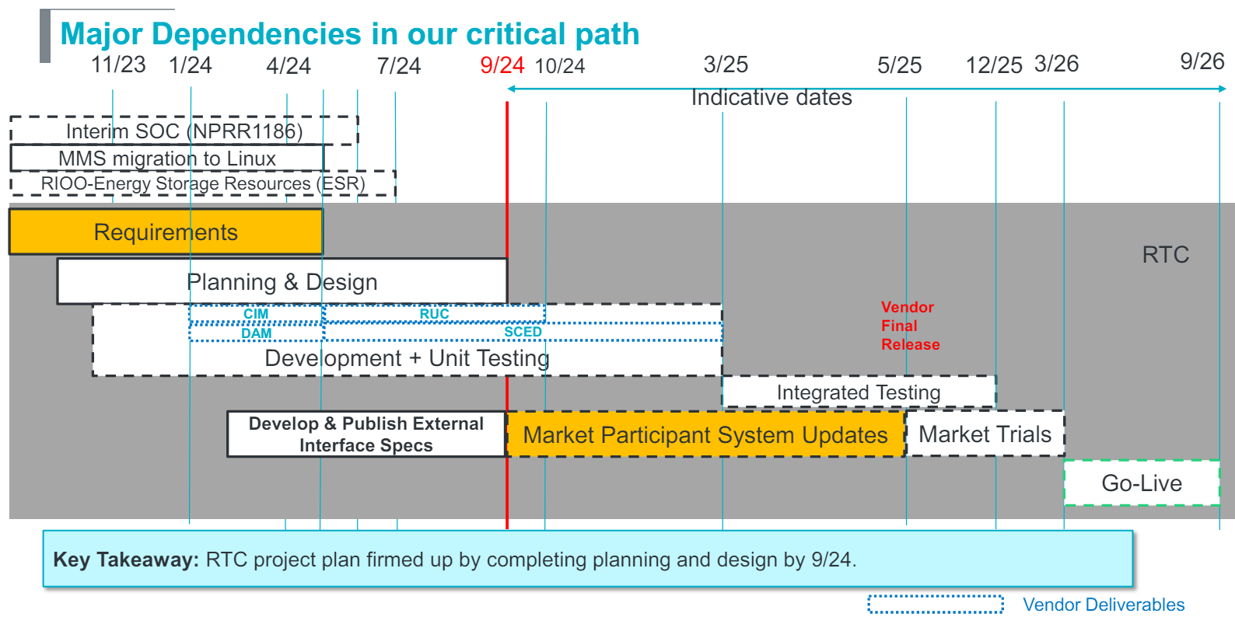
RTC+B Program Update
(excerpt from April Board T&S RTC Update)

Slide 9
Sequence and Potential Dates for Market Trials
(dates subject to change while in Planning phase)
May 2025
June 2025
July 2025
Aug 2025
Sep 2025
Oct 2025
Nov 2025
Dec 2025
QSE Attestation
9 months before Trials
Each activity will have a public-facing Scorecard and exit Criteria
3-4 months
2 months
1 month
DRAFT
RTC QSE Submission Testing
(Submit COP, RT AS Offers,
DAM Virtual AS, Outages for ESRs)
Open-loop RTC SCED
(QSE offers, SCED non-binding award/dispatch)
Closed-loop SCED/LFC
(QSE RTC offers and telemetry to support closed-loop frequency control test 2-3 tests of 2-4 hour durations)
Transition to Go-Live
Upon completion of testing, confirmation of ERCOT and market readiness for Go-Live.
RTC QSE Telemetry Check-out (QSEs add/verify new telemetry points for UDSP, New ramp rates, ESR telemetry)
QSE Telemetry Tests
(Individual QSE to follow UDSP and support new ramp rate and ESR telemetry)
Day-Ahead Market
(Non-binding DAM using QSE offers for at least 2 tests)
Current draft of the earliest possible dates for Market Trials and Go-Live that have been shared through TWG and the RTC+B Workshops, in support of Market Participants readiness at RTCBTF.
Actual Market Trials and Go-Live milestones are to be determined and will be communicated no later than 9/30/24.
1-2 months
Updated 2024-05-22

Slide 10
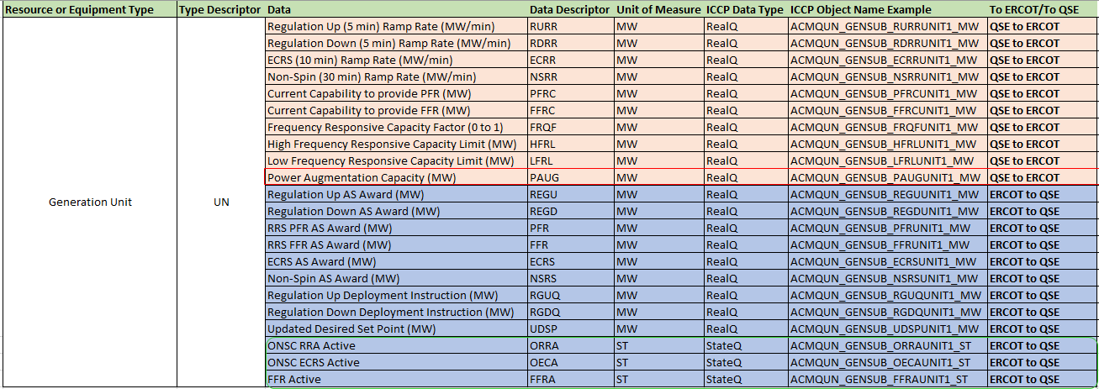
RTC+B ICCP Telemetry Points
Correction to Power Augmentation Capacity Telemetry Point
  It is Power Augmentation Capacity MW, not a status flag
Added 3 additional outbound (ERCOT to QSE) telemetry points at resource level. These are status flags.
  ONSC RRA Active
  ONSC ECRS Active
  FFR Active

Slide 11
RTC+B ICCP Telemetry Points Description
RTC+B ICCP Telemetry Points Description – Slides 12-16

Slide 12
Resource Ancillary Service Telemetry from QSE
The following new telemetry to be submitted by QSEs to inform ERCOT of the current physical capability of a qualified resources to provide
Ancillary Services. The telemetry points will be used as additional limits on Ancillary service awards below what could be awarded given
the Resource’s other constraints such as HSL, HDL, LDL and LSL.
Product or Sub-product | Unit | Description | References
Regulation Up Ramp Rate | MW/Minute | 5-Minute blended ramp rate that reflects the current physical capability of the qualified resource to provide Regulation Up. In addition to the Resource Limits and Regulation Up qualified MW, limits amount of Regulation Up that SCED can award to the Resource. | 1. RTC Key Principle 1.4 https://www.ercot.com/mktrules/puctDirectives/kp1p4 2. RTCBTF refresher, as presented in RTCBTF on 9/7/2023 https://www.ercot.com/files/docs/2023/09/01/2_refresher-on-real-time-co-optimization-key-principles-rtcbtf-090823_v2.pptx 3. NPRR1010 6.5.5.2 (2) (q) 4. NPRR1010 6.5.5.2 (5) (m)
Regulation Down Ramp Rate | MW/Minute | 5-minute blended ramp rate that reflects the current physical capability of the qualified resource to provide Regulation Down. In addition to the Resource Limits and Regulation Down qualified MW, limits the amount of Regulation Down that SCED can award to the Resource.
ECRS Ramp Rate | MW/Minute | 10-minute blended ramp rate that reflects the current physical capability of the qualified resource to provide ECRS. In addition to Resource limits and ECRS qualified MW, limits the amount of ECRS that SCED can award to the Resource. This value will be the ten-min output change capability of the Resource divided by 10. For NCLRs, the ECRS capability telemetry includes the self-provided MWs.
Non-Spin Ramp Rate | MW/Minute | 30-minute blended ramp rate that reflects the current physical capability of the qualified resource to provide Non-Spin. In addition to Resource limits and Non-Spin Qualified MW, limits the amount of Non-Spin that SCED can award the Resource. This value will be the 30-minute output change capability of the Resource divided by 30.

Slide 13
Resource Ancillary Service Telemetry from QSE
Product or Sub-product | Unit | Description | References
Current Capability to Provide RRS-PFR | MW | Reflects the current capability of the qualified resource to provide RRS from PFR via Governor response. In addition to Resource Limits and qualification, limits the amount of RRS-PFR that SCED can award to the Resource. | 1. RTC Key Principle 1.4 https://www.ercot.com/mktrules/puctDirectives/kp1p4 2. RTCBTF refresher, as presented in RTCBTF on 9/7/2023 https://www.ercot.com/files/docs/2023/09/01/2_refresher-on-real-time-co-optimization-key-principles-rtcbtf-090823_v2.pptx 3. NPRR1010 6.5.5.2 (2) (p) 4. NPRR1010 6.5.5.2 (5) (l)
Current Capability to Provide RRS-FFR | MW | Reflects the current capability of the qualified resource to provide Fast Frequency Response. In addition to the Resource limits and Qualified MW, limits the amount of RRS-FFR that SCED can award to the Resource. For NCLRs, the RRS-FFR capability telemetry includes the self-provided MWs.
Current Capability to Provide RRS-UFR | MW | Reflects the current capability of the qualified resource to provide RRS via UFR. In addition to Resource Limits and Qualified MW, limits the amount of RRS-UFR that SCED can award to the Resource. For NCLRs, the RRS-UFR capability telemetry includes the self-provided MWs.

Slide 14
Resource Ancillary Service Telemetry from QSE
Non-Controllable Load Resources that have UFR relay armed shall submit self-provision MW quantities based on Day-Ahead Market (DAM)
awards, self-arranged and AS trades submitted by end of the adjustment period.
Product or Sub-product | Unit | Description | References
Self-Provided RRS-UFR | MW | Self-provided RRS-UFR for Non-Controllable Load Resources that have UFR relay armed, limited by the DAM Awards, self-arranged and AS trades. | 1. RTC Key Principle 1.3 https://www.ercot.com/mktrules/puctDirectives/kp1p3 2. RTCBTF refresher, as presented in RTCBTF on 9/7/2023 https://www.ercot.com/files/docs/2023/09/01/2_refresher-on-real-time-co-optimization-key-principles-rtcbtf-090823_v2.pptx 3. NPRR1010 6.4.9.1.1 (3) 4. NPRR1010 6.5.5.2 (5) (f)
Self-Provided RRS-FFR | MW | Self-provided RRS-FFR for Non-Controllable Load Resources that have UFR relay armed, limited by the DAM Awards, self-arranged and AS trades.
Self Provided ECRS | MW | Self-provided RRS-UFR for Non-Controllable Load Resources that have UFR relay armed, limited by the DAM Awards, self-arranged and AS trades.

Slide 15
Resources with Inactive Power Augmentation Capacity
The following telemetry is for Generation Resources that have Power Augmentation Capacity that is not active yet, that capacity is not
frequency responsive and not eligible for frequency responsive Ancillary Service Awards.
Telemetry | Unit | Description | References
Inactive Power Augmentation Capacity | MW | Power Augmentation capacity that is not On-Line for Resources that have power augmentation capacity included in HSL. This is used in SCED to determine the portion of the Non-Spin award that will be provided by power augmentation capacity that is not active and deployed as offline Non-Spin. | 1. RTC Key Principle 1.3 https://www.ercot.com/mktrules/puctDirectives/kp1p3 2. RTCBTF refresher, as presented in RTCBTF on 9/7/2023 https://www.ercot.com/files/docs/2023/09/01/2_refresher-on-real-time-co-optimization-key-principles-rtcbtf-090823_v2.pptx 3. NPRR1010 6.5.5.2(2) (j)&(o)
High Frequency Responsive Capacity Limit | MW | High limit of the Resource’s capacity that is frequency responsive, used in SCED to ensure Regulation Up, Regulation Down and RRS-PFR awards are awarded on frequency responsive capacity.
Low Frequency Responsive Capacity Limit | MW | Low limit of the Resource’s capacity that is frequency responsive, used in SCED to ensure Regulation Up, Regulation Down and RRS-PFR awards are awarded on frequency responsive capacity.
Frequency Responsive Capacity Factor |  | Maximum amount of total Base Point provided by the frequency responsive capacity of the resource, used in SCED to ensure Regulation Up, Regulation Down and RRS-PFR awards are awarded on frequency responsive capacity.

Slide 16
Resource level telemetry from ERCOT to QSEs
Telemetry | Unit | Description
Regulation Up Award | MW | Regulation Up award from each SCED execution. | 1. RTC Key Principle 1.3 https://www.ercot.com/mktrules/puctDirectives/kp1p3 2. RTC Key Principle 1.5 https://www.ercot.com/mktrules/puctDirectives/kp1p5 3. RTCBTF refresher, as presented in RTCBTF on 9/7/2023 https://www.ercot.com/files/docs/2023/09/01/2_refresher-on-real-time-co-optimization-key-principles-rtcbtf-090823_v2.pptx 4. NPRR1010 6.5.7.4.1 5. NPRR1010 6.5.7.6.2.1 (8) (9) & (10)
Regulation Down Award | MW | Regulation Down award from each SCED execution.
RRS-PFR Award | MW | RRS-PFR award from each SCED execution.
RRS-FFR Award | MW | RRS-FFR award from each SCED execution.
RRS-UFR Award | MW | RRS-UFR award from each SCED execution.
ECRS Award | MW | ECRS award from each SCED execution.
Non-Spin Award | MW | Non-Spin award from each SCED execution.
UDSP | MW | UDSP = Base Ramp + Regulation Instruction; Base Ramp will be a 4-min ramp to the new Base Point, starting MW of the Base Ramp is expected MW output of the resource using previous Base Point and last Resource specific Regulation Instruction from LFC. Ending MW of the Base Ramp is the new Base Point.
Regulation Up Instruction | MW | The calculated system level Regulation Up requirement will be allocated to each resource proportionate to their Regulation Up awards and Resource limits. This telemetry is information only, Resource level Regulation Up Instruction is included in UDSP.
Regulation Down Instruction | MW | The calculated system level Regulation Down requirement will be allocated to each resource proportionate to their Regulation Down awards and Resource limits. This telemetry is information only, Resource level Regulation Down Instruction is included in UDSP.

Slide 17
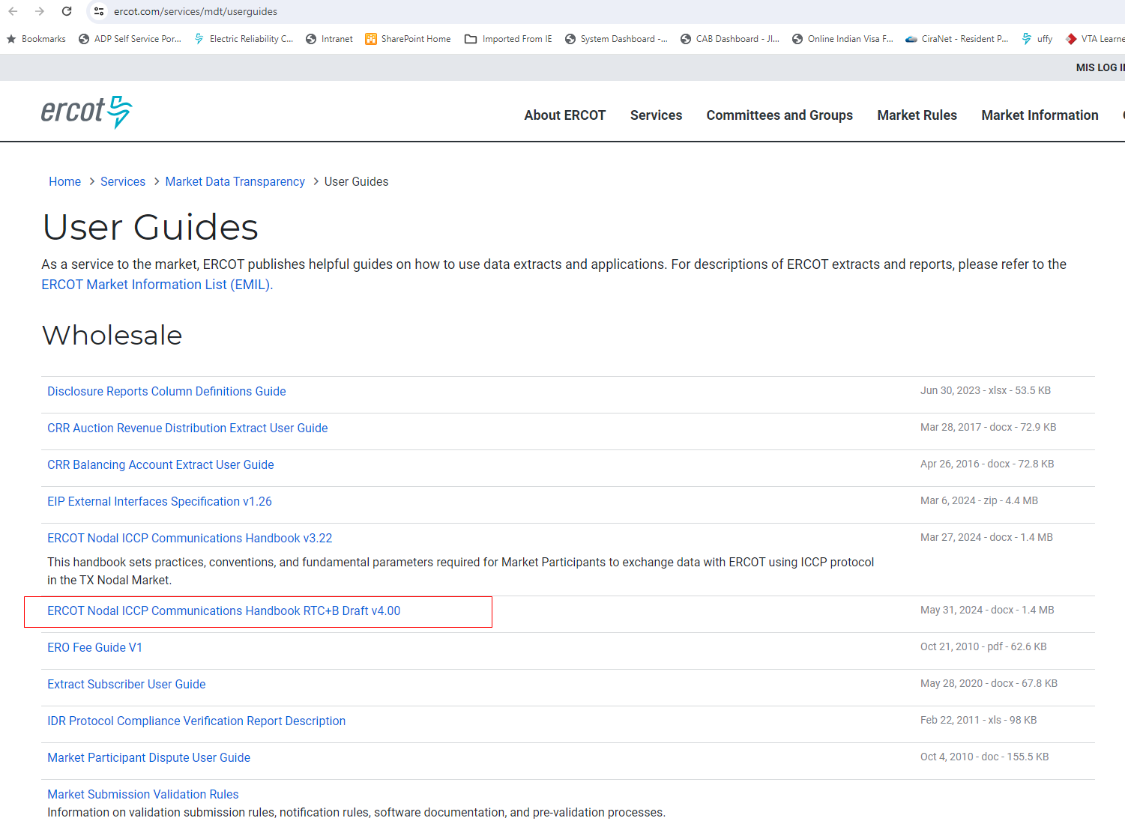
RTC+B ICCP Handbook Updates
ICCP Handbook draft version with RTC+B ICCP Telemetry points modeling was published to ERCOT website (https://www.ercot.com/services/mdt/userguides) on 05/31/2024

Slide 18
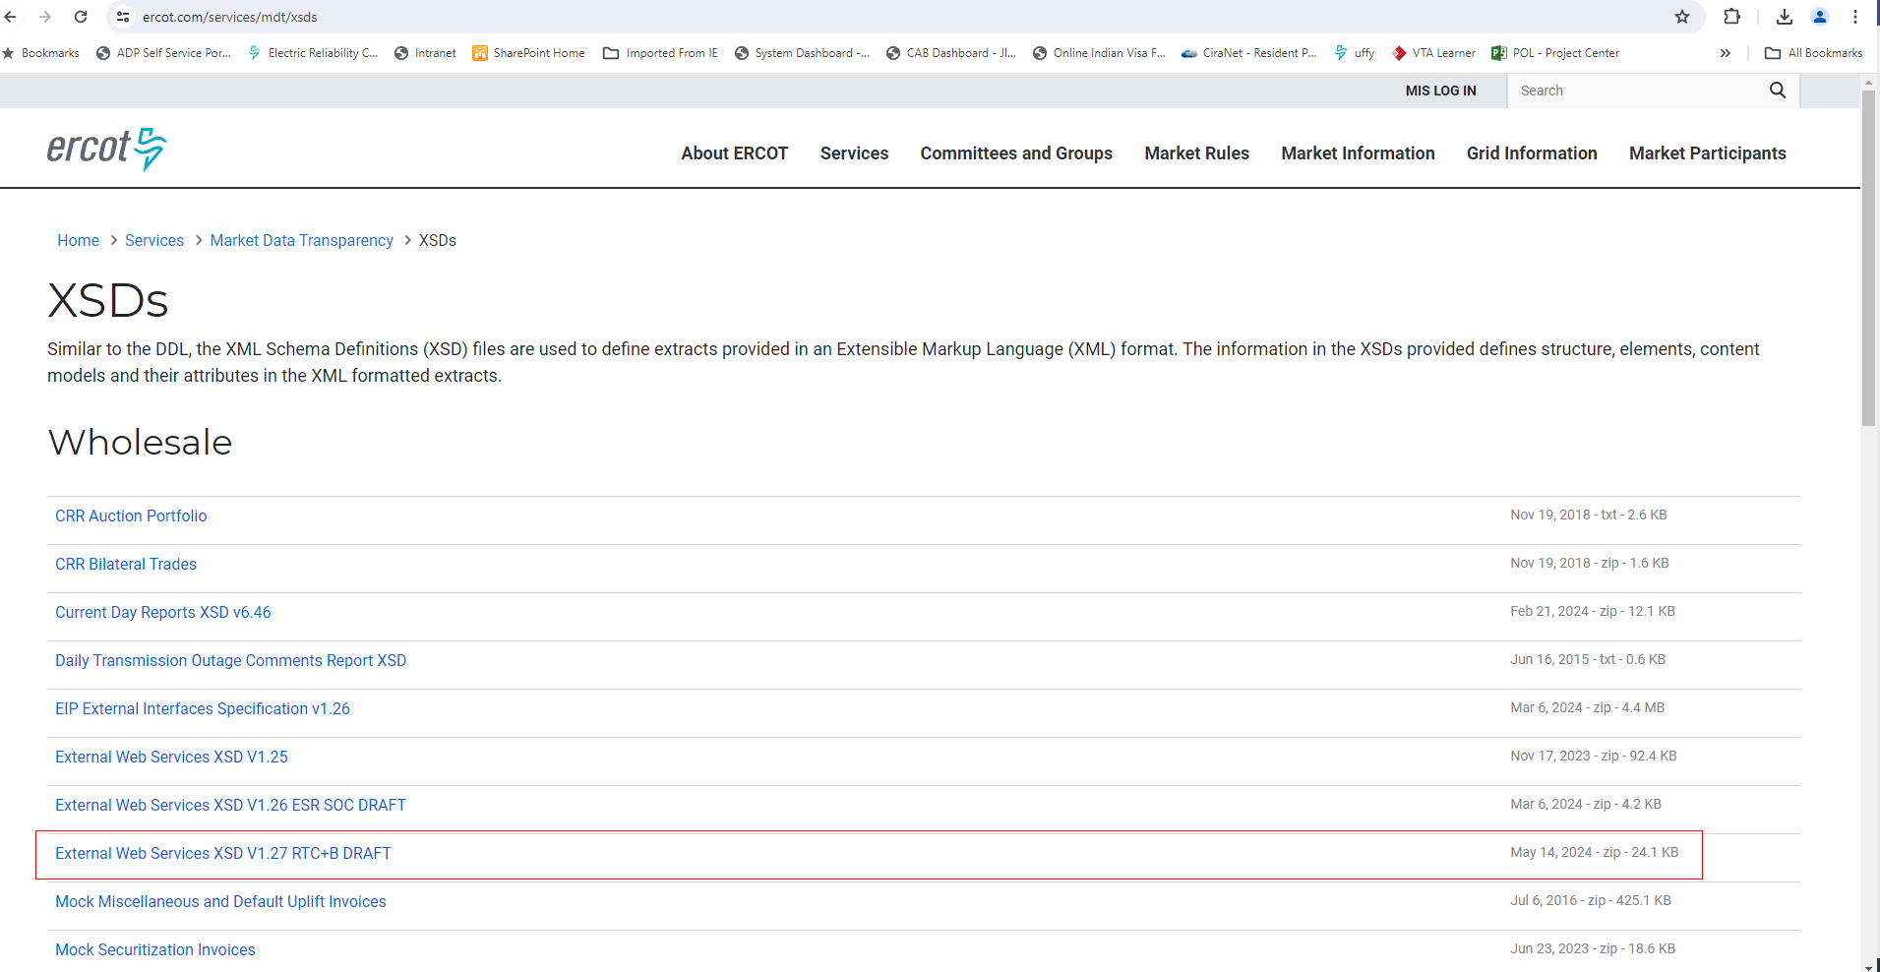
RTC+B Market External Interfaces XSD changes
RTC+B XSD changes (along with Example XML Payloads) draft version (high lighted in below screenshot) was published to ercot website at https://www.ercot.com/services/mdt/xsds on 05/14/2024.
These XSD changes include Only RTC+B Market Submissions, Reports related to Awards, Outage submissions along with examples.

Slide 19
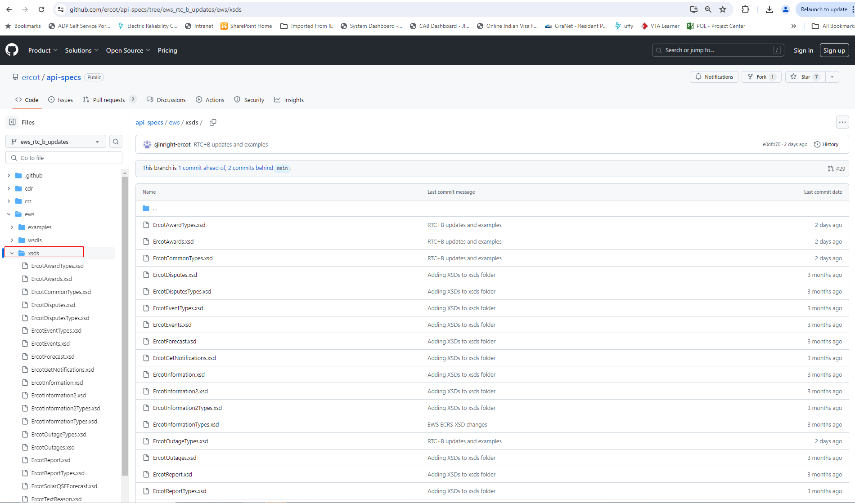
RTC+B Market External Interfaces XSD changes
RTC+B XSD changes draft version was also posted on 05/14/2024 to ERCOT developer portal (https://developer.ercot.com). It is accessible to public users.
  Below is the direct link to developer portal github where you can see the RTC+B XSD changes.
    https://github.com/ercot/api-specs/tree/ews_rtc_b_updates/ews
  Below is the screen of ercot developer portal Github RTC+B XSD changes

Slide 20
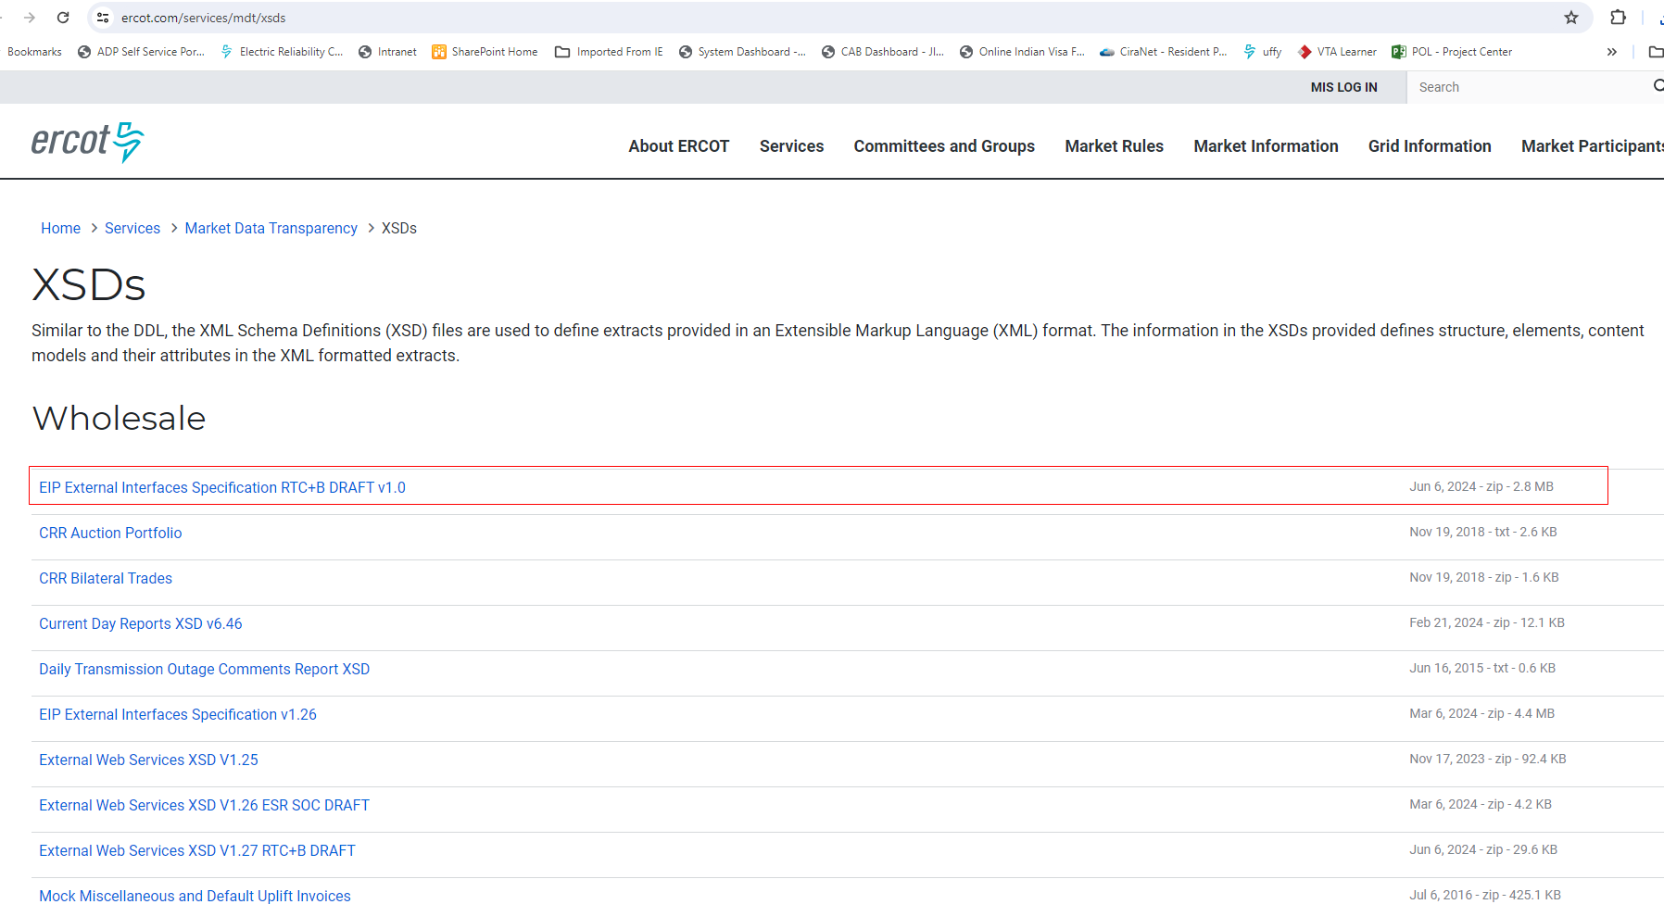
RTC+B – EIP External Interfaces Specifications Document
EIP External Interfaces Specifications document draft version with RTC+B updates is now published to ERCOT website. (https://www.ercot.com/services/mdt/xsds)

Slide 21
RTC+B Technical Workshop
  10 Minutes Break

Slide 22
RTC+B Market Trials
RTC+B Market Trials
  QSE Telemetry Testing/Check-out
    Individual QSEs testing of new telemetry points (ramp rates, UDSP etc.)
  QSE Market Submissions Testing using API and Market Manager UI
    QSE will test their market submissions for defined transaction (COP, RT AS Offers, DAM Virtual AS Offers, etc.)
  QSE Outage Scheduler submissions Testing using API and Outage Scheduler UI
  Open Loop Testing
    RTC SCED execution based on QSE Offers etc.
    RTC SCED non-binding award/dispatch
    DAM execution – QSE bids/offers, non-binding
  Closed Loop Testing
    RTC SCED execution based on QSE Offers etc.
    RTC SCED binding award/dispatch
    2-3 instances of closed loop testing with 2-4 hours duration

Slide 23
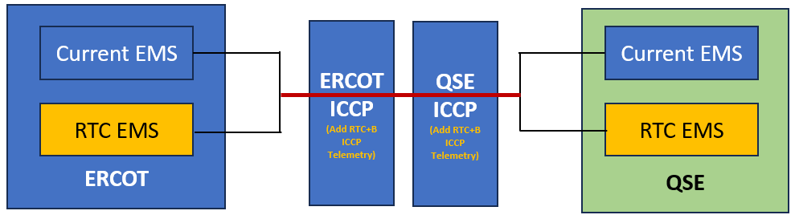
QSE ICCP Telemetry Configuration for Market Trials and Go-Live
QSE ICCP system configuration
  Add RTC+B telemetry points to current production ICCP system
    Setup and test on Test ICCP system as applicable
    Add new RTC+B telemetry points to current production ERCOT & QSE ICCP systems.
    Maintain the new RTC+B telemetry points through weekly model loads for existing & new resources and QSEs.
    Market Trials and Go live will be with current Production ICCP systems.
    RTC+B EMS Applications (SE, RTCA, LFC, RLC etc.) will use RTC+B single model ESR CIM.
ERCOT is standing up new parallel RTC EMS system.
Need for QSEs to stand up new RTC EMS system depends on their current EMS system architecture.
  QSEs should have capability to support parallel operations.

Slide 24
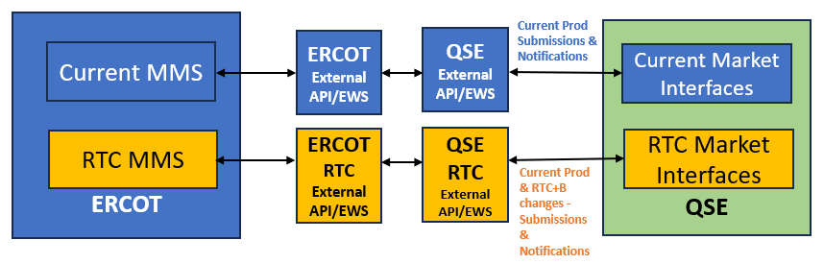
RTC+B Market External Interfaces Systems Configuration
ERCOT and QSEs to stand up new parallel External API/EWS Systems for RTC+B Project.
  Deploy RTC+B code and test the market and OS submissions
  Market Trials including Closed Loop Testing will be performed using new parallel EWS Systems
    Dual Entry into current production and RTC+B during market trials
  Maintain and support this new parallel systems until go live
  Go live on new parallel EWS Systems
  QSEs may choose to make modifications to existing system instead of standing up new system to support dual entry of market submissions.
QSEs to submit RTC+B market and OS submissions as well as current production submissions not changed by RTC+B project
  No change to WSDL files and API communication
  Change is only in XSDs and XML inside Payload

Slide 25
RTC+B Market External Interfaces Systems Configuration
New RTC+B External API EWS end point will be provided for QSEs.
QSEs will have to setup and provide new RTC+B notification listener end point URL to ERCOT.
QSEs can use current Production digital certs for RTC+B project External API.
ERCOT will provide new Market Manager UI and Outage Scheduler UI URLs to QSEs for Market Trials and Go Live.
  QSEs can use current production digital certs to launch RTC+B Market Manager UI and Outage Scheduler UI

Slide 26
Market Trials – Market Submissions Dual Entry
Submission Type | Submission | RTC XSD Change? | RTC Validation Change? | Dual entry to Current Production and Market Trials? | Comments
Resource Specific | COP | Y | Y | Y | • Modified list of Resource Status' • AS Responsibility replaced by AS Capability • HSL, LSL, HEL, LEL can be negative for ESR
 | Three-Part Offer (including ESR offer/bid curve) | N | Y | Y | Allow negative MW for ESRs
 | AS Offer | N | Y | Y | Allow AS offer submission in RTM
 | Output Schedule | N | Y | Y | Allow negative MW for ESRs
 | Availability Plan | N | N | N
 | RTM Energy Bid | N | N | Y | Required for Non-ESR CLRs to run RTC SCED
 | Exceptional Fuel Cost | N | N | N
Trades | Capacity Trade | N | N | N
 | Energy Trade | N | N | N
 | AS Trade | N | N | N

Slide 27
Market Trials – Market Submissions Dual Entry
Submission Type | Submission | RTC XSD Change? | RTC Validation Change? | Dual entry to Prod and Market Trials? | Comments
Bids and Offers | DAM Energy-Only Offer | N | N | N
 | DAM Energy Bid | N | N | N
 | PTP Obligation bid | N | N | N
 | PTP Obligation with Links to Option | N | N | N
 | DAM AS-Only Offer | Y | Y | Y | New offer type for DAM AS Types - REGUP, REGDN, RRSPF, ECRSS, NSPIN
Schedules | Self-Schedule | N | N | N
Self-AS | AS Self-Arrangement | N | Y | N | Self-AS cannot exceed advisory AS obligation

Slide 28
Market Trials – Market Submissions Dual Entry
Submission Type | Submission | RTC XSD Change? | RTC Validation Change? | Dual entry to Prod and Market Trials? | Comments
Resource Parameters | Resource Parameters | Y | Y | N | ESR Parameters added under Generation Resource Parameters submission: • Max Nameplate SOC • Min Nameplate SOC • Round Trip Efficiency • Normal Ramp Rate • Emergency Ramp Rate
Outage Scheduler | Outages | Y | Y | N | Added ESR enumeration under ResourceType. Equipment Type ESR can have a negative LSL/HSL.
Market Submissions Dual Entry Duration
  Still under discussions, timelines not finalized yet.
  QSEs should have capability to support dual entry of market submissions for certain time during Market Trials.

Slide 29
Single Model ESR Registration
RE to submit Single Model ESR registration data into RIOO after RIOO ESR project go live
  Current planned go live date is end of July.
We are NOT requesting REs to re-register existing ESRs in RIOO
  The transition to Single Model ESR registration will occur in two stages:
    Late July – Go Live release will enable new ESR interconnection requests to be made with a single submission
    Late September - A database transformation will be executed on in-flight interconnection requests and existing ESRs to transition to the new single model format
  REs may need to provide us single model specific ESR registration data for existing ESRs.
  More details on the Single Model ESR registration data migration will be shared through TWG meeting and Training sessions as part of RIOO-ESR Project go live readiness.
Model conversion tool will be developed to generate combo model from RIOO single model registration data until RTC+B project go live.

Slide 30

Q&A Session

Slide 31
Next Steps
Request QSEs/Vendors to review RTC+B ICCP Handbook, Market External Interfaces XSD and EIP External Specification document changes and provide feedback by 06/19/2024.
ERCOT will finalize and publish final versions of these artifacts by 06/21/2024.
Next RTC+B Technical Workshop is on Current Day Reports (CDR) External Specifications and XSD changes. ERCOT will notify RTC+B Technical Workshops participants when it is scheduled.
RTC+B Project updates and future technical workshop details will be provided through RTCBTF and TWG forums.
For any questions and feedback, contact me at Sreenivas.Badri@ercot.com

Slide 32
RTC+B Technical Workshops
Thank You!!!

