Slide 1
NPRR1234 and PGRR115 – Overview and Key Concepts
Agee Springer
Sr. Manager, Grid Interconnections
LFLTF
June 3, 2024

Slide 2
Agenda
Overview of Significant Changes in NPRR1234 and New Modeling Requirements
Overview of Significant Changes in PGRR115
Appendix – Summary of NPRR1234 and PGRR115 by Section

Slide 3
NPRR1234
New Concepts and
Significant Changes from NPRR1191

Slide 4
NPRR1234 – New Concepts & Significant Changes from NPRR1191
This NPRR implements the changed approach announced at the April 1 LFLTF. The following concepts from NPRR1191 do not appear in NPRR1234
Registered Curtailable Loads (RCLs)
Ramping limitations on Large Loads
Voltage Ride Through (VRT) requirements for Large Loads
ERCOT remains concerned about the ramping and VRT issues and will explore other solutions such as procurement of additional AS and other system improvements.
Language in Section 16 requiring the registration of a load 25 MW or greater with ERCOT has been removed and replaced with a new requirement in Section 3.10.7.2 requiring identification and classification of loads 25 MW or greater in the Network Operations Model.

Slide 5
Modeling of Loads 25 MW or Greater – Additional Details
TSPs will need to identify a load point or collection of load points serving a site with a historical, requested, or expected peak Demand 25 MW or greater in the ERCOT Network Operations Model.
RE will need to identify a load point or collection of load points serving a behind the meter load (excluding aux load) with a historical, requested, or expected peak Demand 25 MW or greater in the Resource Registration Data.
Load points serving sites 25-75 MW may include additional customers <25 MW.
For each load point identified, the TSP/RE must also provide the primary end-use activity from a list of broad categories.
The goal of these requirements is to allow ERCOT to improve its load forecasts and to provide real-time visibility to system operators.

Slide 6
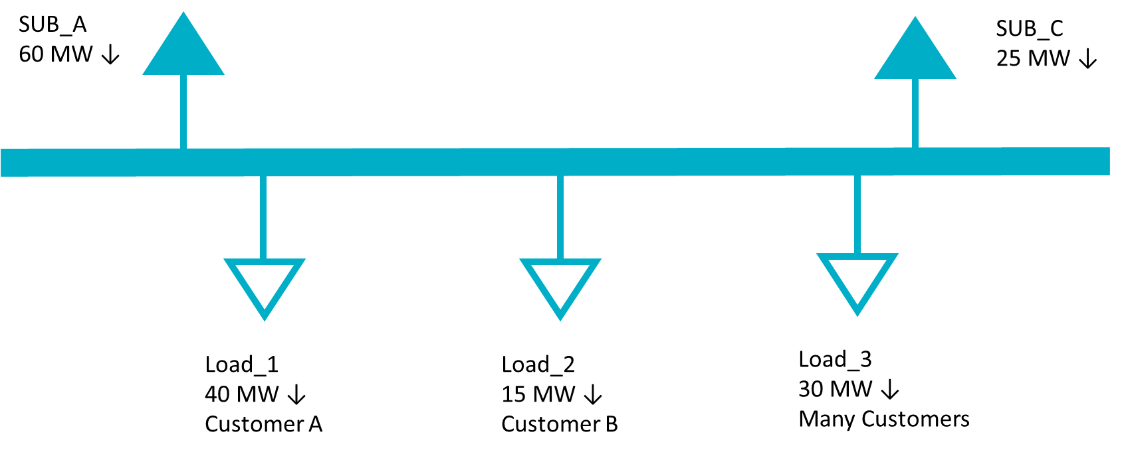
Modeling of Loads 25 MW or Greater – Conceptual Examples
Example 1
A single customer and/or site with a historical peak Demand of 25 MW or larger served from a single load point in the Network Operations Model.
In the example below, a substation serves 85 MW of customer load. Load_1 serves a single facility with a peak Demand of 40 MW and does not include any other customer load. Load_2 represents a single, smaller customer and Load_3 includes many customers across multiple sites, none of whom are 25 MW or greater individually.
TSP Actions
Identify Load_1 as a 25 MW or greater facility in the ERCOT Network Operations Model
Identify the primary end use category of Load_1 from a pre-defined list.
Load_2 does not need to be identified since it is less than 25 MW.
Load_3 does not need to be identified because it is composed of many customers and facilities.

Slide 7
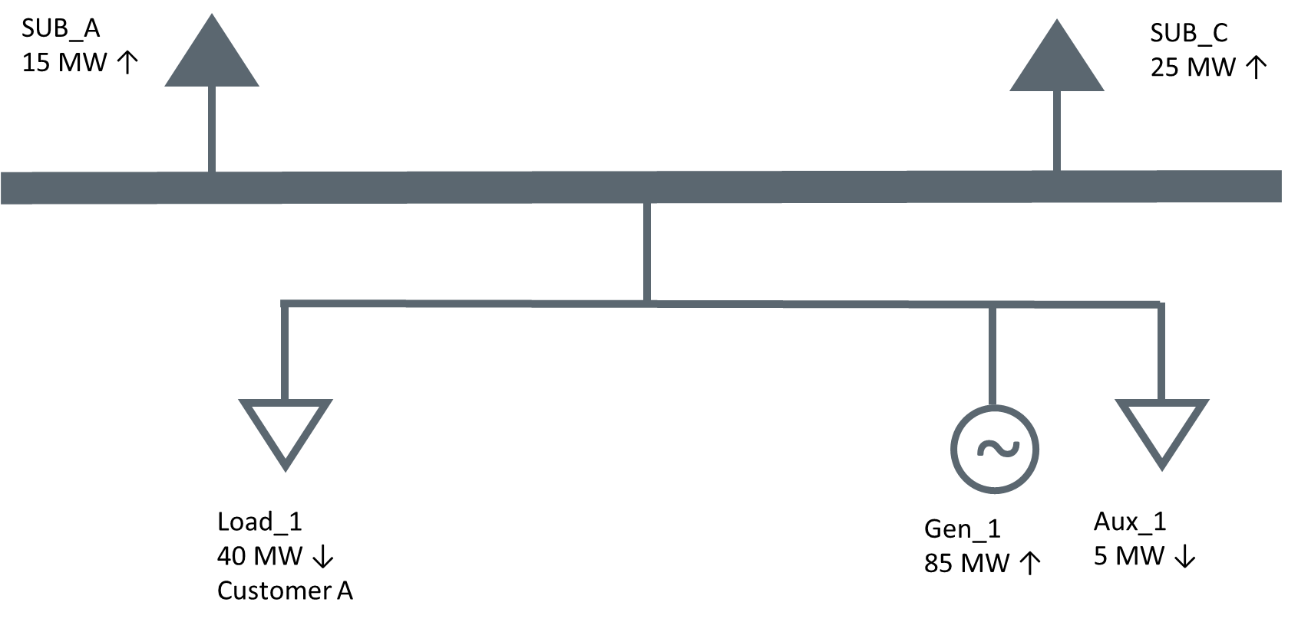
Modeling of Loads 25 MW or Greater – Conceptual Examples
Example 2
A single customer and/or site with a historical peak Demand of 25 MW or larger located with a Generation Resource served from a single load point in the Network Operations Model.
In this example, the same Load_1 from the previous example is served behind the meter of a Generation Resource. The generator also has 5 MW of Aux load.
RE Actions
Identify Load_1 as associated with a 25 MW or greater facility in its Resource Registration Data.
Identify the primary end use category of Load_1 from a pre-defined list.
The Aux load should not be identified as a 25 MW or greater facility.

Slide 8
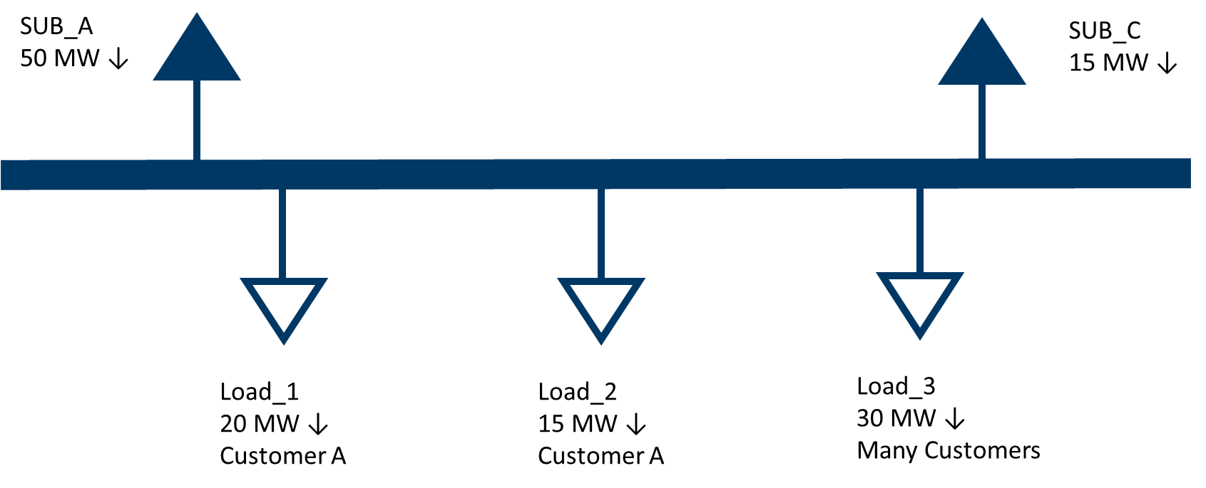
Modeling of Loads 25 MW or Greater – Conceptual Examples
Example 3
A single customer and/or site with a historical peak Demand of 25 MW or larger served from a multiple load points in the Network Operations Model.
In the example below, a substation serves 65 MW of customer load. Load_1 and Load_2 correspond to a single site with a peak Demand of 35 MW. Load_3 includes many customers across a multiple sites, none of whom are 25 MW or greater individually.
TSP Actions
Identify Load_1 AND Load_2 as associated with a 25 MW or greater site in the ERCOT Network Operations Model. Even though neither point individually exceeds 25 MW, both should be included because the correspond to a single site.
Identify the primary end use category of Load_1 and Load_2 from a pre-defined list.
Load_3 does not need to be identified because it is composed of many customers and sites.

Slide 9
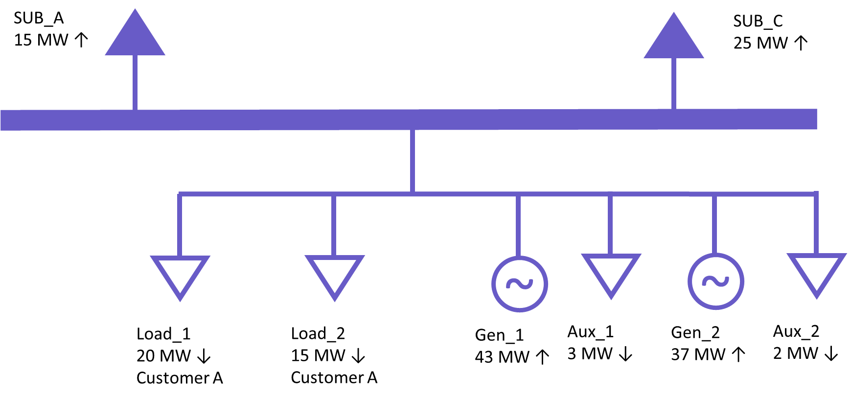
Modeling of Loads 25 MW or Greater – Conceptual Examples
Example 4
A single customer and/or site with a historical peak Demand of 25 MW or larger located with a Generation Resource served from multiple load points in the Network Operations Model.
In this example, the same Load_1 and Load_2 from the previous example are served behind the meter of a Generation Resource. The generator also has 5 MW of Aux load.
RE Actions
Identify Load_1 AND Load_2 as associated with a 25 MW or greater facility in the Resource Registration data. Even though neither point individually exceeds 25 MW, both should be included because the total load, excluding aux load, behind the POI exceeds 25 MW.
Identify the primary end use category of Load_1 and Load_2 from a pre-defined list.
The Aux loads should not be identified as part of a 25 MW or greater facility.

Slide 10
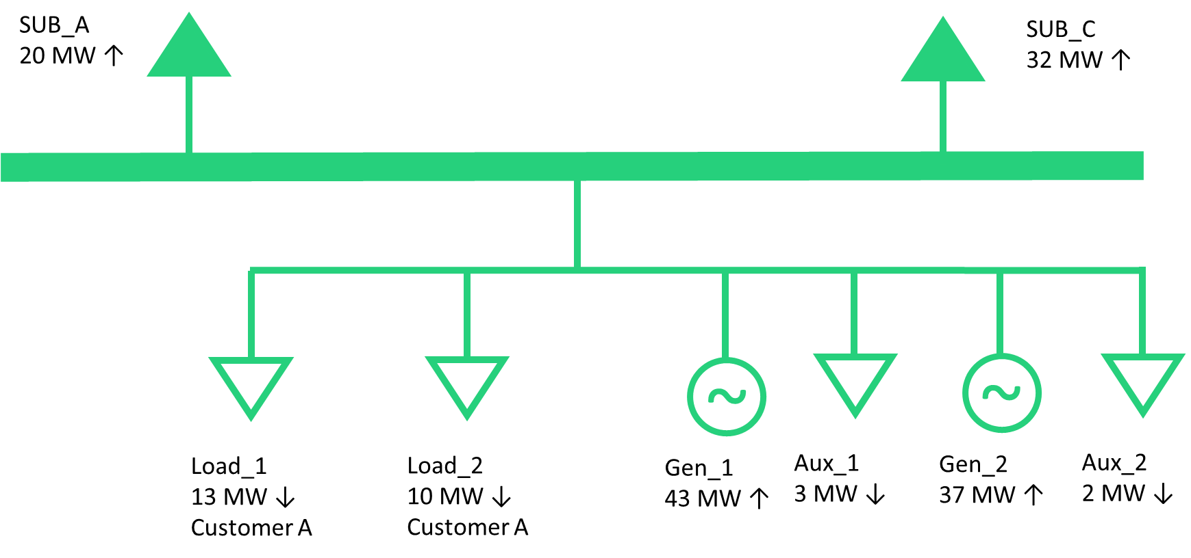
Modeling of Loads 25 MW or Greater – Conceptual Examples
Example 5
A single customer and/or site with a historical peak Demand of 22 MW located with a Generation Resource served from multiple load points in the Network Operations Model.
In this example, the same Load_1 and Load_2 from the previous example are served behind the meter of a Generation Resource. The total peak Demand of these two load points is 22 MW. The generator also has 5 MW of Aux load.
RE Actions
No loads need to be identified as associated with a 25 MW or greater facility in the Resource Registration data. Even though the total load behind the POI exceeds 25 MW, the non-aux load peak Demand is less than 25 MW.

Slide 11
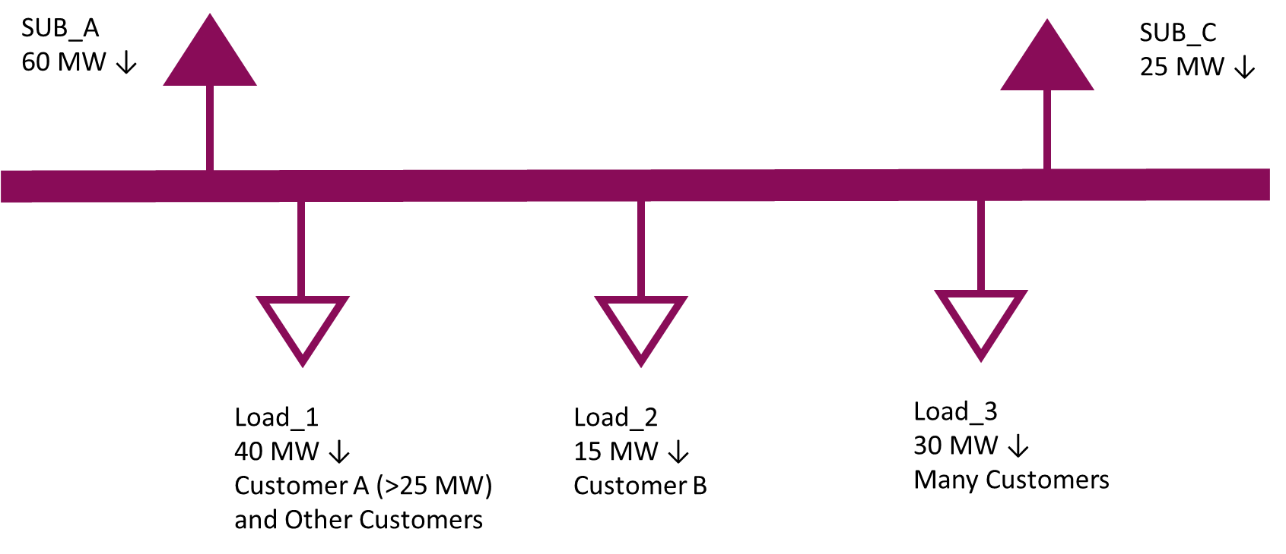
Modeling of Loads 25 MW or Greater – Conceptual Examples
Example 6
A single customer and/or site with a historical peak Demand of 25 MW or larger served from a single load point in the Network Operations Model that includes other customers.
In the example below, a substation serves 85 MW of customer load. Load_1 serves a site with a peak Demand greater than 25 MW and other, smaller customers. Load_2 represents a single, smaller customer and Load_3 includes many customers across multiple sites, none of whom are 25 MW or greater individually.
TSP Actions
Identify Load_1 as associated with a 25 MW or greater facility in the ERCOT Network Operations Model.
Identify the primary end use category of the largest customer behind Load_1 from a pre-defined list.
Load_2 does not need to be identified since it is less than 25 MW.
Load_3 does not need to be identified because it is composed of many customers and facilities.

Slide 12
Loads 25 MW or Greater - Draft End Use Classifications
Oil and Gas Production, Processing, and Transmission
Oil and Chemical Refining
Steel Manufacturing
Cryptocurrency Mining
Data Center (non-Cryptocurrency)
Hydrogen and Electrofuel Production
Other Industrial

Slide 13
PGRR115
New Concepts and
Significant Changes from PGRR111

Slide 14
PGRR115 – New Concepts & Significant Changes from PGRR111
The Large Load Interconnection Study (LLIS) process now applies to all Large Load interconnection requests, regardless of timeline.
All LLIS interactions will be between ERCOT and the interconnecting TSP (and IE/RE, if applicable).
The Interconnecting Large Load Entity (ILLE) is still required to pay a LLIS fee to ERCOT. There is an option for the TSP to pay this fee on the customer’s behalf.
All interconnection requests subject to the LLIS must be studied in the Quarterly Stability Assessment (QSA) prior to energization.

Slide 15
PGRR115 – LLIS Process Flow – High-Level Overview
TSP Requests LLIS
Kick-off Meeting Held
TSP Performs Studies
ERCOT Determines Reliability Limit(s)
Approved to Energize
TSP/RE Requests Approval to Energize
Large Load Added to Network Ops Model
Large Load Studied in QSA
Evidence of IA Provided to ERCOT

Slide 16
PGRR115 – New Concepts & Significant Changes from PGRR111
Removed all requirements limiting when a Large Load can be added to SSWG cases. There are still requirements that must be met prior to adding a Large Load to the Network Operations Model.
All provisions allowing for a load intending to register as a Controllable Load Resource (CLR) to potentially interconnect additional MWs have been removed.
This concept may be reintroduced in a future PGRR after approval of NPRR1188 and PGRR115.
Clearer requirements for what project modifications may require LLIS restudy are established in a new section 9.2.3

Slide 17
Appendix
Summary of NPRR1234 and PGRR115 by Section

Slide 18
NPRR1234 – Changes to Section 2
Section 2.1 – Definitions
Interconnecting Large Load Entity (ILLE) – Any Entity that has submitted a request to interconnect a Large Load to the ERCOT system. Analagous to an Interconnecting Entity in the generation interconnection process
Large Load – One or more Facilities at a single site with an aggregate peak Demand greater than or equal to 75 MW behind one or more common Points of Interconnection (POIs) or Service Delivery Points
Large Load Interconnection Study (LLIS) – The set of interconnection studies done by the TSP for a Large Load connecting in 2 years or less
Other New or Modified Terms – Subsynchronous Ferroresonance (SSFR), Torque Amplification
Section 2.2 – Acronyms
Added acronyms for ILLE, LLIS, and SSFR

Slide 19
NPRR1234 – Changes to Section 3
Section 3.1.1 – Role of ERCOT
Updated “SSR” to “SSO”
Section 3.1.5.11 – Evaluation of Transmission Facilities Planned Outage or Maintenance Outage Requests
Updated “SSR” to “SSO”
Section 3.3.2 – Types of Work Requiring ERCOT Approval
Added subparagraph (e), Large Load Interconnections, to the list of modeling work that requires ERCOT approval

Slide 20
NPRR1234 – Changes to Section 3 (continued)
Section 3.10.7.2 – Modeling of Resources and Transmission Loads
Modified paragraph (7) to apply to Resource Entities and changed “Model Load” to “Load Point.”
Added new paragraphs (14), (15), and (16) to describe Transmission Service Providers’, Resource Entities’, or Interconnecting Entities’ responsibilities to identify in the Network Operations Model load points serving customer with peak Demand of 25 MW or greater.
Section 3.10.7.5 – Telemetry Requirements
Modified paragraph (4) to change “Model Load” to “Load Point.”
Section 3.10.7.5.1
Modified paragraph (4)(a) to change “Model Load” to “Load Point.”

Slide 21
NPRR1234 – Changes to Section 3 (continued)
Section 3.15 – Voltage Support
Modified paragraph (13) to specify that the addition of a 20 MW or greater Load to a Generation site constitutes a modification that requires a new reactive study.
Section 3.15.3 – Generation Resource Requirements Related to Voltage Support
Added paragraph (12), which requires a new reactive study if a Load 20 MW or more is added to a Generation site.

Slide 22
NPRR1234 – Changes to Section 3 (continued)
Section 3.22 – Subsynchronous Oscillation
Section heading changed to replace “Resonance” with “Oscillation.”
Section 3.22.1 – Subsynchronous Oscillation Vulnerability Assessment
Section heading changed to replace “Resonance” with “Oscillation.”
Changed “SSR” to “SSO” and “Subsynchronous Resonance” to “Subsynchronous Oscillation.”
Added paragraph (2) to require that the SSO vulnerability assessment includes the interactions between Generation Resources and series capacitors.
Section 3.22.1.1 – Existing Generation Resource Assessment
Changed “SSR” to “SSO” and “Subsynchronous Resonance” to “Subsynchronous Oscillation.”
Clarified screening criteria.
Section 3.22.1.2 – Generation Resource or Energy Storage Resource Interconnection Assessment
Changed “SSR” to “SSO” and “Subsynchronous Resonance” to “Subsynchronous Oscillation.”
Clarified screening criteria.

Slide 23
NPRR1234 – Changes to Section 3 (continued)
Section 3.22.1.3 – Transmission Project Assessment
Changed “SSR” to “SSO” and “Subsynchronous Resonance” to “Subsynchronous Oscillation.”
Clarified screening criteria.
In paragraph (2), added that existing Large Loads and Large Loads that have completed all planning studies must be including in an SSO vulnerability assessment for a new transmission project.
Added new paragraphs (7) and (8) to provide more details when and how mitigation should be addressed for SSO interactions between Large Loads and transmission projects.
(NEW) Section 3.22.1.4 – Large Load Interconnection Assessment
Added a new section to address SSO interactions on existing Facilities from the proposed interconnection of a new Large Load, including load modeling, mitigation, and countermeasures.

Slide 24
NPRR1234 – Changes to Section 3 (continued)
Section 3.22.1.5 – Annual SSO Review
Renumbered section after the addition of the new 3.22.1.4, Large Load Interconnection Assessment.
Changed “SSR” to “SSO” and “Subsynchronous Resonance” to “Subsynchronous Oscillation.”
Clarified screening criteria.
Added a new paragraph (1)(c) to detail the ongoing obligations of Large Loads in the annual SSO review.
Section 3.22.2 – Subsynchronous Oscillation Vulnerability Assessment Criteria
Changed “SSR” to “SSO” and “Subsynchronous Resonance” to “Subsynchronous Oscillation.”
Clarified screening criteria.

Slide 25
NPRR1234 – Changes to Section 3 (continued)
Section 3.22.3 – Subsynchronous Resonance Monitoring
Changed “SSR” to “SSO.”
Clarified screening criteria.
Added paragraph (2) to describe how Large Loads will be assessed for potential vulnerability to SSO.
Modified paragraph (4) to clarify which assessments apply to Generation Resources and those that apply to Large Loads.

Slide 26
NPRR1234 – Changes to Section 16 and ERCOT Fee Schedule
Section 16.5 – Registration of a Resource Entity
Changed “SSR” to “SSO.”
ERCOT Fee Schedule
Added a $14,000 Large Load Interconnection Study fee to the ERCOT Fee Schedule.

Slide 27
PGRR115 – Changes to Section 2
Section 2.1 – Definitions
Load Commissioning Plan – A schedule furnished by the interconnecting TSP for a Large Load detailing dates and peak Demand amounts from the Initial Energization date to the date peak consumption is reached

Slide 28
PGRR115 – Changes to Section 4
Section 4.1.1.1 – Planning Assumptions
Added paragraph (7), which requires the level of Demand for a Large Load included in a planning study to be consistent with the most current Load Commissioning Plan.
Section 4.1.1.2 – Planning Assumptions
Added subparagraph (1)(c), which establishes planning-study criteria for Large Loads.
Added additional contingency loss of a Large Load to renumbered subparagraphs (1)(d) - (1)(f).

Slide 29
PGRR115 – Changes to Section 5
(NEW) Section 5.2.10 – Required Interconnection Equipment
New language that bans hard taps for the interconnection of Generation Resources, Energy Storage Resources (ESRs), and Settlement Only Generators (SOGs) by requiring breakers and segmentation capability at the Point of Interconnection (POI).
This formalizes current practices in a binding document.
Section 5.3.5 – ERCOT Quarterly Stability Assessment
Added subparagraph (1)(b) and paragraph (5) to address Large Loads in the QSA.
Edits to paragraphs (2), (3), and (6) to align with the inclusion of Large Loads in the QSA.
Some non-substantive, structural edits related to FIS studies.

Slide 30
PGRR115 – Changes to Section 6
(NEW) Section 6.6 – Modeling of Large Loads
New section to address the inclusion of Large Loads in the Network Operations Model. Requires completion of planning studies, an interconnection agreement, inclusion and study in the QSA, and for co-located Large Loads, completion of applicable requirement in Section 6.9.
(NEW) Section 6.6.1 – Modeling of Large Loads Not Co-Located with a Generation Resource, Energy Storage Resource (ESR), or Settlement Only Generator (SOG)
(NEW) Section 6.6.2 – Modeling of Large Loads Co-Located with an Existing Generation Resource, Energy Storage Resource (ESR), or Settlement Only Generator (SOG)
(NEW) Section 6.6.3 – Modeling of Large Loads Co-Located with a Proposed Generation Resource, Energy Storage Resource (ESR), or Settlement Only Generator (SOG)

Slide 31
PGRR115 – (NEW) Section 9 – Large Load Additions
A new section of the Planning Guide defining the process and requirements for interconnecting a Large Load to the ERCOT system.
(NEW) Section 9.1 – Introduction
Paragraph (1) establishes general requirements for Large Load interconnections.
Paragraph (2) documents that ERCOT will post submission format for Large Load information on the ERCOT website.
Paragraph (3) documents that ERCOT will maintain a TSP-only email list to facilitate communication of confidential information

Slide 32
PGRR115 – (NEW) Section 9.2 – General Provisions
(NEW) Section 9.2.1 – Applicability of the Large Load Interconnection Study Process
Sets out the criteria to identify loads that must be reviewed through the Large Load Interconnection Study (LLIS) process.
The LLIS process is generally applicable to
New loads 75 MW or larger
Additions to existing loads of 75 MW or more
Load additions of 20 MW or more that make an existing load into a Large Load; or
Any Large Load that proposes to change its point of interconnection

Slide 33
PGRR115 – (NEW) Section 9.2 – General Provisions (continued)
(NEW) Section 9.2.2 – Submission of Large Load Project Information and Initiation of the Large Load Interconnection Study (LLIS)
Sets out information that must be submitted to ERCOT prior to the initiation of the LLIS.
Defines the interconnecting TSP as being responsible for submitting project information.
Requires payment of an interconnection study fee before the LLIS can be initiated.
(NEW) Section 9.2.3 – Modification of Large Load Project Information
Requires that ERCOT be notified of a material modification to the requested load.
Documents that some project modifications may require restudy.
Requires the interconnecting TSP to adhere to any reliability limits identified in any completed LLIS studies, even if the modified project is no longer required to complete the LLIS.

Slide 34
PGRR115 – (NEW) Section 9.2 – General Provisions (continued)
(NEW) Section 9.2.4 – Load Commissioning Plan
Requires the creation and maintenance of a Load Commissioning Plan until the full requested load amount is installed and able to take and receive service.
Requires that the Load Commissioning Plan shall be consistent with the results of completed LLIS studies and signed interconnection agreements.
(NEW) Section 9.2.5 – Required Interconnection Equipment
Requires remotely controlled load isolation equipment for Large Loads interconnected at transmission voltage.
This section is analogous, but not identical, to proposed Section 5.2.10 for generation interconnections.

Slide 35
(NEW) 9.3 – Interconnection Study Procedures for Large Loads
(NEW) Section 9.3.1 – Large Load Interconnection Study (LLIS)
This section provides an overview of the LLIS.
Permits the use of the Full Interconnection Study (FIS) to satisfy the LLIS requirements for projects that include both generation and Large Load.
(NEW) Section 9.3.2 – Large Load Interconnection Study Scoping Process
Sets out the timeline and process for holding a LLIS kick-off meeting and scoping the required studies.
Defines the conditions under which multiple TSPs should be included in the study process.
Sets out a timeline for ERCOT and all involved TSPs to approve the LLIS study scope.

Slide 36
(NEW) 9.3 – Interconnection Study Procedures for Large Loads
(NEW) Section 9.3.3 – Large Load Interconnection Study Description and Methodology
This section sets describes the LLIS methodology and gives an overview of LLIS study elements.
(NEW) Section 9.3.4 – Large Load Interconnection Study Elements
Describes the planning studies that comprise the LLIS, study methodology, permitted base case modification, and LLIS report expectations.
(NEW) Section 9.3.4.1 – Steady-State Analysis
(NEW) Section 9.3.4.2 – System Protection (Short-Circuit) Analysis
(NEW) Section 9.3.4.3 – Dynamic and Transient Stability (Load Stability, Voltage) Analysis

Slide 37
PGRR115 – (NEW) Section 9.4 – LLIS Report and Follow-up
Paragraphs (1) through (8) set out the review of the LLIS studies and the communication of the results and any resulting demand limits.
Paragraph (9) states that a material change to the proposed load or the transmission system that impacts LLIS study assumptions before the execution of necessary interconnection agreements may require restudy of the Large Load interconnection project.
Paragraph (10) allows, but does not require, ERCOT to consider a project cancelled after 180 days if the LLIS is complete but required interconnection agreements have not been executed. If ERCOT considers a project cancelled, the LLIS would have to be redone for the project move forward.
Paragraph (11) allows ERCOT to require updated LLIS studies if a project is not energized within 365 days of the Initial Energization date included in the LLIS studies.

Slide 38
(NEW) 9.5 – Interconnection Agreements and Responsibilities
This section sets out the requirement for the interconnecting TSP to notify ERCOT that the necessary interconnection agreements have been executed.
(NEW) Section 9.5.1 – Interconnection Agreement for Large Loads not Co-Located with one or more Generation Resource Facilities Registered as a Private Use Network
(NEW) Section 9.5.2 – Interconnection Agreement for Large Loads Co-Located with one or more Generation Resource Facilities Registered as a Private Use Network

Slide 39
(NEW) 9.6 – Initial Energization and Continuing Operations
Paragraph (1) establishes requirements that must be met before a Large Load will be granted approval to energize by ERCOT.
Paragraph (2) requires continued coordination between the interconnecting TSP to
Notify ERCOT when transmission improvements required to serve higher levels of Demand become operational and receive acknowledgement from ERCOT prior to energizing additional load.
Provide updated dynamic Load models as needed.

