Slide 1
Supply Analysis Working Group (SAWG) Update to WMS
May 24, 2024
Kevin Hanson (National Grid) Chair
Greg Lackey (CPS Energy) Co-Vice Chair
Pete Warnken (ERCOT) Co-Vice Chair

Slide 2
SAWG Agenda – May 2024
New Battery Energy Storage ELCC Methodology Study
Draft CONE Study Results
CDR NPRR Update
Reliability Standard and VOLL Survey Status
Summer Outlook/CDR Overview and Q&A

Slide 3
New Battery ELCC methodology
ASTRAPE Consulting presented on the study
Purpose of the study: To investigate a methodology to generate marginal ELCCs by technology for 2 non-dispatchable technologies (e.g. 0-75GW Solar PV, 0-75GW Wind) and unlimited combinations of storage duration (X GW of 2 Hr Battery, X GW of 4 Hr Battery, X GW of 8 Hr Battery)
Proposal : simplify the problem by leveraging SERVM to produce numerous LOLE Events for combinations of solar and wind at 0.1 LOLE, and utilizing out of model approach to establish storage value for each portfolio

Slide 4
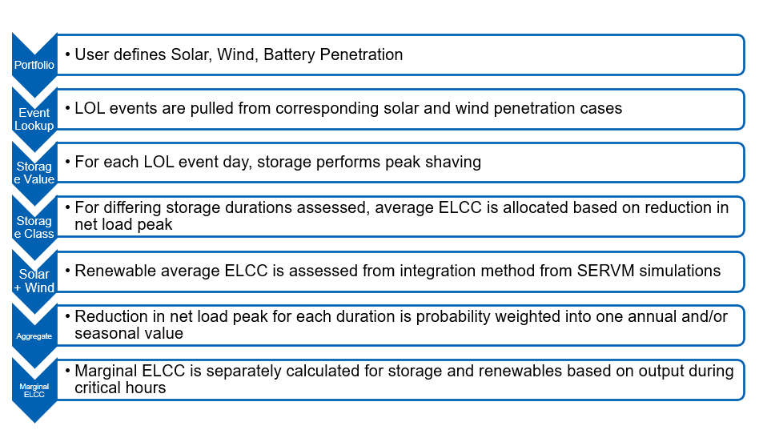
New Battery ELCC methodology

Slide 5
Draft Cost of New Entry results
Brattle presented the ERCOT CONE Study Draft
CONE represents the first-year revenues a resource would need to enter, given its costs, its projected future net revenue trajectory, and its cost of capital.
Cost estimates are a bottom-up method of development of the Capital and O&M costs for the reference technology
Reference technology is an aeroderivative LM6000 in Harris County
The alternate reference technology is a Solar PV + BESS Hybrid (200 MW PV + 100 MW 2-hr BESS in Brazoria County

Slide 6
Draft Cost of New Entry results
The calculated cost of New Entry will be presented at next meeting.

Slide 7
CDR NPRR update
Pete Warnken of ERCOT presented on the CDR NPRR
  Based on feedback from Supply Analysis Working Group participants, ERCOT recommends changes to proposed new Section 3.2.6.2, Effective Load Carrying Capability (ELCC) Studies, and proposed new language in Section 3.2.6.4, Total Capacity Estimates. The changes (1) remove the word “annual” from average ELCC references to clarify that seasonal ELCC values will be used in the Report on Capacity, Demand and Reserves in the ERCOT Region (CDR), and (2) removes the ESR design duration class definitions. This latter change reflects a new ELCC calculation methodology that will not require the specification of such class definitions.

Slide 8
Reliability study update
May 16 PUC Open Meeting:
  Commissioners agreed to adopt the proposal
  0.1 Frequency (Expected loss-of-load event once every 10 years)
  12-hour maximum duration with 1% exceedance probability
  Maximum magnitude determined by ERCOT analysis of the load shed that can be safely rotated during an event, along with a 0.25% exceedance probability
    Exceedance value to be updated on a schedule determined by the Commission
    Commission seeking stakeholder input on an appropriate value
  Initial review of the Reliability Standard starting in January 2026 (to align with market design review), and every five years thereafter
  Request to provide the normalized Expected Unserved Energy (EUE) as another data point (EUE divided by system load)

Slide 9
Value of Lost Load (VOLL) survey
VOLL Survey closed for most customers on May 17th but will remain open for additional responses from certain large commercial & industrial customer classes until May 31st
Strong response rates from residential and small/medium sized commercial customers
Large industrial response rate likely to be ~30% of 100 response target; working with AEP Texas on sharing responses from their VOLL survey
Next Steps: reviewing and analyzing survey data with a final VOLL Report expected by end of August

Slide 10
CDR Overview
Released on 5/24/2024
Discussion addressing the solar contribution to peak showing zero beginning in CY 2028 due to peak moving to later hours
Discussion around the possibility of adding the hour of the forecasted peak load
Additional information included for new “contracted” and “non-contracted” loads

