Slide 1

NERC EMSWG Update
Wei Qiu, NERC EA
ERCOT TWG Conference Call
May 29, 2024

Slide 2
Ongoing Projects
White Paper – AI/ML in Real-time System Operation
  Led by NERC
  RTOS and EMSWG
  Target: RSTC Q3
Reference Document - Risks and Mitigations for Losing EMS Functions Reference Document (2024)
  Target: RSTC Q3

Slide 3
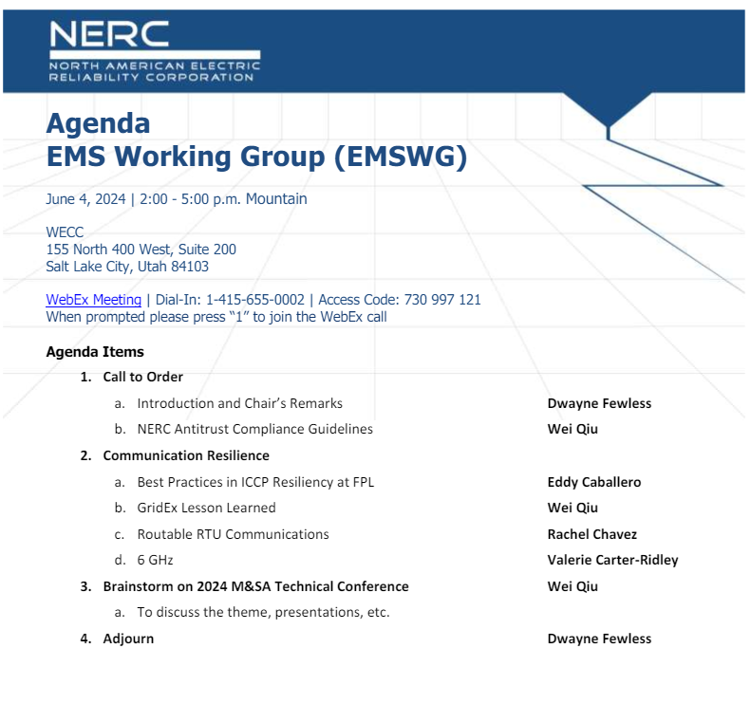
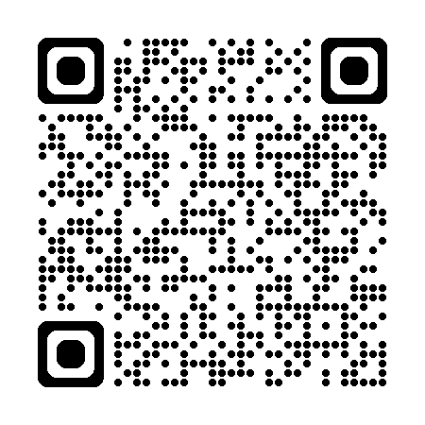
Hybrid Meeting at WECC
https://www.nerc.com/comm/RSTC/EMSWG/EMSWG_Agenda_20240604.pdf

Slide 4
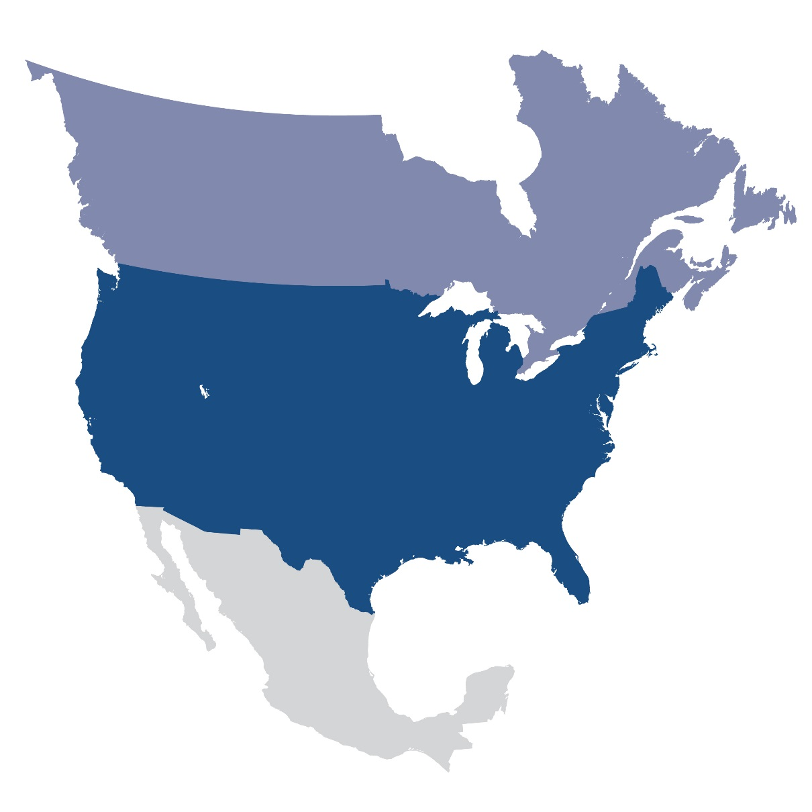
Questions and Answers
Contact Information:
wei.qiu@nerc.net

