Slide 1
SCR799 – ERCOT Outage Study Cases in the System Operations Test Environment (SOTE)
Shireesha Methuku
May 29, 2024

Slide 2
SCR799 - ERCOT Outage Study Cases in the System Operations Test Environment (SOTE)
The System Operations Test Environment (SOTE) is an environment of the ERCOT Energy Management System (EMS) where the Network Operations Model and the results of the Real-Time State Estimator (SE) are available for review and analysis within five minutes of the Real-Time solution.
This environment is provided as a tool to Transmission Service Providers (TSPs) to perform power flow studies, contingency analyses and validation of SE results.
SCR799 enables ERCOT to provide 7day ahead, 60 day, and 90 day outage study cases in SOTE for TSPs.
Providing access to these ERCOT outage cases in SOTE improves the ability of TSPs to evaluate outages prior to submittal to ERCOT, there by increasing the likelihood of outage approvals by ERCOT.
ERCOT is planning to start implementation of SCR799 in June 2024 and complete by Q4 of 2024.

Slide 3
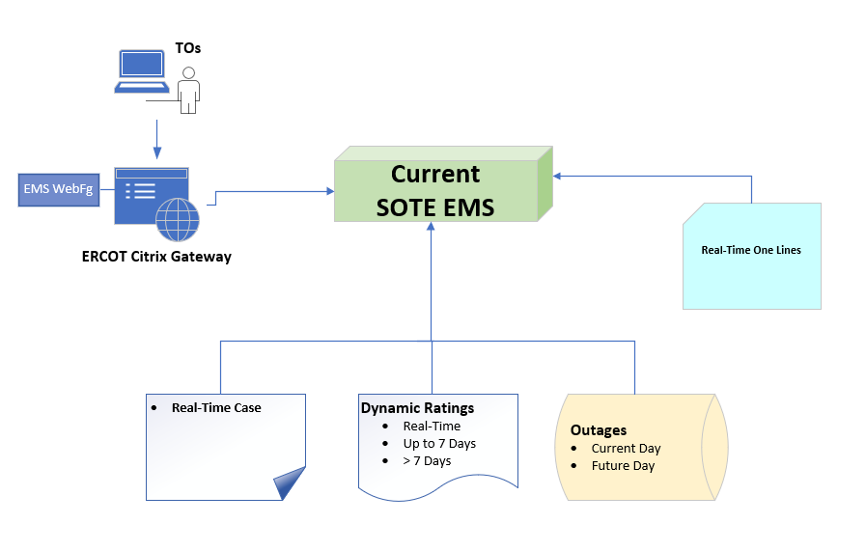
SOTE – Current State

Slide 4
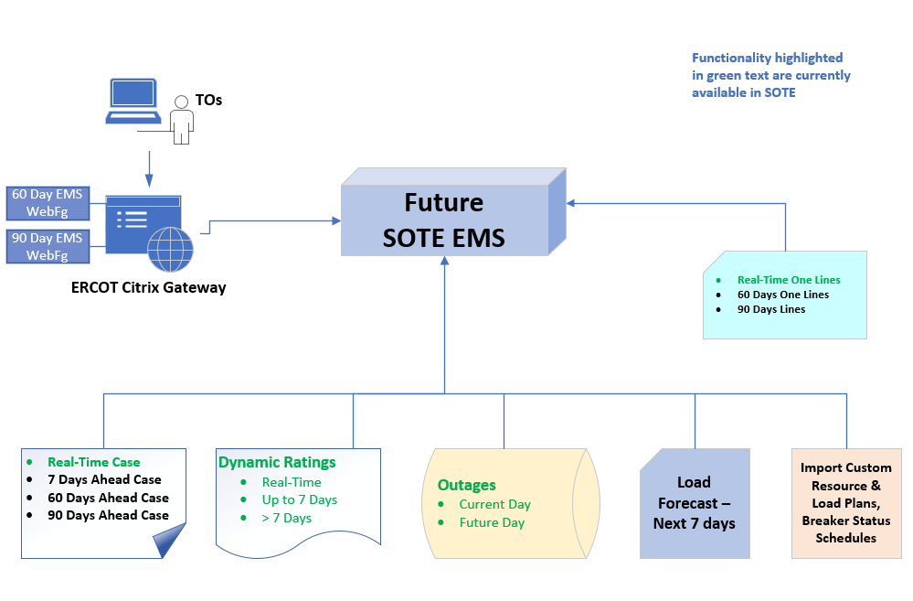
SOTE – Future State (Post SCR799) - Draft
* This is draft only – will finalize during implementation phase

