Slide 1
ERCOT Technology Working Group (TWG)
May 29, 2024

Slide 2
ERCOT TWG
WELCOME

Slide 3
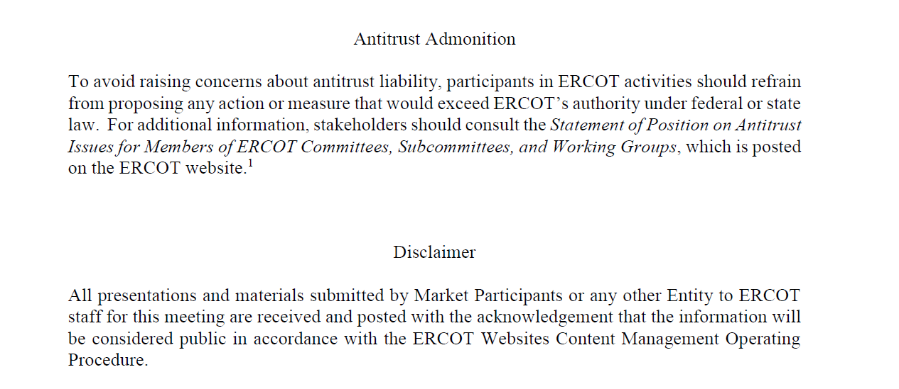
ERCOT TWG

Slide 4
ERCOT TWG Agenda
Item # | Item Description | Presenter | Start Time
1 | Antitrust admonition | Sreenivas Badri | 2:00 PM
2 | NERC Update – EMSWG | Wei Qiu | 2:05 PM
3 | Project Updates | Troy Anderson | 2:15 PM
4 | RTC+B Updates | Matt Mereness | 2:25 PM
5 | RTC+B Technical Workshops Updates | Sreenivas Badri | 2:35 PM
6 | RIOO – Single Model ESR Project updates | Andy Adams | 2:45 PM
7 | NPRR1217 – Technical Discussion | Blake Holt (LCRA) | 3:10 PM
8 | Other Projects/Initiatives status updates |  | 3:20 PM
 | NPRR1186 Updates | Rachel Villarreal
 | SCR820- Real-Time Operator Messaging Demo Tool – TOs Evaluation | Sreenivas Badri
 | SCR799 - ERCOT Outage Study Cases in the System Operations Test Environment (SOTE) | Shireesha Methuku
9 | Future Topics of Interest | Sreenivas Badri | 3:55 PM
10 | Adjourn | Sreenivas Badri | 4:00 PM

Slide 5
NERC EMSWG Update
NERC EMSWG Update – Wei Qiu

Slide 6
Project Updates
Project Updates – Troy Anderson

Slide 7
RTC+B Updates
RTC+B Updates – Sreenivas Badri

Slide 8
RTC+B Technical Workshops Updates
RTC+B Technical Workshops Updates – Sreenivas Badri

Slide 9
RIOO – Single Model ESR Project updates
RIOO – Single Model ESR Project updates – Andy Adams

Slide 10
NPRR1217 – Technical Discussion
NPRR1217 – Technical Discussion on ERS and Load Resource XML Instructions – Blake Holt (from LCRA)

Slide 11
Other Projects/Initiatives Status Updates
NPRR1186 Updates – Rachel Villarreal
SCR820- Real-Time Operator Messaging Demo Tool – TOs Evaluation – Sreenivas Badri
SCR799 - ERCOT Outage Study Cases in the System Operations Test Environment (SOTE) – Shireesha Methuku

Slide 12
ERCOT TWG – Open Forum
Future Topics of Interest
Topics and presentations from TWG members

Slide 13
ERCOT TWG
Thank You
You can reach me at
Sreenivas.Badri@ercot.com

