Slide 1
RTC+B Technical Workshops – Updates
Sreenivas Badri
May 29, 2024

Slide 2
RTC+B Technical Workshops
Key Objectives
  Help QSEs, and their vendors start planning their RTC+B systems design and implementation early to align with ERCOT’s RTC+B project implementation timelines which is critical for ERCOT to deliver this project successfully and on time.
  Based on the feedback from these workshops, ERCOT will finalize ICCP/Market External Interfaces design specifications and publish draft versions to the ERCOT website.
RTC+B Technical Workshops - Completed
    RTC+B Technical Workshop - April 18, 2024: 1:00 PM – 4:00 PM :
    Overview of ICCP Telemetry/EMS SCADA/AGC changes & ICCP Configurations for parallel testing.
    RTC+B Technical Workshop - May 6, 2024: 1:00 PM – 4:00 PM :
    Finalize approach on ICCP configuration approaches for parallel testing and transition.
    RTC+B Technical Workshop - May 15, 2024: 1:00 PM – 4:00 PM :
    Market Interfaces design specifications (submissions - External API/Market Manager, notifications, and reports)

Slide 3
RTC+B Technical Workshops - Recap
  Workshop#1
    Had detailed discussion on EMS/AGC design on new RTC+B ICCP telemetry points additions and deletions.
    Introduced ICCP Configurations for parallel testing
  Workshop#2
    Went over questions/comments from Workshop#1
    Had further discussion on new RTC+B ICCP telemetry points additions and deletions
    Discussed in detail ICCP Configurations for parallel testing, pros/cons for two options presented
  Workshop#3
    ERCOT selected ICCP Configuration Option#1 for parallel testing which is Add RTC+B telemetry points to current production ICCP system
    Discussed in detail
      New/Modified Market Submissions in RTC+B
      Discussed in detail Market External Interfaces – Market Manager/Outage Scheduler UI changes, API/XSD changes, XML alerts and notices.
      Discussed in detail RTC+B Market External Interfaces Systems Configuration - stand up new parallel External API/EWS Systems for RTC+B Project for dual entry during Market Trials
    Published draft Market External Interfaces RTC+B XSD changes.

Slide 4
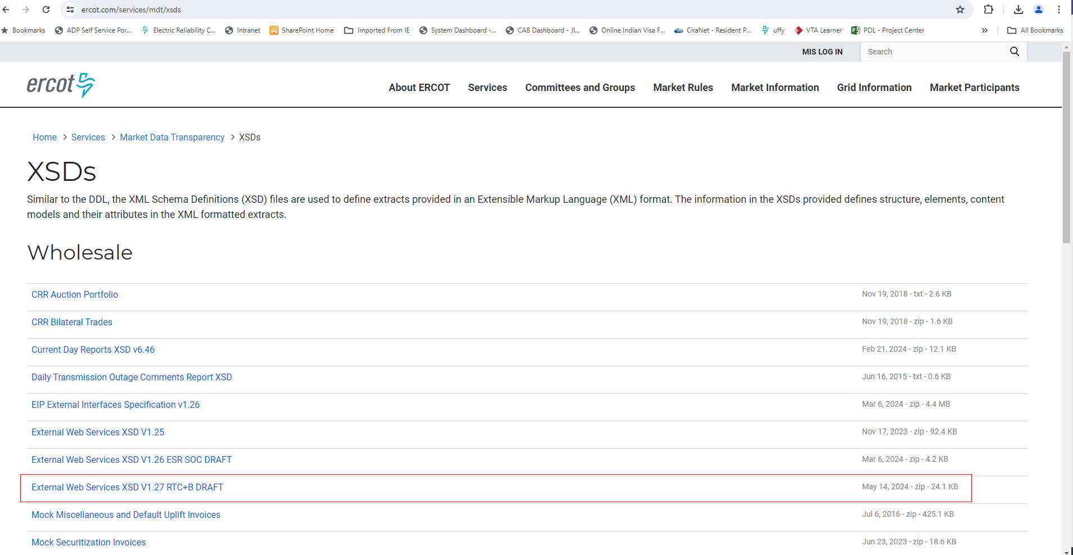
RTC+B Market External Interfaces XSD changes
RTC+B XSD changes (along with Example XML Payloads) draft version (high lighted in below screenshot) is available in ercot website at https://www.ercot.com/services/mdt/xsds
These XSD changes include Only RTC+B Market Submissions, Reports related to Awards, Outage submissions along with examples.

Slide 5
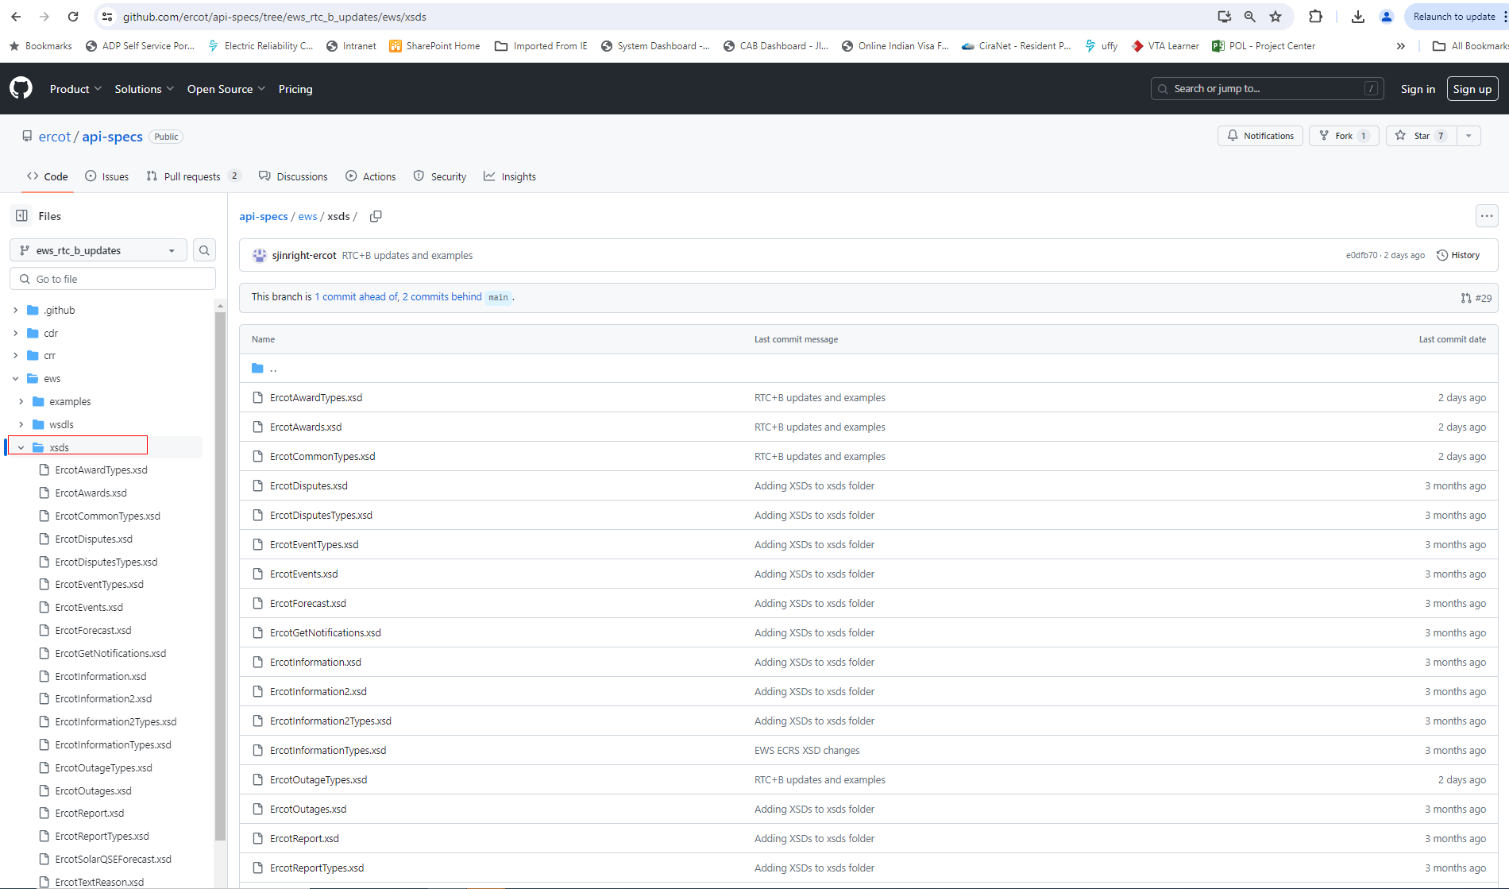
RTC+B Market External Interfaces XSD changes
RTC+B XSD changes draft version is also posted to ERCOT developer portal (https://developer.ercot.com). It is accessible to public users.
  Below is the direct link to developer portal github where you can see the RTC+B XSD changes.
    https://github.com/ercot/api-specs/tree/ews_rtc_b_updates/ews
  Below is the screen of ercot developer portal Github RTC+B XSD changes

Slide 6
Action Items and Next Steps
ICCP Handbook draft version with RTC+B ICCP Telemetry points modeling will be published to ERCOT website (https://www.ercot.com/services/mdt/userguides) by end of this month (05/31/2024).
ERCOT is actively working on EIP External Interfaces Specifications document updates and plan to publish draft version to ERCOT website (https://www.ercot.com/services/mdt/xsds) by June 1st week.
QSEs/Vendors to plan the RTC+B Market External Interfaces design and implementation to align with ERCOT Market Trials timelines.

Slide 7
RTC+B Technical Workshops
In Workshop#3, requested participants to provide us the feedback if any topics presented in last 3 workshops should be revisited to further clarify or any new topics related to RTC+B ICCP/EMS/Market External Interfaces system design/setup and implementation to be presented in next workshop#4 on 06/06/2024.
Last RTC+B Technical Workshop in this limited series
    RTC+B Technical Workshop - June 6, 2024: 1:00 PM – 4:00 PM :
      ICCP Telemetry points descriptions
      Parallel Operation of External Market Interfaces (Current and RTC+B)
      Review EIP External Interfaces Specifications document changes
Next RTC+B Technical Workshop is on Current Day Reports (CDR) External Specifications and XSD changes. ERCOT will notify RTC+B Technical Workshops participants when it is scheduled.
For any questions and feedback, contact me at Sreenivas.Badri@ercot.com

