Slide 1

TDTMS Update
RMS
June 4, 2024

Slide 2
TDTMS
ERCOT Reporting
MIS API project update – No issues with the April 25 release to correct the issue of the missing key date; key dates are populating as expected.
Market Notice Archives – All market notices that failed to archive due to character limit exceeded in the subject title have been posted. ERCOT is working on a fix.
Digital Certificates – Require updates periodically for cybersecurity. All users required an update of the root certificates by May 21 @ 7PM. First market notice was February 2, then February 21, and final notice on May 17.

Slide 3
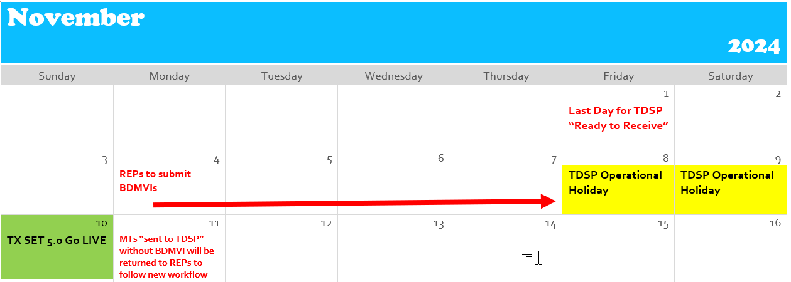
TDTMS
SCR 817
The group is working on approving the proposed User’s Guide revisions. ACTION item:
provide any comments/edits to Tammy Stewart for the Inadvertent Gain section
• Bulk Insert appendix and templates will be worked on next to reflect the changes.
All testing was reported to be going well and there were no current questions for the working group.
Proposed Transition Plan

Slide 4
TDTMS
SCR 817
The working group discussed an extensive communication plan around the changes including a Market Workshop, likely in late June.
The orientation would include the following:
MarkeTrak high level changes
Overall Transition Plan
FlighTrak registration requirements
FlighTrak testing scripts
High level checklist of requirements for readiness
Kathryn Thurman’s presentation from January on changes

Slide 5
TDTMS
TDTMS Other Topics
MarkeTrak Subtypes Volume for 2023 – ERCOT has provided “data dump” and smaller group will sort through data providing a deeper dive into Rescissions, Cancel w/ Approval, Service Orders, and DEVs
Data/Talking Points to Client Services on MT Analysis – Client Services is prepared to provide REP #s and direct REPs to the monthly IAG reports provided by ERCOT
TXSET 5.0 Related topics:
County Name attribute – sample flat files ERCOT requested via MarkeTrak to test the flat file process for adding to all ESIs. .txt files were requested by May
TDSP ESI Extract – when the new county name and optional meter service type will be added, where will the placement be in the extract?

Slide 6
TDTMS
Next Meeting – Tuesday, May 21st
DRAFT Agenda:
ERCOT Reports
Wednesday, June 12 - 9:30 AM WebEx only
System Instances & MT Performance
Listserv
Market Notice Archives
SCR817 Business Requirements Discussion
Review of User’s Guide drafts
Communicating Transition Plan updates
MarkeTrak Subtypes Volume Analysis 2023 – progress update

