Slide 1
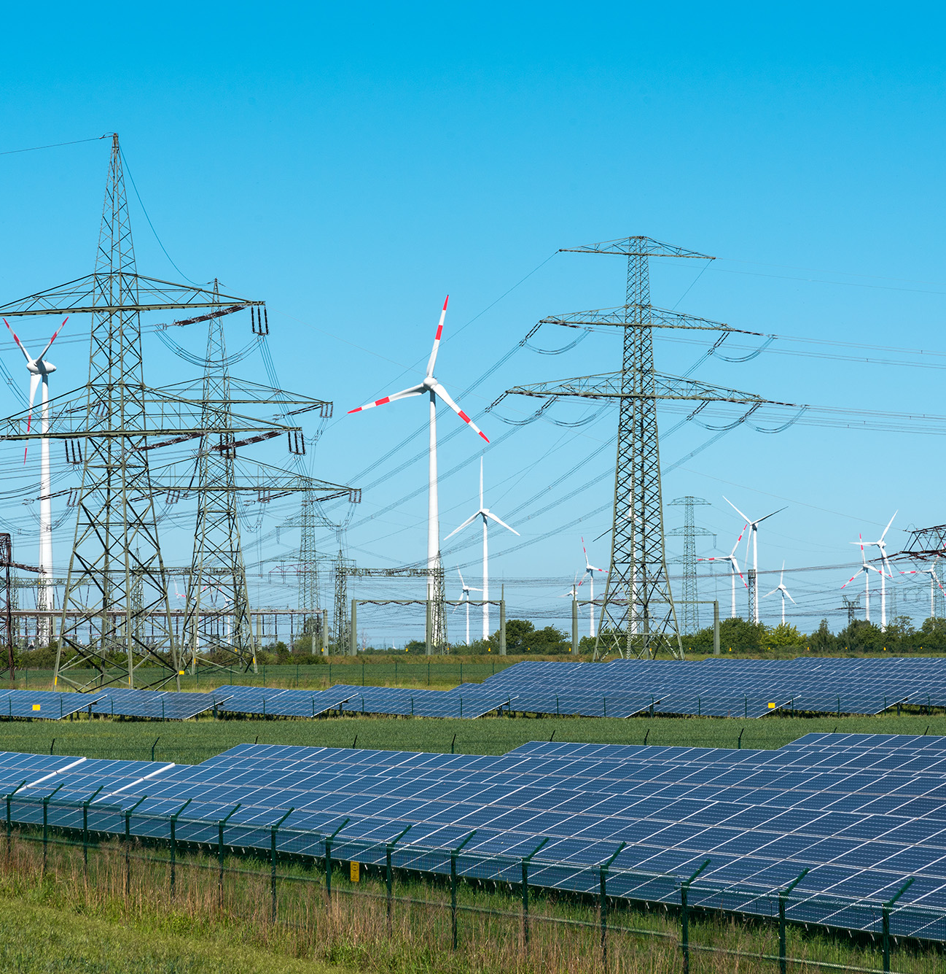
ERCOT CONE Study Draft
Prepared By
  The Brattle Group
  Sam Newell
  Andrew W. Thompson
  Rohan Janakiraman
  Sargent & Lundy
  Sang Gang
  Joshua Jungé
  Hyojin Lee
  Preksha Nair
Prepared For
  ERCOT
May 24, 2024

Slide 2
Agenda
Executive Summary
Bottom-up Costs for Reference and Alternative Technology
Draft CONE Results
Project Timeline and Next Steps

Slide 3
1. Executive Summary

Slide 4
Overview of CONE approach
1. Executive summary
1. Choose reference technology characteristics
2. Conduct bottom-up
cost analysis
3. Calculate Cost of New Entry (CONE)
Presented at March 22nd, 2024 SAWG meeting
Longstanding “Revealed Preference” method led to:
Reference Technology
Aeroderivative LM6000 plant with 291 MW (at ISO conditions) in Harris County
Alternative Technology
Solar PV + BESS Hybrid with 200 MW PV + 100 MW 2-hr BESS in Brazoria County
Will be presented in this meeting
Cost Estimates
Bottom-up estimates of Capital and O&M costs as of April 2024
Then costs escalated to the mid-point construction period
Will be presented in this meeting
CONE represents the first-year revenues a resource would need to earn to enter, given its costs, its projected future net revenue trajectory, and its cost of capital
CONE Calculation
  Determine levelization “shape” (e.g., level-nominal) and lifetime
  Develop ATWACC
  Calculate first-year revenue requirement for NPV=0 in
  CONE spreadsheet model (accounts for taxes w/depreciation, etc.)

Slide 5
Summary of CONE Estimates for Reference Plants with COD June 2026
1. Executive summary
CONE Estimate for 291 MW (at ISO cond.) 6x0 LM6000
Definitions
  “Overnight cost” is the cost of all the inputs on a certain date (in our analysis, based on April 2024 cost rates and escalated to the middle of the construction period and expressed in nominal$.
  “Capital charge rate” is defined such that CONE = overnight cost × capital charge rate + levelized FOM.
Comparisons to some benchmarks
  Cost of LM6000 plant is comparable to EIA’s latest.
  CONE of LM6000 is much higher than in PJM 2022 study ($190/kW-yr CC and $151/kW-yr Frame CT) because aeros cost more per kW and because ATWACC is 150 bp higher
  Alt tech has lower CONE and greater net E&AS revenues but serves a different purpose in the market.
  The range reflects inherent differences and uncertainties.
CONE Estimate for 200 MW PV w/100 MW 2-hr BESS
Notes: Both calculations use 10.35% ATWACC. The aero has a higher capital charge rate because of a longer construction period (incurring cost of capital) and longer depreciation.
The CONE estimate for the hybrid is expressed as cost per kW of just the PV capacity, even though it includes BESS costs (and ITC on BESS components but not on PV components).

Slide 6
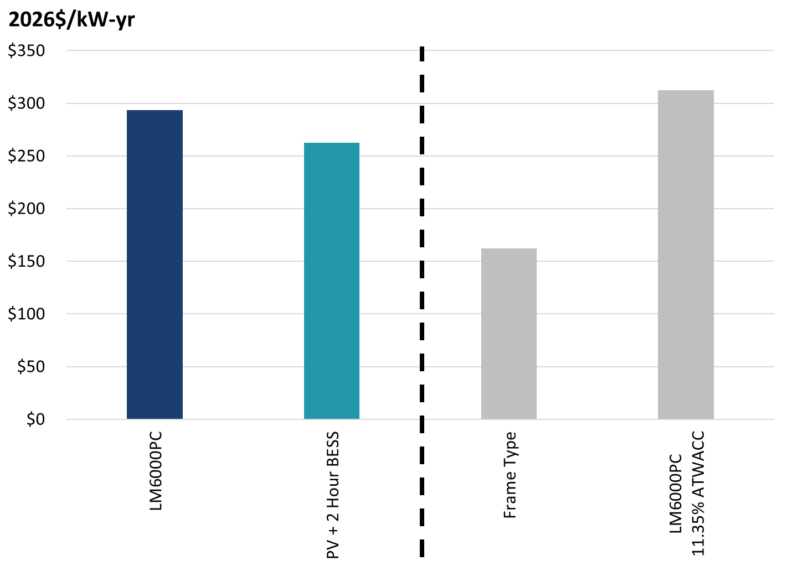
Uncertainty Drivers of CONE
1. Executive summary
  To explore uncertainty drivers, we provide indicative estimates under some alternative assumptions.
  Choice of technology is the biggest uncertainty driver for CONE, with some offsetting E&AS value differences.
    Frame CT has much lower costs based on scaling to EIA, but with more “shaft risk” and somewhat less flexibility. The indicative Frame CONE starts with our current ERCOT aero CONE and scales the capital and FOM components to that of a Frame vs. aero within the EIA study.
    New LM6000s may differ from the refurbished ones dominating recent/planned ERCOT projects. We do not have visibility into the cost discount on the refurbished turbines.
    Choice of reference technology is the most controversial aspect of CONE estimates in capacity markets, too (even though they subtract net E&AS revenues).
  ATWACC and levelization may be smaller drivers here.
  Sensitivities to plant configuration & input costs not explored here.
Bottom-Up CONE for Reference and Alternative Tech compared with indicative sensitivity analyses
Source: EIA, Capital Cost and Performance Characteristics for Utility-Scale Electric Power Generating Technologies, prepared by Sargent & Lundy, January 2024, Brattle analysis

Slide 7
What Can Policymakers Do with This Information
1. Executive summary
  Recognize that projecting CONE is not an exact science
  The “revealed preference” approach reflects developer choices under current market conditions; preferences could change
  We analyze current bottom-up costs, but input costs can change
  We estimate costs for a competitive developer, although costs vary
  The ATWACC is grounded in empiricism but without plentiful data on the full cost of capital for projects exactly like the ref tech
  “Levelization” depends on developer views of revenue trajectory
  With choice of reference tech being the biggest uncertainty driver, is the aero the right technology with its high cost?
  Multi LM6000PC is what developers are building and planning (in addition to PV hybrids and standalone BESS). This must be for a reason.
    Developers emphasize flexibility and low shaft risk in a market that sharply punishes unavailability in shortages.
    (And an unknown discount for refurbished turbines that may have limited availability).
  Not for us to second-guess or speculate about other technologies they should prefer under other conditions.
  Hence we have no better recommendation than our LM6000 CONE estimate, while recognizing the likelihood of some upward bias relative to refurbished LM6000s, and that as conditions change, developer preferences could change.
  One can modify our assumptions to change CONE
  Our CONE model will be posted, so one can change the key assumptions.
  Or one can scale our results, e.g., our scaled indicated Frame estimate.
  What are the implications of overstating or understating CONE?
  For PNM purposes: higher CONE increases the “3xCONE” PNM threshold where offer caps are lowered, which could increase costs for consumers.
  For Reliability Standard cost impact estimation, higher CONE increases system costs; for MERM estimation higher CONE decreases MERM.
  For PCM purposes: a higher CONE could raise Net CONE, which could increase the demand curve and boost reliability but increase costs.
  (For all of these purposes, CONE accuracy matters, but so too does the estimation of net E&AS revenues).
  Other points on context
  ERCOT could update CONE frequently in such a dynamic environment.
  Texas Energy Fund (TEF) might subsidize certain new entrants, but to support unsubsidized merchant entry, the market would need prices to reach unsubsidized CONE.
  Note that the PV+BESS benefits from incentives (ITC on BESS lowering CONE, and PTC on PV increasing E&AS revenues), but those are widely available for many years under the IRA, so we included them.

Slide 8
2. Reference and Alternative Technology Characteristics

Slide 9
Technical Assumptions: LM6000 Reference Technology
2. Reference and Alternative technology Characteristics
Clarification: CONE calculation is in terms of seasonal net combustion turbine capacities, which for LM6000PC turbines with SPRINT are
  50.1 MW in winter (37°F),
  48.5 MW at ISO conditions (59°F) and
  40.7 MW in summer (94°F).
Update: Changed reference technology to a “6 x 0” plant configuration partially due to stakeholder feedback and better alignment with median number of units in dataset.
See additional responses in public document.
Technical Specs for LM6000 Plant

Slide 10
Technical Assumptions: Hybrid Alternative Technology
2. Reference and Alternative technology Characteristics
No clarifications or updates to Alternative Technology technical characteristics presented at March 22nd SAWG meeting.
Technical Specs for PV+BESS Hybrid

Slide 11
3. Bottom-up Cost Estimates

Slide 12
LM6000 Plant: CAPEX
3. Bottom-up Cost Estimates
Salient Observations
  The CTGs are the biggest component, by far.
    The choice of PC reflects “revealed preference” from actual projects
    We assume new rather than refurbished and don’t know if developers will still choose this technology if refurbished ones are not available (e.g., new PF costs a little more than new PC but adds about 13% more capacity; new frame is much cheaper per kW but has very different operating characteristics)
  Next biggest are other equipment, then labor
  Then EPC fees & contingency, based on % of EPC costs
Key Assumptions
  Sales tax is 7.5% of materials costs
  EPC contractor fee + contingency are 19% of other EPC costs
  Project development (5%), mobilization and start-up (1%) and non-fuel inventories (1.5%) costs are based on total EPC costs
  Electrical interconnection covered by Texas SB 1500 allowance
  Gas interconnection assumes ½ mile lateral at $3.5m/mile
  Owner’s contingency is 10% of other Owner’s costs

Slide 13
LM6000 Plant: O&M
3. Bottom-up Cost Estimates
Salient Observations
  Insurance and firm gas contract are largest component
  Next biggest are labor then property taxes
  First-level nominal FOM costs are 18% higher than actual first year FOM costs
Key Assumptions
  Air emission standards are assumed to be met with the inclusion of selective catalytic reduction systems
  Maintenance and minor repairs are 10% of LTSA fixed costs
  Firm gas costs are $3.1 million per year based on firm fuel costs at existing/planned WattBridge facilities
  Property taxes are 0.3% of overnight capital costs
  Insurance is 0.6% of overnight capital costs

Slide 14
Comparison of LM6000 to 2024 EIA benchmark
3. Bottom-up Cost Estimates
Overnight costs for the LM6000 plant are $82/kW higher in this study than in the 2024 EIA study
  Our EPC costs are $161/kW higher because PFs deliver 13% more power for a small additional absolute cost compared to PCs
  Our Non-EPC costs are $79/kW lower because
    Our bigger 6x0 plant has better economies of scale on non-EPC costs
    Our electrical interconnection costs are covered by the Texas Senate Bill 1500 allowance
    Our gas interconnection excludes metering station costs because of the high local availability of natural gas transmission lines sufficient for CT operation in Harris County
Comparison to EIA Benchmark
Source: EIA, Capital Cost and Performance Characteristics for Utility-Scale Electric Power Generating Technologies, prepared by Sargent & Lundy, January 2024.

Slide 15
PV+BESS: CAPEX
3. Bottom-up Cost Estimates
Salient Observations
  Nearly 70% of capital costs comes from PV and BESS equipment supply costs, even with steep declines over past several years
    PV modules at only $355/kW
    BESS at only $928/kW or $464/kWh for a 2-hour battery
  Project development costs are responsible for 75% of non-EPC costs
Key Assumptions
  EPC contractor fee is 5% of other EPC costs
  EPC contingency is 5% of other EPC costs + EPC contractor fee
  Project development (5%), mobilization and start-up (1%) are based on total EPC costs
  Owner’s contingency is 10% of other Owner’s costs

Slide 16
PV+BESS: O&M
3. Bottom-up Cost Estimates
Salient Observations
  Maintenance costs comprise over half of total O&M costs
Key Assumptions
  Land lease costs are based on a lease cost of $500 per acre and 1,400 acres needed
  Property taxes (0.6%) and insurance (0.3%) are based on overnight capital costs
  Augmentation costs
    28 MWh of augmentation are required in years 5, 10, and 15 after COD to maintain capacity rating all 20 years
    Starting augmentation costs are $313/kWh in 2024$
    Augmentation costs are (de)escalated based on the moderate case for the overnight capital cost trajectory for 2-hour BESS from 2023 NREL ATB
Levelized Augmentation Costs (Nominal $/kW-yr)
Notes: Calculated present value of augmentation costs based on 10.35% ATWACC. Applied capital charge to derive level-normalized first year revenue requirement and divided figure by PV capacity.

Slide 17
4. Calculate CONE

Slide 18
A. Escalate Bottom-up Costs to Construction Period
4. Calculate CONE
  Objective: Escalate April 1st, 2024 cost estimates provided by Sargent & Lundy to the mid-point construction date
Cost Escalation During Construction
  Estimate cost escalation rates based on short-term inflation and real cost declines
    Short-Term Inflation: Blended inflation rate from annual inflation forecasts (2024 = 3.0%, 2025 = 2.3%), based on Wolter Kluwers’ Blue Chip Economic Indicators
    LM6000 Real Cost Decline: 0.8% per year, based on 2023 NREL ATB
    PV-BESS Real Cost Decline: 5.7% per year, based on 2023 NREL ATB
  Establish mid-point construction date based on June 1st, 2026 online date, months needed for construction, and months needed for 50% of capital drawdown
    LM6000: Construction Midpoint = T – 11 months, so July 1st, 2025
    PV-BESS: Construction Midpoint = T – 8 months, so October 1st, 2025
  Escalate costs to mid-point construction date

Slide 19
B. Design Levelization Approach
4. Calculate CONE
CONE represents the first-year revenues a resource would need to enter, given its costs, its projected future net revenue trajectory, and its cost of capital.
ERCOT agreed to assume the same 20-year level-nominal levelization we recommended in PJM
  Level-nominal: assumes that future revenues are constant in nominal terms.
    This is appropriate where future entrants have increasingly competitive costs and performance, which will set market prices lower and reduce the revenues of a plant built today, at approximately the rate of inflation in real terms.
    LM6000 plant costs per kW are projected to decline at 0.8%/yr real, with bigger turbines with better economies of scale; plus they would enjoy performance improvements.
  Economic Lifetime: We assume a 20-year economic lifetime
    This does not mean the useful life is only 20-years since new natural gas-fired plants can physically operate for 30 years or longer, only that developers commonly expressed a preference to recover their capital in 20 years
Note that for the PV+BESS alternative tech technology progress is so rapid that a new entrant needs a more front-loaded revenue recovery to compensate for future entrants sharply competing down prices
  Based on NREL’s projected 3.0% real decline rate over the next 20 years, one could adopt a steeper levelization, but we approximate with level-nominal, since that already assumes a 2.2% real decline
  We still assume 20-year asset life

Slide 20
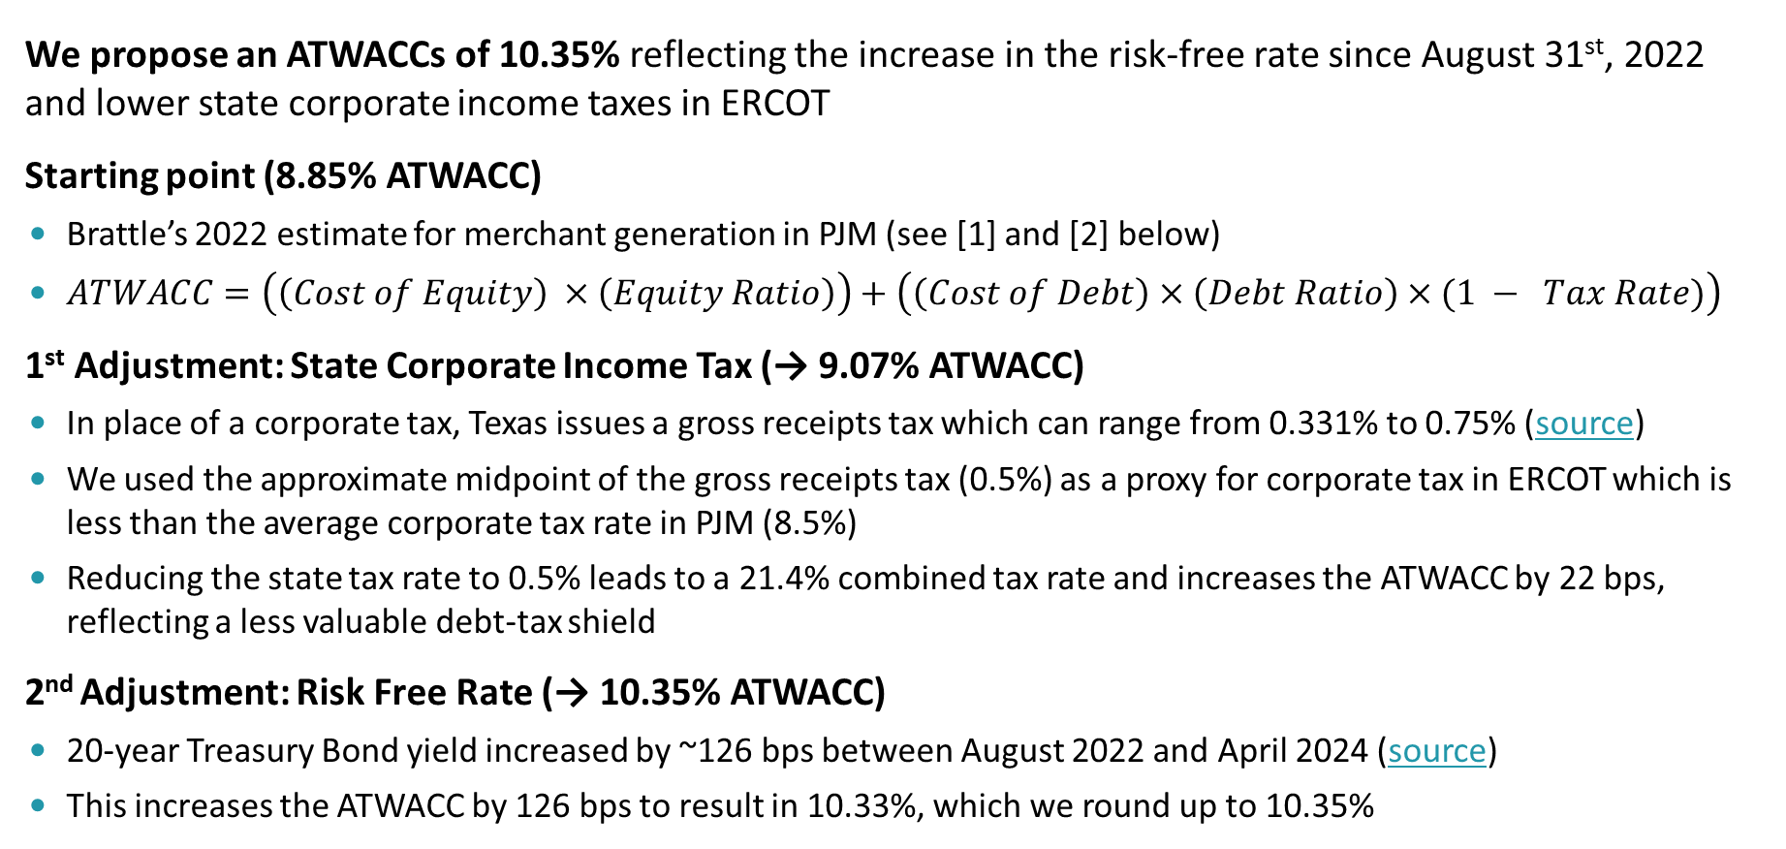
C. Adjust Prior PJM ATWACC Estimate for ERCOT today
4. Calculate CONE
We propose an ATWACCs of 10.35% reflecting the increase in the risk-free rate since August 31st, 2022 and lower state corporate income taxes in ERCOT
Starting point (8.85% ATWACC)
  Brattle’s 2022 estimate for merchant generation in PJM (see [1] and [2] below)
  $ATWACC=\left(\left(Cost of Equity\right) ×\left(Equity Ratio\right)\right)+\left(\left(Cost of Debt\right)×\left(Debt Ratio\right)×(1 − Tax Rate)\right)$
1st Adjustment: State Corporate Income Tax (→ 9.07% ATWACC)
In place of a corporate tax, Texas issues a gross receipts tax which can range from 0.331% to 0.75% (source)
We used the approximate midpoint of the gross receipts tax (0.5%) as a proxy for corporate tax in ERCOT which is less than the average corporate tax rate in PJM (8.5%)
Reducing the state tax rate to 0.5% leads to a 21.4% combined tax rate and increases the ATWACC by 22 bps, reflecting a less valuable debt-tax shield
2nd Adjustment: Risk Free Rate (→ 10.35% ATWACC)
  20-year Treasury Bond yield increased by ~126 bps between August 2022 and April 2024 (source)
  This increases the ATWACC by 126 bps to result in 10.33%, which we round up to 10.35%
Sources: [1] PJM CONE 2026/2027 Report; [2] Docket No. ER22-2984-000, PJM Interconnection LLC; [3] Gross Receipts, Tax Foundation; [4] 20-year treasury bond yield, FRED

Slide 21
Application of ATWACC to CONE
4. Calculate CONE
  A risk-appropriate discount rate is needed for translating risky future cash flows into present values and deriving the CONE value that makes the NPV equal to zero.
  It is standard practice to discount all-equity cash flows (i.e., without deducted interest payments) using an after-tax weighted-average cost of capital (ATWACC).
  The ATWACC therefore reflects the systemic financial market risks of the project’s future cash flows and is used to derive the first-year revenue requirement.
  Only the ATWACC impacts the CONE calculation, not the individual components of ATWACC, since these are inter-related and cannot be estimated in isolation; MM Theorem II, states that a company’s cost of debt and cost of equity both increase with the amount of debt relative to the value of the project (“financial leverage”).
  Some stakeholders mentioned that there could be higher, non-diversifiable risk in ERCOT vs PJM due to the market regulatory environment which could warrant a 100 bps risk premium adder, this would result in an ATWACC of 11.35%. While we do not adopt this as our base case, we show the implications for CONE.

Slide 22
LM6000 Plant CONE
4. Calculate CONE
Salient Observations
  Charge rate is fairly high because of 10.35% ATWACC, combined with 20-yr level-nominal (charge rate = first-year capital recovery, where CONE = Overnight Cost × Charge Rate + FOM)
  48% of CONE comes from turbine equipment costs
  21% of CONE comes from labor costs
Key Assumptions
  ATWACC = 10.35%
  Overnight cost is the cost of all the inputs in April 2024, escalated to middle of the construction period and expressed in nominal $
  Installed cost includes overnight cost plus the cost of capital between construction and the online date
  CONE calculation is performed in a spreadsheet model that accounts for taxes and depreciation
CONE Calculation for LM6000 Plant
Note: CONE per 244 MW at Summer capacity would be $350/kW-year; and per 301 MW at Winter capacity would be $284/kW-year in nominal $.

Slide 23
PV+BESS CONE
4. Calculate CONE
  Salient Observations
  Two-thirds of CONE comes from PV and BESS equipment costs
  Including PV and BESS cost declines from the 2023 NREL ATB reduces CONE by $17/kW-year
  Including the impact of the ITC reduces CONE by $18/kW-year
  Augmentation costs contribute $3/kW-year to CONE
  Key Assumptions
  ATWACC = 10.35%
  Storage enjoys 30% ITC; assume PV opts for PTC with no effect on CONE
  PV and BESS equipment costs are escalated at a negative nominal rate because the magnitude of real cost declines exceed general inflation
  Other costs escalated at the rate of inflation
CONE Calculation for PV + BESS Plant

Slide 24
CONE Sensitivities
4. Calculate CONE
  To explore uncertainty drivers, we provide indicative estimates under some alternative assumptions, shown on the right
  Choice of technology is the biggest uncertainty driver for CONE, likely with some offsetting E&AS value differences
    Frame has much lower costs based on scaling to EIA, albeit with more “shaft risk” and somewhat less flexibility
    New turbines may differ from the refurbished ones dominating recent/planned ERCOT projects. We do not have visibility into the cost of the limited refurbished turbine opportunities.
  ATWACC and levelization may be smaller drivers in this context
  Sensitivities to plant configuration & input costs not explored here
CONE estimates compared with indicative sensitivities
CONE Sensitivity to Levelization

Slide 25
Timeline and Next Steps

Slide 26
Project Timeline

Slide 27
Next Steps
Listen to feedback today, and consider making changes accordingly
Finalize and publish CONE Model (an Excel workbook) and the CONE report

Slide 28
Potential Future Study
4. Calculate CONE
Revisit Choice of Ref Tech
  Consider resources further out in the queue
  Interview developers on potential future technologies.
Refine Ref Tech E&AS analysis
  CONE is useful in combination with other analyses of the net E&AS revenues a plant can earn, whether that analysis is conducted within “PNM” tracker, a MERM study, or a potential PCM reference price setting exercise (based on Net CONE).
  Ensure that those analyses adequately account for volatility
Refine ATWACC: analyze empirical evidence on possible ERCOT risk premium:
  Although the cost of equity of a peaker plant in ERCOT is not publicly traded and cannot be determined by market evidence, we can calculate gross margins on a quarterly basis (electricity revenues less fuel costs, divided by the electricity revenues).
  One could use these gross margins to estimate the peaker’s “quasi-beta,” i.e., the correlation with overall market returns (while recognizing that gross margins are not the same as returns on equity). Similarly, one could estimate the quasi-betas of publicly-traded Gencos, since these Gencos’ quarterly gross margins are reported in the SEC filings.
  One could use the relative magnitudes of the quasi-betas to determine if peaker units in ERCOT are exposed to more systematic (non-diversifiable) risks than elsewhere. If yes, the ratios of the quasi-betas can be used to determine the additional risk premium for the COC of peaking plants.

