Slide 1
ERCOT ELCC Surface Simplification
Astrapé Consulting
May 2024
Notes:
1

Slide 2
Purpose
To investigate a methodology to generate marginal ELCCs by technology for 2 non-dispatchable technologies (e.g. 0-75GW Solar PV, 0-75GW Wind) and unlimited combinations of storage duration (X GW of 2 Hr Battery, X GW of 4 Hr Battery, X GW of 8 Hr Battery)
Approach should allow the user to define any given portfolio within a specified range
Ideally this approach will avoid requiring prohibitively high amount of simulations to generate ELCCs

Slide 3
Proposal
Simplify problem by leveraging SERVM to produce numerous LOLE Events for combinations of solar and wind at 0.1 LOLE, and utilizing out of model approach to establish storage value for each portfolio
 |  | Wind MW
 |  | 30000 | 35000 | 40000 | 45000 | 50000 | 55000 | 60000
Solar MW | 20000
 | 25000
 | 30000
 | 35000
 | 40000
 | 45000
 | 50000
Simulated cases at 0.1 LOLE with LOLE Events cataloged

Slide 4
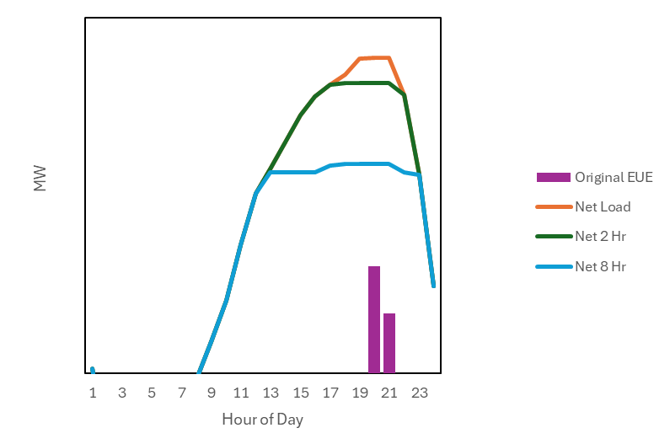
Proposal Cont’d
For each solar and wind combination at 0.1, and for each day with any EUE, the peak shaving capability of storage technology/technologies can be evaluated

Slide 5
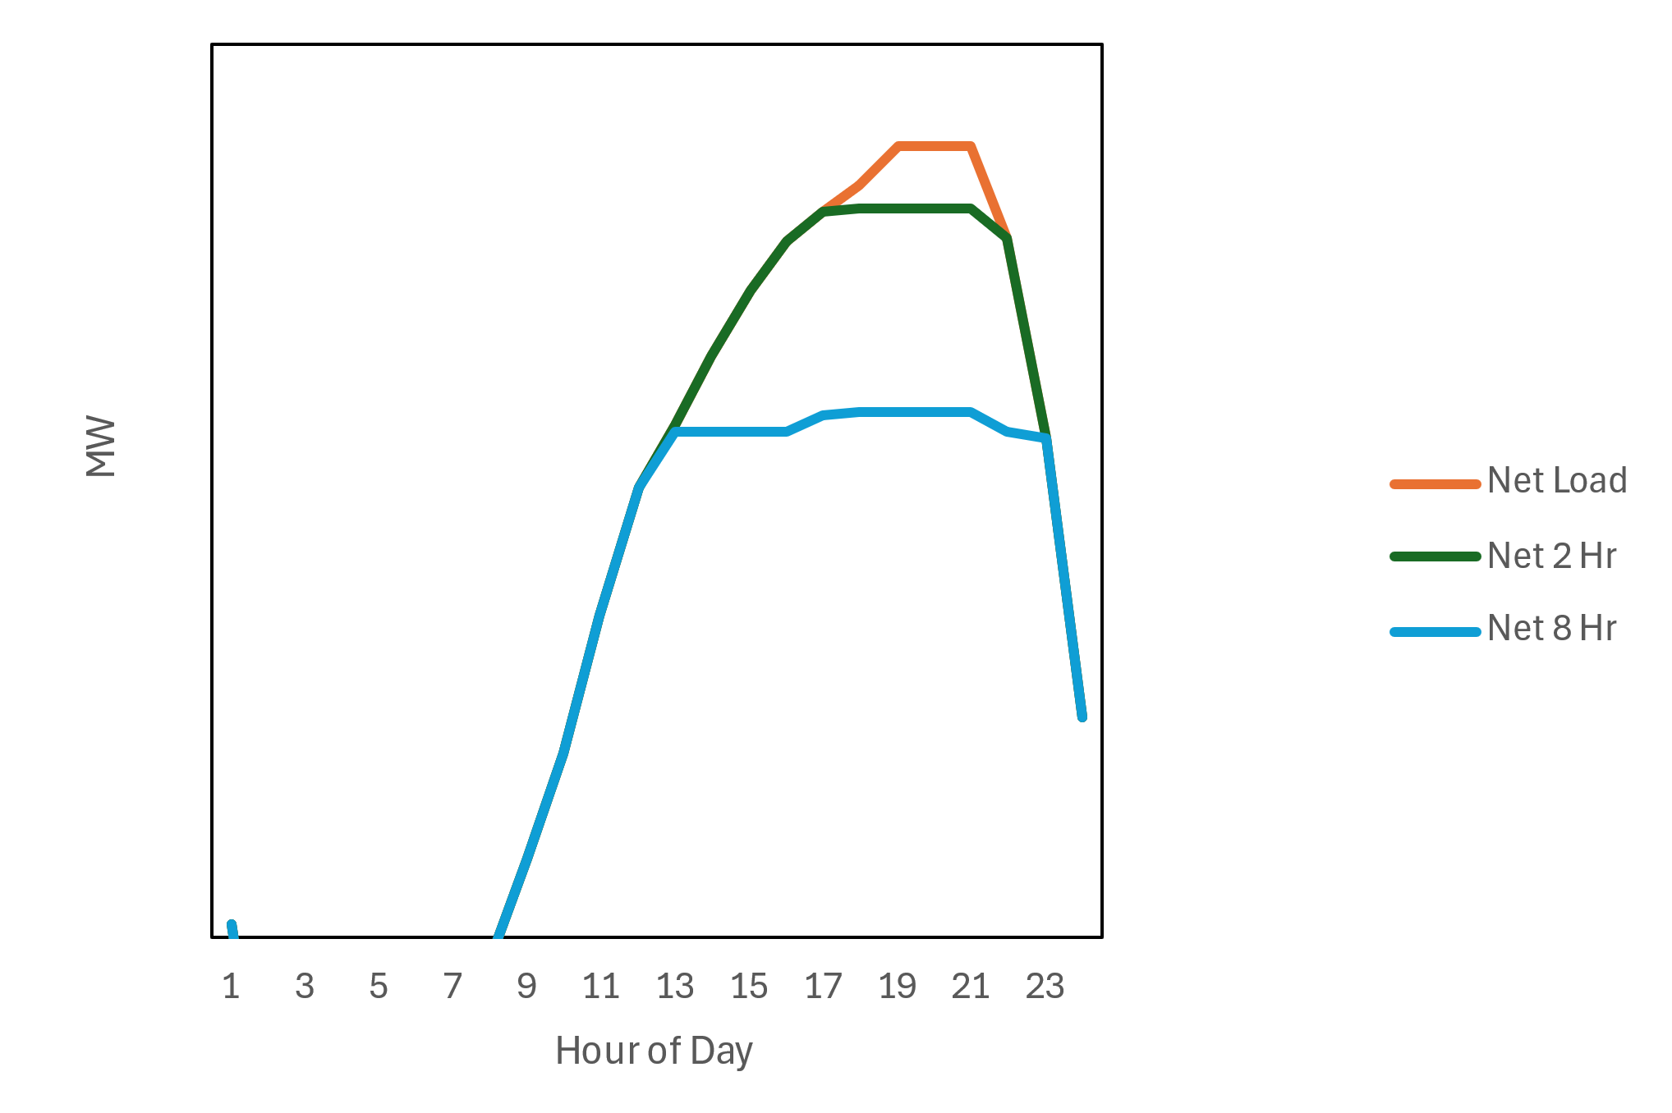
Storage Accreditation
Storage is used to shave the net load peak in ascending order of storage duration
Peak shaved MW for each class of duration defines its average ELCC
Critical Hours
Resource Class | Installed MW | Total Peak Shaved (MW) | Avg ELCC (%) | Avg Output during energy constrained period (MW) | Marginal ELCC (%)
All Storage | 12,000 | 10,425 | - | 10,012 | -
2 Hour | 4,000 | 2,425 | 61% | 2,012 | 50%
8 Hour | 8,000 | 8,000 | 100% | 8,000 | 100%
Peak Shaved

Slide 6
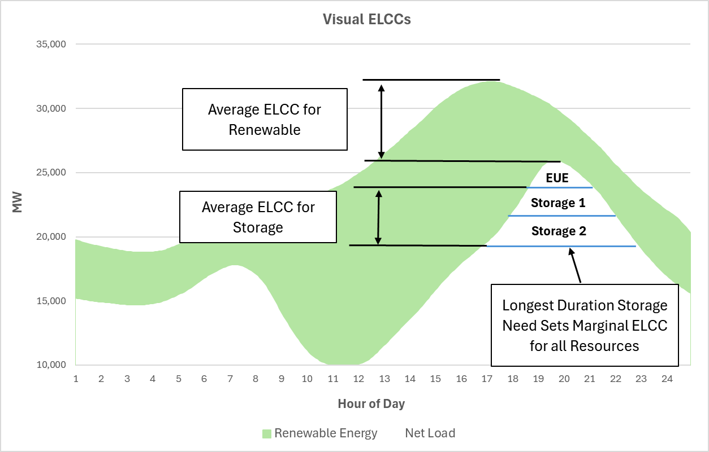
ELCC Visualization

Slide 7
ELCC Calculations
Average ELCC
Renewables
Heuristic: reduction from gross load peak to net load peak
Calculated as portfolio ELCC from SERVM simulations
Technology ELCCs allocated via integration method
Storage
Heuristic: net load peak shaving
Calculated as portfolio ELCC from analytical approach calibrated with SERVM simulations
In the case of multiple durations of storage, value can be allocated amongst durations according to each tranche’s contribution to the reduction in net load peak
Marginal ELCC
All technologies assessed at average output during storage constrained periods

Slide 8
Expected Process Summary
Portfolio
User defines Solar, Wind, Battery Penetration
Event Lookup
LOL events are pulled from corresponding solar and wind penetration cases
Storage Value
For each LOL event day, storage performs peak shaving
Storage Class
For differing storage durations assessed, average ELCC is allocated based on reduction in net load peak
Solar + Wind
Renewable average ELCC is assessed from integration method from SERVM simulations
Aggregate
Reduction in net load peak for each duration is probability weighted into one annual and/or seasonal value
Marginal ELCC
Marginal ELCC is separately calculated for storage and renewables based on output during critical hours

Slide 9
Expected UI
Input | MW | Duration (Hr)
Solar | 30,000 | -
Wind | 35,000 | -
Storage 1 | 5,000 | 2
Storage 2 | 2,000 | 4
Out of model storage dispatch simulation and MW allocation
Output | MW | %
Renewable Portfolio Value (Average) | 30,000 | -
Solar Average ELCC | 5,000 | 16.6%
Wind Average ELCC | 10,000 | 28.6%
Storage Total Peak Shaved | 5,000 | 71%
Storage 1 Allocated Average ELCC | 4,000 | 80%
Storage 2 Allocated Average ELCC | 1,000 | 50%

Slide 10
Discussion and Observations
Approach is expected to avoid limitations seen in ELCC Surface approach (limited flexibility in selecting battery duration and combinations of batteries)
Will require testing between the proposed method and a full ELCC approach within SERVM to ensure reasonableness of results
Desired portfolios not included within original renewable combinations simulated (Green Cells on slide 3) simulated will require interpolation of results between levels to ensure accurate ELCC values

