Slide 1
Average Sulfur Dioxide (SO₂) and Nitrogen Oxide (NO_{X}) Emission Index Prices in Verifiable Cost Calculations
RCWG
ERCOT Staff
May 28, 2024

Slide 2
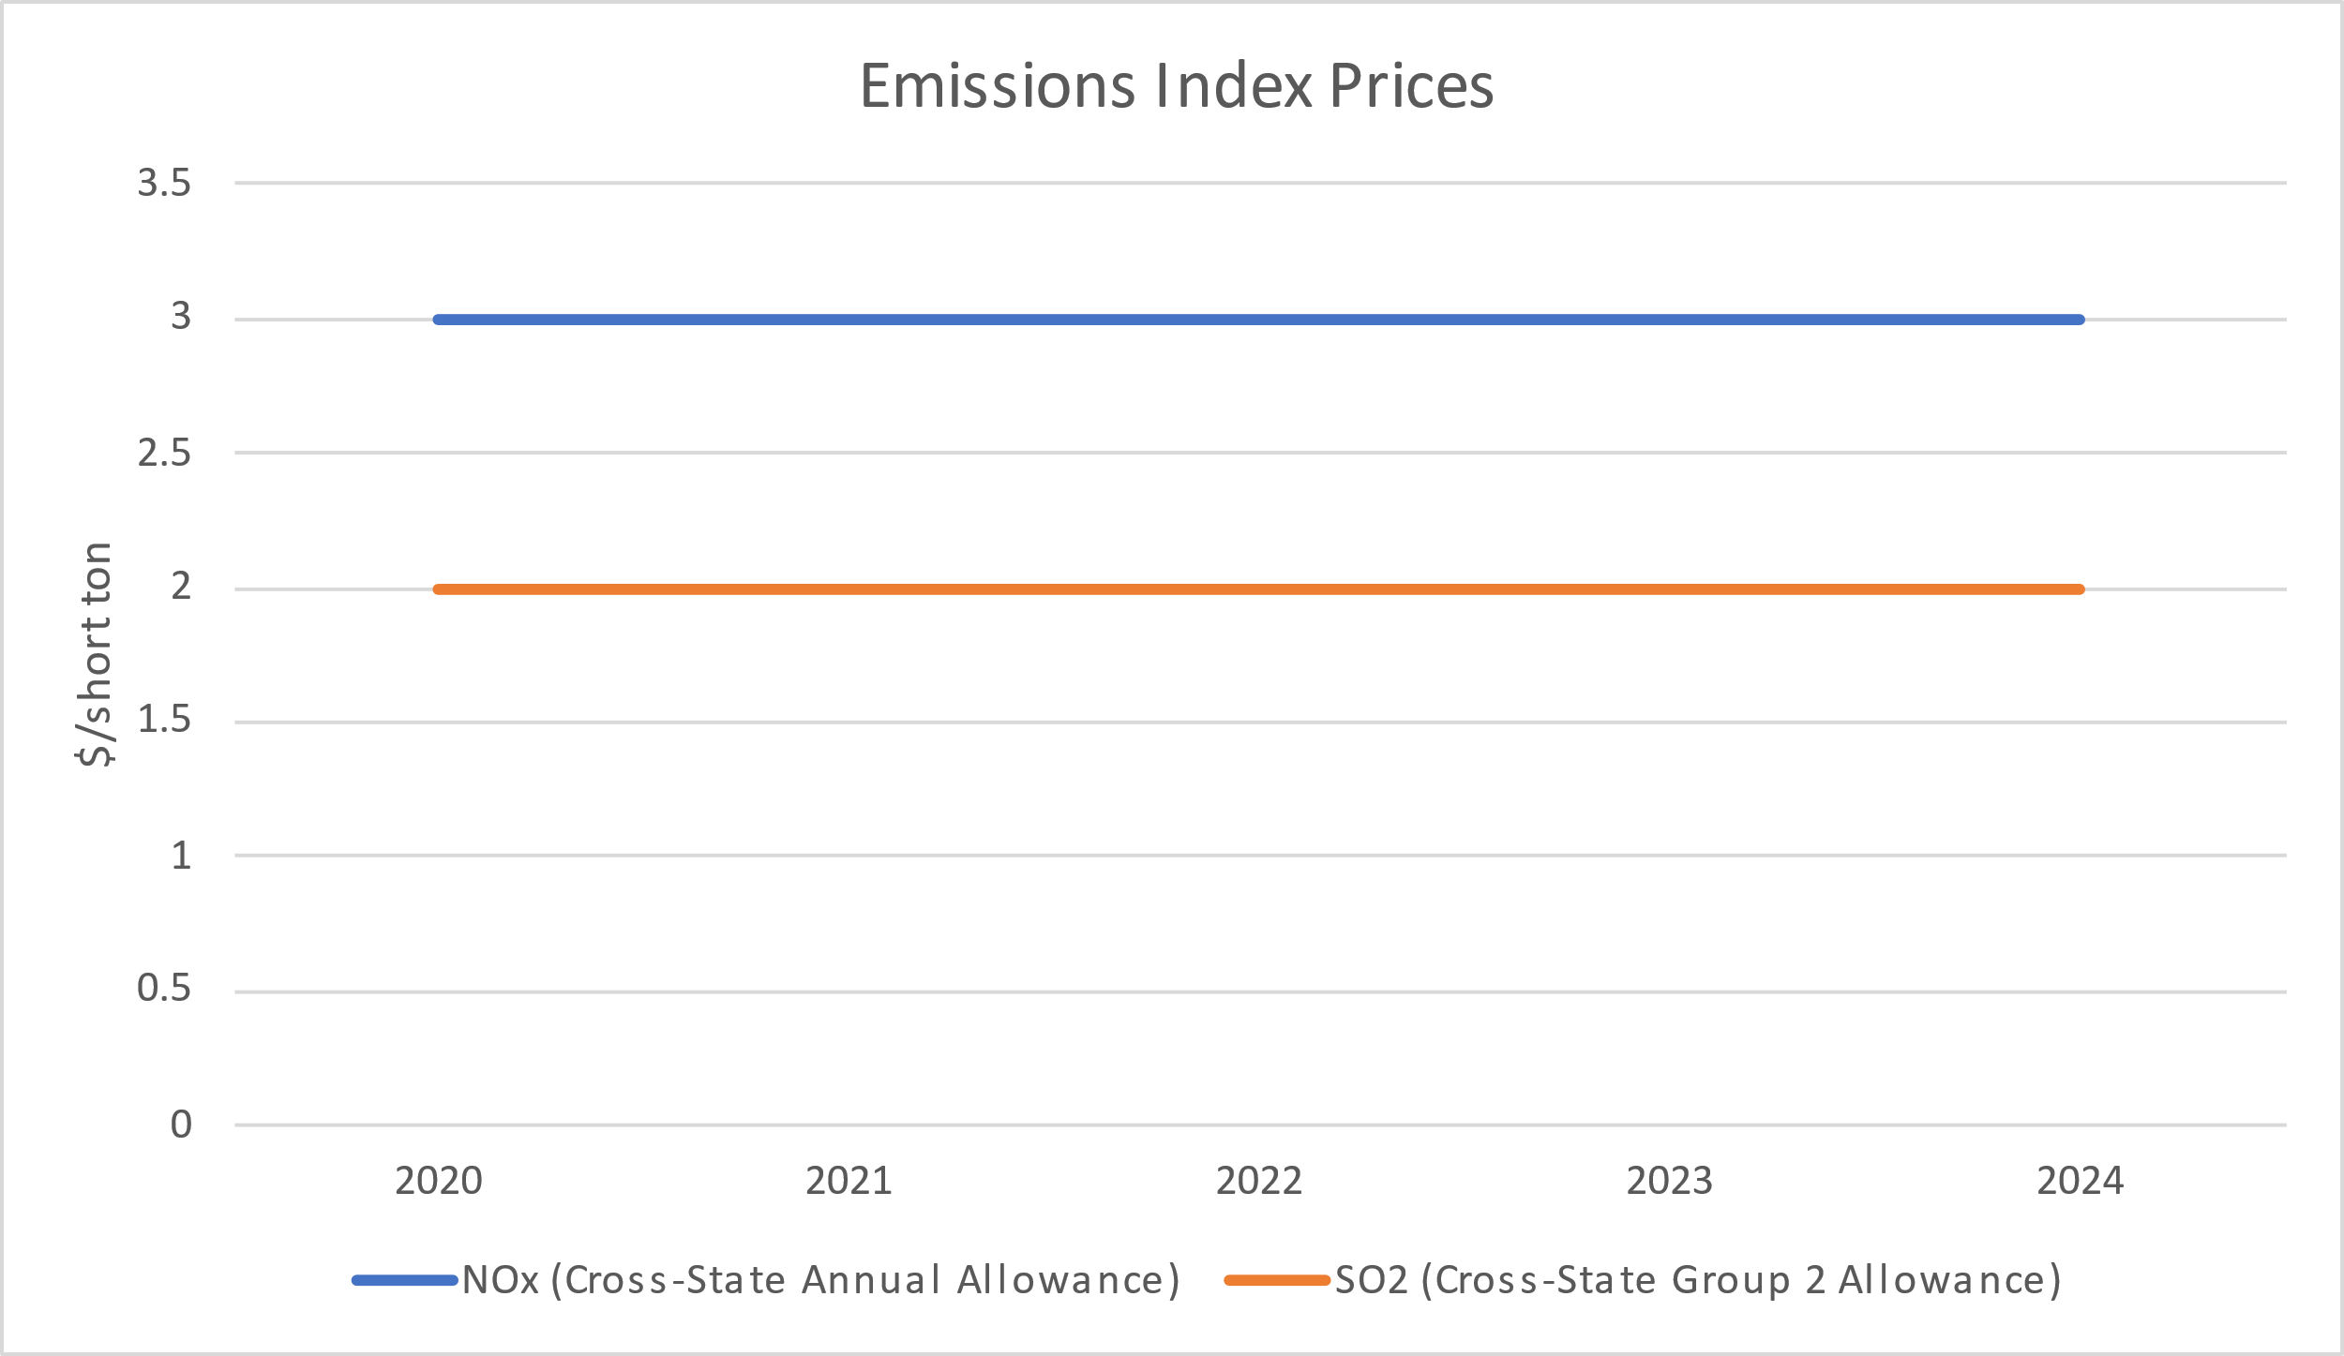
Average SO₂ and NO_{x} Emissions Index Prices (2020-2024)¹
¹ For Current Emissions Vendor

Slide 3
Average O&M Impact of Current Emission Prices
Operational Emissions¹ | Minimum ($/MWh) | Median ($/MWh) | Maximum ($/MWh)
NO_{X} | 0.00 | 0.00072 | 0.013
SO₂ | 0.00 | 0.0000072 | 0.0081
¹ O&M values calculated based on $3/short ton (NO_{x}) and $2/short ton (SO₂)

Slide 4
Emissions VCMRR
Eliminates current Index Price Subscription cost.
Removes requirement to use indices for the price of SO₂ and NO_{X}
Temporarily Replaces indices with fixed prices to calculate emission costs.
$3/short ton for NO_{X}
$2/short ton for SO₂
Fixed prices would remain until:
New EPA requirements substantially affecting SO₂ and NO_{X} emissions prices go into effect,
ERCOT determines that a competitive market for SO₂ and NO_{X} exists, or
As directed by TAC

Slide 5
Next Steps
Questions?

