Slide 1
RTC+B Technical Workshops
ERCOT Staff
May 15, 2024

Slide 2
RTC+B Technical Workshops
WELCOME
Workshop#3 - Market Interfaces design specifications (submissions - External API/Market Manager, notifications, and reports).

Slide 3
RTC+B Technical Workshops

Slide 4
Agenda
Item # | Item Description | Presenter | Start Time
1 | Antitrust admonition | Sreenivas Badri | 1:00 PM
2 | Introduction | Sreenivas Badri | 1:05 PM
3 | Recap of Workshop#2 | ERCOT Staff | 1:10 PM
4 | RTC+B Program Updates and Market Trials Timelines | Matt Mereness | 1:20 PM
5 | New/Modified Market Submissions in RTC+B | Nathan Smith | 1:30 PM
6 | RTC+B Market Manager UI and Outage Scheduler UI changes | Sruthi Hariharan | 2:00 PM
 | Break | Break | 2:20 PM
7 | Market External Interfaces – EWS XSD/EIP External Specification changes | Sreenivas Badri/Susan Jinright/Xiangjun Xu | 2:30 PM
8 | RTC+B Market External Interfaces Systems Configuration for Market Trials and Go Live | Sreenivas Badri/Indra Mallu | 3:00 PM
9 | Q&A Session | ERCOT Staff/QSEs/Vendors | 3:30 PM
10 | Workshop#4 Topics and Next Steps | Sreenivas Badri | 3:50 PM
11 | Adjourn | Sreenivas Badri | 4:00 PM

Slide 5
RTC+B Technical Workshops – Key Objectives
Key Objectives
Help QSEs, and their vendors start planning their RTC+B systems design and implementation early to align with ERCOT’s RTC+B project implementation timelines which is critical for ERCOT to deliver this project successfully and on time.
Based on the feedback from these workshops, ERCOT will finalize ICCP/Market External Interfaces design specifications and publish draft versions to the ERCOT website.
Upcoming RTC+B Technical Workshop Schedule
RTC+B Technical Workshop - June 6, 2024: 1:00 PM – 4:00 PM :
Reserved for further discussions if needed and Q&A session.

Slide 6
RTC+B Technical Workshops – Workshop #3
Focus of today’s meeting
Recap of Workshop#2
Go over RTC+B Market Submissions changes
Market Manager UI and Outage Scheduler UI changes
Market External Interfaces XSD/EIP External Interfaces Specification changes
RTC+B Market External Interfaces (External API/EWS) Systems Configuration
Out of Scope items from today meeting
RTC+B CDR Reports EWS XSD changes
Market Trials Readiness Plan
Closed Loop Testing and Cutover Plan

Slide 7
Recap of Workshop#2
Based on the feedback we received in workshop#2 on ICCP configurations pros/cons and further internal discussions:
ERCOT selected Option 1 - Add RTC+B telemetry points to current production ICCP system
Plan to publish ICCP Handbook draft version with RTC+B ICCP Telemetry points modeling by end of this month (05/31/2024).

Slide 8
RTC+B Program Update (excerpt from April Board T&S RTC Update)

Slide 9
Sequence and Potential Dates for Market Trials (dates subject to change while in Planning phase)
May 2025
June 2025
July 2025
Aug 2025
Sep 2025
Oct 2025
Nov 2025
Dec 2025
2 months
1-2 months
2 months
1 month
DRAFT
RTC QSE Submission Testing
(Submit COP, RT AS Offers,
DAM Virtual AS, Outages for ESRs)
Open-loop RTC SCED
(QSE offers, SCED non-binding award/dispatch)
Closed-loop RTC SCED
(QSE offers, SCED binding award and dispatch for 2-3 instances of 2-4 hours)
Transition to Go-Live
Upon completion of testing, confirmation of ERCOT and market readiness for Go-Live.
RTC QSE Telemetry Testing/Check-out
(Individual QSE testing of UDSP, New ramp rates, ESR telemetry)
Day-Ahead Market
(Non-binding DAM using QSE offers at least 2 times)
2-3 months
1-2 months

Slide 10
New/Modified Market Submissions in RTC+B
RTC+B Input Changes | Current Implementation | RTC+B Changes | Details
COP | Resource limits and status AS Responsibility from DAM/SASM AS Awards and Self-Arranged | AS Responsibility is replaced by AS Capability by AS type AS Capability represents a resource's total AS capacity available by AS type HSL, LSL, HEL, LEL can be negative for ESR | AS Capability Fields: REGUP REGDN RRSPFR RRSUFR RRSFFR ECRS – ECRSS/ECRSM based on Res Type NSPIN – OFFNS/ONNS/NSPNM SCED will use telemetered AS Capability
Resource AS Offers | Used by DAM/SASM | Resource AS Offers in the DAM will also be used in RUC and SCED if not cancelled prior to the relevant study interval SASM being removed | Existing AS Offer structure will be used for DAM, RUC, and SCED. RUC and SCED Resource AS Offers same as current DAM/SASM AS Offers
AS Only Offers(new) | N/A | Implement virtual AS Only Offers for DAM Only used by DAM | Virtual AS Offers are not associated with any resource Each offer can have up to 5 price/quantity block pairs Only 1 AS Type per AS Only Offer. Multiple offers for same AS Type allowed by Offer ID 5 AS Types for AS-Only REGUP REGDN RRSPF ECRSS ONNS

Slide 11
New/Modified Market Submissions in RTC+B
RTC+B Input Changes | Current Implementation | RTC+B Changes | Details
ESR Energy Bid/Offer Curve(new) | N/A | Single curve used for both gen and load side of ESR used by DAM/RUC/SCED | Existing TPO submission will be used EOC where negative MW values can be submitted as part of the curve. Negative MW values indicate the bid side (charging) while positive MW values indicate the offer side (discharging)
Three Part Offer | Used by DAM/RUC/SCED | Allow negative MW quantities for ESRs to implement ESR Energy Bid/Offer Curve for DAM/RUC/SCED | Only change is for ESR

Slide 12
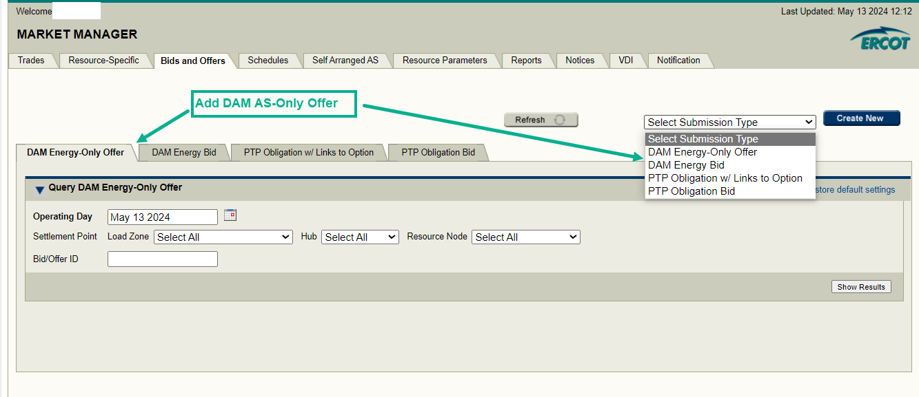
Market Manager UI RTC+B changes – DAM AS-Only Offers

Slide 13
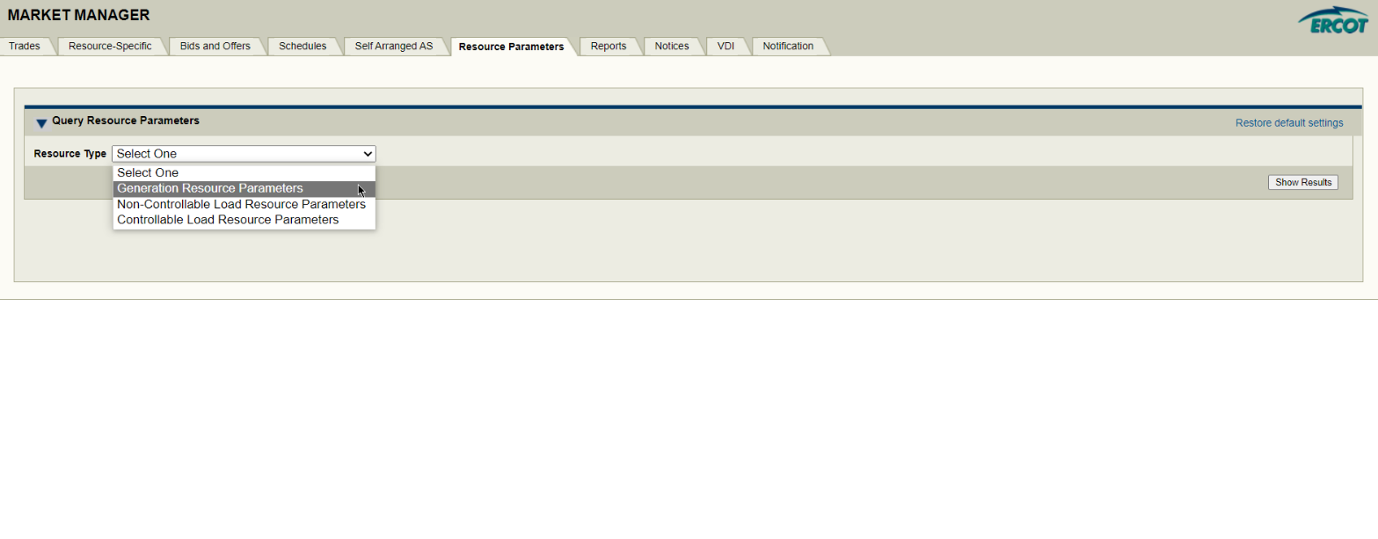
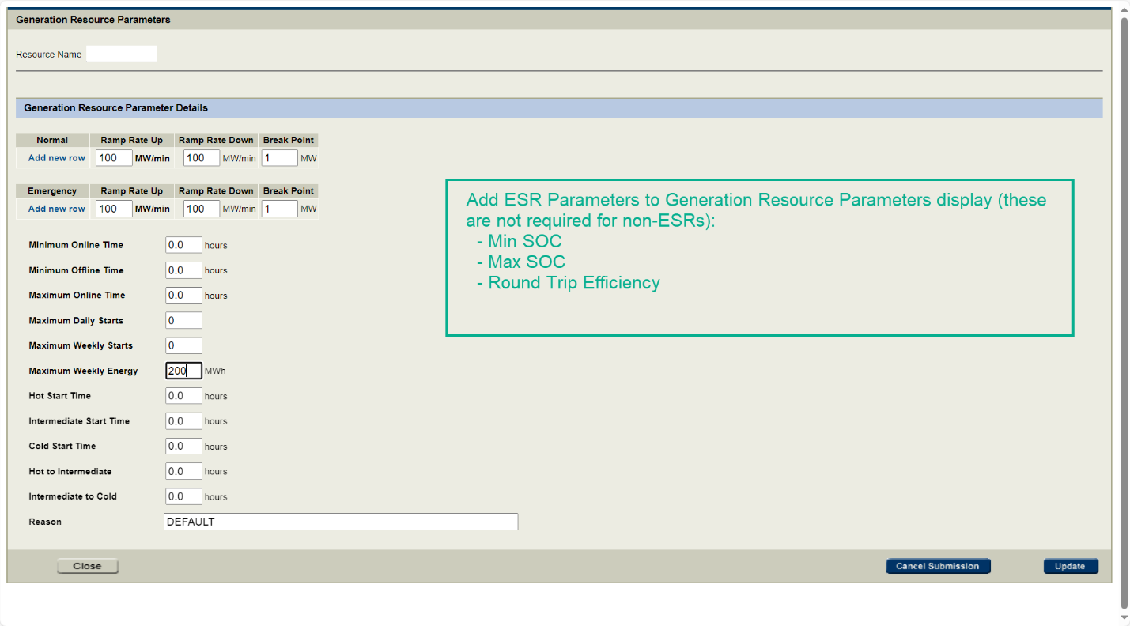
Market Manager UI RTC+B changes – Resource Parameters

Slide 14
Market Manager UI RTC+B changes - COP

Slide 15
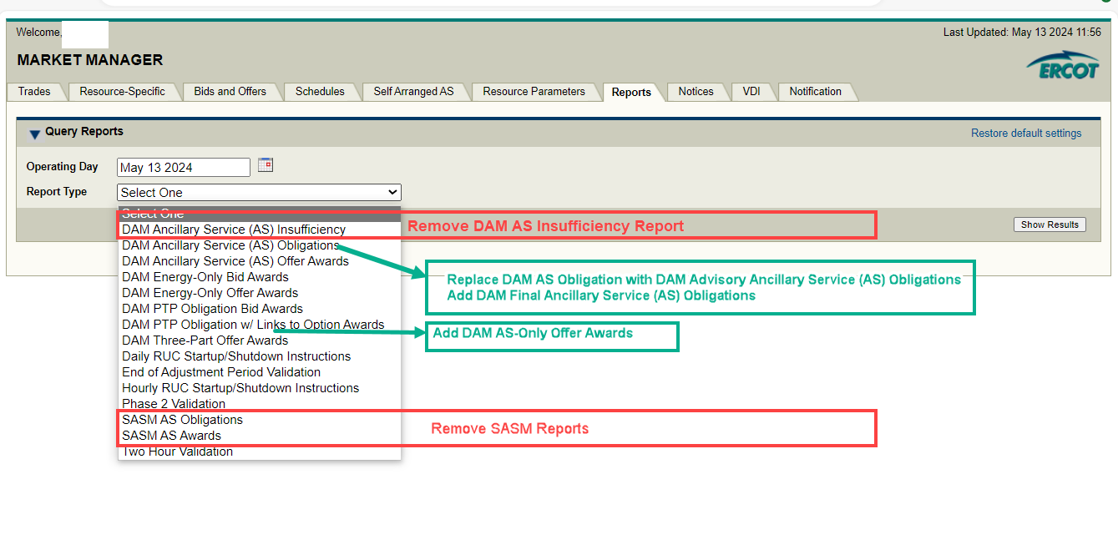
Market Manager UI RTC+B changes - Reports

Slide 16
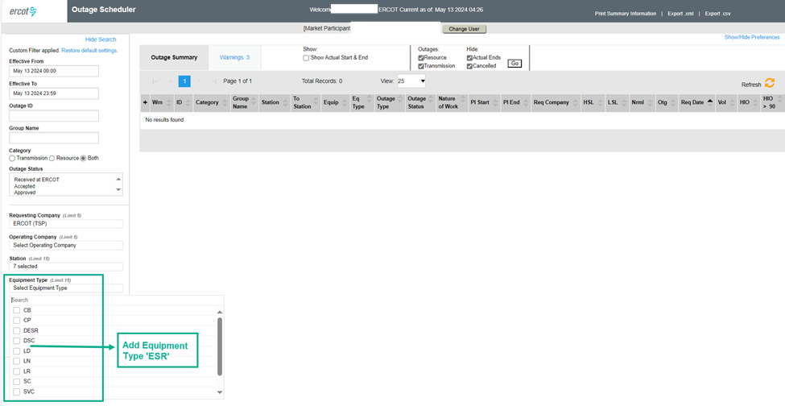
RTC+B Outage Scheduler UI changes
Transmission Level Single Model Battery - ESR equipment type will be added to Outage Scheduler UI for ESR Outage Submissions.

Slide 17
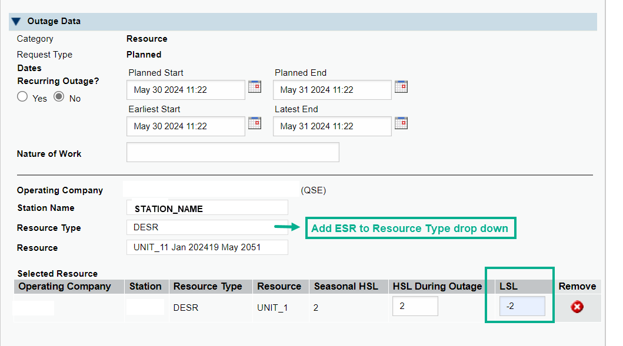
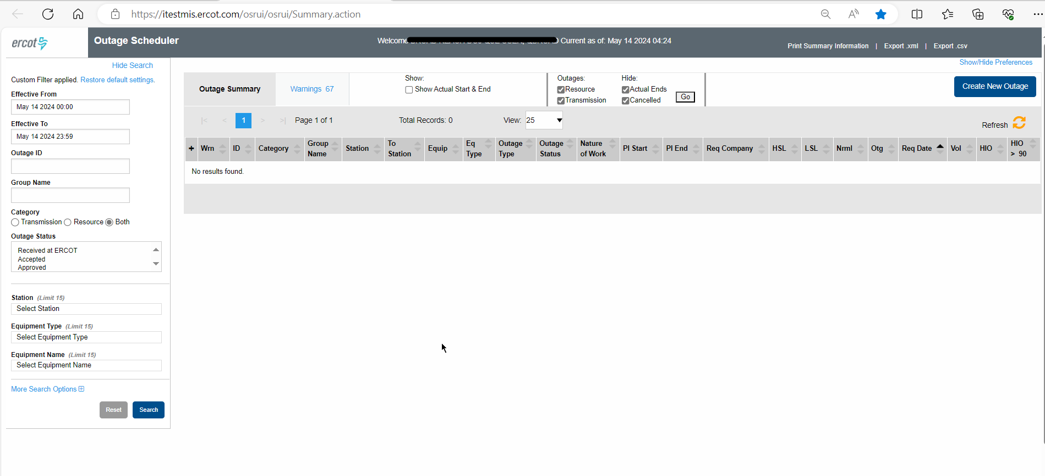
RTC+B Outage Scheduler UI changes
Transmission level Energy Storage Resources (ESRs)
Equipment Type ESR can have a negative HSL/LSL. It is a validation change in internal OS application.
Equipment Type ESR should have a fuel type of BAT. Fuel type is populated by internal OS application.
Distribution level Single Model Battery – DESR
Distribution Energy Storage Resources (battery) is already modeled as DESR in Outage Scheduler.
Equipment type DESR can have a negative HSL/LSL. It is a validation change in internal OS application.
Equipment type DESR should have a fuel type of BAT. Fuel type is populated by internal OS application.

Slide 18
RTC+B Technical Workshop
10 Minutes Break

Slide 19
RTC+B Market External Interfaces – EWS XSD changes - Submissions
Component | Details | XSD Change Required? | Notes
DAM AS Only Offers | REGUP, REGDN, RRSPF, ECRSS, NSPIN AS Types | Yes – New Submission Type – ASOnlyOffer | XSD files changed: ErcotTransactions.xsd ErcotCommonTypes.xsd ErcotTransactionTypes.xsd
ESR Energy Bid/Offer Curve | new Bid/Offer Curve for ESRs | No – Use existing Three Part Offer Curve | o EOC where negative MW values can be submitted as part of the curve. o Negative MW values indicate the bid side (charging) while positive MW values indicate the offer side (discharging).
ESR Parameter submission | Below ESR Parameters will be added under Generation Resource Parameters submission: • Max Nameplate SOC • Min Nameplate SOC • Round Trip Efficiency • Normal Ramp Rate • Emergency Ramp Rate | Yes – Modify Generation Resource Parameters Submission | XSD files changed: ErcotTransactionTypes.xsd ErcotCommonTypes.xsd
COP | • Resource statuses changes • For ESRs - HSL, LSL, HEL, LEL can be negative | Yes – Modify Operating Mode enumerations | o XSD changes are required to add RTC+B Resource Status changes and remove existing resource status XSD file(s) changed: ErcotCommonTypes.xsd o For ESRs, XSD already allows negative HSL/LSL
Three Part Offer | Allow MW quantities to be negative for ESRs | No | XSD already allows negative MWs
Output Schedule | MW quantities can be negative for ESRs | No | XSD already allows negative MWs

Slide 20
RTC+B Market External Interfaces – EWS XSD changes – MMS Reports
Component | Details | XSD Change Required? | Notes
MMS Reports - API | DAM AS Insufficiency | Yes - delete | ErcotAwards.xsd and ErcotAwardTypes.xsd files changed to delete DAM AS insufficiency
 | DAM AS obligation | Yes - Modify DAM AS Obligation | o Update EIP External Interfaces Specification document to change DAM AS Obligation to Advisory DAM AS Obligation o Removed SASMID element from ErcotAwardTypes.xsd file
 | DAM AS obligation - Final | No - New Report will be published with XSD format same as current DAM AS Obligation Report | o After DAM publish - final AS Obligation based on the total DAM AS procurement quantity, comprised of DAM AS awards and Self-Arranged AS Quantities for each service and for each hour of the Operating Day. o XSD format is same as DAM AS Obligation o Two new nouns in GetASObligation call (DAM Advisory AS Obligation and DAM Final AS Obligation) will be added to EIP External Interfaces Specification document and AS Obligation will be removed from this document. o This is just an EIP External Interfaces Specification Documentation Update, No XSD change is required.
 | DAM TPO Offer awards | No | Existing XSD allows awarded quantity to be negative for ESRs
 | DAM AS Only Offer Awards | Yes - New Report | New Report – ErcotAwards.xsd and ErcotAwardTypes.xsd files changed
 | SASM AS obligation | Yes – delete | ErcotAwardTypes.xsd file was changed to delete SASMID from AS Obligation Report
 | SASM AS awards | Yes - delete | ErcotAwardTypes.xsd file was changed to delete SASMID from AS Awards Report.

Slide 21
RTC+B Market External Interfaces – EWS XSD changes – Outages
Component | Details | XSD Change Required? | Notes
Outage Scheduler – ESR Equipment Type | Transmission Level Single Model Battery -new “ESR” equipment type of resource equipment | Yes | o ErcotOutageTypes.xsd change to add ESR enumeration under ResourceType. o Equipment Type ESR can have a negative LSL/HSL. Current OS XSD allows negative values. o Equipment Type ESR should have a fuel type of BAT o ESR have the same life cycles as Resource equipment type UN.

Slide 22
XML Alerts and Notices – Message Specifications
NSPIN, RRS-UFR, ECRSM AS deployments instructions XML structure is NOT expected to change in RTC+B.
AS Responsibility, SASM related XML notifications will be deleted.
“DAM AS Only Offer Award Report Available” XML notification will be added.
DAM-ASONLYAWD-RPT Reports on AS-Only Awards for operating date 05/14/2024 are available.
EIP External Interfaces Specification document will be updated with complete list of Alerts and Notices changes.

Slide 23
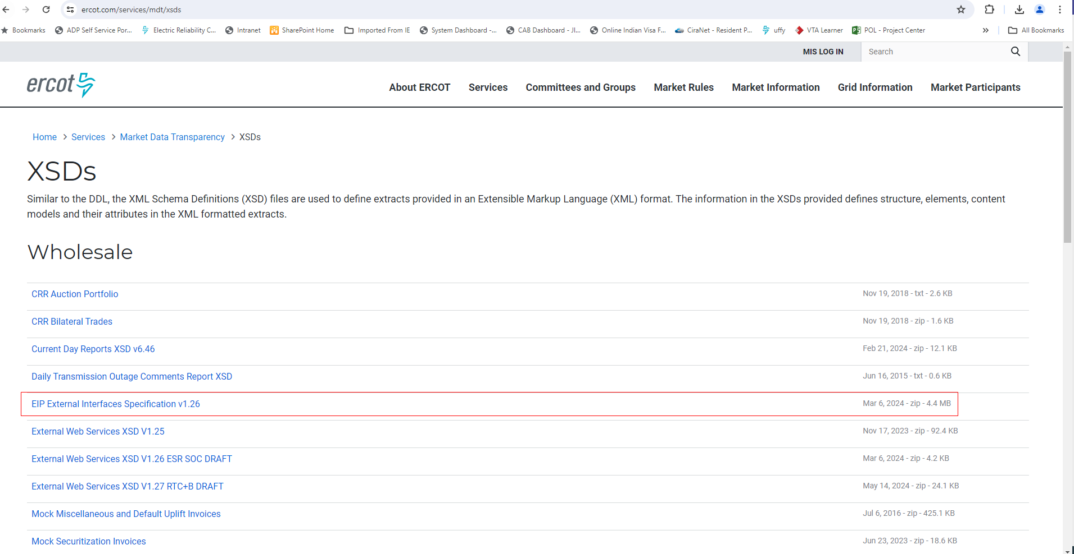
RTC+B - External Interfaces Specification Document Link
EIP External Interfaces Specification document draft version will be published to ercot.com website by June 1st week. It will also include XML notification changes.
https://www.ercot.com/services/mdt/xsds

Slide 24
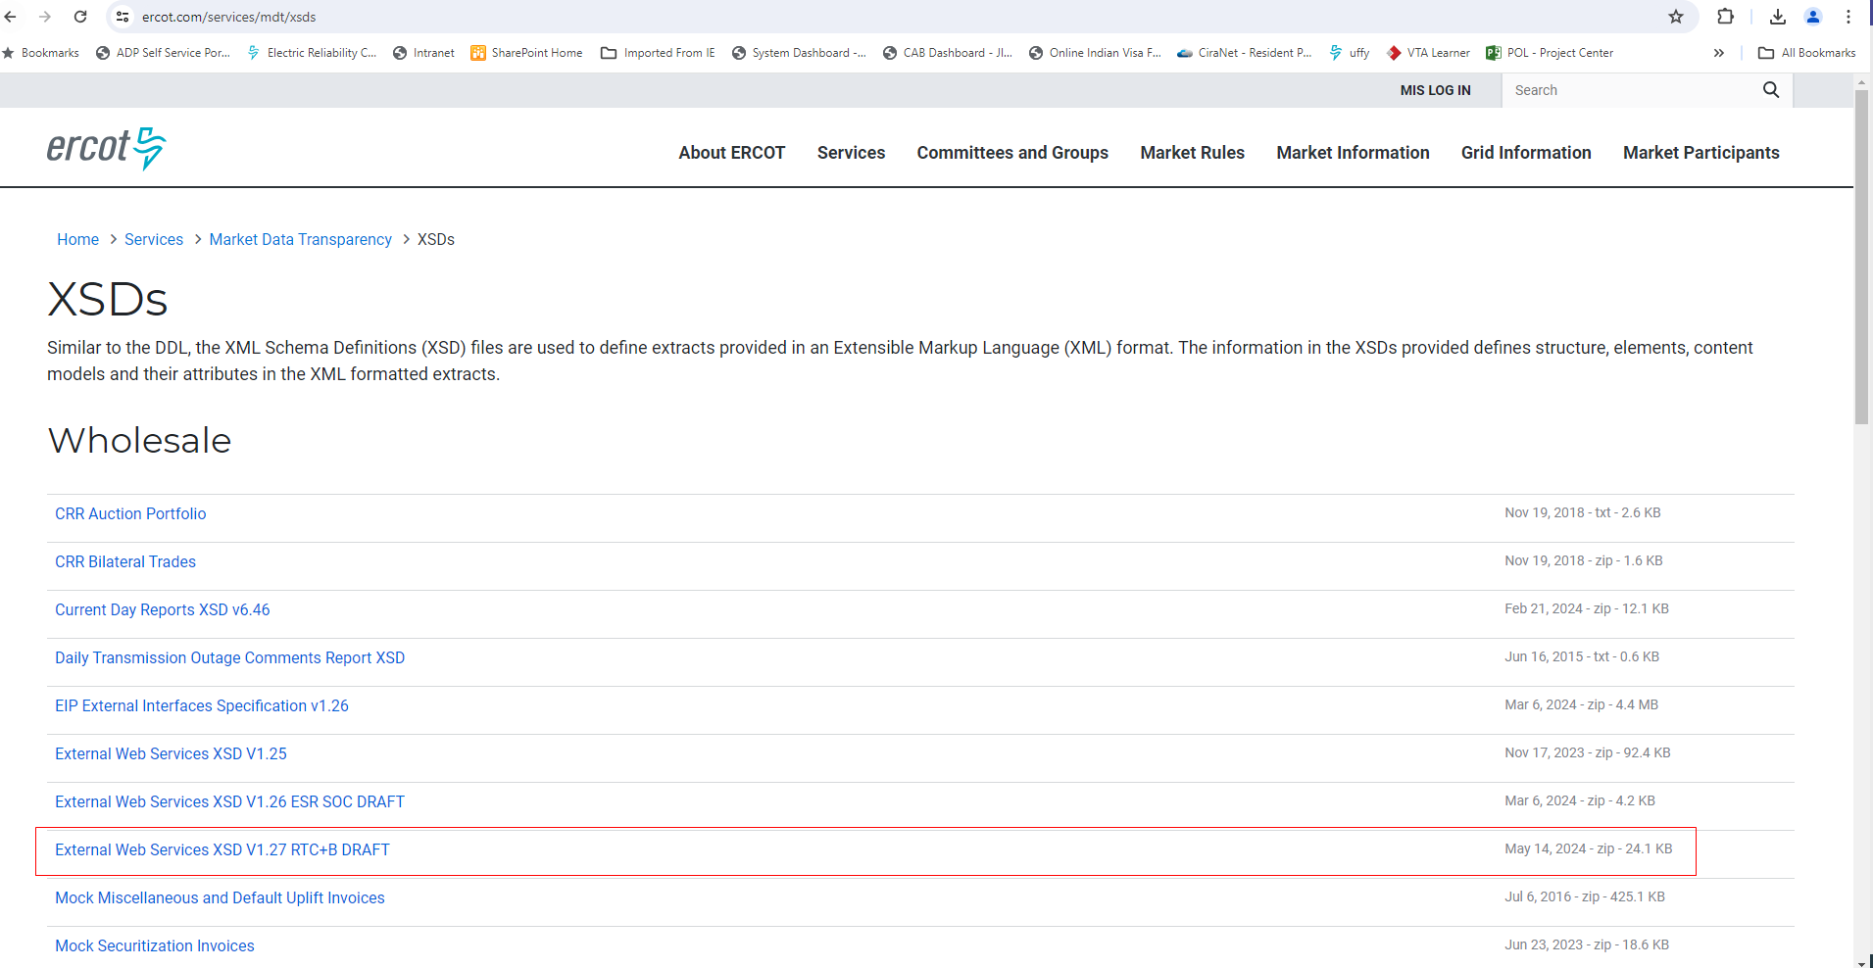
RTC+B Market External Interfaces XSD changes
RTC+B XSD changes (along with Example XML Payloads) draft version high lighted in below screenshot is available in ercot website at https://www.ercot.com/services/mdt/xsds
These XSD changes include Only RTC+B Market Submissions, Reports related to Awards, Outage submissions along with examples.

Slide 25
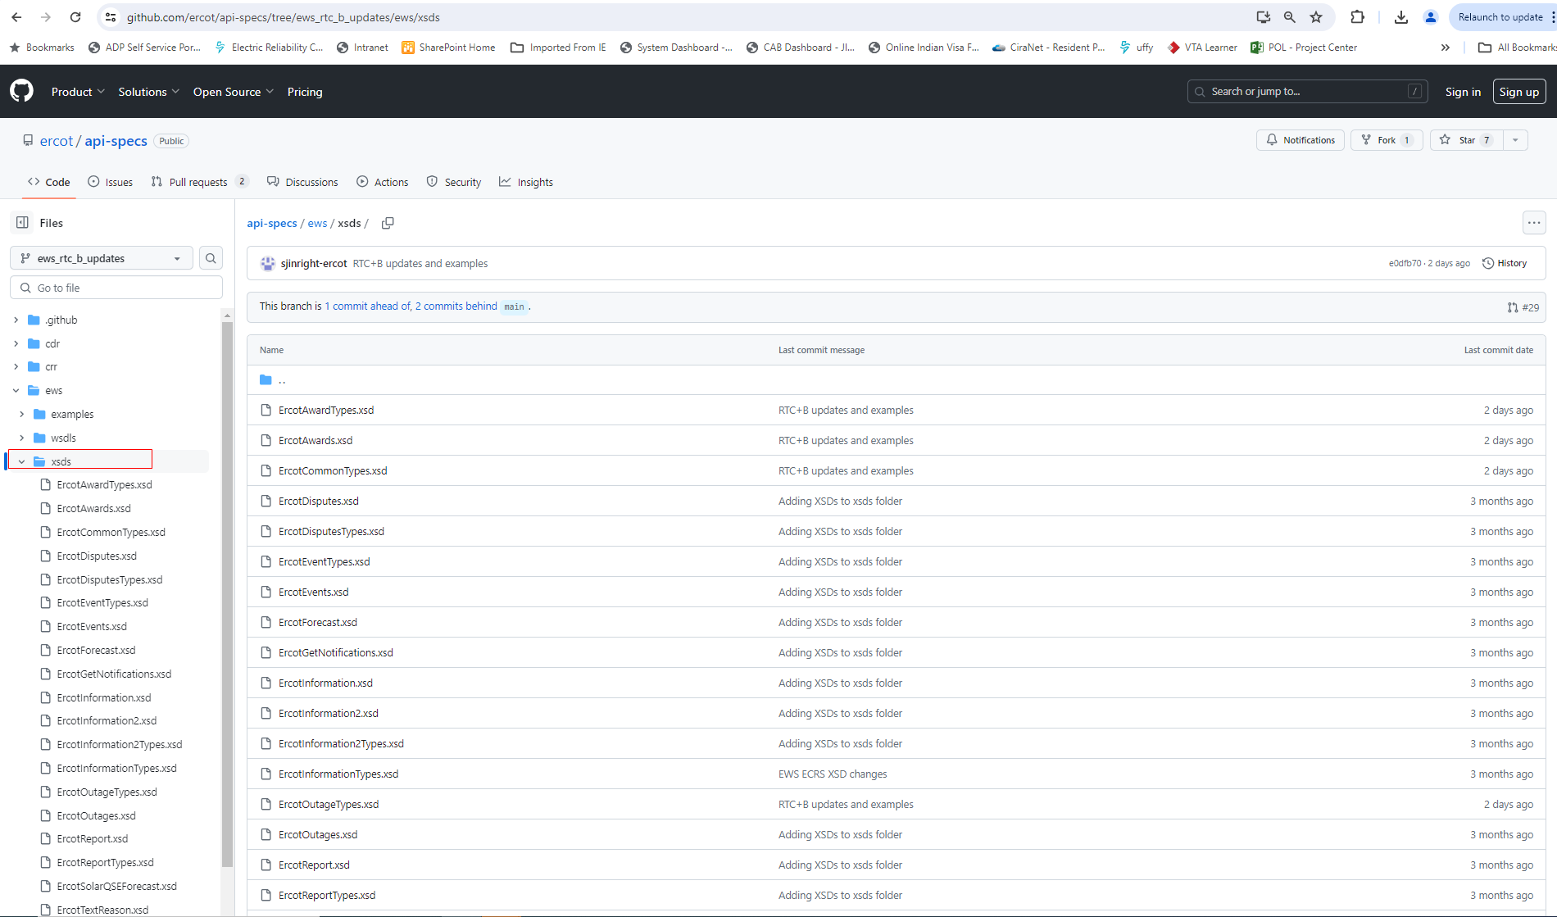
RTC+B Market External Interfaces XSD changes
RTC+B XSD changes draft version is also posted to ERCOT developer portal (https://developer.ercot.com). It is accessible to public users.
Below is the direct link to developer portal github where you can see the RTC+B XSD changes.
https://github.com/ercot/api-specs/tree/ews_rtc_b_updates/ews
Below is the screen of ercot developer portal Github RTC+B XSD changes

Slide 26
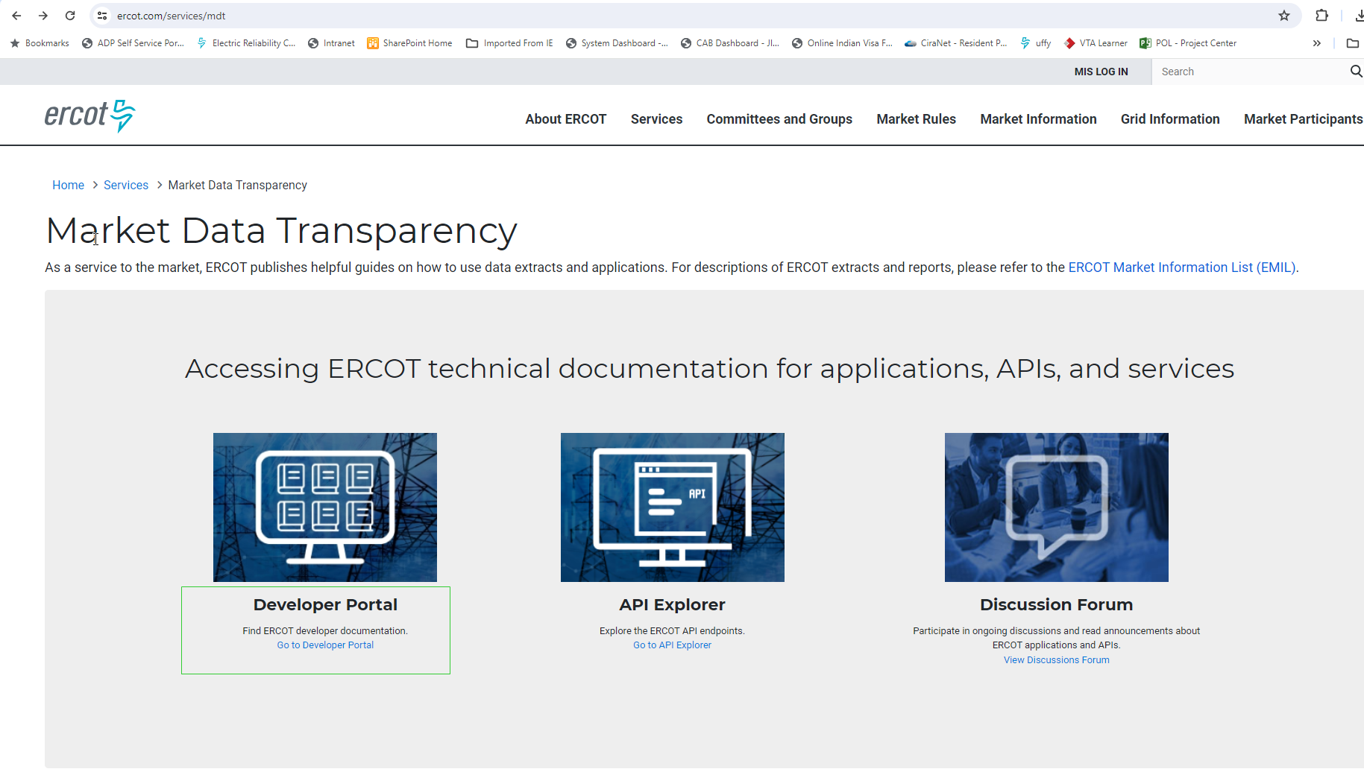
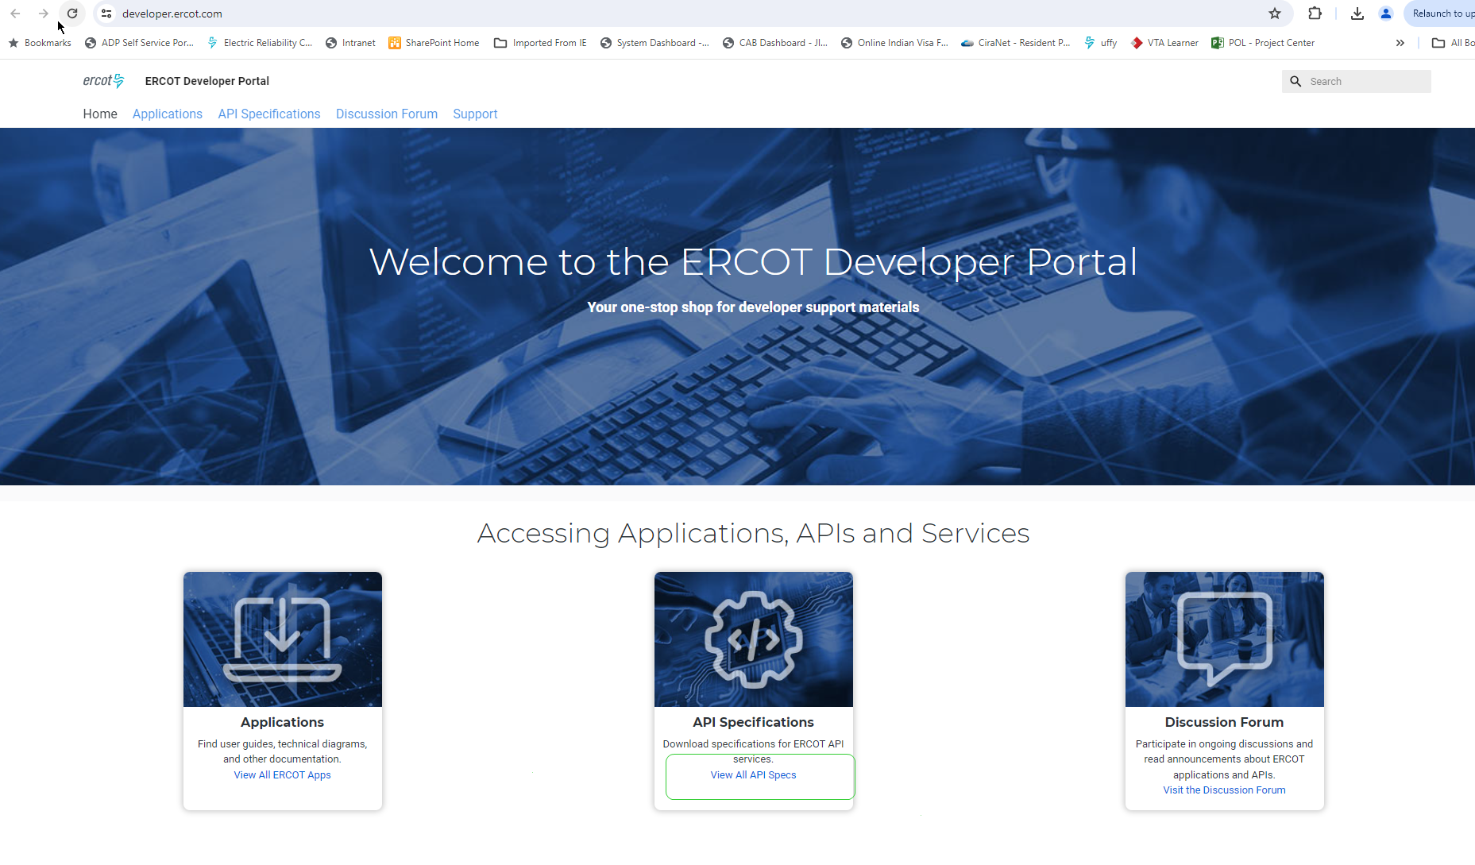
RTC+B Market External Interfaces XSD changes
ERCOT Developer portal is accessible through ercot.com Market Data Transparency web page as well. Follow below steps to launch developer portal.

Slide 27
RTC+B Market External Interfaces Systems Configuration – Market Trials
Market External Interfaces – Market Submissions, Notifications, Awards, Outage Submissions.
RTC+B Market Trials
QSE Market Submissions Testing using API and Market Manager UI
QSE will test their market submissions for defined transaction (COP, RT AS Offers, DAM Virtual AS Offers, etc.)
QSE Outage Scheduler submissions Testing using API and Outage Scheduler UI
Open Loop Testing
RTC SCED execution based on QSE Offers etc.
RTC SCED non-binding award/dispatch
DAM execution – QSE bids/offers, non-binding
Closed Loop Testing
RTC SCED execution based on QSE Offers etc.
RTC SCED binding award/dispatch
2-3 instances of closed loop testing with 2-4 hours duration

Slide 28
RTC+B Market External Interfaces Systems Configuration
ERCOT and QSEs to stand up new parallel External API/EWS Systems for RTC+B Project.
Deploy RTC+B code and test the market and OS submissions
Market Trials including Closed Loop Testing will be performed using new parallel EWS Systems
Dual Entry into current production and RTC+B during market trials
Maintain and support this new parallel systems until go live
Go live on new parallel EWS Systems
QSEs to submit RTC+B market and OS submissions as well as current production submissions not changed by RTC+B project
No change to WSDL files and API communication
Change is only in XSDs and XML inside Payload

Slide 29
RTC+B Market External Interfaces Systems Configuration
New RTC+B External API EWS end point will be provided for QSEs.
QSEs will have to setup and provide new RTC+B notification listener end point URL to ERCOT.
QSEs can use current Production digital certs for RTC+B project External API.
ERCOT will provide new Market Manager UI and Outage Scheduler UI URLs to QSEs for Market Trials and Go Live.
QSEs can use current production digital certs to launch RTC+B Market Manager UI and Outage Scheduler UI

Slide 30
Q&A Session

Slide 31
Workshop#4 - Topics
Workshop#4 scheduled on 06/06/2024 as a place holder.
For any additional discussions on RTC+B ICCP/EMS/Market External Interfaces systems design and implementation related topics, reach out to Sreenivas.Badri@ercot.com

Slide 32
Next Steps
ERCOT to update EIP External Interfaces Specifications document and publish draft versions to the ERCOT website by June 1st week.
https://www.ercot.com/services/mdt/xsds
QSEs/Vendors to plan the RTC+B Market External Interfaces design and implementation to align with ERCOT Market Trials timelines.
For any questions and feedback, contact me at Sreenivas.Badri@ercot.com

Slide 33
RTC+B Technical Workshops
Thank You!!!

