Slide 1
Credit Exposure Update
Market Credit Work Group
ERCOT Public
May 2024

Slide 2
Monthly Highlights March 2024 - April 2024
Market-wide average Total Potential Exposure (TPE) increased from $1.37 billion in March 2024 to $1.52 billion in April 2024.
  TPE increased due to higher forward adjustment factors and real-time and day-ahead prices
    Discretionary Collateral is defined as Secured Collateral in excess of TPE,CRR Locked ACL and DAM Exposure
  Average Discretionary Collateral decreased from $4.43 billion in March 2024 to $4.10 billion in April 2024
Four Counter-parties defaulted for not posting the required Independent Amount after NPRR 1165 was implemented on April 1st. All four CPs did not have any activity in the market and did not want to post Independent Amounts.

Slide 3
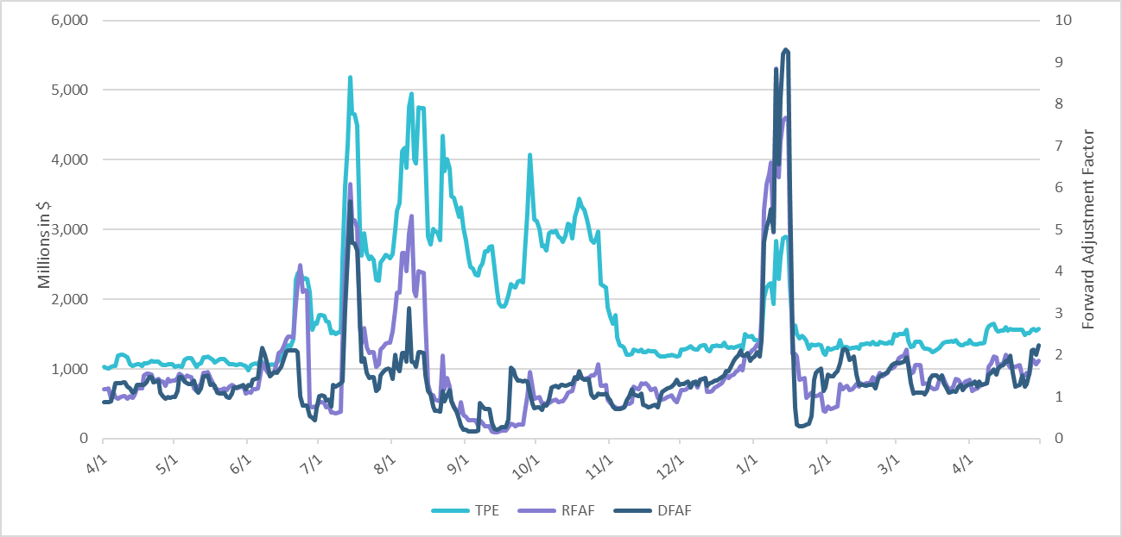
TPE and Forward Adjustment Factors: April 2023 – April 2024
*TPE adjusted to exclude short pay entities eliminating data skew

Slide 4
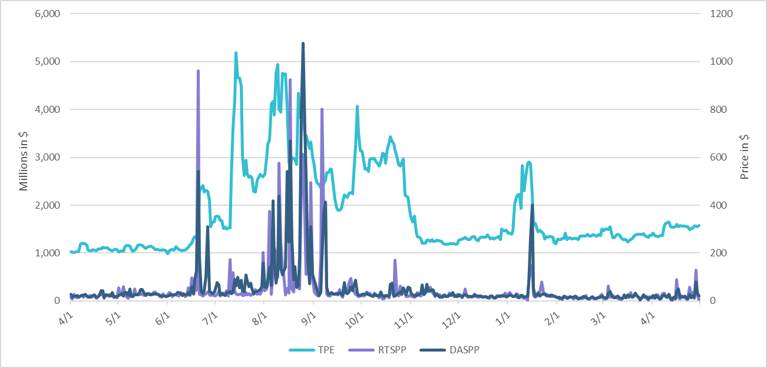
TPE/Real-Time & Day-Ahead Daily Average Settlement Point Prices for HB_NORT:H April 2023 – April 2024
* TPE adjusted to exclude short pay entities eliminating data skew

Slide 5
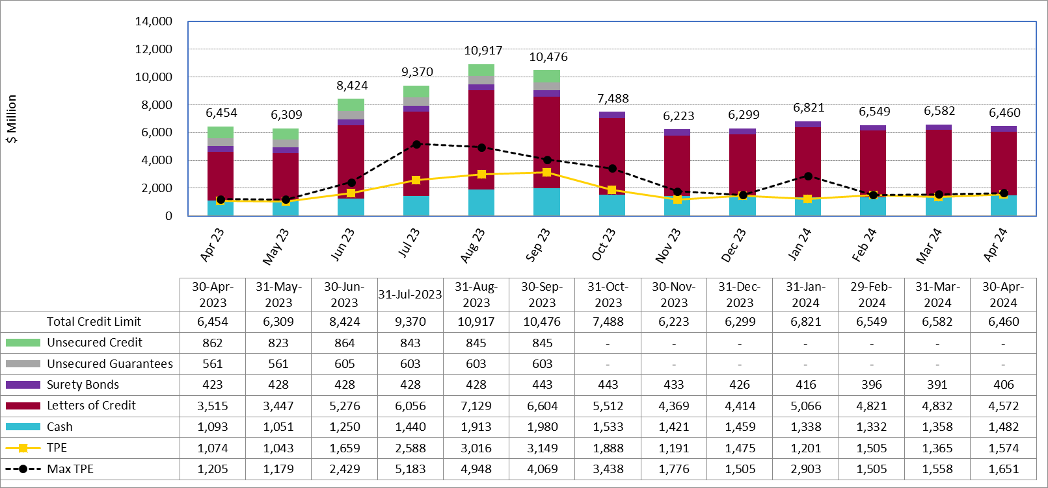
Available Credit by Type Compared to Total Potential Exposure (TPE):
April 2023 – April 2024
Numbers are as of month-end except for Max TPE
Max TPE is the highest TPE for the corresponding month

Slide 6
Issuer Credit Limits vs Total LC Amounts Per Issuer: End-April 2024
As of April 30, 2024
There are a total of 36 banks that have issued LCs.

Slide 7
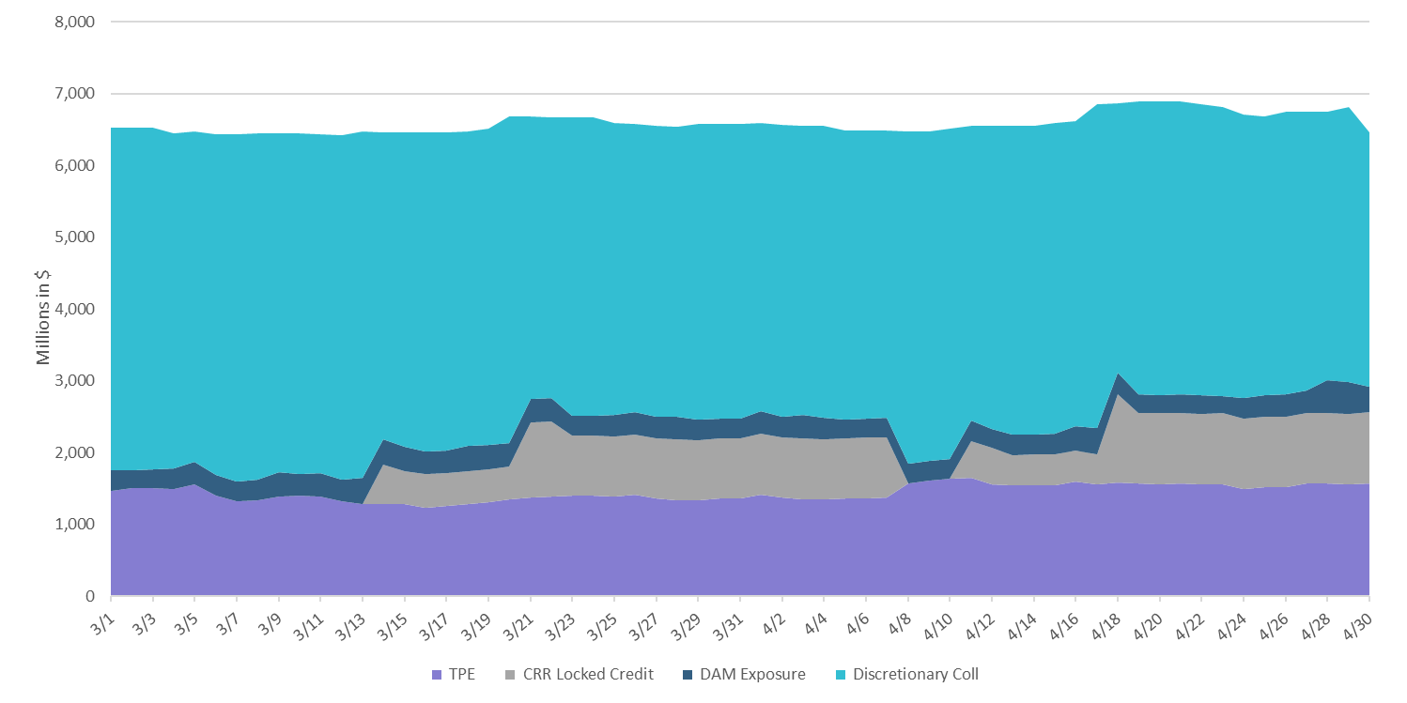
Discretionary Collateral March 2024 – April 2024
* Discretionary collateral doesn’t include Unsecured Credit Limit or parent guarantees

Slide 8
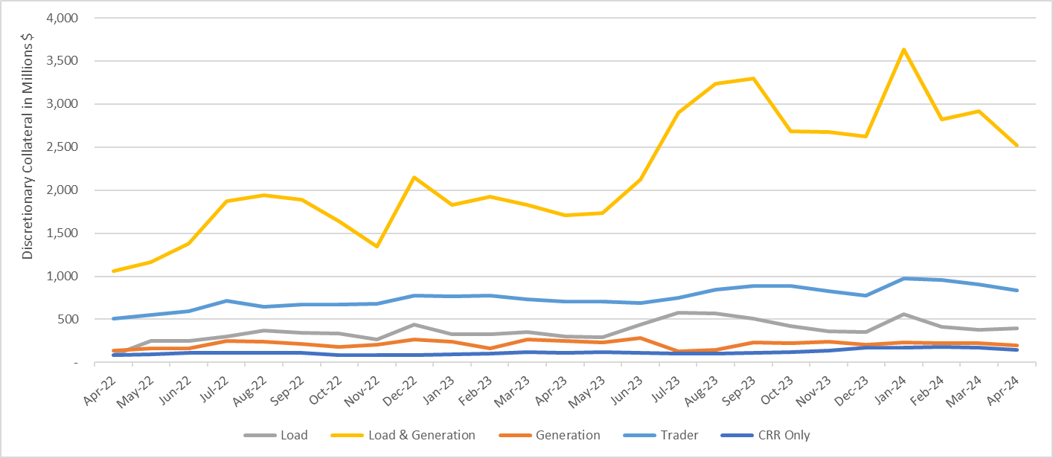
Discretionary Collateral by Market Segment April 2022 - April 2024
* Discretionary Collateral adjusted to exclude short pay amounts eliminating data skew

Slide 9
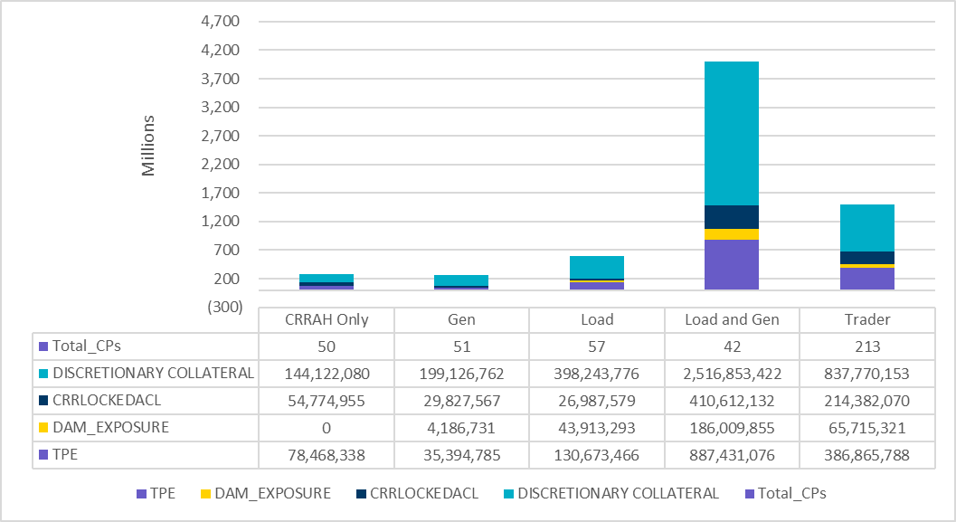
TPE and Discretionary Collateral by Market Segment - April 2024
Load and Generation entities accounted for the largest portion of discretionary collateral

Slide 10
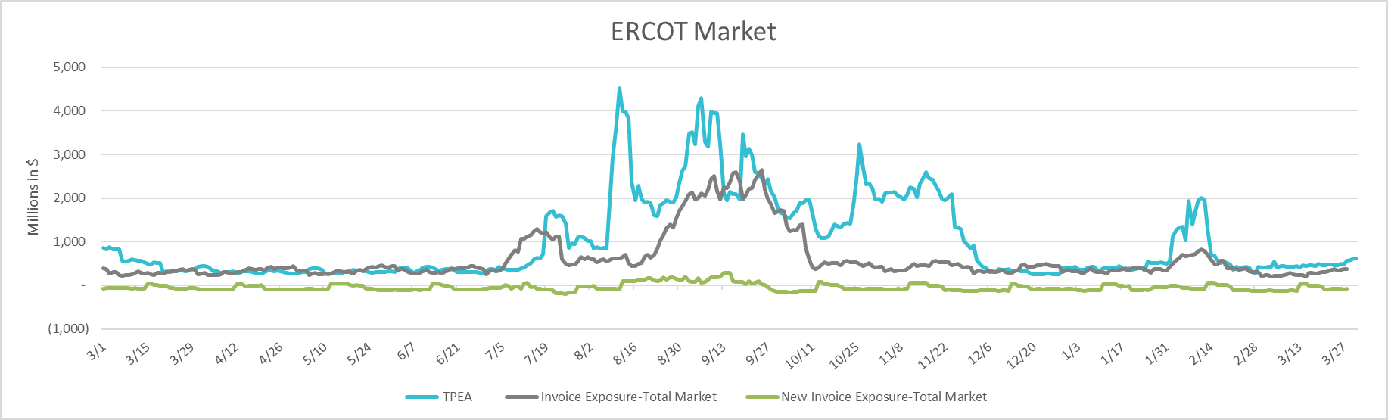
TPEA Coverage of Settlements March 2023 - March 2024
Invoice Exposure | Historical | Future
Existing Invoice Exposure | RTLCNS + UDAA | M1 Days (including current day) Forward Charge Invoice Amounts
New Invoice Exposure | 7 Days Back Net Invoice Amounts (Charges & Credits) | M1 Days (including current day) Forward Net Invoice Amounts (Charges & Credits); Excluding: 1) Securitization Invoices; 2) CRR Auction Invoices; and 3) Subchapter N Funds Distribution Invoice
TPEA closely approximates actual/invoice exposure

Slide 11
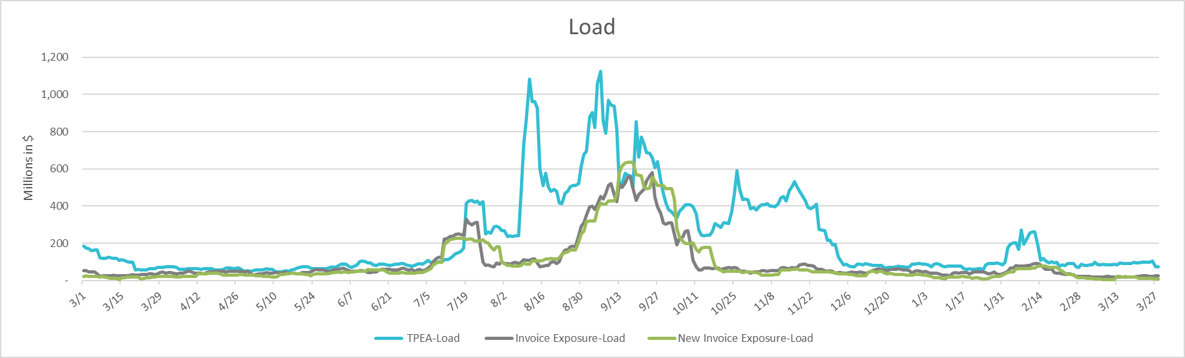
TPEA Coverage of Settlements March 2023 - March 2024
Invoice Exposure | Historical | Future
Existing Invoice Exposure | RTLCNS + UDAA | M1 Days (including current day) Forward Charge Invoice Amounts
New Invoice Exposure | 7 Days Back Net Invoice Amounts (Charges & Credits) | M1 Days (including current day) Forward Net Invoice Amounts (Charges & Credits); Excluding: 1) Securitization Invoices; 2) CRR Auction Invoices; 3) Subchapter N Funds Distribution Invoice
*TPEA exceeds invoice exposure

Slide 12
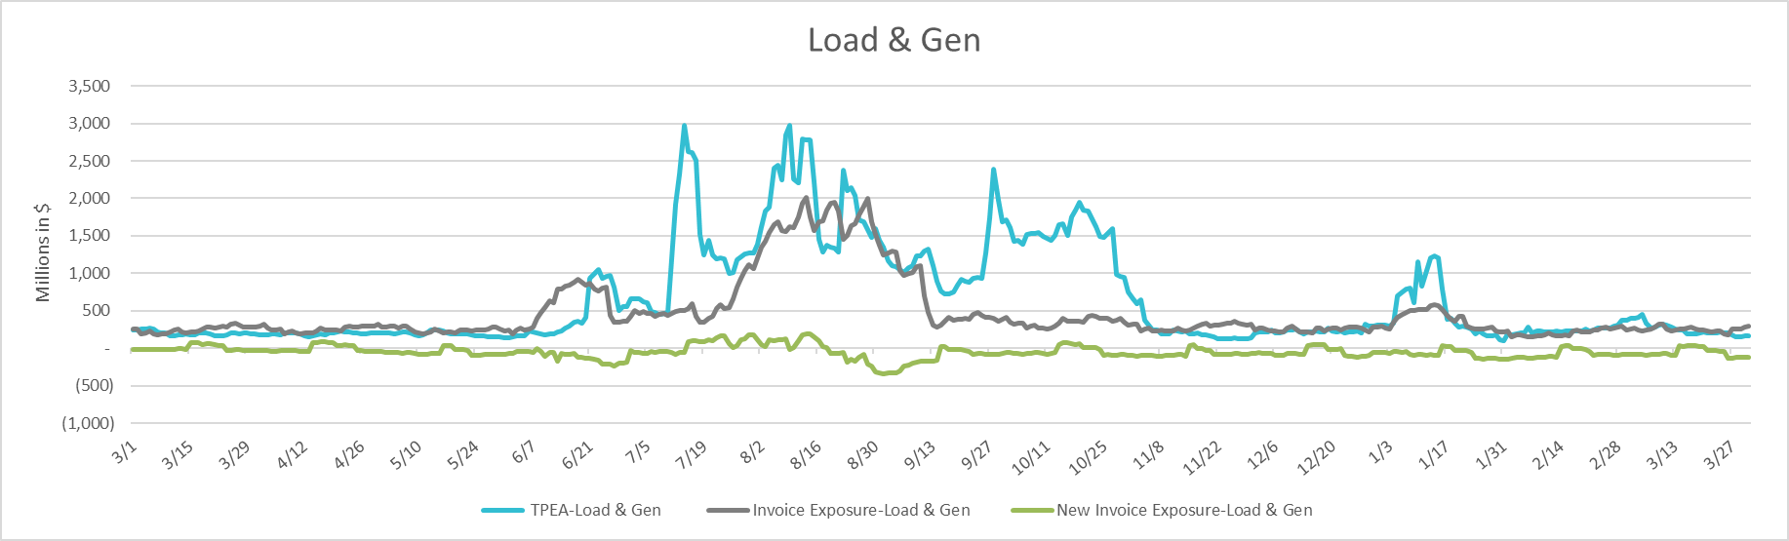
TPEA Coverage of Settlements March 2023 - March 2024
Invoice Exposure | Historical | Future
Existing Invoice Exposure | RTLCNS + UDAA | M1 Days (including current day) Forward Charge Invoice Amounts
New Invoice Exposure | 7 Days Back Net Invoice Amounts (Charges & Credits) | M1 Days (including current day) Forward Net Invoice Amounts (Charges & Credits); Excluding: 1) Securitization Invoices; 2) CRR Auction Invoices; 3) Subchapter N Funds Distribution Invoice
Invoice exposure generally exceeds TPEA

Slide 13
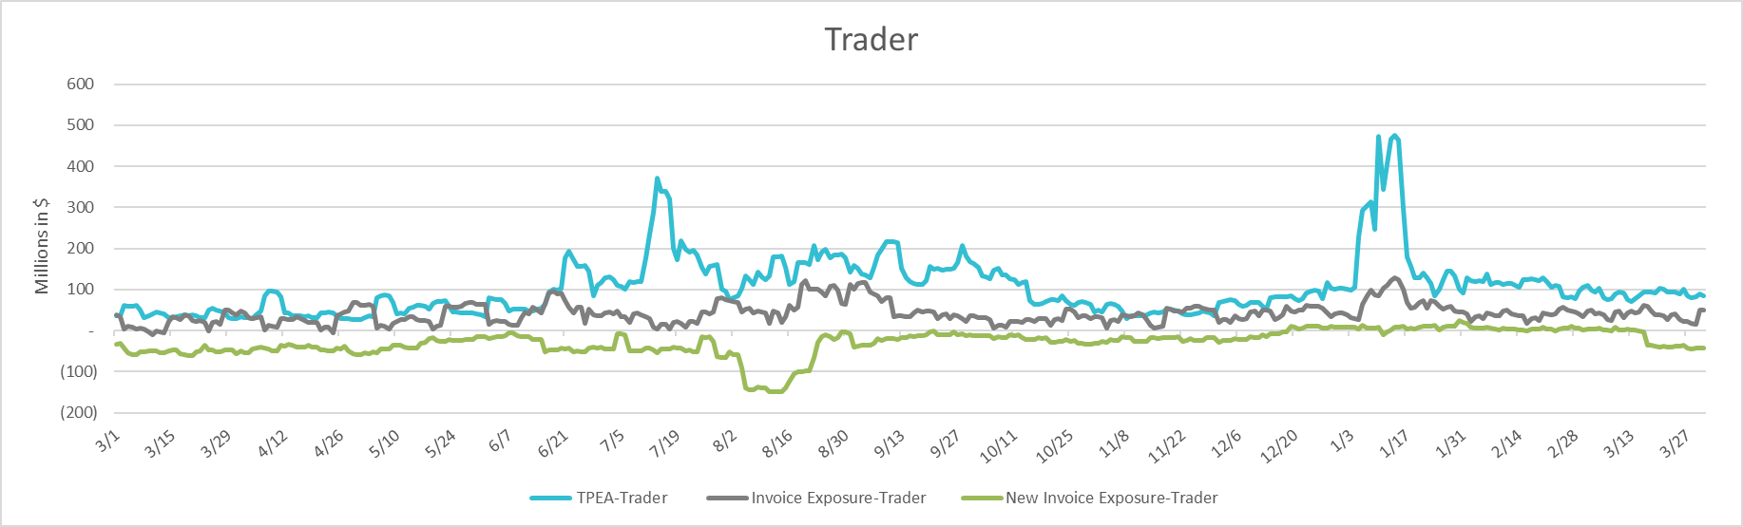
TPEA Coverage of Settlements March 2023 - March 2024
Invoice Exposure | Historical | Future
Existing Invoice Exposure | RTLCNS + UDAA | M1 Days (including current day) Forward Charge Invoice Amounts
New Invoice Exposure | 7 Days Back Net Invoice Amounts (Charges & Credits) | M1 Days (including current day) Forward Net Invoice Amounts (Charges & Credits); Excluding: 1) Securitization Invoices; 2) CRR Auction Invoices; 3) Subchapter N Funds Distribution Invoice
*TPEA generally exceeds invoice exposure

Slide 14
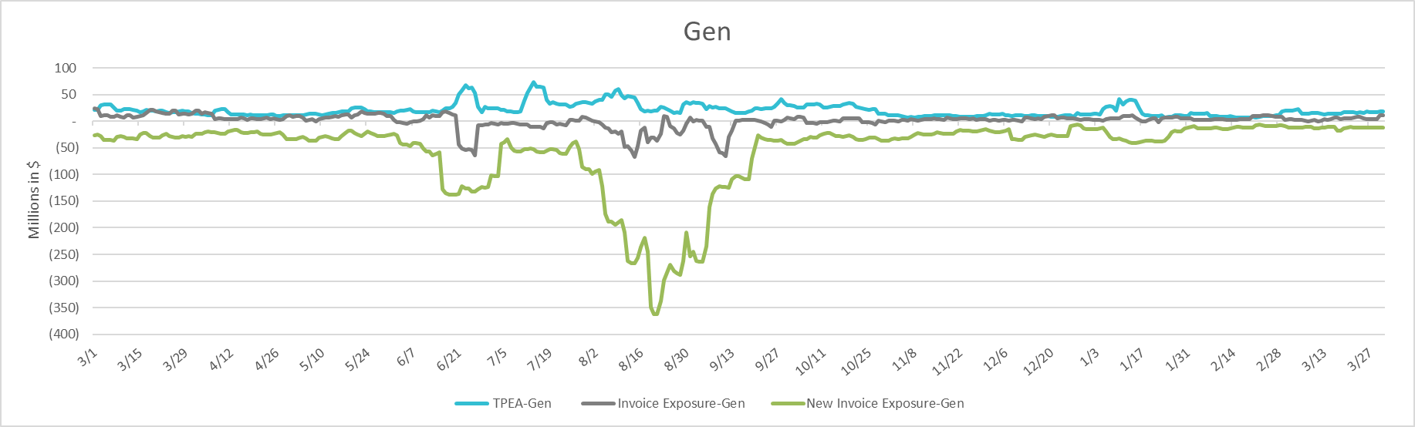
TPEA Coverage of Settlements March 2023 - March 2024
Invoice Exposure | Historical | Future
Existing Invoice Exposure | RTLCNS + UDAA | M1 Days (including current day) Forward Charge Invoice Amounts
New Invoice Exposure | 7 Days Back Net Invoice Amounts (Charges & Credits) | M1 Days (including current day) Forward Net Invoice Amounts (Charges & Credits); Excluding: 1) Securitization Invoices; 2) CRR Auction Invoices; 3) Subchapter N Funds Distribution Invoice
* TPEA generally exceeds Invoice exposure

Slide 15
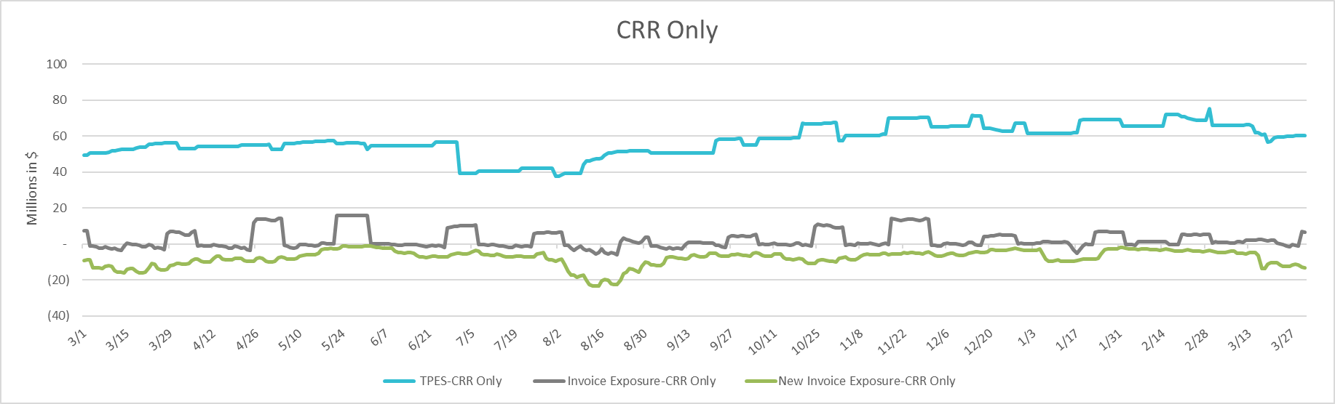
TPEA Coverage of Settlements March 2023 - March 2024
Invoice Exposure | Historical | Future
Existing Invoice Exposure | RTLCNS + UDAA | M1 Days (including current day) Forward Charge Invoice Amounts
New Invoice Exposure | 7 Days Back Net Invoice Amounts (Charges & Credits) | M1 Days (including current day) Forward Net Invoice Amounts (Charges & Credits); Excluding: 1) Securitization Invoices; 2) CRR Auction Invoices; 3) Subchapter N Funds Distribution Invoice
*TPES exceeds actual/invoice exposure

Slide 16
Questions

