Slide 1
EAL Change Proposals – Scenario #4
Sanchir Dashnyam
ERCOT Market Credit Manager
ERCOT Public
May 17, 2024

Slide 2
Invoice Exposures – Definitions
Invoice exposures – New
M1 days forward invoices + 7 days look back actual invoices
M1 days could range from 10 to 21 days depending on weekends/holidays, MP activity
Invoices exclude M&N securitization invoices, CRR auction invoices and miscellaneous invoices relating to $2B distributed to market for Sec N on 6/21/22
Data is for a period covering 1/1/2022 through 2/29/24
TPEA excludes Uri invoices and PUL uplift
TPEA – Invoice exposures = Gap
Negative gap is when invoice exposures exceed TPEA (less than -$10,000)
Positive gap is when TPEA exceeds invoice exposures (more than $10,000)
Independent amounts posted as a result of NPRR1165 are not included in these calculations. IA’s are part of TPES.

Slide 3
Current EAL Formula vs. Scenarios #1, #1a and 1b
Current: EAL _{q} = Max [IEL during the first 40-day period only beginning on the date that the Counter-Party commences activity in ERCOT markets, RFAF * Max {RTLE during the previous lrq days}, RTLF] + DFAF * DALE + Max [RTLCNS, Max {URTA during the previous lrq days}] + OUT _{q} + ILE _{q}
OUT _{q} = OIA _{q} + UDAA _{q} + UFA _{q} + UTA _{q} + CARD
Scenario #1: EAL t = Max [RFAF * Max { RTNLE during the previous lrt days}, FAF*RTNLF] + DFAF * DALE + Max [RTLCNS NLCD, Max {ULERTA during the previous lrq days}] + OUT (included UDAA)
NLE = Total net liability extrapolated (Last 14 days RTM Initial Statement Average + Last 14 days DAM Initial Statement Average based on RTM Initial OD)*M1. Use same RTM ODs for DAM as well
NLF = net liability forward = 1.5 * NLCD
NLCD = (7 most recent Operating days Real time estimates + 7 most recent DAM ODs day-ahead) if settled data is available use settled else estimates – no price cap
FAF = 21 future / most recent days 7 RTM Prices
ULE = unbilled liability extrapolated (Last 14 days RTM Initial Statement Average + Last 14 days DAM Initial Statement Average based on RTM Initial OD)*M2 - use same RTM ODs for DAM as well
Scenario #1a: EAL = Max [RFAF * Max { RTNLE during the previous lrt days}, FAF*RTNLF] + DFAF * DALE + Max [RTLCNS (RTLCNS + UDAA), Max {ULERTA during the previous lrq days}] + OUT
Scenario #1b EAL t = Max [RFAF * Max { RTNLE during the previous lrt days}, FAF*RTNLF] + DFAF * DALE + Max [RTLCNS NLCD, Max {ULERTA during the previous lrq days}] + OUT
OUT t = OIA + UFA + UTA + CARD (S1a and S1b excludes UDAA)

Slide 4
Scenarios #2, #3 and #4
Scenario #2: EAL q = Max [IEL during the first 40-day period only beginning on the date that the Counter-Party commences activity in ERCOT markets, Max{(RFAF * Max {RTLE) during the previous lrq days}, RTLF] + DFAF * DALE + Max [RTLCNS, Max {URTA during the previous lrq days}] + OUT q + ILE q
Scenario #3: EAL q = Max [IEL during the first 40-day period only beginning on the date that the Counter-Party commences activity in ERCOT markets, RFAF * Max {RTLE during the previous lrq days}, RTLF] + DFAF * DALE + Max [RTLCNS, Max {URTA during the previous lrq days}] + OUT q + ILE q
Two RFAF’s: CP specific RFAF and Global RFAF
CP specific RFAF = Projected Real-Time ICE Forward Average Price / Max RTLE date Historic Real-Time Settled Average Price
Global RFAF is calculated based on existing methodology. Global RFAF is used in MCE calculations.
Scenario #4: Take Scenario #1a as a basis: EAL = Max [RFAF * Max { RTNLE*FAF during the previous lrt days}, FAF*RTNLF] + DFAF * DALE + Max [RTLCNS (RTLCNS + UDAA), Max {ULERTA during the previous lrq days}] + OUT
Apply FAF against NLE, then take the Max and compare against FAF*NLF. Essentially combine Scenario #2 and Scenario #1
Establish a floor for FAF at 1
Increase MCE for load entities (2 days from 1 day)

Slide 5
TPEA for Scenarios – market
S4 patterns
Scenario #4 results in the highest TPEA
Due to netting, NLE now captures DAM exposures over the look back period. Max of FAF*NLE is driving the jump in EAL rather than FAF*NLF. This explains the difference in “height” or distance between S4 TPEA vs TPEAs for the rest of scenarios.
Because of Max [{ NLE*FAF during the previous lrt days}, FAF*NLF] over the look back period, the peak endures and stays on until it rolls off. This explains the “box” or “square” shape of the TPEA for Scenario #4.

Slide 6
Negative and Positive Gaps: Market
S4 significantly decreases the negative gap events, however, it also increases positive gaps.

Slide 7
Negative Gaps: Winter storm Elliott
S4 decreases the negative gap events, however, it also increases positive gaps.

Slide 8
Negative Gaps: Winter storm Elliott by activity type
S4 Negative gaps increase for traders as compared to the rest. This is primarily due to netting.

Slide 9
Positive Gaps: Winter storm Elliott
S4 Positive gaps decrease for traders as compared to the rest which experienced an increase. This is primarily due to netting.

Slide 10
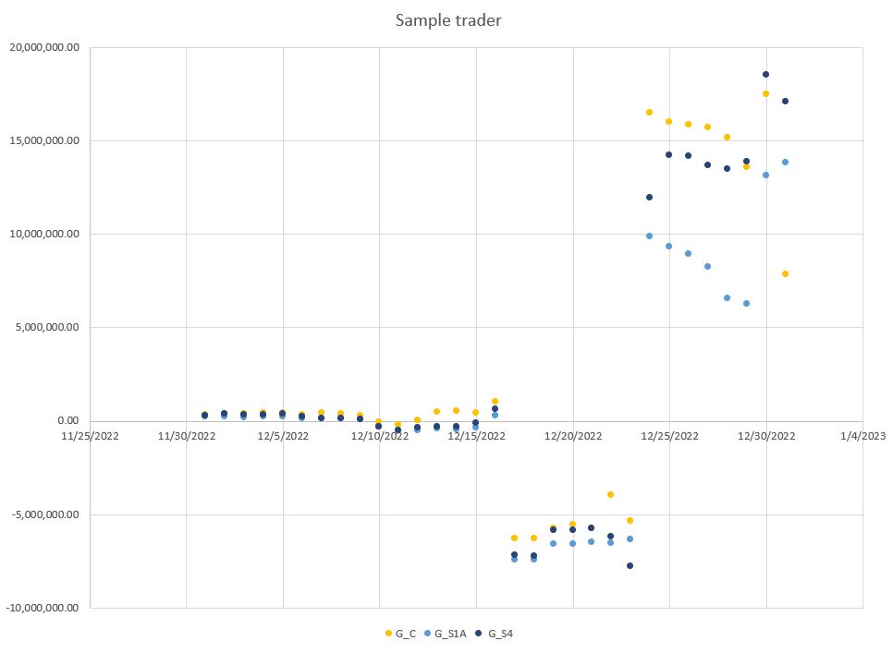
Sample trader during Winter Storm Elliott

Slide 11
Next steps: potential improvements/alternatives
Cap FAF as it is applied against NLE but not NLF, or, alternatively use a multiplier of 1.5 or 2.00 against NLE (instead of FAF). This is to have a floor but not too high of a floor, especially after the event.
Reduce/adjust the look back period depending on seasons. This could help with the positive gaps.
For NLE: Gross up/down charges/credits, similar to the treatment of RTLCNS. Essentially, increase exposures (charges) and discount the credits by 10%-20%. Currently for RTLCNS we are upping the charges and discounting the credits by 10% when coming up with the real time liability amount from the Real Time Imbalance Amount.
For Traders, for NLE calculation do not net and take the positive (whether it is DA or RT), but do not apply a factor.
For Traders, just leave it “as is” and do not apply any netting.

