Slide 1
Collateral Holds
Leslie Wiley
Treasurer
ERCOT Public
May 17, 2024

Slide 2
Collateral Holds
Collateral Holds
Current Process
Protocol section: 16.11.5 (6)(c)
Hold invoice(s) once collateral call is issued
Collateral Holds
Proposed Process
Protocol section: 16.11.5 (6)(c)
Hold invoice(s) once collateral call is past due and putting into collateral

Slide 3
Current Process
Treasury receives an email from credit that identifies which MP to hold funds for and how much of the invoice amount should be held
If the collateral hold amount is greater than the invoice, the entire invoice amount is held
If the collateral hold amount is less than the invoice, partial payment is held
Treasury deletes or changes the amount of the wire(s) in the bank, then approves and releases the wire(s)
On the next day, if the MP is no longer on the collateral hold email, Treasury will return the held funds and update files
Each day, as the collateral hold amount changes, or is cured, Treasury makes manual adjustments and either holds or releases the invoice amounts

Slide 4
History
Year | # of Defaults | # of Holds | Recovered/Held
2019 | 3 | 77 | 0.00%
2020 | 1 | 35 | 0.00%
2021 | 10 | 699 | 0.10%
2022 | 2 | 163 | 0.00%
2023 | 2 | 330 | 0.00%
2024 | 6 | 170 | 0.00%
Total | 22 | 1,474 | 0.09%

Slide 5
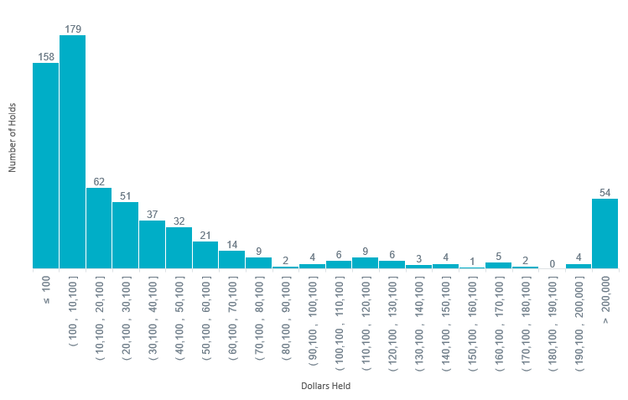
2022-2024 Collateral Holds

Slide 6
Risks
Risk
Incorrect amount/recipient Incorrect financial reporting | Manually manipulating wire amounts Could hold beyond release date CP/QSE translation Does not count toward collateral amount

Slide 7
ISO Comparison
 | ERCOT | CAISO | NYISO | MISO | SPP
Do you hold invoices? | Yes | Yes | Yes | Yes | Yes
When do you start holding? | Issue date | Past due | Past due | Past due | Past due
Where do you account for hold amount? | Unpaid invoices | Collateral account | Collateral account | Collateral account or toward unpaid invoices | Collateral account or toward unpaid invoices

Slide 8
Protocol Language
16.11.5 Monitoring of a Counter-Party’s Creditworthiness and Credit Exposure by ERCOT
(6) To the extent that a Counter-Party fails to maintain Financial Security in amounts equal to or greater than its TPES or Remainder Collateral in amounts equal to or greater than its TPEA, each as defined in Section 16.11.4:
(c) ERCOT is not required to make any payment to that Counter-Party unless and until the Counter-Party increases its Financial Security. The payments that ERCOT will not make to a Counter-Party include Invoice receipts, CRR revenues, CRR credits, reimbursements for short payments, and any other reimbursements or credits under any other agreement between the Market Participant and ERCOT. ERCOT may retain all such amounts until the Counter-Party has fully discharged all payment obligations owed to ERCOT under the Counter-Party Agreement, other agreements, and these Protocols.
16.11.6.1.1 No Payments by ERCOT to Market Participant
(1) ERCOT is not required to make any payment to a Market Participant unless and until the Market Participant satisfies the Payment Breach by paying the past due amount in full, including amounts due under Section 16.11.6.1.3, Aggregate Amount Owed by Breaching Market Participant Immediately Due. The payments that ERCOT will not make include Invoice receipts, CRR Auction revenues, CRR credits, reimbursements for short payments and any other reimbursements or credits under any and all other agreements between ERCOT and the Market Participant. ERCOT shall retain all such amounts, and may apply all withheld funds toward the payment of the delinquent amount(s), until the Market Participant has fully paid all amounts owed to ERCOT under any agreements and these Protocols. If the Market Participant should fail to pay the full amount due within the cure period, ERCOT may apply all funds it withheld toward the payment of the delinquent amount(s).

Slide 9
Collateral Holds
Collateral Holds
Proposed Process
Protocol section: 16.11.5 (6)(c)
Hold invoice(s) once collateral call is past due and putting into collateral

