Slide 1
ERCOT Frequency Events
April 2024
ERCOT
Operations Planning
PDCWG | May 15, 2024

Slide 2
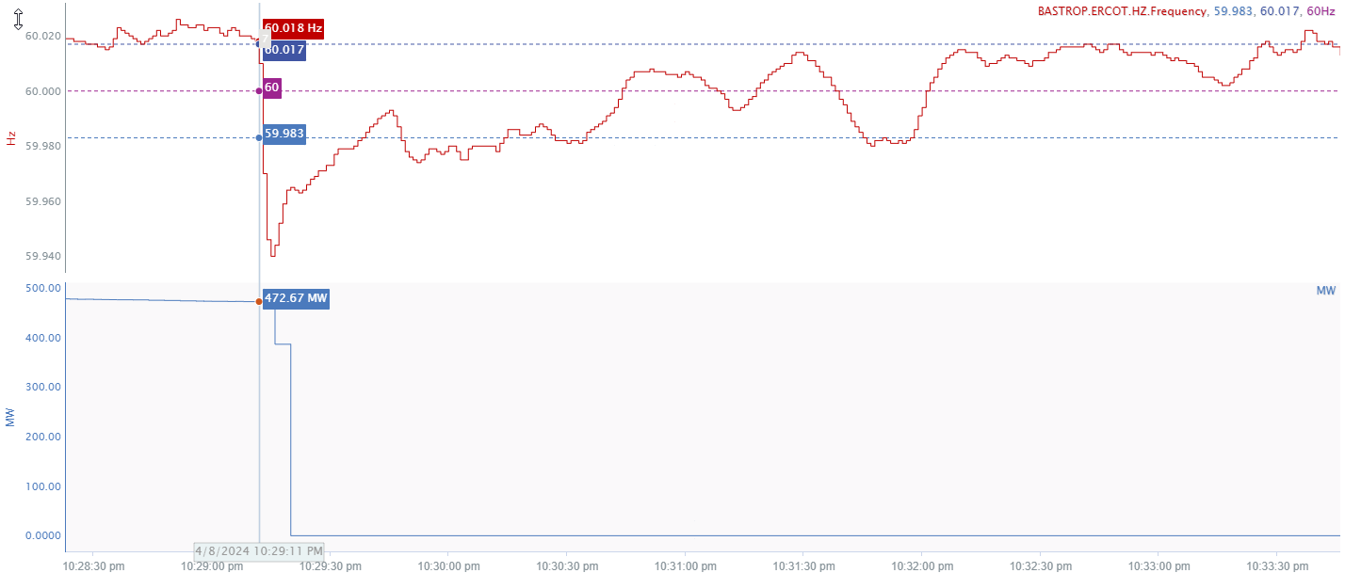
4/8/2024 22:29:11(Non-FME)
Notes:
The unit tripped offline while carrying approximately 472 MW
Starting Frequency: 60.018 Hz
Minimum Frequency: 59.94 Hz
A-C Time : 4 seconds
Recovery Time(back to deadband): 0 minutes 30 seconds
ECRS Released: 0 MW
Trip Reason: Lightning Strike in switchyard
Contextual Information: A total of 25 MW of regulation Up was deployed during the event
No Selection Reason: Delta frequency is small, C point is 59.94 Hz

Slide 3
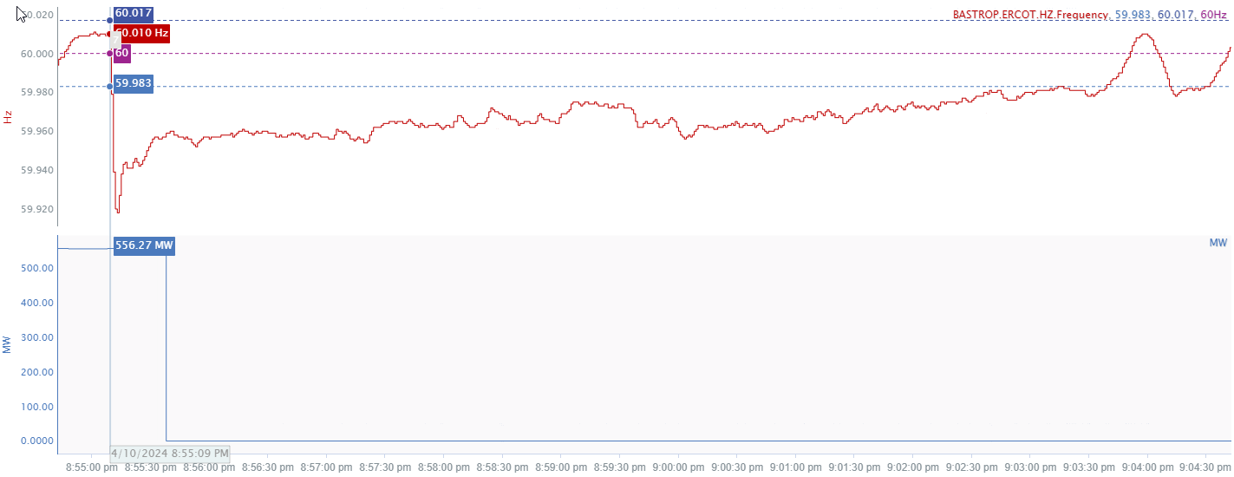
4/10/2024 20:55:09(FME)
Notes:
The unit tripped offline while carrying approximately 556 MW
Starting Frequency: 60.010 Hz
Minimum Frequency: 59.918 Hz
A-C Time : 4 seconds
Recovery Time(back to deadband): 8 minutes 31 seconds
ECRS Released: 0 MW
Trip Reason: Storms in the area
Contextual Information: A total of 333 MW of regulation up was deployed during this time

Slide 4
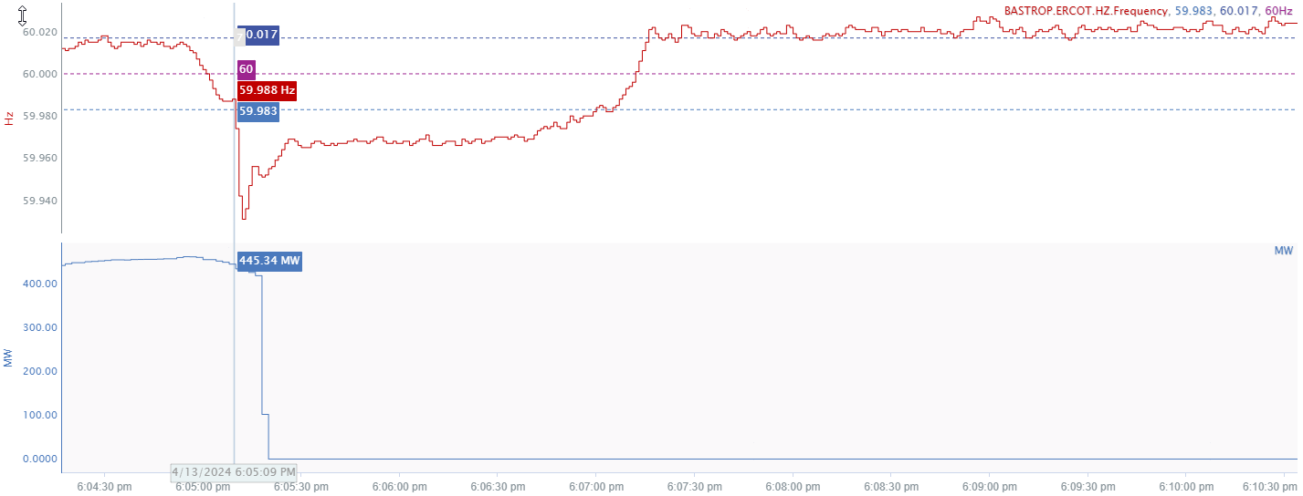
4/13/2024 18:05:09 (Non-FME)
Notes:
The unit experienced a runback and tripped offline while carrying approximately 419 MW
Starting Frequency: 59.998 Hz
Minimum Frequency: 59.931 Hz
A-C Time : 3 seconds
Recovery Time(back to deadband): 1 minute 51 seconds
ECRS Released: 0 MW
Trip Reason: Feed water and tube leak issue
Contextual Information: A total of 198 MW of regulation up was deployed during this time
No Selection Reason: delta frequency is low

Slide 5
Questions?
Thank you!

