Slide 1
NOGRR 245 Board Remand
Technical Advisory Committee
Workshop for NOGRR 245
May 10, 2024

Slide 2
NOGRR 245 History
Proposed Jan. 2023 to enhance IBR ride-through and align w/ IEEE 2800 and NERC
ERCOT comments (4/5/23 & 6/22/23) lowered requirements and extended timelines based on stakeholder feedback (some RE’s still opposed)
ROS narrowly approved a version on 9/14/23 (ERCOT opposed)
RFI results from REs and OEMs presented at December TAC meeting
FERC Order 901:
  NERC must address same risks NOGRR245 addresses
  Need for retroactive applicability w/ limited technical exemptions for legacy IBRs
  Planners/operators must address risk caused by exemptions
ERCOT comments (1/8/24) considering RFI results (some RE’s still opposed)
ERCOT compromise (3/20/24) assumed similar compromise from Joint Commenters
TAC narrowly approved (3/27/24) based on comments - making reliability worse (ERCOT opposed)
ERCOT comments (4/15/24) revising TAC-recommended version to improve reliability
ERCOT BOD remanded to TAC with instructions on 4/23/24

Slide 3
Board Action
Remanded NOGRR245 to TAC with instructions:
  TAC to address ERCOT’s reliability concerns
  TAC to provide detailed comments supporting version of NOGRR245 sent back to Board
  Comments should provide rationale regarding why TAC did or did not address ERCOT’s key concerns as laid out in its presentation at R&M committee

Slide 4
Board Remand - Key Takeaways
From Board/Commissioner comments (See Transcript)
Reliability is paramount and must trump cost if conflict exists
  ERCOT must consider reliability impact when evaluating exemption requests
“Commercially reasonable” must include firm criteria uniformly applied (minimize subjectivity & have objective evidence in case of appeal to PUC):
  Impact on Texas citizens of reliability failure (cascading outages)
  Impact on Texas citizens of installing transmission solutions
  Resource Entities' costs for non-compliance
“Commercial” standard not allowing ERCOT to look at system reliability is not acceptable (will also lead to many appeals to PUC)
Final solution should minimize technically complex disputes to Commission and contain sufficient objective information to evaluate exemption denial

Slide 5
Potential Impacts of ERCOT Load Loss
Value of Lost Load (VOLL) assumption = $5,000 MWh
 | Duration (HRS)
MW loss | 1 | 8 | 24 | 72 | 168
1,000 | $ 5 Million | $ 40 Million | $ 120 Million | $ 360 Million | $ 840 Million
5,000 | $ 25 Million | $ 200 Million | $ 600 Million | $ 1.8 Billion | $ 4.2 Billion
15,000 | $ 75 Million | $ 600 Million | $ 1.8 Billion | $ 5.4 Billion | $ 12.6 Billion
40,000 | $ 200 Million | $ 1.6 Billion | $ 4.8 Billion | $ 14.4 Billion | $ 33.6 Billion
80,000 | $ 400 Million | $ 3.2 Billion | $ 9.6 Billion | $ 28.8 Billion | $ 67.2 Billion
$5,000/MWh is VOLL assumption
Scenarios paint range of partial-to-full system load loss across various ranges
Ranges do not account for societal impact of such an event
Texas Comptroller estimated Winter Storm Uri impact at $80 billion to $130 billion
Impact does not include affect on consumers/Market Participants for additional transmission projects, additional transmission congestion, or additional manpower in event analysis, mitigation activities, planning activities, tool impacts caused by performance failures and exemption mitigation
Key Takeaway: Must evaluate economic impact on Texans from insufficient reliability against claimed commercial impact on Resource Entities to establish appropriate policy to ensure ride-through.

Slide 6
Presentation Key Takeaways
ERCOT will support:
Software/parameterization to maximize to full capability of equipment
Exemption process allowing ERCOT to assess reliability risk and costs as part of review/approval
No exemptions for unknown/unverified capability, including phase angle jump and RoCoF
One-time exemption process with no after-the-fact exemptions for performance failures or later discovery – those must be mitigated
Exemption process allowing ERCOT sufficient time to review all requests
Exemption process that maintains performance requirements until exemption is approved
Exemption process for SGIAs after 6/1/23 if a technical/justifiable reliability reason is provided
Not limiting ERCOT’s ability to impose operational restrictions to protect reliability
ERCOT will not support subjective “commercially reasonable” standard as proposed and will only support taking cost into considering in exemption process if the solution being cost prohibitive is clear, objective, quantifiable and repeatable regardless of technology, unique commercial characteristics or plant age

Slide 7
Major Outstanding Issues
Software/parameterization language does not maximize to full capability of equipment
Exemption process:
  Does not allow ERCOT to assess reliability risk and costs
  Allows exemptions for unknown/unverified issues and for phase angle jump/RoCoF uncertainty
  Criteria for solution being cost prohibitive is unclear, subjective, not easily quantifiable nor repeatable and may vary greatly based on technology, unique characteristics or plant age
  Does not ensure maintaining performance requirements until exemption approved
  Does not allow ERCOT sufficient time to acknowledge/review exemptions or appeals
  Allows multiple passes of exemptions and after-performance-failure or later-discovered issues to get exemptions - effectively lowering requirements over time
Performance failure mitigation not required for new IBRs
Moving 6/1/23 date to 6/1/24 (or beyond) delays 22 - 24 GW of new, modern, and more capable IBRs from having to meet new requirements with no technical/ justifiable reliability reason
Lowers VRT curve for new IBRs below legacy .25 pu

Slide 8
Key Issue 1: Software and Parameter Changes
NERC Alert on 3/14/23* recommended setting protection and controls to maximize ride through performance up to equipment capability, even if it exceeds the requirements
ERCOT version required frequency and voltage ride-through capability set to maximum equipment capability to meet or exceed ride-through requirements in §2.6.2.1, §2.9.1.2 and §2.9.1.2
But TAC version, (§ 2.11) limits settings to minimum requirements not equipment capability (see, language below)
  (1) “Commercially reasonable efforts” means that the Resource Entity must evaluate its facilities and available modifications it can make to its equipment, if any, to maximize its frequency and/or voltage ride-through capability up to the frequency and voltage ride-through requirements set forth in Section 2.6.2.1…and Section 2.9.1.2, Legacy Voltage Ride-Through Requirements….
  (a) Technically feasible modifications involving only software, firmware, settings or parameterization changes are presumed to be commercially reasonable unless ERCOT and the Resource Entity agree the pricing is unreasonable for the modification.
Key Question: Did TAC members intend to approve language requiring software and parameterization changes only up to Legacy (current) requirements and not full equipment capability? If so, why?
* https://www.nerc.com/pa/rrm/bpsa/Alerts%20DL/NERC%20Alert%20R-2023-03-14-01%20Level%202%20-%20Inverter-B ased%20Resource%20Performance%20Issues.pdf

Slide 9
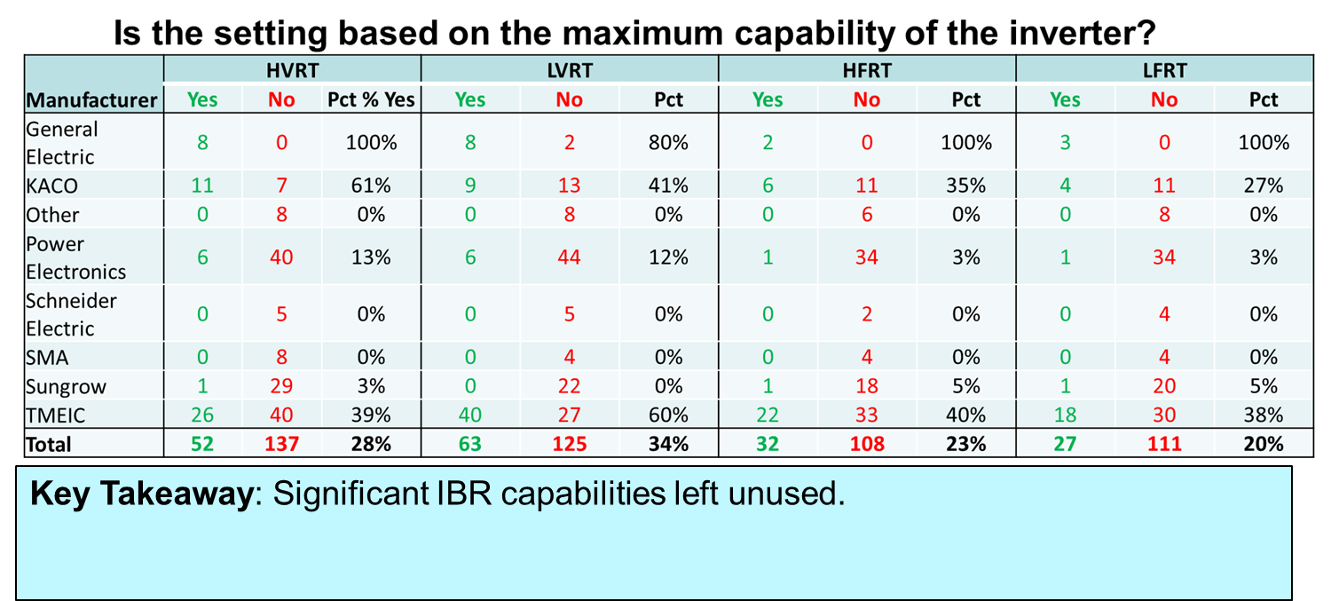
Key Issue 1: Software and Parameters – Underutilized
For example: On 10/13/23, Texas RE presented NERC alert summary findings (PVGR only) for ERCOT highlighting available frequency and voltage ride-through equipment full capability (beyond requirements) not being utilized
https://www.ercot.com/files/docs/2023/10/17/ibr-alert-summary.pptx

Slide 10
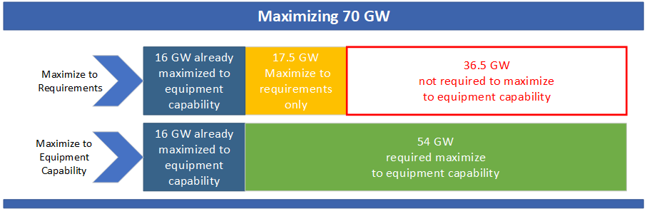
Key Issue 1: Software and Parameters – Assessment of Impact
Per Texas RE presentation (RFI results for solar in ERCOT – Slide 8)
  20-34% of IBRs set to ride-through to equipment max capability
In the TAC version, ERCOT estimates only units with SGIA before 1/16/14 (~16GW) need to maximize to "requirements" because units after 1/16/14 would otherwise be non-compliant
If only 16 GW of older IBRs would "maximize" to requirements and if ~25% of 70GW (16 GW) are already maximized, there may be 36+ GW not maximized to equipment capability (as recommended by NERC)
This means 36+ GW of cost-effective improvement and model validation is not required in the TAC-recommended version

Slide 11
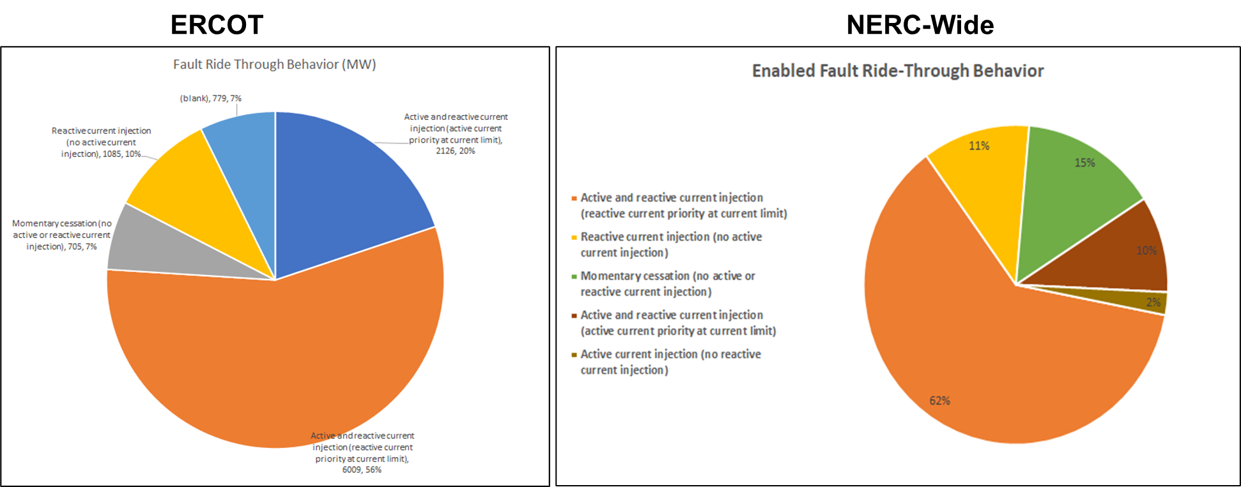
Key Issue 1: Software and Parameters – Incorrect settings
Texas RE showed additional incorrect settings up to 44% (e.g., momentary cessation, reactive current w/o active current or active current priority settings)
Key Takeaway: Maximizing to equipment capability will also help address incorrect settings.
https://www.ercot.com/files/docs/2023/10/17/ibr-alert-summary.pptx

Slide 12
Key Issue 1: Software and Parameters
H_{New}
H_{New}
H
< 2014
(8GW)
L
L_{New}
Must ensure IBRs maximize ride-through capability to full equipment capability
Settings changes will ensure field settings match model and improve model quality
Helps IBRs perform to requirements where terminal conditions differ from POIB
~45-55 GW of installed IBRs could improve performance up to equipment capability through software and parameters
Limiting ride-through only to minimum requirements could lower this amount to < 16 GW and does not comport with NERC recommendations
X
< 2023
45GW
Voltage
< 2009
(8GW)
L
L_{New}
L_{New}
Maximize to equipment capability
Maximize to requirements
Current LVRT capability
Current HVRT capability
L
H
H_{New}
New HVRT capability
New LVRT capability
L_{New}
X
No change in capability
Key Takeaway: Language should require that software, parameters, protection and control settings maximize to equipment capability - not just to requirements.

Slide 13
Key Issue 1: Software and Parameters
Key Decision: Do TAC members support software/parameterization improvements maximized to equipment capability or only to current requirements?

Slide 14
Exemption Assessment Issues
Issue 4:SGIA date discussed later
Issue 2C: “Commercially reasonable” varies from site-to-site and is subjective (difficult for PUCT to evaluate appeals)
Issue 2A:ERCOT cannot deny for reliability reasons
Issue 2B:
Allowed Exemption Requests for Unknown or PAJ/RoCoF uncertainties
Issue 2D: Until exemption is assessed and granted, performance requirements must remain to ensure reliability
Issue 2E: Insufficient
time to review exemptions & appeals

Slide 15
Key Issue 2A: ERCOT Limited in Exemption Review
TAC-recommended Section 2.13.1 Exemptions and Extensions
(2) Subject to the appeal process in this Section, ERCOT may deny a request for an exemption or extension if the Requesting Entity fails to demonstrate, to ERCOT’s reasonable satisfaction:
(a) For [Resource with SGIA executed prior to June 1, 2024] that meets the criteria in paragraph (5) of Section 2.9.1, or [Resource] seeking an exemption as described in paragraph (7) of Section 2.9.1, the Requesting Entity has:
(i) Maximized the ride-through capability of the [Resource] with all available commercially reasonable modifications; and
(ii) Represented the limitations…which form the basis for the exemption, to the best of the Requesting Entity’s understanding and in accordance with Section 2.13.1.1 Submission of Exemption Requests and Section 2.13.1.2 Submission of Extension Requests
Key Takeaway: TAC-recommended version only allows ERCOT to deny an exemption if it believes available commercially reasonable modifications exist and if model does not represent limitations to “best of RE’s understanding”
Key Question: Do TAC members want to allow ERCOT to deny exemption if it would cause unacceptable reliability risk to ERCOT system? (if not, must explain why to Board)

Slide 16
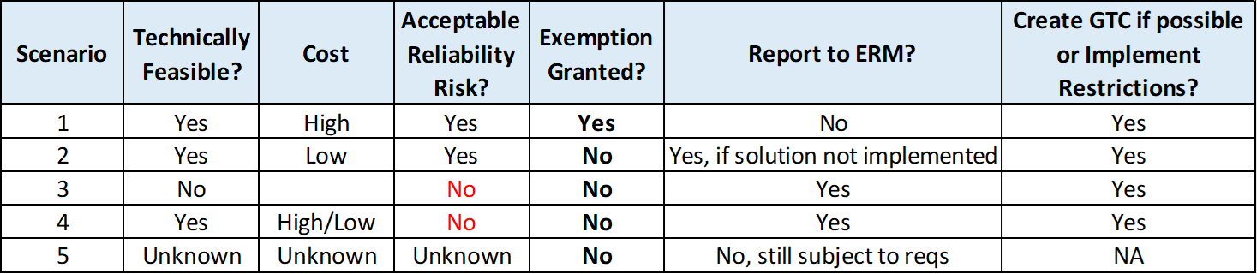
Exemption Process - ERCOT Can Support
Exemption process must give ERCOT flexibility to grant/deny based on reliability
Scenario 1: Not technically feasible or technically feasible (high cost) solution w/ acceptable reliability risk
  Exemption granted
  ERCOT creates GTC or implements restrictions
Scenario 2: Technically feasible (low cost) solution w/ acceptable reliability risk
  No exemption (report to ERM if solution not implemented)
  ERCOT creates GTC or implements restrictions until solution implemented
Scenario 3: No technically feasible solution, unacceptable reliability risk
  No exemption (report to ERM)
  ERCOT creates GTC or implements restrictions
Scenario 4: Technically feasible (high or low cost) solution w/ unacceptable reliability risk
  No exemption (report to ERM if solution not implemented)
  ERCOT creates GTC or implements restrictions until solution implemented
Scenario 5: Unknown capability or Phase Angle / RoCoF
  No exemption for unknown capability or Phase Angle/RoCoF

Slide 17
Exemption Process - ERCOT Supports (Assumptions)
General Assumptions:
  Exemption assessment relies on accurate models - inaccurate models sent to ERM
  Exemptions evaluated on individual impact and aggregated System impact
  Exemption assessment cannot be fully completed until after all exemption requests are received.
  If system changes or model inaccuracies reveal additional limitations, exemptions may be revisited
  Operational restrictions (full/partial) = backstop for unacceptable reliability risk not mitigated
  ERCOT must receive necessary data/information to perform assessment
Unacceptable reliability risk includes any of:
  Uncontrolled separation, Instability, or Cascading Outages
  Loss of Gen capacity > 500 MW
  Unnecessary loss of load >75 MW
  Safety or neighboring equipment damage risk
Cost
  Low Cost = software, firmware, parameter changes
  Low Cost = physical changes < 50%* of replacement cost per turbine/inverter
    PPC replacement
    Controller card upgrade kits (cost per inverter)
    Protection relay upgrades
    Communication upgrades (inverter to PPC)
    Component upgrades (DC chopper, PLL controller, vibration monitoring, DC controller)
  High Cost = physical changes ≥ 50%* of replacement cost per turbine/inverter
    Full replacement
    Converter replacement only
    Major component upgrades
*TAC can consider alternative, reasonable threshold

Slide 18
Key Issue 2A: ERCOT Limited in Exemption Review
Any assessment for exemptions must include reliability and guardrails:
Reliability assessment should evaluate impact of individual plant and aggregate impact of all exemptions
No exemptions for unknown/unverified capability deficiencies
No exemptions for Phase Angle Jump or Rate-of-Change of Frequency during fault conditions until future NOGRR can address those issues (Key Issue 2B)
Exemptions cannot materially reduce performance versus current requirements
Exemption evaluation of cost impact on RE must be clear, objective, and repeatable (e.g., fixed percentage of cost to replace with a new in-kind inverter/converter on a per inverter/converter basis)
Exemptions cannot be indefinite or prohibit ERCOT from implementing restrictions if it cannot otherwise maintain reliability
Key Takeaway: Language should include a reliability assessment attempting to balance cost impact and reliability impact w/ reliability guardrails to ensure no exemptions for unknown/unverified capability or issues.

Slide 19
Key Issue 2A: ERCOT Limited in Exemption Review
Key Decision: Do TAC members support an exemption process that ERCOT can support or an alternative that still ensures ERCOT can deny exemption for unacceptable reliability risk?
Key Decision: Do TAC members support an exemption process that does not allow a material reduction of current reliability requirements?

Slide 20
Key Issue 2B: Allowed Exemptions for uncertainties
The majority of "No" responses on the December RFI were due to the Resource Entities with unverified capabilities
Without guardrails, these "unknown" capabilities may prompt many exemption requests with no ability to assess the impact
Key Takeaway: Exemption language should include guardrails to not allow exemptions for "unknown" or "unverified" capabilities to avoid performance requirements.

Slide 21
Key Issue 2B: Allowed Exemptions for Uncertainties
P2800-2 IEEE SDT has subject matter experts who weighed in on Phase Angle Jump and Rate of Change of Frequency (RoCoF) requirements
First draft clearly states:
  Phase angle change and RoCoF cannot be reliably measured during fault occurrence and clearance
  IBR should not trip due to any measured change during fault disturbance and recovery period
  IBR owner and transmission system owner should agree on a method to measure frequency and calculate RoCoF during events
ERCOT proposes to sponsor a separate NOGRR so IBRWG can find a consistent method to measure these parameters and validate with Odessa events that 25 degrees and 5 Hz/will ensure reliability
Exemptions should not currently be allowed due to the uncertainty at this time
Key Takeaway: Exemption language should include guardrails to not allow exemptions for IBRs to trip for Phase Angle Jump or RoCoF during fault and get clarity on measurements before solidifying requirements

Slide 22
Key Issue 2B: Allowed Exemptions for uncertainties
Key Decision: Do TAC members support allowing exemptions for when the RE does not know or has not verified what its ride-through capability is?
Key Decision: Do TAC members support allowing exemptions for phase angle jump or RoCoF limitations with no clear or consistent definition of how to measure it yet?

Slide 23
Key Issue 2C: Loose Criteria for Cost Prohibitive Claims
TAC-recommended Section 2.11 Commercially Reasonable Efforts
(2) In determining whether any equipment upgrades or improvements that require physical modification are commercially reasonable, the Resource Entity may consider factors such as: (i) availability and/or cost of hardware; (ii) whether the improvements are technically feasible; (iii) facility’s depreciated value; (iv) cost of capital; (v) facility’s expected profitability for the remainder of its expected operational life; (vi) whether the improvement would materially enhance its ride through capabilities; and (vii) any other relevant factor.
Key Takeaway: TAC-recommended version uses loose set of criteria varying greatly from resource-to-resource complicating exemption reviews and appeals to Commission
Key Question: Do TAC members support a firm, repeatable, objective criteria? (if not, must explain why to Board)

Slide 24
Key Issue 2C: Loose Criteria for Cost Prohibitive Claims
vs
Key Takeaway: TAC should create a firm, repeatable, cost-based criteria to determine when improvement is cost prohibitive.

Slide 25
Key Issue 2C: Loose Criteria for Cost Prohibitive Claims
Types of improvements in each cost category - examples:
Low-Cost includes software, firmware, parametrization changes.
Low-Cost physical changes
  Power Plant Controller (PPC) replacement
  Controller card upgrade kits (cost per inverter)
  Protection relay upgrades
  Communication upgrades (inverter to PPC)
  Component upgrades (DC chopper, PLL controller, vibration monitoring, DC controller)
High-Cost physical changes
  Full replacement
  Converter replacement only
  Major component upgrades
Key Takeaway: TAC should consider firm criteria requiring types of physical improvements that provide additional ride-through capability for lower relative cost.
Key Question: What types of physical improvements have RE’s made to address ride-through failures or that are currently available (e.g., controller card replacements, PPC replacements, etc.)?

Slide 26
Key Issue 2C: Loose Criteria for Cost Prohibitive Claims
Key Decision: Considering BOD/Commission feedback, do TAC members support highly variable criteria to determine “cost prohibitive” or firm, repeatable criteria?
Key Decision: If firm, what cost threshold should be used to provide reliability improvements?

Slide 27
Key Issue 2D: Requirements During Exemption Review
TAC-recommended Section 2.13.1 Exemptions and Extensions
(10) During the pendency of an exemption, extension, or appeal process under Section 2.13, or a related proceeding before the Public Utility Commission of Texas (PUCT) or other Governmental Authority, the IBR, Type 1 WGR or Type 2 WGR that is the subject of the exemption or extension request is required to meet its documented maximum capabilities provided to ERCOT.
ERCOT believes the approach does not support reliability and can create a loophole that bypasses reliability assurance and temporarily lower requirements.
Timeline is variable for appeals and could extend for a period of time.
If a performance failure occurred to the requirements and an exemption was ultimately granted, enforcement staff at the commission can consider the exemption and dismiss the violation at that time.
Key Takeaway: TAC-recommended version allows any IBR, Type 1 WGR or Type 2 WGR to avoid performance requirements without any exemption approval by simply requesting an exemption.
Key Question: Do TAC members support allowing the resource to automatically not be required to meet performance requirements without any exemption assessment that considers reliability impact or a denied exemption assessment?

Slide 28
Key Issue 2D: Requirements During Exemption Review
Key Decision: Do TAC members support subjecting Resource to performance requirements during exemption/extension process to support reliability?
Key Decision: Do TAC members support allowing Resource to perform below the performance requirements simply by applying for an exemption/extension?

Slide 29
Key Issue 2E: Insufficient Time for ERCOT Exemption Review
TAC-recommended § 2.13.1.3 Timeline for Submission and Determination of Exemption and Extension Requests
  (1) Not later than ten Business Days of receiving a request for an exemption or extension, ERCOT shall provide the Requesting Entity with written confirmation of receipt and notification that either:
(a) The submission was complete and ERCOT is reviewing the request; or
(b) The submission was incomplete. For incomplete submissions, ERCOT will:
(i) Identify the missing information; and
(ii) Provide instructions for the Requesting Entity to submit the missing information (e.g., to ERCOT Legal at MPRegistration@ercot.com or through the RIOO system).
(3) Not later than 180 days of receiving a request for an exemption or extension or as otherwise agreed to in writing by the Parties, ERCOT shall provide the Requesting Entity with written notification that ERCOT has completed its review and ERCOT’s determination that the exemption or extension is:….
TAC-recommended § 2.13.1.3 Appeal Process and Timeline:
(3) Not later than three Business Days of the appeal initiation date, ERCOT shall provide the Requesting Entity with written confirmation of receipt and the designation of the ERCOT dispute representative. The ERCOT dispute representative should be an executive-level employee with decision making authority.
* * *
(5) Within ten Business Days of the appeal meeting, or if an appeal meeting is not requested by the Requesting Entity, then within 30 days of the appeal initiation date, ERCOT will provide the Requesting Entity with notice of its appeal decision, including an explanation of the rationale if ERCOT denies the Requesting Entity’s appeal in whole or part.
Key Takeaway: Short/firm times do not contemplate multiple, simultaneous requests and should allow sufficient time/flexibility for complex assessments.

Slide 30
Key Issue 2E: Insufficient Time for ERCOT Exemption Review
With potential for 3 – 5 GW of exemption requests + unknown level of extension requests/appeals, ERCOT cannot meet proposed timelines if multiple concurrent requests (potentially hundreds)
Model interpretation and technical review of reliability impact in dynamic simulations are specialized skill sets
Processing new models as part of maximizing to full equipment capability will concurrently stress same staff with specialized skill sets
ERCOT committed to process exemptions/extensions ASAP
Key Takeaway: ERCOT is committed to processing exemptions/extensions as soon as practicable but needs a reasonable amount of time to process hundreds of IBR changes concurrently.

Slide 31
Key Issue 2E: Insufficient Time for ERCOT Exemption Review
Key Decision: Do TAC members support ERCOT having sufficient time to review exemption requests?
Key Decision: Do TAC members support ERCOT evaluating the reliability impact of individual exemption request along with cumulative impact of all exemptions?

Slide 32
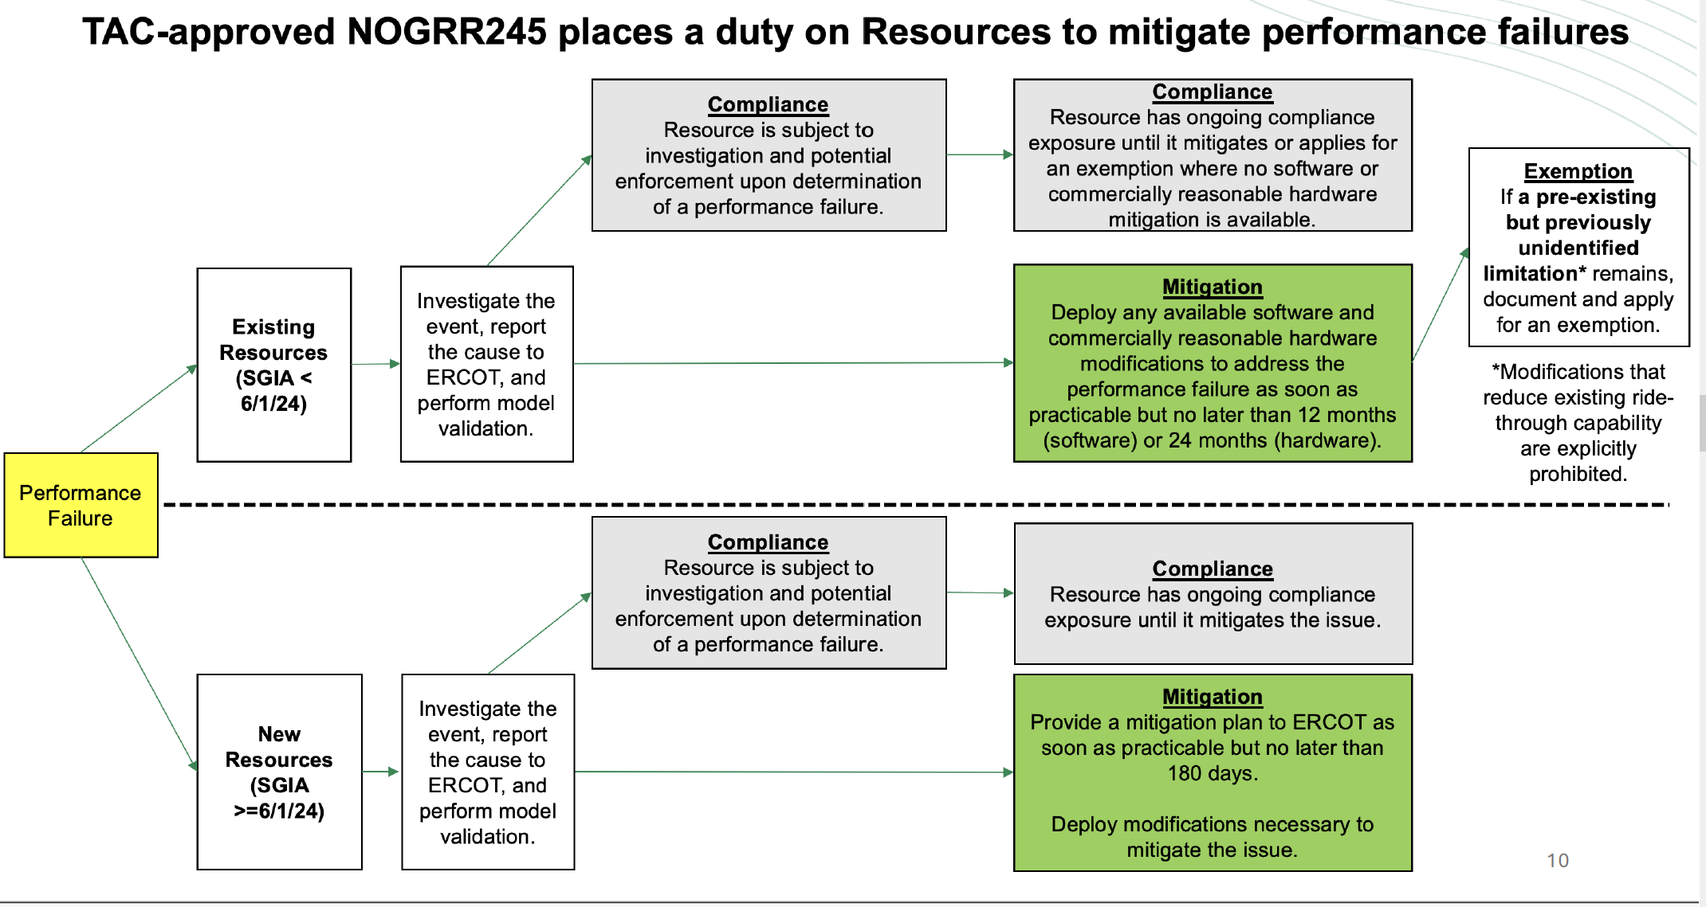
Performance Assessment
Issue 2F: Performance failures can lead to additional exemptions - effectively lowering requirements
Issue 2F: Different interpretations of what is a performance failure
Issue 4:SGIA date for new requirements
Update
Issue 3 : No requirement to implement mitigation

Slide 33
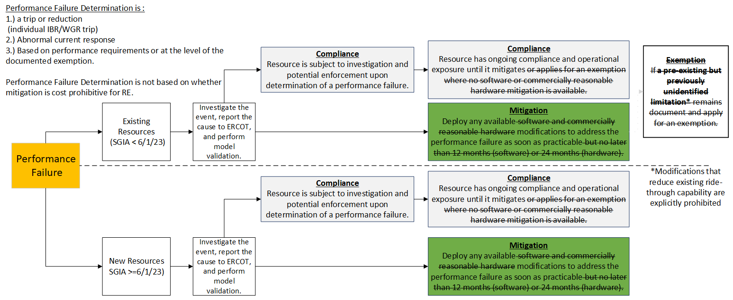
Key Issue 2F: Performance Assessment – ERCOT Supports
Key Takeaways: Mitigation following performance failures must always be implemented as soon as practicable with enforcement penalty as driver for timeliness. Exemptions must be a one-time allowance and not on-going.

Slide 34
Key Issue 2F: Performance Failures Lower Requirements
Key Decision: Do TAC members support requiring that performance failures are based on failing to meet requirements or only due to a failure to implement an improvement the RE determined was cost effective?
Key Decision: Do TAC members, considering the risk of additional ride-through failures, support requiring mitigation as soon as practicable with enforcement as an incentive or allowing 12 to 24 months (or beyond) to mitigate performance failures?
Key Decision: To address reliability risks from ride-through performance failures, do TAC members support a policy of firm performance requirements or a policy allowing progressive lowering of performance requirements?

Slide 35
Key Issue 3: No Requirement to Implement Mitigation
TAC-recommended § 2.14.1 (Actions Following an Apparent Failure to Ride-through)
(4) The Resource Entity [with SGIA prior to 6/1/24] which experiences an Apparent Performance Failure shall:
(a) Submit to ERCOT a new exemption or extension request under Section 2.13…or update the information provided in any existing exemption or extension request to reflect new information arising from the Apparent Performance Failure, including, documented limitations that were previously unknown, and any known and available commercially reasonable modifications to mitigate the identified cause of such Apparent Performance Failure; and
Make any such commercially reasonable modifications in accordance with the timelines in Section 2.11, Commercially Reasonable Efforts.
* * *
(6) The Resource Entity [with SGIA after 6/1/24] shall provide ERCOT with a mitigation plan to meet the applicable ride-through requirements as soon as practicable but no later than 180 days, unless a longer timeline is mutually agreed upon by the Resource Entity and ERCOT.
Legacy units must submit new exemption or update existing exemption for every performance failure regardless of mitigation, if any
Does not require mitigation of performance failure and associated risk
New IBRs have no requirement to implement mitigation plan
Key Takeaway: TAC-recommended version allows legacy IBRs to mitigate to only self-determined level and new IBRs to submit mitigation plan but not implement it. Language requires new exemption requests or updating of existing exemptions for every failure.

Slide 36
Key Issue 3: No Requirement to Implement Mitigation
Key Decision: Do TAC members support an RE receiving a new exemption or updating an existing exemption for every performance failure?
Key Decision: Do TAC members support clearly requiring implementation of a mitigation plan to address performance failures or only that a mitigation plan be created?

Slide 37
Key Issue 4: Date for New IBR Requirements
ERCOT delayed date from 1/1/23 to 6/1/23 (allows ~6.3 GW of IBRs to perform to only legacy requirements - 616 Wind, 2,683 Solar, 3,063 ESR)
As of 5/1/24, moving to 6/1/24 allows ~23.6 GW more to perform to only legacy requirements (May averages)
  15 GW of 21.6 GW (69%) have financial security posted
  19.4 of 21.6 GW (90%) have projected COD before 12/31/26
  All 21.6 GW (100%) have projected COD before 12/31/28
ERCOT proposed exemptions (COD before 12/31/26) and extensions (COD before 12/31/28) as phase-in
NOGRR124 (enhanced HVRT requirements) used similar approach to effective date/event (1/16/14) to limit reliability risk of lower requirements*
  NOGRR124 had 4/24/14 TAC recommendation with effective date of 1/16/14 SGIA
  NOGRR124 had no exemption/extension phase-in provision
Extension date accommodates OEM stating it needs additional time to fully meet all requirements (could provide additional retrofit kits in 2026)
ERCOT justified allowing risk from exemptions for older IBRs with maximizing equipment capability, updating models, and 6/1/23 for new requirements (highlighting why picking some language to revise is a problem)
Key Question: With ability to grant exemptions/extensions, why does TAC recommend delayed effective date to 6/1/24 considering impact on reliability?
* 124nogrr_15_ercot_comments_041714 comments

Slide 38
Key Issue 4: New IBR Requirements - Flow Chart
Key Takeaway: Exemptions/extensions allow flexibility as OEMs adapt to fully meeting IEEE 2800

Slide 39
Key Issue 4: GIS Report Breakdown (5/1/24)
* 6/1/24 assumes new additions in May 2024 will be average of previous 11 months

Slide 40
Key Issue 4: Capable of more, requiring less
If modern IBRs can help mitigate risk from older IBRs and performance failures, it harms reliability to continue allowing lower performance requirements
L
L_{e}
L
L
L
L_{e}
< 6/23
(22GW)
IEEE 2800 requirements
for Solar/ESR
Legacy requirements
Voltage
Assumes all IBRs maximize ride-through capability to equipment capability
97% of IBRs with SGIA after 6/1/23 are solar or ESR
Most can meet majority of new requirements
ERCOT version allows exemptions/extensions to address phase-in
If modern IBRs can meet new requirements, why lower requirements to legacy level?
Planning /Operational decisions are made on modeled capability
Majority of faults are > .5 pu voltage dip
IEEE 2800 requirements for Wind
.5 pu
Key Takeaway: Most modern IBRs can meet IEEE 2800 requirements and help mitigate risk from slower or longer voltage recovery times during longer clearing faults or other IBR performance failures.

Slide 41
Key Issue 4: IEEE 2800 Requirements
Negative Sequence Current Injection During Fault – If absent in high IBR penetration areas, can lead to protection system misops (i.e., events more severe than contingencies in planning/operations); noted as SPWG concern by ONCOR in 3/7/23 comments and informal discussion later addressed by referencing IEEE 2800 Sections 5, 7, and 9 (6/22/23 comments)
Transient Overvoltage Ride-through Requirements –Table 14 requires riding through transient overvoltage and instantaneous voltage spikes; ERCOT has seen large load rejection events and very aggressive large-load growth is forecasted (making these capabilities increasingly important). NOGRR255 allows high resolution data for this risk
Additional Current Injection Capabilities – Provides clarity during fault to minimize active current drops during faults due to more stringent current injection/absorption requirements; increasing this capability can slow (eventually prevent) unnecessary frequency drops to prevent unnecessary UFLS activation
Multiple Excursion – Requires IBRs to ride-through multiple excursions (part of cause in one ERCOT event and 2016 Australia event); extreme weather also increases likelihood of multiple excursions (i.e., multiple faults in few seconds)
More Stringent VRT Curves – Tables 11 and 12 require additional ride-through durations for more common voltage dips above .5 pu; longer duration faults (e.g., stuck breaker or protection misops) do occur (although rare)
Multiple Elements of Protection Coordination Specificity – Section 9 provides specifics helping prevent trips rather than trip and mitigate; Sections 9.1 (Frequency Protection), 9.2 (RoCoF), 9.3 (AC voltage protection), 9.4 (AC overcurrent protection), 9.5 (Unintentional islanding protection), and 9.6 (Interconnection system protection)
Key Takeaway: Conformity with IEEE 2800-2022 mitigates reliability risk for existing events (and beyond) for rapidly emerging risks as system transitions to IBR- dominated grid.

Slide 42
Key Issue 4: Key Thoughts for TAC members
Everyone agrees a majority (97%) of new SGIAs since 6/1/23 are ESRs/Solar with improved capabilities
  If capable and everyone agrees to maximize to equipment capability, why oppose maintaining that better capability or higher performance requirements closer to the models ERCOT and TSPs use for planning and operations decisions?
Most opposition is based on principle and precedent of "not retroactive“ but SGIA date of 6/1/23 w/ exemptions/extensions isn’t “retroactive”
  If NOGRR124 clearly provides precedent and FERC Order 901 states requirements should apply to existing IBRs, why oppose?
Opposition based on comments at board meeting that wind farm developer purchased old technology during pandemic w/o an SGIA, aren‘t exemptions/extensions sufficient?
With only 539 MW of wind development on 3 projects after 6/1/23, if that is primary reason, should ERCOT Region delay applicability of new requirements to other, more capable 21-23 GW of IBRs considering the significant reliability risk of failures?
Does opposition seeking to avoid compliance risk for non-performance outweigh reliability risk to ERCOT System?
Key Takeaway: Delaying implementation of preferred requirements when vast majority of new IBRs can meet them does not make sense when exemptions/ extensions offset the impact considering reliability risk.

Slide 43
Odessa 2022 Event Report: ERCOT Recommended Actions*
ERCOT Adoption of Reliability Guideline Content
As stated in multiple NERC reports and guidelines, ERCOT (and all TOs, TPs, and PCs) should comprehensively adopt any applicable recommendations contained in the NERC reliability guidelines to ensure mitigating actions are put in place to prevent these types of issues in the future. Many of the performance issues in this event could have been mitigated if appropriate modeling and performance requirements were established and conformance with those requirements was enforced. NERC reliability guidelines (and other resources, such as IEEE 2800-2022) provide additional specificity and clarity that can help enhance existing performance requirements established by TOs, TPs, and/or PCs. (emphasis added)
* https://www.nerc.com/comm/RSTC_Reliability_Guidelines/NERC_2022_Odessa_Disturbance_Report%20%281%29.pdf

Slide 44
Key Issue 4: New IBR Requirements Date
Key Decision: Considering the current reliability risk of continue IBR performance failures, the additional reliability risk of rapid growth of new IBRs and the likelihood of exemptions for some older IBRs, do TAC members support a 6/1/23 date, 6/1/24 date, or some other option to adequately address the collective, critical reliability risk?

Slide 45
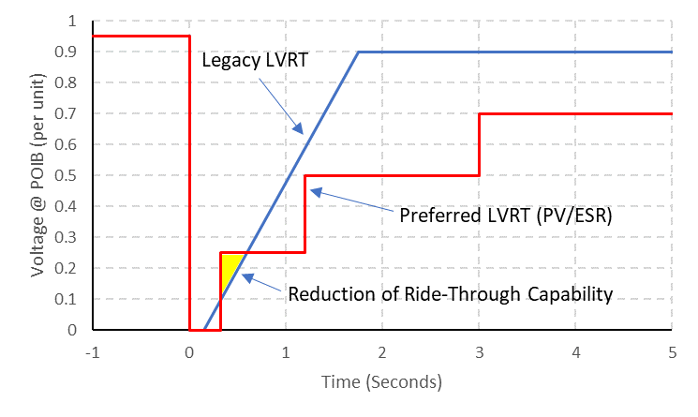
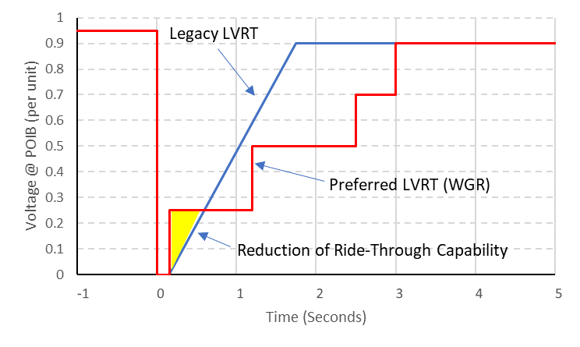
Key Issue 5: Lower Requirements for New IBRs
Key Takeaway: TAC approved version lowers the LVRT curves for new IBRs

Slide 46
Key Issue 5: Lower Requirements for New IBRs
Key Decision: Do TAC members support lowering (worsening) LVRT requirements below .25 pu for new IBRs or maintaining the requirements for LVRT below .25 pu for new IBRs?

Slide 47
Basis for ERCOT proposals
Use 6/1/23 to make IBRs subject to § 2.9.1.1 and IEEE 2800 because:
  Issues known since at least 2017 (from NERC and ERCOT)
  Initial date of 1/1/23
    Move to 6/1/23 results in ~ 6 GW not having to meet new requirements
    Delay to 6/1/24 results in additional 22- 24 GWs not required to meet new requirements
    > 70 GW of existing IBRs is already not required to meet improved requirements with ERCOT proposal
  Reasonable “phased” approach for IBRs post-6/1/23
    IBR w/ COD before 12/31/26 can request exemption for portions it cannot meet
    IBR w/ COD after 12/31/26 can request extension up to 12/31/28 to fully comply
RE prohibitive cost claims:
    Cannot trump reliability as reliability failure is orders of magnitude more expensive
    Having no firm requirements does not incentivize OEMs to develop better solutions
    Must be consistent, objective, repeatable criteria for all REs
    Should not shift burden of transmission upgrades, congestion charges, potential blackouts and equipment impacts to “innocent bystander” stakeholders to accommodate IBR owners
After performance failure, RE must mitigate to meet objective, applicable requirements

Slide 48
Additional Assumptions
IBR performance requirements are one part of solution to address risk
  System upgrades (e.g., 6 new synchronous condensers)
  Grid Forming capability adoption
  Modeling/testing improvements (DWG/IBRWG collaboration)
  Install disturbance monitoring equipment (NOGRR255)
  Potential planning criteria adjustments
To offset risk, exemptions must include:
  Clear expectations regarding the potential need for operating restrictions on IBRs that experience performance failures or whose limitations pose unacceptable reliability risk
  Models and contingencies accurately reflect limitations
  Proper active/reactive power controls coordination
Actions to offset risk could lead to additional operation/planning impacts (e.g., congestion and system improvements)
Future NOGRR must address clarity and consistency on phase angle and RoCoF measurements and protections.

Slide 49
Questions?

Slide 50
Appendix

Slide 51
Appendix A
Framing Reliability Risk and Impact

Slide 52
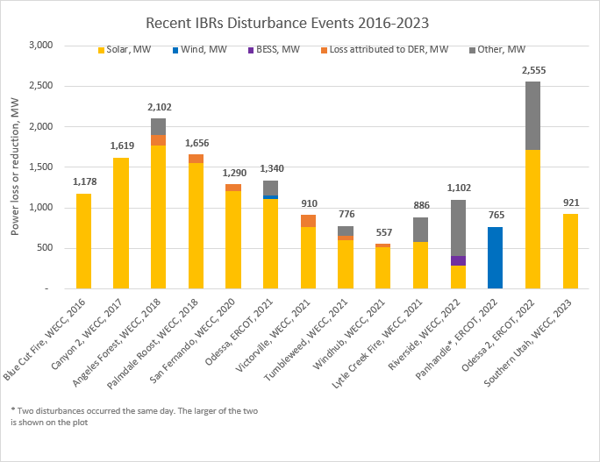
List of Major US Events
Key Takeaway: IBR ride-through failures happen throughout US in areas w/ high IBR penetration; voluntary recommendations have not mitigated risk causing need for mandatory requirements.

Slide 53
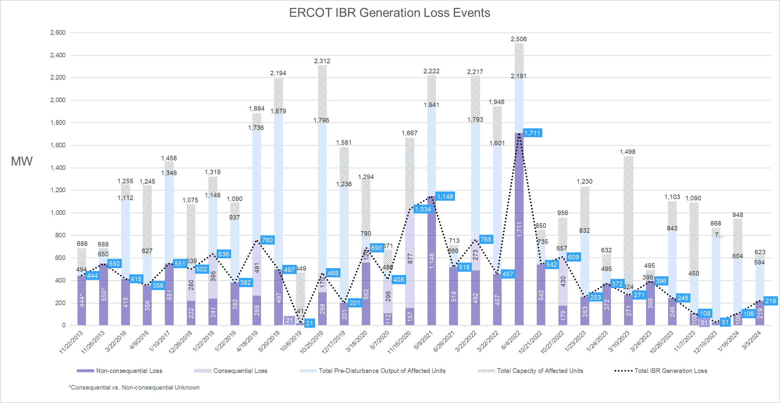
List of Events in ERCOT
32 events listed that do not typically include individual IBR trips & smaller reductions (i.e., <10 MW)
Actual instantaneous loss from trips or unnecessary active current reductions may be much larger than measured loss (150% or higher).
24 events wind only, 6 events solar only, 2 events wind and solar

Slide 54
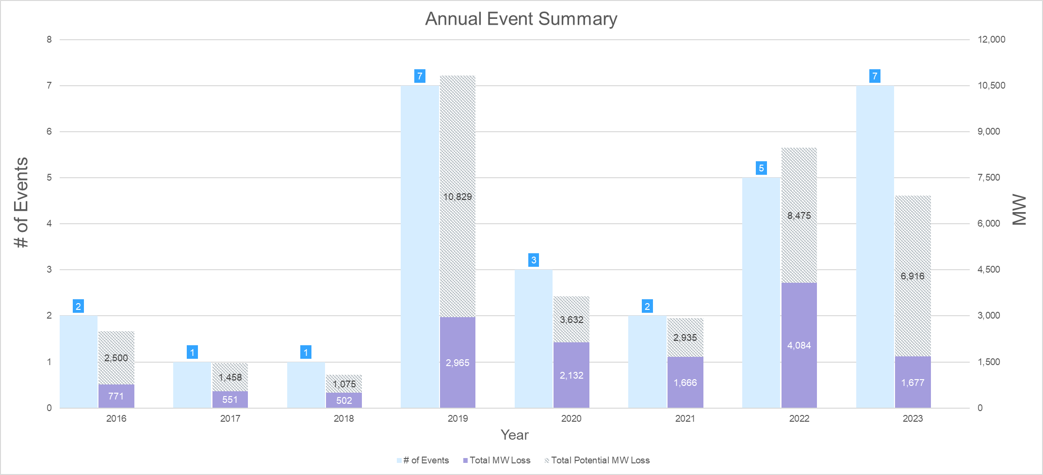
Events in ERCOT (Annual Rollup - # of Events & MWs)
Initial version of NOGRR 245 sough to eliminate IBR ride-through failures, ERCOT's recent comments seeks to reduce risk to one minor event per year (or less).
Target maximum magnitude should be < 500 MW (threshold for NERC reporting per future EOP-004) and performance failures or model deficiencies should always be promptly mitigated

Slide 55
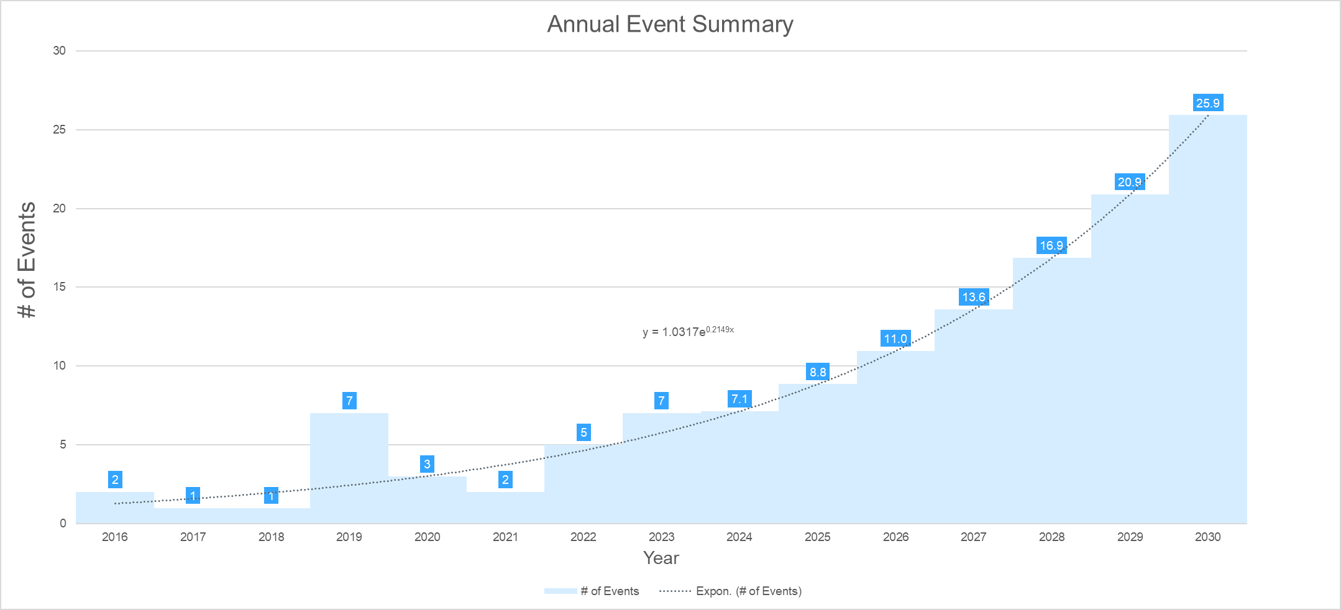
Events in ERCOT (Annual Forecast - # of Events)
Future Do nothing
Target <= 1 event per year
Target < 500 MW
Key Takeaway: Current trajectory is unsustainable for ERCOT Region. ERCOT target is less than 1 event per year and no more than 500 MW. ERCOT does not believe TAC-recommended version achieves target.

Slide 56
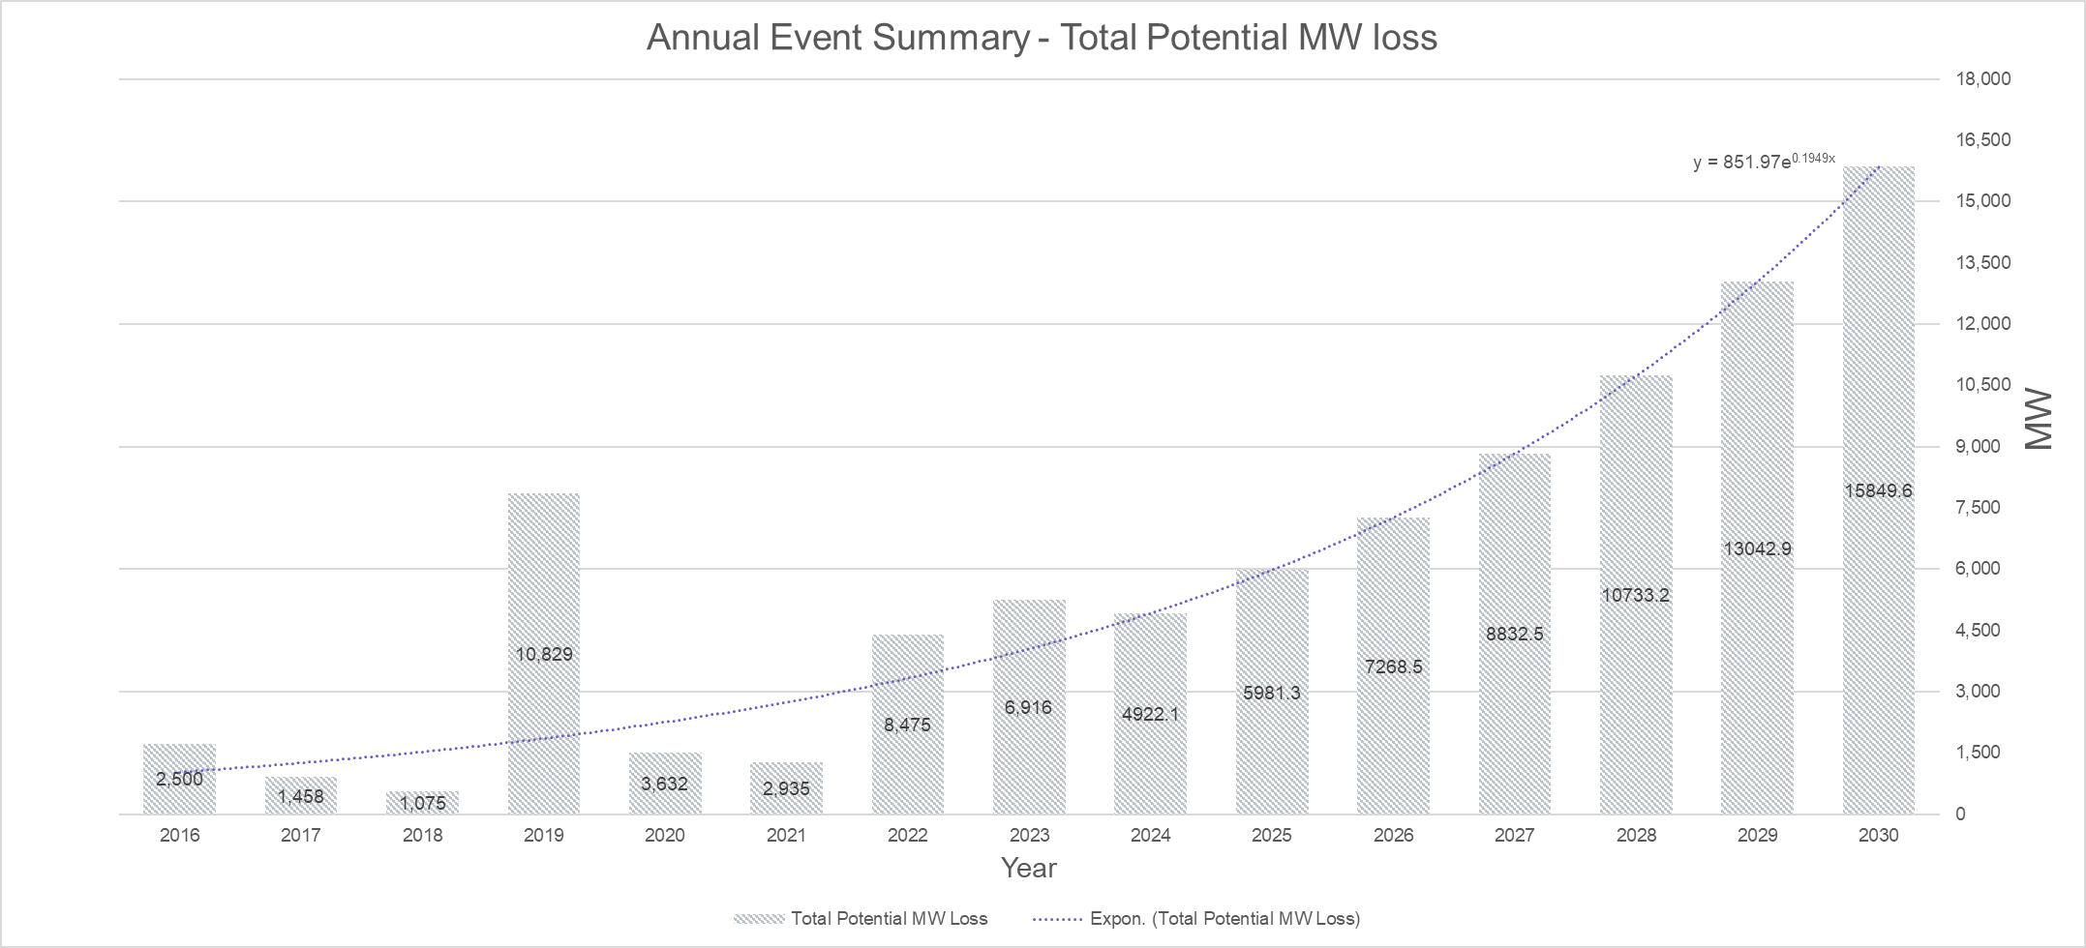
Events in ERCOT (Annual Forecast Rollups)
Future Do nothing
< 500 MW
Key Takeaway: Current trajectory is unsustainable for ERCOT Region. ERCOT target is less than 1 event per year and no more than 500 MW. ERCOT does not believe TAC-recommended version achieves target.

Slide 57
Issue – Frequency and Voltage Transient Stability
Ride-through performance failures expose ERCOT to different transient stability risk timeframes
Planning/stability limit studies assume IBRs/non-IBR WGRs will ride-through as modeled (they don’t)
Large reductions of instantaneous trips/reductions can instantaneously trip generators below 57.5 Hz
Large reductions of near instantaneous trips can activate UFLS causing system-wide collapse
Multiple unplanned reductions can cause previously-identified transient instability leading to additional generator/load trips
Key Takeaway: Ride-through performance failures can cause unplanned loss of generation and load up to complete system collapse - risks are at different levels at different times.

Slide 58
Issue – How Low Can Instantaneous Frequency Go?
Frequency
MW loss
MW loss is estimate of amount including trip and reductions (inverter/turbine trips and active current reductions)
Frequency dip depends on factors like: inertia, spinning headroom, high set Load Resource deployment timing and PFR/FFR timing
Odessa 2022 first fault lowest frequency measurement was 58.818 Hz w/ available PMUs from an estimated 3500 - 4000 MW instantaneous loss
Estimates are linear projections beyond 59.3 Hz ranges
Odessa 2022 Event
Frequency Range | Delay to Trip
Above 59.4 Hz | No automatic tripping (Continuous operation)
Above 58.4 Hz up to And including 59.4 Hz | Not less than 9 minutes
Above 58.0 Hz up to And including 58.4 Hz | Not less than 30 seconds
Above 57.5 Hz up to And including 58.0 Hz | Not less than 2 seconds
57.5 Hz or below | No time delay required
Key Takeaway: Instantaneous risk from frequency drop can cause additional generators to trip, resulting in uncontrolled/cascading condition.

Slide 59
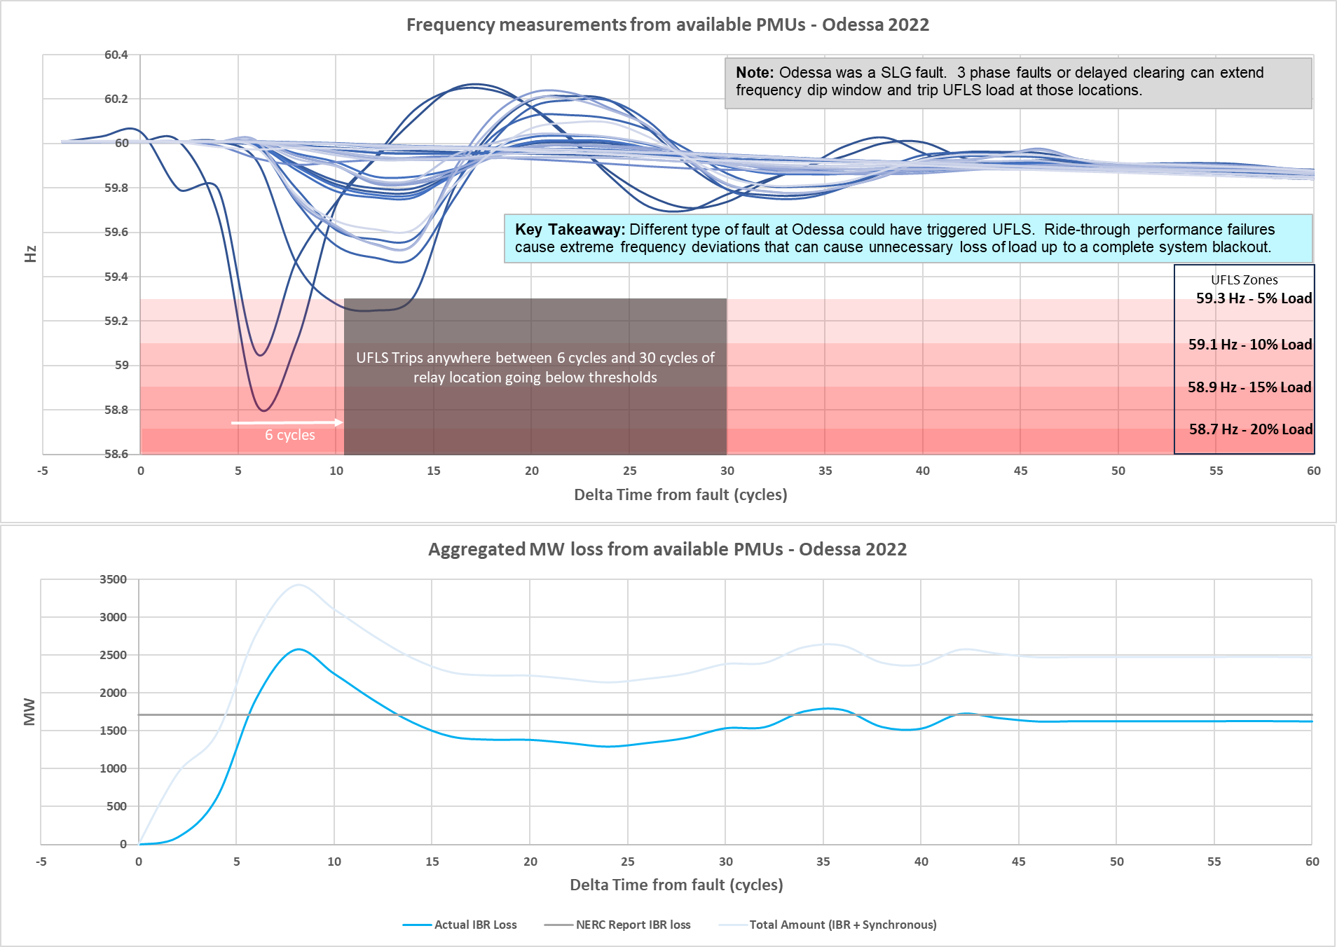
Near Instantaneous - Odessa 2022 Event

Slide 60
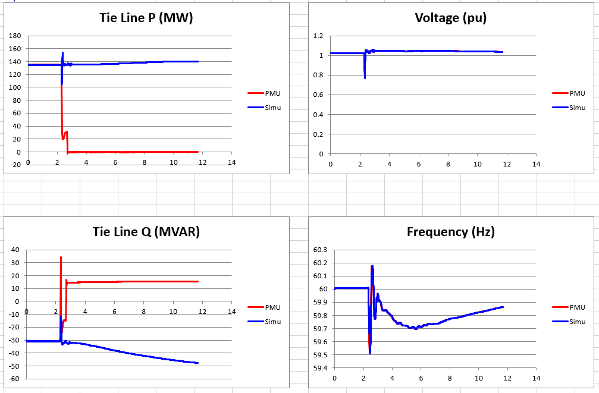
Issue - Models Do Not Match Actual Performance
Key Takeaway: Invalid models pose significant risk because all planning & operational decisions are based on models - IBRs must ride-through disturbances as models demonstrate.

Slide 61
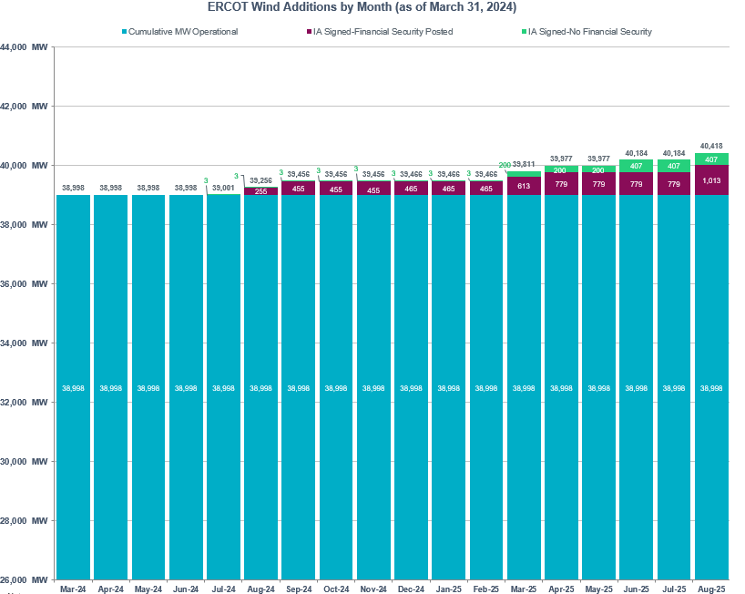
Wind Capacity Changes – short term
Key Takeaway: Wind growth in short term continues at slower pace. Risk is not stagnant.

Slide 62
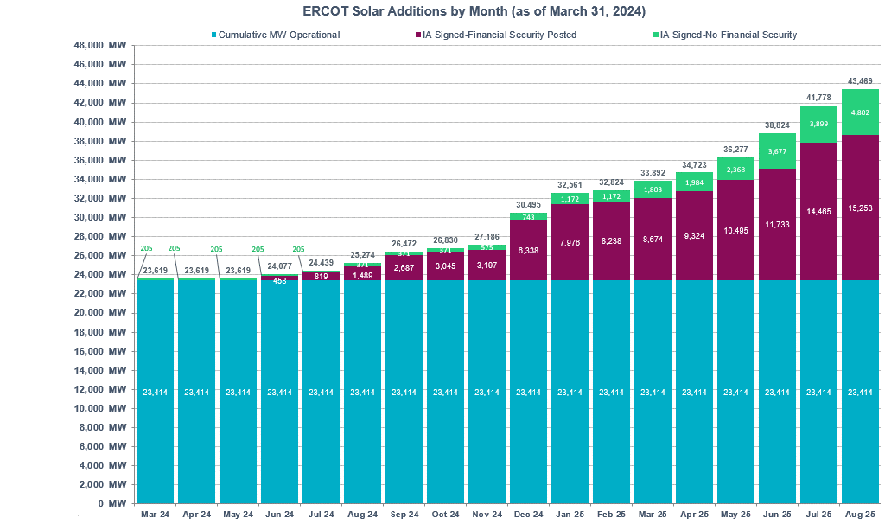
Solar Capacity Changes – Short Term
Key Takeaway: Solar growth may almost double capacity in the next year. Risk is increasing rapidly.

Slide 63
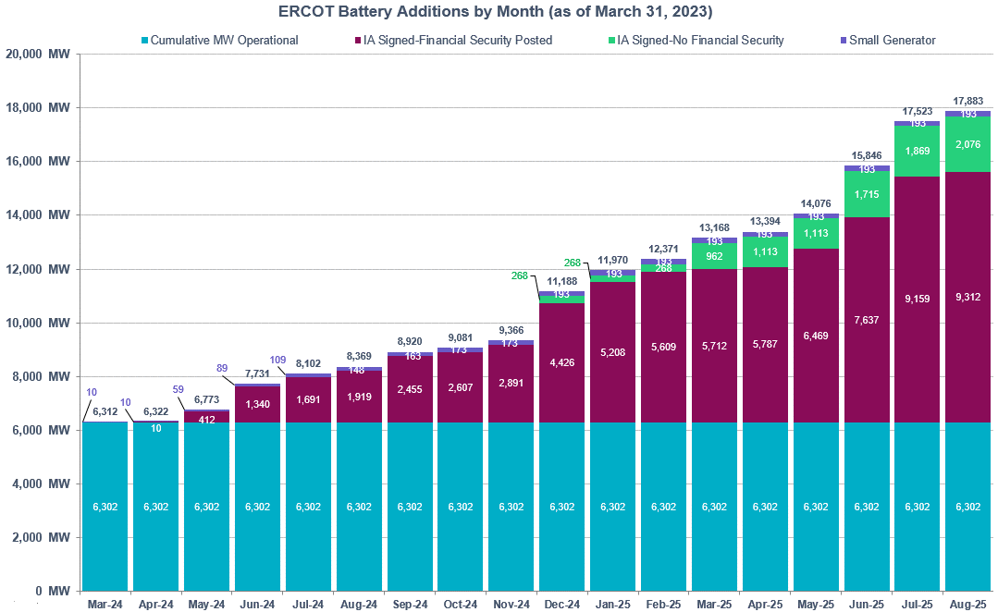
Battery Capacity Changes – Short term
Key Takeaway: ESR growth may almost triple capacity in the next year. Risk is increasing rapidly.

Slide 64
Appendix B
November 2023 RFI breakdown by type

Slide 65
RFI Results – December TAC
OEM RFI and part of RE RFI asked if technically feasible to comply w/ requirements in ERCOT-recommended language in 8/18/23 comments
Some RE responses may reflect late info from OEMs
Remainder of RE RFI asked if it was commercially reasonable to comply with requirements as captured in the ROS approved language from the September 14, 2023.
VRT curves are more stringent in ROS approved language

Slide 66
RFI Results – Breakdown by Type
 |  | 2.6.2.1 (1) Frequency Ride Through curve | 2.6.2.1(3) Protection System Coordination | 2.6.2.1(3) Rate of Change of Frequency (RoCoF) | 2.6.2.1 (4) Current injection settings | 2.6.2.1 (5) Controls system coordination | 2.6.2 (3) Filtered quantities/ time delay use | Section 2.9.1.2 (1) Table A VRT Curves | 2.9.1.2 (3) Protection System Coordination | 2.9.1.2 (4) Current injection settings | 2.9.1.2 (5) Controls system coordination | 2.9.1.1 (6) Filtered quantities/ time delay use | 2.9.1.2 (7) Multiple excursion requirements | 2.9.1.2 (8) Phase Angle Jump
OEM 66,777 MW | Can Comply (Yes) | 57980 | 65890 | 39793 | 66168 | 65890 | 66168 | 57700 | 65890 | 63410 | 65890 | 66168 | 38053 | 40378
 | Cannot comply(No)Wind[39,439] | 8756 | 566 | 25882 | 288 | 566 | 288 | 8756 | 566 | 3046 | 566 | 288 | 27807 | 25297
 | Cannot comply(No)non-wind[27,338] | 41 | 321 | 1102 | 321 | 321 | 321 | 321 | 321 | 321 | 321 | 321 | 917 | 1102
 | % Can comply (Yes) | 87% | 99% | 60% | 99% | 99% | 99% | 86% | 99% | 95% | 99% | 99% | 57% | 60%
RE 54,953 MW | Can Comply (Yes) | 45062 | 46049 | 25499 | 49028 | 48937 | 47976 | 39559 | 41651 | 40953 | 47786 | 47013 | 20770 | 24383
 | Cannot comply(No)Wind[35,531] | 5292 | 3467 | 23600 | 2050 | 2141 | 2836 | 9556 | 7059 | 9967 | 3134 | 3165 | 26832 | 25158
 | Cannot comply(No)PVGR[15,762] | 3704 | 4479 | 5288 | 3369 | 3369 | 3635 | 4855 | 5285 | 3527 | 3527 | 4269 | 6736 | 4886
 | Cannot comply(No)ESR[3,659] | 895 | 958 | 566 | 506 | 506 | 506 | 983 | 958 | 506 | 506 | 506 | 615 | 526
 | % Can comply (Yes) | 82% | 84% | 46% | 89% | 89% | 87% | 72% | 76% | 75% | 87% | 86% | 38% | 44%
 |  | 2.6.2.1 (1) Frequency Ride Through curve | 2.6.2.1(3) Protection System Coordination | 2.6.2.1(3) Rate of Change of Frequency (RoCoF) | 2.6.2.1 (4) Current injection settings | 2.6.2.1 (5) Controls system coordination | 2.6.2 (3) Filtered quantities/ time delay use | Section 2.9.1.2 (1) Table A VRT Curves | 2.9.1.1 (1) Table C VRT Curves? | 2.9.1.2 (3) Protection System Coordination | 2.9.1.2 (4) Current injection settings | 2.9.1.2 (5) Controls system coordination | 2.9.1.1 (6) Filtered quantities/ time delay use | 2.9.1.2 (7) Multiple excursion requirements | 2.9.1.2 (8) Phase Angle Jump
RE 54,742 MW | Can Comply (Yes) | 38482 | 38185 | 20124 | 40628 | 41243 | 39729 | 23779 | 11427 | 33876 | 32299 | 38867 | 39989 | 15427 | 17909
 | Cannot comply(No)Wind [35,484] | 9369 | 8828 | 26251 | 7686 | 7332 | 8319 | 22462 | 30462 | 12361 | 15857 | 9289 | 7941 | 29400 | 27848
 | Cannot comply(No)PVGR[15,778] | 5939 | 6714 | 7784 | 5865 | 5604 | 6131 | 7499 | 10845 | 7470 | 6023 | 6023 | 6249 | 9283 | 8402
 | Cannot comply(No)ESR[3,480] | 952 | 1015 | 583 | 563 | 563 | 563 | 1002 | 2008 | 1035 | 563 | 563 | 563 | 632 | 583
 | % Can comply (Yes) | 70% | 70% | 37% | 74% | 75% | 73% | 43% | 21% | 62% | 59% | 71% | 73% | 28% | 33%

Slide 67
Appendix C
Timeline

Slide 68
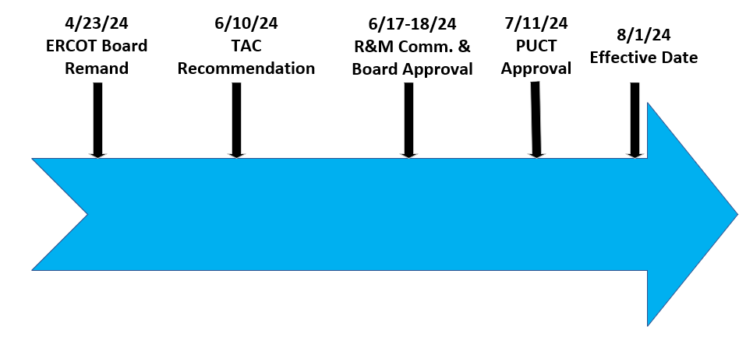
Updated timeline for NOGRR 245 (Next steps)

Slide 69
Appendix D
Odessa 2022 ERCOT Recommended Actions

Slide 70
Odessa 2022 Event Report: ERCOT Recommended Actions*
ERCOT Improvement to Interconnection Process
ERCOT should prioritize making improvements to their interconnection process…to close known gaps in model quality. ERCOT should focus on using user-defined EMT and positive sequence models verified by the original equipment manufacturers in tandem throughout the interconnection process. Both the EMT and positive sequence models should be verified against designed parameters with any gaps clearly explained such that ERCOT is aware of all model limitations. Prior to commercial operation, ERCOT should ensure that as-commissioned equipment settings and protections match those that were used throughout the interconnection study process. Any discrepancies should be clearly documented by the GO, reviewed by ERCOT, and “trued up” prior to commercial operation.
ERCOT Adoption of Reliability Guideline Content
As stated in multiple NERC reports and guidelines, ERCOT (and all TOs, TPs, and PCs) should comprehensively adopt any applicable recommendations contained in the NERC reliability guidelines to ensure mitigating actions are put in place to prevent these types of issues in the future. Many of the performance issues in this event could have been mitigated if appropriate modeling and performance requirements were established and conformance with those requirements was enforced. NERC reliability guidelines (and other resources, such as IEEE 2800-2022) provide additional specificity and clarity that can help enhance existing performance requirements established by TOs, TPs, and/or PCs. (emphasis added)
* https://www.nerc.com/comm/RSTC_Reliability_Guidelines/NERC_2022_Odessa_Disturbance_Report%20%281%29.pdf

Slide 71
Odessa 2022 Event Report: ERCOT Recommended Actions (cont’d)
ERCOT Follow-Up with all Inverter-Based Resources in Texas Interconnection
ERCOT should continue its strong stakeholder outreach and education programs to ensure all GOs and GOPs of inverter-based resources in the Texas Interconnection are implementing mitigating actions to address reliability issues. This may include enforcing its comprehensive ride-through requirements and model quality checks. (emphasis added)
ERCOT System Model Validation Effort
NERC strongly recommends ERCOT conduct a system model validation effort by using both positive sequence and EMT models to ensure that those models reflect as-commissioned equipment settings and can accurately recreate system events. This activity will help improve model quality and ensure that the models can identify future performance issues on the ERCOT system

