Slide 1
RTC+B Technical Workshops
ERCOT Staff
May 06, 2024

Slide 2
RTC+B Technical Workshops
WELCOME
Workshop#2 - Finalize approach on ICCP configuration approaches for parallel testing and transition.

Slide 3
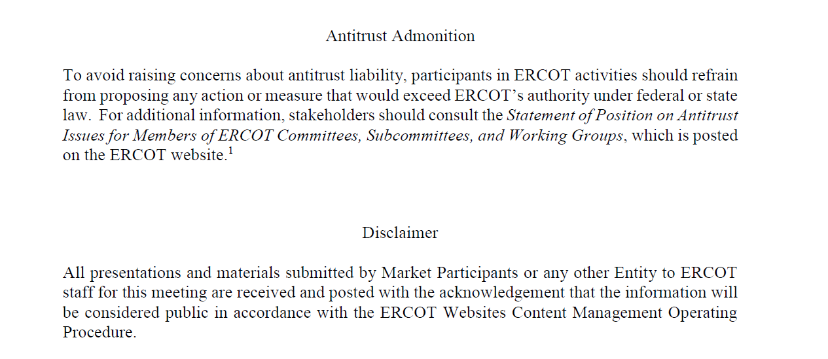
RTC+B Technical Workshops

Slide 4
Agenda
Item # | Item Description | Presenter | Start Time
1 | Antitrust admonition | Sreenivas Badri | 1:00 PM
2 | Introduction | Sreenivas Badri | 1:05 PM
3 | Recap of workshop#1 | ERCOT Staff | 1:10 PM
4 | Revisit existing telemetry deletions and RTC+B new telemetry additions | Tejaswi Potluri/Kevin McGarrahan | 1:40 PM
5 | ESR Telemetry and Model changes | Sreenivas Badri | 2:05 PM
 | Break | Break | 2:20 PM
6 | Market Trials Objectives | Sreenivas Badri | 2:30 PM
7 | ICCP Configurations for Market Trials and Go Live Revisit two options discussed in workshop#1 Single Model ESR additional telemetry changes with Option 1 Pros and Cons of the options | Kevin McGarrahan/Sreenivas Badri | 2:40 PM
8 | Finalize one ICCP Configuration | ERCOT Staff/QSEs | 3:15 PM
9 | Q&A Session |  | 3:30 PM
10 | Next Steps | Sreenivas Badri | 3:55 PM
11 | Adjourn | Sreenivas Badri | 4:00 PM

Slide 5
RTC+B Technical Workshops – Key Objectives
Key Objectives
  Help QSEs, and their vendors start planning their RTC+B systems design and implementation early to align with ERCOT’s RTC+B project implementation timelines which is critical for ERCOT to deliver this project successfully and on time.
  Based on the feedback from these workshops, ERCOT will finalize ICCP/Market Interface design specifications and publish draft versions to the ERCOT website.
Upcoming RTC+B Technical Workshops Schedule
    RTC+B Technical Workshop - May 15, 2024: 1:00 PM – 4:00 PM :
    Market Interfaces design specifications (submissions - External API/Market Manager, notifications, and reports)
    RTC+B Technical Workshop - June 6, 2024: 1:00 PM – 4:00 PM :
    Reserved for further discussions if needed and Q&A session.

Slide 6
RTC+B Technical Workshops – Workshop #2
  Focus of today’s meeting
    Recap of Workshop#1
    Revisit existing telemetry deletions and RTC+B new telemetry additions
    Objectives of Market Trials
    Go over ICCP Configurations (two options) again and their Pros and Cons
  Key objective of today’s meeting
    Finalize one ICCP Configuration for Market Trials/Closed Loop Testing/Go Live

Slide 7
RTC+B Technical Workshops – Workshop #2
  Out of Scope items from today meeting
    Market Interfaces (External Specs/XSD changes, API, Report Specs etc.)
    Market Trials readiness
    Closed Loop Testing and Cutover Plan

Slide 8
Recap of Workshop#1
  RTC+B References
  AS Deployments
  Details on RTC+B Telemetered Resource Statuses
  Updated Desired Setpoint (UDSP)
  New telemetry points frequency and Descriptions

Slide 9
Recap of Workshop#1
  RTC+B References
Real-Time Co-optimization plus Batteries Task Force (RTCBTF)
  https://www.ercot.com/committees/tac/rtcbtf
Real Time Co-optimization (NPRR 1007-1013)
  PUCT Directives and RTC Key Principles - https://www.ercot.com/mktrules/puctDirectives/rtCoOptimization
  RTCBTF refresher, as presented in RTCBTF on 9/7/2023
    https://www.ercot.com/files/docs/2023/09/01/2_refresher-on-real-time-co-optimization-key-principles-rtcbtf-090823_v2.pptx
Single model for Batteries (NPRR 1014)
  As presented in RTCBTF on 9/7/2023
    https://www.ercot.com/files/docs/2023/09/01/3_refresher_nprr-1014-single-model-overview_090823%20as%20of%209-7-23%201045.pptx

Slide 10
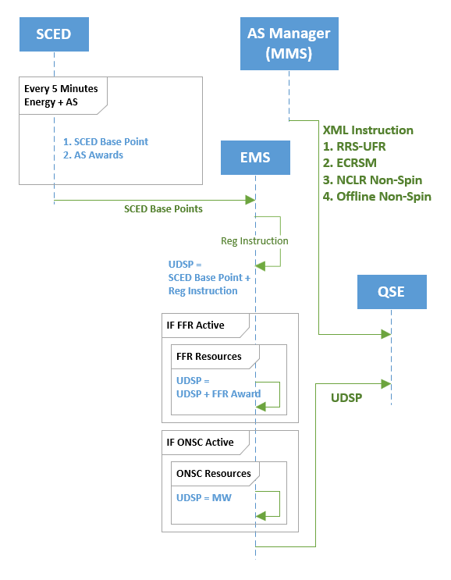
Recap of Workshop#1
AS Deployments

Slide 11
Recap of Workshop#1
AS Deployments
  Refer to RTCBTF Meeting Material
https://www.ercot.com/calendar/06222020- RTCTF-Special-Topic_-AS

Slide 12
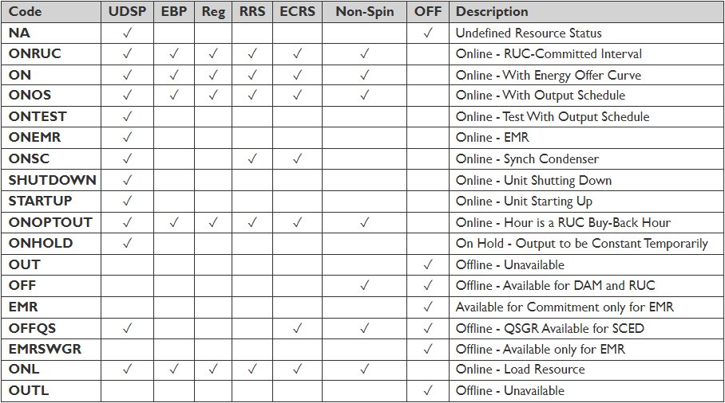
  Telemetered Resource Statuses
Resource Status (RST) codes are changing for all resources
Below are valid resource statuses for RTC+B

Slide 13
Updated Desired Setpoint (UDSP)
UDSP is the sum of a calculated MW value representing the expected MW output of a Resource ramping to a SCED Base Point and the Resource-specific Regulation Service instruction from ERCOT.
LFC shall send Resource-specific UDSP to QSEs every four seconds
UDSP replaces current UDBP

Slide 14
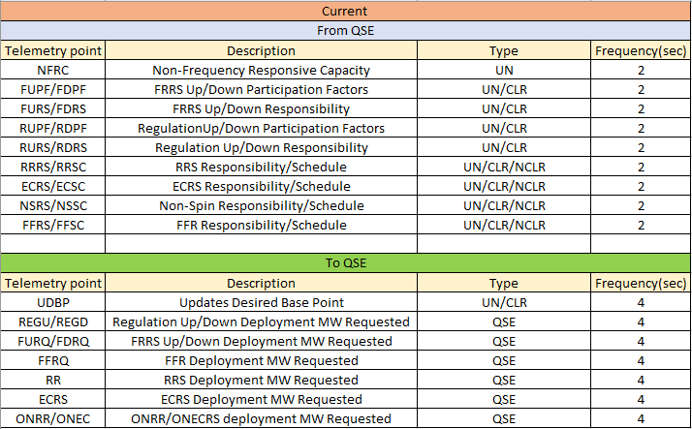
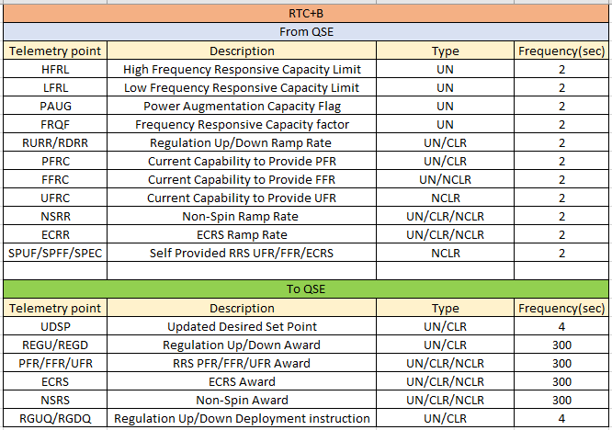
Telemetry Points From/To QSE – Current* and RTC+B
In Current implementation, UN includes ESR-GN and CLR includes ESR-CLR telemetry. In RTC+B implementation, UN includes ESR telemetry.
All telemetry points listed under Current implementation will be deleted post RTC+B go-live.
*ERCOT Nodal ICCP Communications Handbook

Slide 15
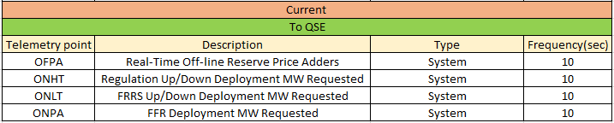
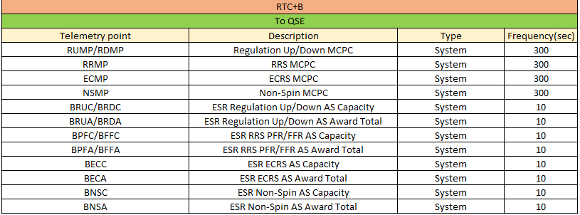
Telemetry Points From/To QSE – Current* and RTC+B
All telemetry points listed under Current implementation will be deleted post RTC+B go-live.
*ERCOT Nodal ICCP Communications Handbook

Slide 16
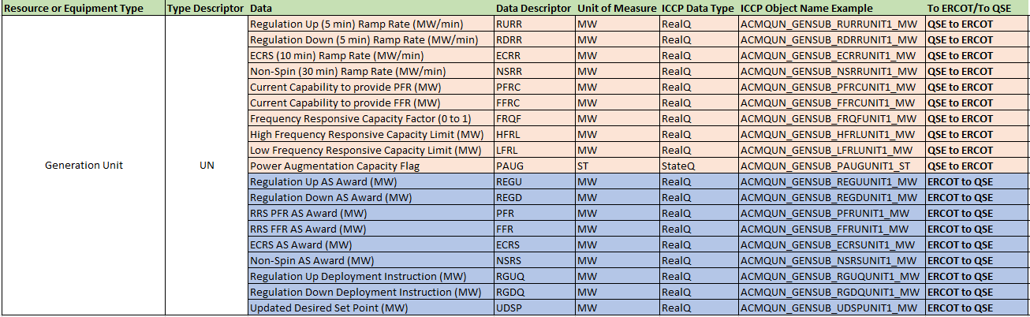
RTC+B Telemetry Points – ICCP Object Names - GR
Generation Resource (GR) telemetry additions and their ICCP Object Name examples.
  Physical Units Telemetry points like Gross MW, NetMW, AVR, PSS remain same
  Data Descriptor/Object Names subject to small changes as design is updated.

Slide 17
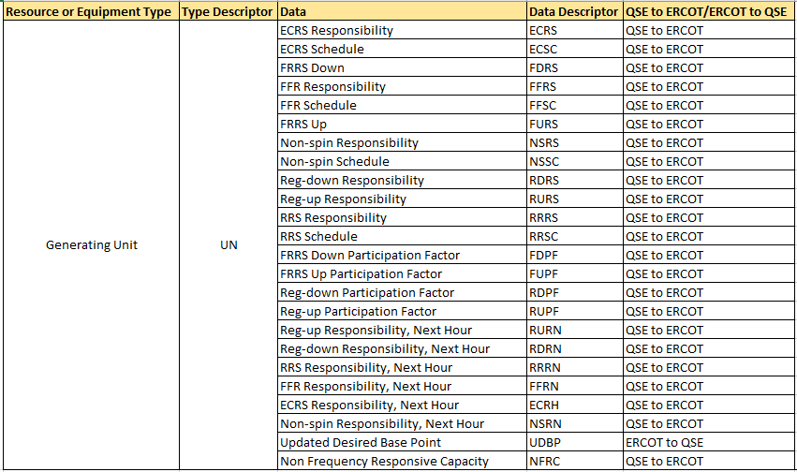
Current Telemetry Points – Deletions - GR
Generating Resource (GR) telemetry point deletions.
  Deletions happen post Go-Live

Slide 18
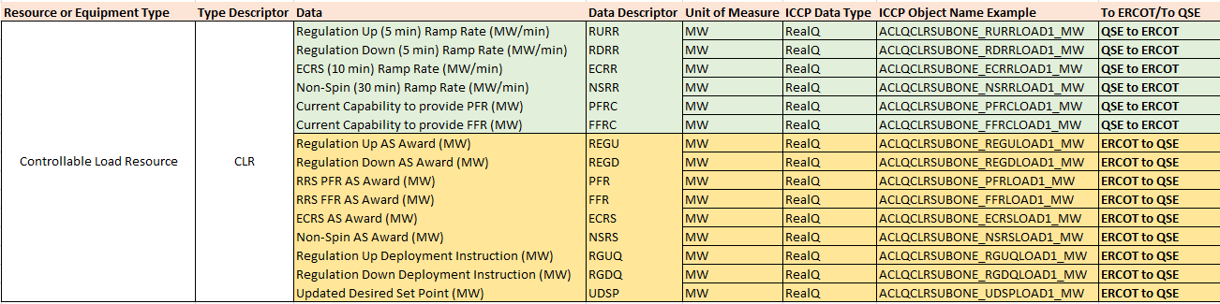
RTC+B Telemetry Points – ICCP Object Names – CLR
Controllable Load Resources telemetry additions and their ICCP Object Name examples.
  Data Descriptor/Object Names subject to small changes as design is updated.

Slide 19
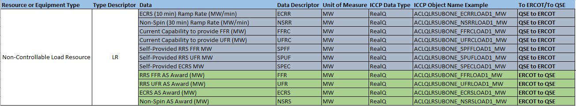
RTC+B Telemetry Points – ICCP Object Names - NCLR
Non-Controllable Load Resources telemetry additions and their ICCP Object Name examples.
  Data Descriptor/Object Names subject to small changes as design is updated

Slide 20
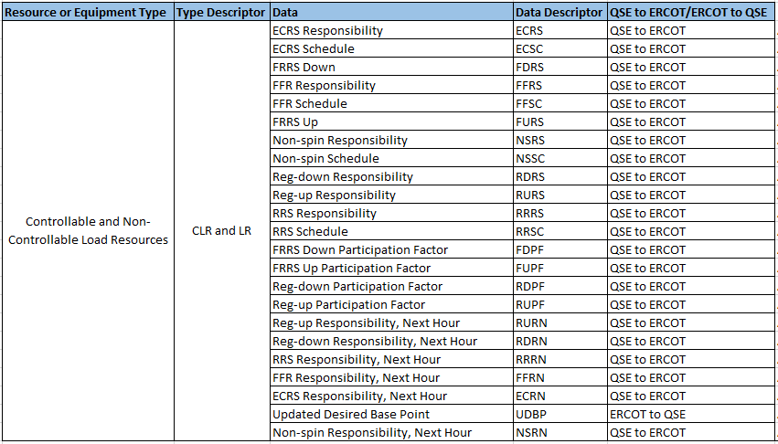
Current Telemetry Points – Deletions – CLR and NCLR
Load Resources telemetry point deletions
  Deletions happen post Go-Live

Slide 21
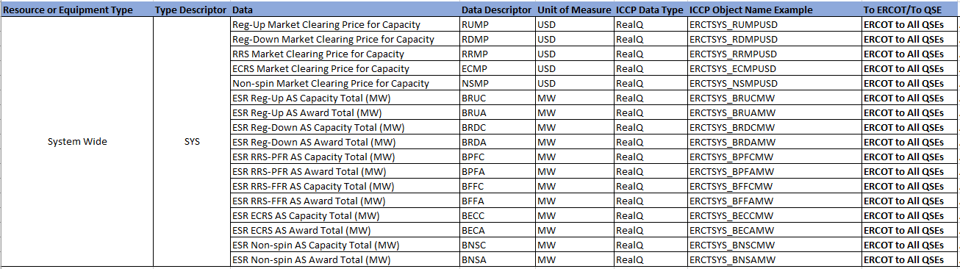
RTC+B Telemetry Points – ICCP Object Names - System
System Level telemetry additions and their ICCP Object Name examples.
  Data Descriptor/Object Names subject to small changes as design is updated.

Slide 22
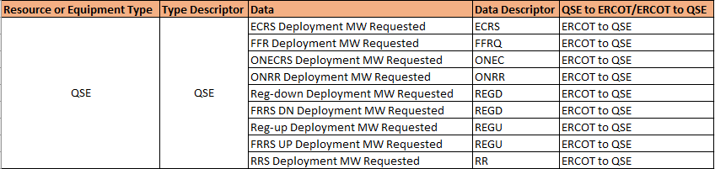
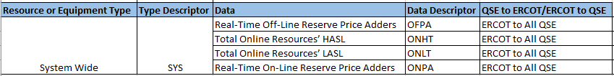
Current Telemetry Points – Deletions – QSE and System
QSE and System level telemetry points deletions.
  Deletions happen post Go-Live

Slide 23
Single Model ESR Telemetry and Validation changes
ESR-GR telemetry points will be retained and ESR-CLR telemetry points will be removed.
Modified validation on Single Model ESR telemetry points from QSE
      LSL - can be negative
      HSL - can be negative
      Net MW - can be negative
      Gross MW - can be negative

Slide 24
Single Model ESR Model Changes
Single Model ESR Model changes
  RE to submit Single Model ESR data into RIOO after RIOO ESR project go live (current planned go live date is end of July)
  Model conversion tool to generate combo model from RIOO single model data until RTC+B project go live.

Slide 25
Proposed Naming Convention for Single Model ESR
Existing Name for the GR part of the battery
Existing Name for the CLR part of the battery
Single
Resource
“SITECODE_ESR#”
RES_NAME (BES-GR) | RES_NAME (BES-CLR) | Single Model ESR NAME Concatenate "SiteCode" with "ESR#" | "Single Model Unit" Name
STATION1_UNIT1 | STATION1_LD1 | STATION1_ESR1 | ESR1
STATION2_BES1 | STATION2_LD1 | STATION2_ESR1 | ESR1
STATION2_BES2 | STATION2_LD2 | STATION2_ESR2 | ESR2
In the combo model world, none of the existing names for the GR part or the CLR part use “ESR”.
For single model world, the single-model name will be:
Concatenate "SiteCode" with "ESR#”
Coordinate with Single-Model Registration which is targeted to go-live summer 2024.
25

Slide 26
RTC+B Telemetry Points - Model Submissions
RTC+B ICCP Telemetry Model changes
  QSEs to Submit new ICCP telemetry points requests
  QSEs/ERCOT to maintain new ICCP telemetry points for current and new telemetry points through weekly model loads.

Slide 27
RTC+B Technical Workshop
  10 Minutes Break

Slide 28
Market Trials Objectives
Market Trials
  Validate telemetry quality and values
  QSE Submission Testing (COP, RT AS Offers, DAM Virtual AS etc.)
  Parallel Testing - Open Loop Testing
    QSE ICCP Telemetry and Offers for RTC+B EMS/SCED applications
    Testing of RTC+B ERCOT EMS/SCED applications with QSE EMS/AGC and QSE Market Interfaces.
    Testing of QSE EMS/AGC and QSE Market Interfaces with RTC+B ERCOT inputs.
    SCED non-binding awards and dispatch
  Prepare for Closed Loop Testing and Go live
  Closed Loop Testing
    Cutover to RTC+B production systems from current production systems
    Controlling the grid with RTC+B systems for 2 - 4 hours and cutback to current production systems
    QSE resources will be following UDSP telemetry signal
    SCED binding awards and dispatch

Slide 29
QSE ICCP Telemetry Testing
  QSE ICCP telemetry testing
  Obtain required ICCP telemetry points from QSE (examples: New AS ramp rates and Capabilities etc.)
  Configure and provide ICCP telemetry points to QSE (examples: UDSP, RT AS Awards)
  Individual telemetry points testing
  Maintain through weekly model loads
Telemetry points check out and testing scheduled to start before Market Trials.

Slide 30
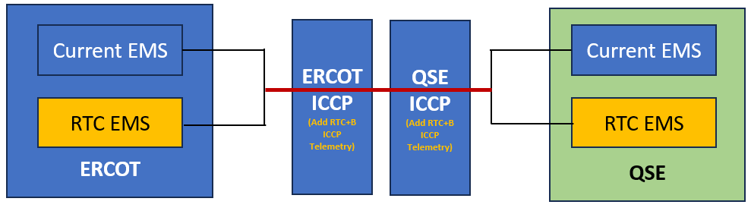
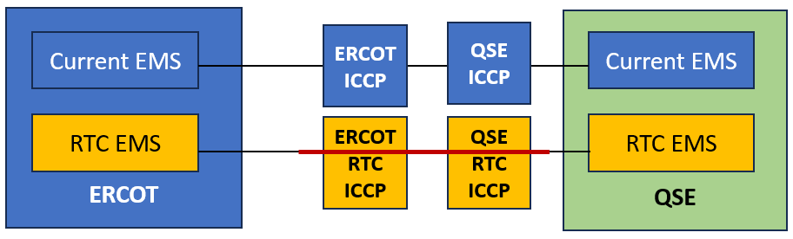
QSE ICCP Telemetry Configurations for Market Trials and Go-Live
QSE ICCP system configurations – Two options
  Option 1 - Add RTC+B telemetry points to current production ICCP system
    Setup and test on Test ICCP system as applicable
    Add new RTC+B telemetry points to current production ERCOT & QSE ICCP systems.
    Maintain the new RTC+B telemetry points through weekly model loads for existing & new resources and QSEs.
    Market Trials and Go live will be with current Production ICCP systems.
    RTC+B EMS Applications (SE, RTCA, LFC, RLC etc.) will use RTC+B single model ESR CIM.
  Option 2 - Standup Parallel ICCP systems for RTC+B Project
    ERCOT & QSE ICCP/EMS systems will operate on RTC+B telemetry points including Single Model Battery.
    Does not include current telemetry points that will be deleted post go live.
    Maintain the new telemetry points through weekly model loads for existing & new resources and QSEs.
    Market Trial and Go live will be on new ERCOT & QSE ICCP systems.
ERCOT & QSEs will have to standup new parallel RTC EMS system for both options

Slide 31
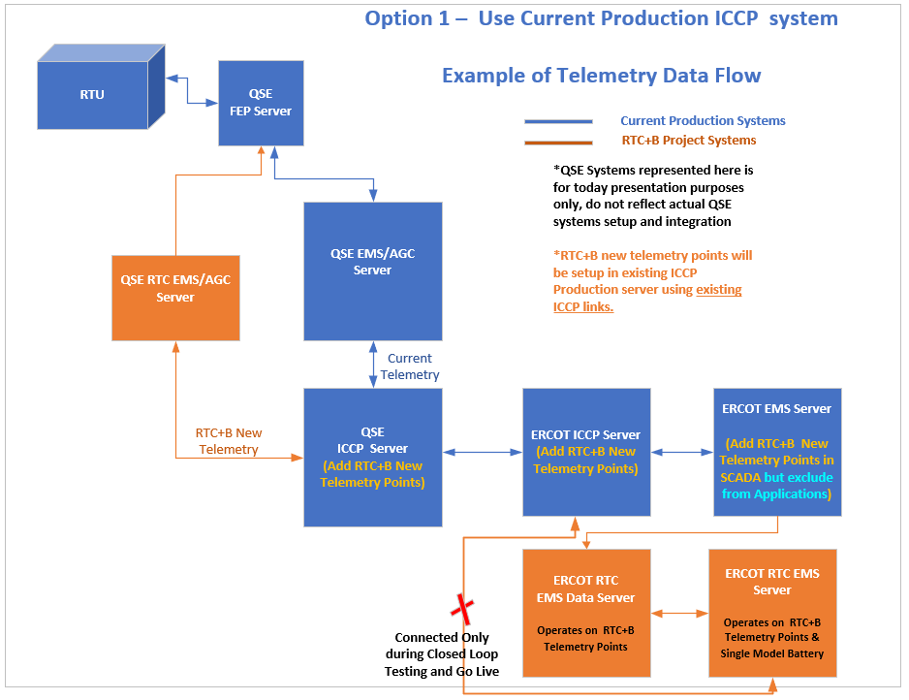
Option 1 – Example of Telemetry Data Flow

Slide 32
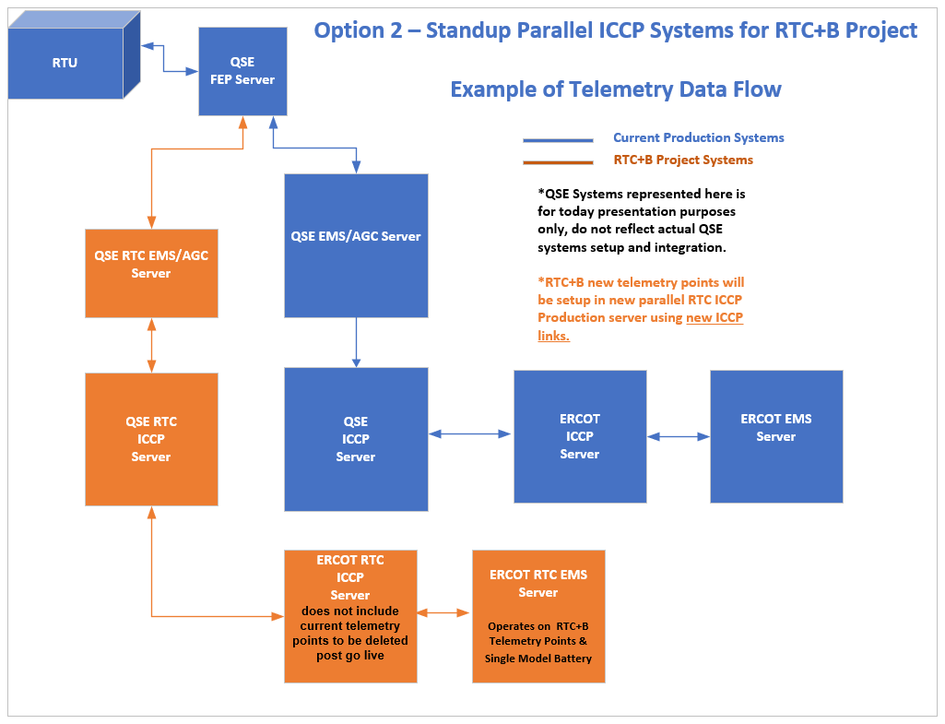
Option 2 – Example of Telemetry Data Flow

Slide 33
Additional Telemetry Points – for Option 1
If Option 1 is selected,
  For Single Model ESRs - New RTC+B telemetry points will be modeled under new ESR device name along with Current telemetry points which are not marked for deletion post go live (example: HSL, LSL, PSS, AVR etc.).
  For All Resources, additional resource status telemetry point (example: RSTB) is still needed.

Slide 34
ICCP Configurations – Pros & Cons
Options 2 – Standup Parallel ICCP Systems for RTC+B Project
  Pros
    Cleaner demarcation between current Production and RTC+B systems - avoids cross-impacts and system performance issues.
    Lower probability of impacts to current production applications.
  Cons
    Incurs hardware cost of new ICCP servers and cost of ICCP systems setup.
    Additional maintenance during market trials (several months) for QSEs and ERCOT to support new ICCP systems.
    Requires significant additional coordination between ERCOT and QSEs for ICCP cutover and cutback during Closed Loop Testing and Go-Live
    ICCP/EMS down times could be longer during Closed Loop Testing and Go-Live.
    Requires maintenance of two ICCP models – current Production and RTC+B project.
    May incur additional ICCP/SCADA databases license cost.
Option 1 – Use Current Production ICCP System
  Pros
    Avoids maintenance and support of new ICCP system for ERCOT and QSEs
    No additional ICCP systems hardware cost
    Does not require ICCP Cutover/Cutback for Closed Loop Testing and Go-Live – less risk involved and requires less coordination.
    Minimizes ICCP/EMS down times during Closed Loop Testing and Go-Live.
    Requires maintenance of only one ICCP model for both current Production as well as RTC+B for weekly model loads.
  Cons
    Current ICCP/SCADA Database size increase could impact system performance.
    Could impact current production applications if RTC+B telemetry points are mapped incorrectly.
    May incur additional ICCP/SCADA databases license cost.

Slide 35

Q&A Session

Slide 36
Next Steps
ERCOT to update ICCP Handbook and publish draft version to the ERCOT website.
QSEs/Vendors to plan the RTC+B ICCP/EMS systems design and implementation to align with ERCOT Market Trials timelines.
For any questions and feedback, contact me at Sreenivas.Badri@ercot.com

Slide 37
RTC+B Technical Workshops
Thank You!!!

