Slide 1
NPRR1230
Freddy Garcia

Slide 2
NPRR1230
Addresses operating conditions observed last summer for what is now South Texas Export IROL
  South Texas Export IROL: as system nears generation scarcity, SCED relaxes the IROL constraint because the optimization engine deems a shadow price cap violation ($5251/MW) a lower cost solution compared to a power balance penalty ($5000 times {MW of generation needed to be redispatched to solve the constraint})
    i.e. Hurting-Resource LMPs are not low enough for SCED to issue a curtailment
  ERCOT is currently using HDL overrides to help mitigate the constraint
    Requires manual operator intervention
    Difficult for the market to hedge/predict
NPRR1230 proposes to increase the Shadow Price Cap for some IROLs
  Establishes a transparent method for determining a new shadow price cap for an individual IROL if needed
  SCED will receive the signal to continue to manage the IROL
  Allows for the continued use of market tools
  Control Room Operators can focus on near-scarcity conditions

Slide 3
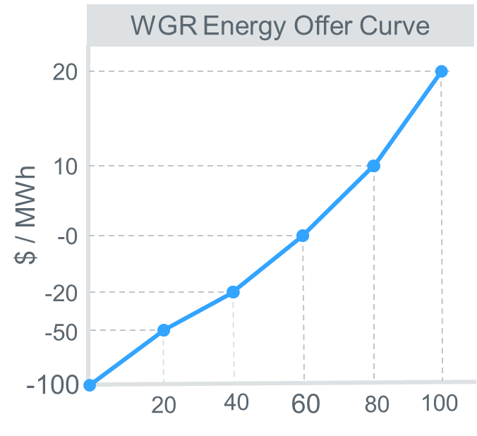
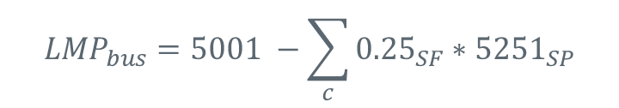
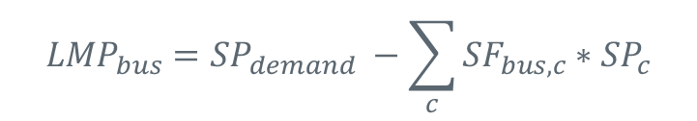

LMP with current IROL Shadow Price Cap
Locational Marginal Prices for Energy
Shadow Price of the Constraint “c”
$${LMP}_{bus}={SP}_{demand} −\sum_{c}{{SF}_{bus, c}∗{SP}_{c}}$$
Shift Factor of the bus on Transmission Constraint “c”
Also known as
System Lambda (λ)
$${LMP}_{bus}=5001 −\sum_{c}{{0.25}_{SF}∗{5251}_{SP}}$$
$${LMP}_{bus}=\$3,689$$
If LMPbus is greater than the Resource’s offer, SCED will violate the constraint under today’s rules.
For constraints with severe consequences (i.e. IROL), a higher shadow price is warranted to protect the system from severe outcomes.
Tradeoff is in the power balance constraint.
MW

Slide 4
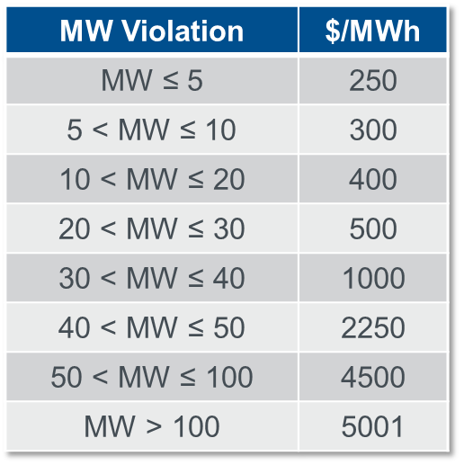
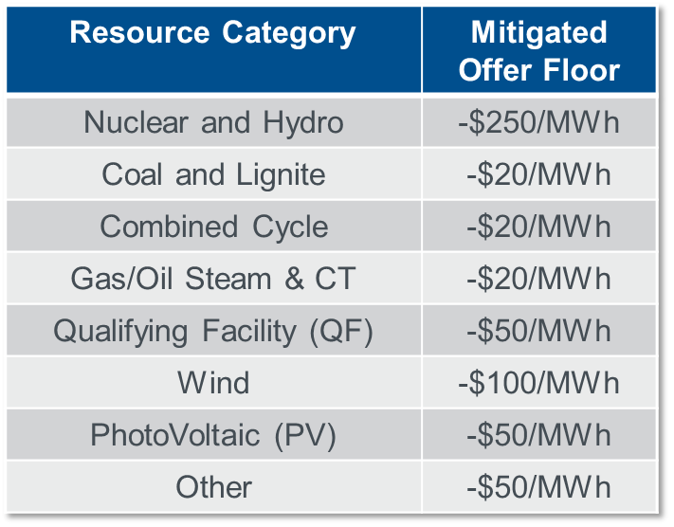

IROL Shadow Price Cap Proposal
The Shadow Price Cap for each IROL will be set upon implementation to either:
  Shadow Price Cap for a Base Case/IROL constraint = $5251
  Or $\frac{{Power balance penalty}_{max} − {Mitigated offer floor}_{Resource H} }{{Shift Factor}_{Resource H} }$ =
New IROL Shadow Price Cap
Power balance penalty
Mitigated offer floor

Slide 5
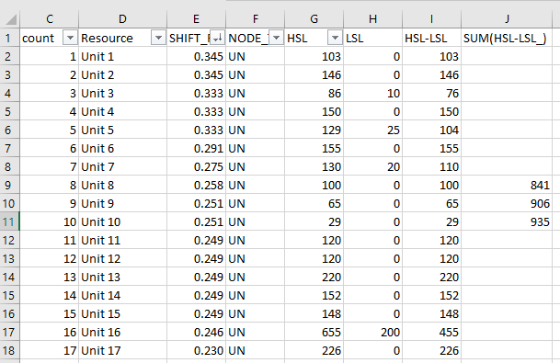
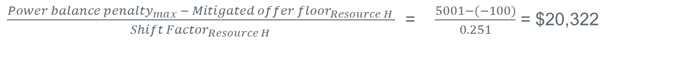
Resource H
Frequency Bias = 895 MW/0.1Hz
Sum of HSL – LSL at Unit = 996MW
Resource H = Unit 9
Resource Shift Factor = 0.251
$\frac{{Power balance penalty}_{max} − {Mitigated offer floor}_{Resource H} }{{Shift Factor}_{Resource H} }$ = $\frac{5001−(−100)}{0.251}$ = $20,322

Slide 6
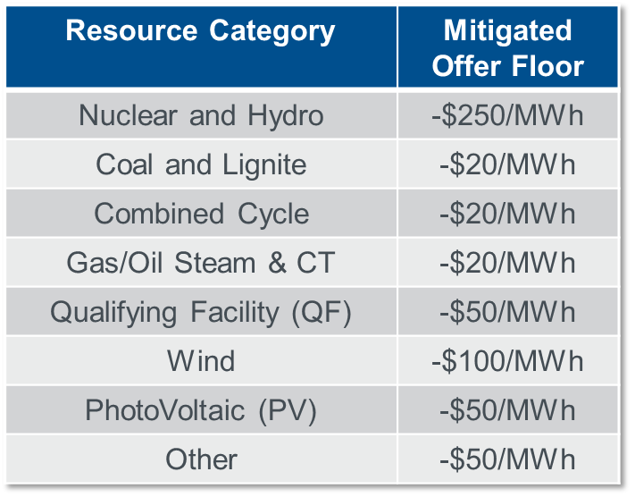
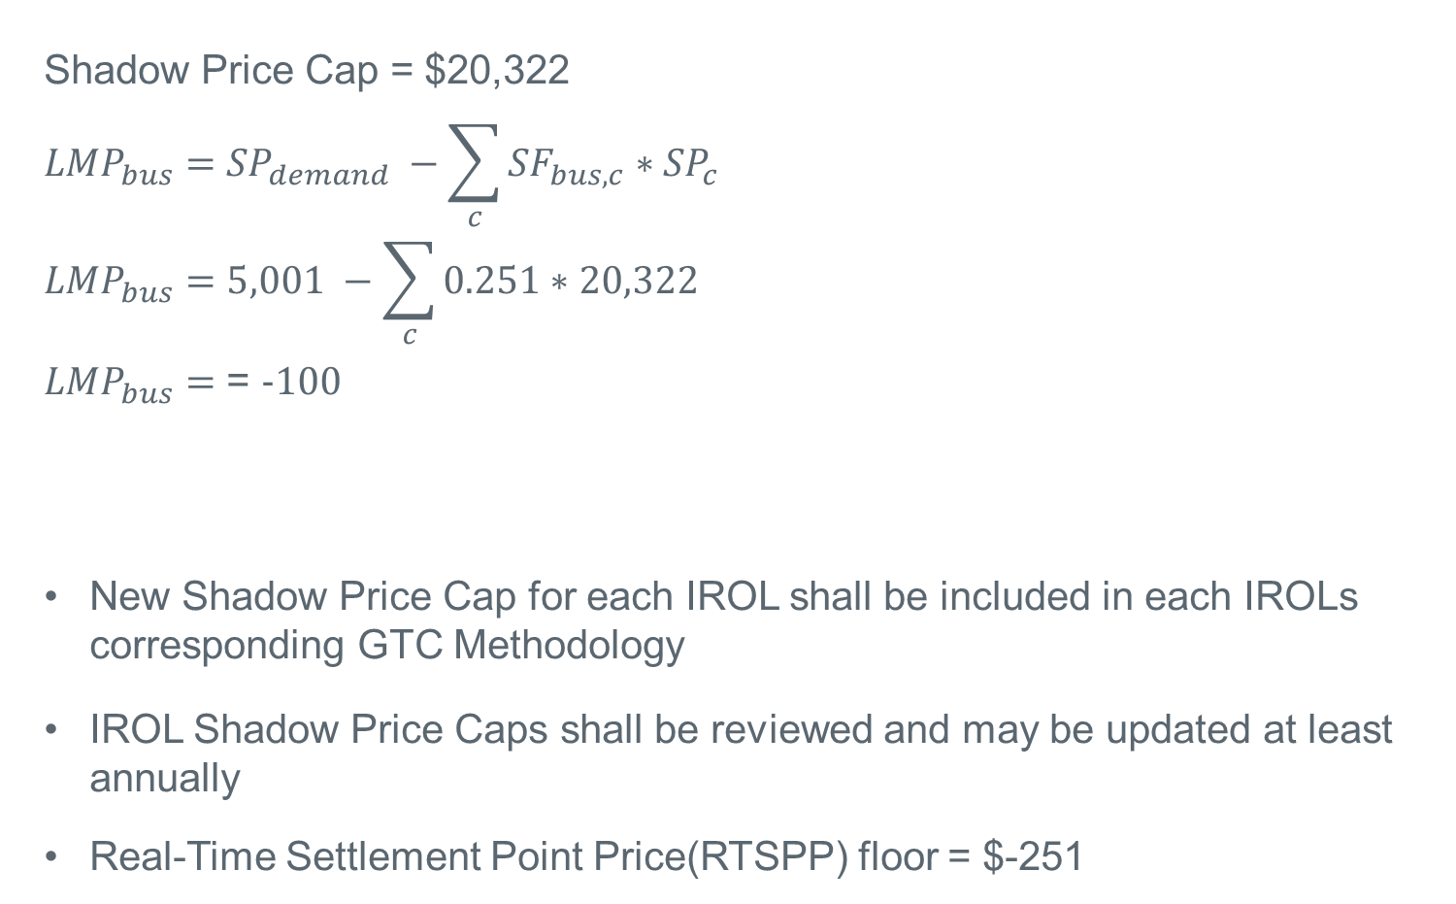
LMP Calculation with new Shadow Price Cap
Shadow Price Cap = $20,322
$${LMP}_{bus}={SP}_{demand} −\sum_{c}{{SF}_{bus, c}∗{SP}_{c}}$$
$${LMP}_{bus}=5,001 −\sum_{c}{0.251∗20,322}$$
${LMP}_{bus}=$ = -100
New Shadow Price Cap for each IROL shall be included in each IROLs corresponding GTC Methodology
IROL Shadow Price Caps shall be reviewed and may be updated at least annually
Real-Time Settlement Point Price(RTSPP) floor = $-251

