Slide 1
IEEE 2800, IEEE P2800.2 and IBRWG Updates
Julia Matevosyan
ERCOT IBRWG chair, IEEE2800.2 SG5 chair, NERC Inverter-Based Resource Performance Subcommittee (IRPS) chair

Slide 2
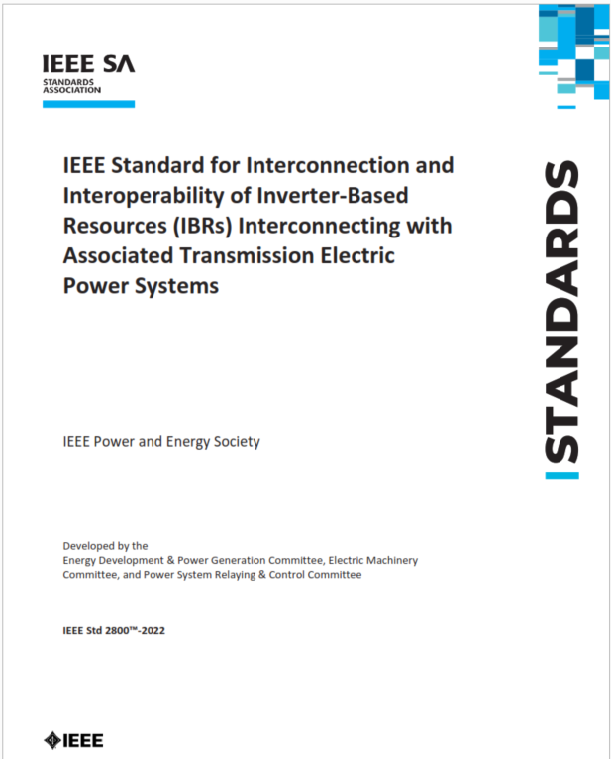
IEEE 2800-2022 Standard
The standard harmonizes Interconnection Requirements for Large Solar, Wind and Storage Plants
It is a consensus-based standard developed by over ~175 Working Group participants from utilities, system operators, transmission planners, & OEMs over 2 years
It has successfully passed the IEEE SA ballot among 466 SA balloters (>94% approval, >90% response rate)
Published on April 22, 2022 (Earth Day)
Only when adopted by the appropriate authorities, IEEE standards become mandatory
More Info at https://sagroups.ieee.org/2800/
Available from IEEE at https://standards.ieee.org/project/2800.html
and via IEEExplore: https://ieeexplore.ieee.org/document/9762253/
Source: IEEE 2800,SEIA-ACP Joint Webinar, May 2022

Slide 3
Source: Adapted from Jens Boemer, EPRI

Slide 4
Adoption Process, Based on Current Practice
IEEE2800 Adoption Process
IEEE 2800 Adoption Process
NO
Existing comprehensive req.?
YES

General Reference
Detailed Reference
Full Specification
Gap Analysis & Prioritization
Decision on applicability date
Decision on applicability date
Ref. to IEEE2800 included in relevant document(s)
Add ref. to IEEE2800 to relevant sections of existing document(s)
Develop new language to add to existing document(s)
Wait for IEEE2800.2 for verification procedures
Develop new verification procedures leveraging IEEE P2800.2 work and existing practices

Slide 5
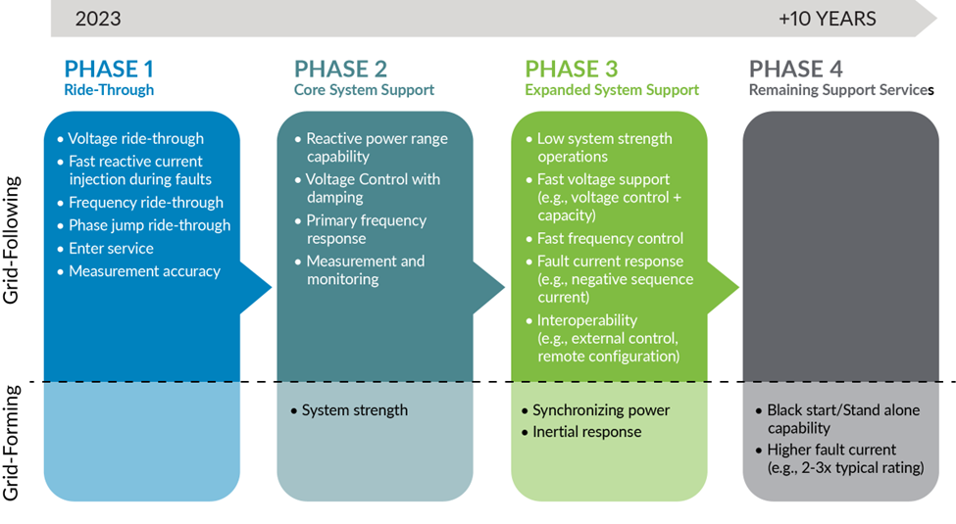
Adoption Priorities – MISO
MISO IEEE2800 Adoption Process
Planned for 2024
Attributes Roadmap Publication: https://cdn.misoenergy.org/2023%20Attributes%20Roadmap631174.pdf

Slide 6
P2800.2 Summary
Title: Recommended Practice for Test and Verification Procedures for Inverter-Based Resources Interconnecting with Bulk Power Systems
Scope:
Defines recommended practices for test and verification procedures that should be used to confirm plant-level conformance of IBRs interconnecting with bulk power systems in compliance with IEEE Std 2800.
Applies to IBRs interconnected to transmission and sub-transmission systems
May also apply to isolated IBRs that are interconnected to an alternating current (AC) transmission system via dedicated voltage source converter high-voltage direct current (VSC-HVDC) transmission facilities, e.g., offshore wind farms
Includes specifications for the equipment, conditions, tests, modeling methods, and other verification procedures that should be used to demonstrate conformance with IEEE 2800
Source: Andy Hoke (NREL), IEEE 2800 Conformity Assessment Pathways, presented at ERCOT IBRWG meeting, October 2023

Slide 7
Overview of conformity assessment steps in IEEE P2800.2 Recommended Practice for Test and Verification Procedures for IBRs Interconnecting with Bulk Power Systems
Type Tests
Lab or field tests of individual IBR unit for model verification
IBR Unit Model Validation
Based on type test data
IBR Plant Model Development
Based on validated IBR unit model(s) and balance of plant
IBR Plant Design Evaluation
Simulations to assess plant conformity to IEEE 2800
As-built Installation Evaluation
Verification of installed plant
Commissioning Tests
Partial field assessment of plant performance
Post-commissioning Monitoring
Monitoring of plant performance during grid events
Post-Commissioning Model Validation
Based on commissioning test data
Periodic Tests and Verifications
Design Evaluation
Plant construction complete
This is a general diagram of the process.
Details are under development in IEEE P2800.2.
Some variations permitted.
Source: Andy Hoke (NREL), Jens Boemer (EPRI)

Slide 8
Potential Adoption Timeline
Current Phase
Jan 2019- Dec 2020
Q2-Q4 2021
Q2 2022
Q2-Q4 2022
2023
2024
2025
2026 and Beyond
2800
WG Drafting in Parallel Subgroups
Balloting and Recirculation
Publication
P2800.2 Conformance verification
Kick-off and Directional Alignment
WG Drafting in Parallel Subgroups
WG Drafting in Parallel Subgroups
Complete WG Draft;
Balloting
Publication
Related activities
IEEE 1547.1 is published
NERC IRPWG Guidelines
FERC GI NOPR
IEEE 1547 Revision Kickoff
Potential 2800 Adoption, FERC 901 and 2023, NERC Stds
Potential 2800 Adoption
Potential 2800 Adoption
Potential P2800.2 Adoption
Source: Andy Hoke (NREL), Jens Boemer (EPRI)

Slide 9
P2800.2 Ongoing Discussions
Technical discussions around RoCoF and phase-jump ride through – cannot be reliably measured during fault conditions; measuring/calculation method to use under non-fault conditions
Multiple ride-through – thermal limitations for some wind turbines
Dynamic reactive current settling time – slower response may be needed during weak grid conditions
Transient overvoltage – how to test, both for inverter-level and plant-level
IEEE2800 conformity under evolving system conditions – what is expected and how to mitigate non-conformity?
ERCOT and IBRWG leadership are bringing these discussions back to IBRWG, NOGRR245 or future RRs language

Slide 10
FERC Order 90: Ongoing NERC Standard Development Efforts
Relevant (to this discussion) NERC Standards in works:
PRC-029 – Frequency and Voltage Ride‐through Requirements for Inverter‐Based Generating Resources – new, High priority completed by 2024.
PRC-028-1 – Disturbance Monitoring and Reporting Requirements for Inverter-Based Resources – new, High priority completed by 2024.
PRC-030-1 – Unexpected Inverter-Based Resource Event Mitigation – new, High priority completed by 2024.
EOP-004-5 – Event Reporting – update of existing standard, Medium priority completed by 2025 and beyond.
Standards are being drafted in alignment with IEEE2800 and, especially, to avoid conflict with IEEE2800

Slide 11
PRC-029 Implementation Plan (Draft)
Entities shall not be required to comply with Requirement R6 until six months after the effective date of Reliability Standard PRC‐029‐1, to assure additional time to complete the equipment limitation process as outlined below.
R6: Each GO… with a documented equipment limitation that would prevent an applicable IBR that is in‐service by the effective date of this standard from meeting voltage ride‐through requirements … shall communicate each equipment limitation to the associated Planning Coordinator(s), Transmission Planner(s), and Reliability Coordinator(s)
To assure compliance with R6 and alignment with FERC Order No. 901, only those IBR that are in operation as of the effective date of PRC‐029‐1 may be considered for potential exemption.
GOs with IBR that meet these criteria for equipment limitations must identify which of those IBR will be unable to meet voltage ride‐through requirements, as described in Requirement R6.
For each identified IBR, the associated GO must document:
Identifying information of the IBR (name, facility #, other)
Which aspects of voltage ride‐through requirements that the IBR would be unable to meet
Information regarding the limiting equipment
Information regarding any plans to repair or replace the limiting equipment that would remove the limitation (such as estimated date of repair/replacement)

Slide 12
IBRWG
Started in February 2022 (as a TF) following disturbance events involving multiple IBRs
Review of the results of disturbance event analysis & follow-ups, IEEE2800 vs ERCOT interconnection requirements gap analysis, discuss NOGRR245/255 updates, OEM presentations on capabilities and limitations, a few generator owners presented on capabilities and limitations of their fleet in fall 2023.
Continuous requests from ERCOT for maximization of ride-through capabilities and for more active participation of developers and GOs in IBRWG
Active participation primarily by OEMs, ERCOT, NERC, TRE, other region SMEs
Note, lack of participation from wider developers/ generator owner community puts additional burden on more pro-active ones.

Slide 13
Odessa Event Follow-Up, TMEIC
Corrective actions identified and implemented for systemic issues identified in Odessa event for 8 Resources involved in the events
As of March 2024, only 2 out of 8 have submitted updated models to ERCOT
Out of 28 other existing facilities with TMEIC inverters, 11 have up to date firmware and recommended protection settings, 9 are scheduled to complete by EOY, 7 are developing scope of work with TMEIC
TMEIC notified ERCOT that all new projects will have the up-to-date firmware with overcurrent mitigation and recommended protection settings.
All of the information is as of March 8th 2024, based on ERCOT’s presentation at IBRWG

Slide 14
Odessa Event Follow-Up, Power Electronics (PE)
Two plants with older inverters continue having ride-through issues, appears to be limitation of the inverter capability. RE re-submitted the models to reflect performance limitations
Another plant also has (different) older inverters and RE has adjusted LVRT and protection settings and facility has shown improved performance during subsequent events. RE re-submitted the models.
For two other plants PE developed firmware updates to improve ride-through performance (dc-side regulation)
Out of 18 other existing facilities with PE inverters, firmware upgrade was implemented at 16.
PE notified ERCOT that all new projects will have the up-to-date firmware with DC side regulation implemented
All of the information is as of March 8th 2024, based on ERCOT’s presentation at IBRWG

Slide 15
Other Events
Other events brought to IBRTF and IBRWG meetings in 2023, for all the events the voltage was well within ride-through requirement envelope:
Jan 2023, West Texas, normally cleared fault resulted in post-disturbance loss of 298 MW of solar generation from 8 different facilities (incl. 7 from Odessa events). During the fault 601 MW reduction was observed.
Oct 2023, West Texas, normally cleared fault resulted in post-event loss of 140 MW across 7 PVGRs, but larger reduction during the fault indicated by relatively large frequency drop of 0.035 Hz
Nov 2023, Dec 2023 and Jan 2024, South Texas Wind Events, normally cleared faults resulted in small (31-108 MW) post-disturbance loss of generation but large (446-900 MW) temporary reduction of wind generation during the fault event.
Following up on stakeholder request, ERCOT also reported of multiple smaller events over last five years involving WGR ride-through issues. Some events may have had a significantly greater MW loss if wind speed was higher at the time
17% (13 of 77 WGRs) with an SGIA before 11/1/2008 experienced ≥1 ride-through failure
34% (23 of 67 WGRs) with an SGIA after 11/1/2008 and before 1/16/14 experienced ≥1 ride-through failure
25% (53 of 211 WGRs) with an SGIA after 1/16/14 experienced ≥1 ride-through failure

Slide 16
Industry Need for Active GO and Developer Involvement
Synchronous generators perform primarily based on their physical characteristics and relatively standardized controls, such as automatic voltage and frequency control and power system stabilizer, with well established and documented principals and models
In contrast, IBR performance is control/software based and significantly more complex. OEMs utilize a variety of control philosophies, plant level control topologies, phase lock loop implementations, freeze and unfreeze logic states, built-in protective functions etc.
Another issue (was brought up during one IBRWG meeting) is lack of continuity between developers and Generator Owners, with projects changing hands multiple times and leading to gaps in plant modeling, understanding of capabilities and potential performance issues.
These complexities mean that developers and Generator Owners need to have more active roles in the forums where IBR performance is being discussed, converting lessons learned into implementable solutions.

Slide 17
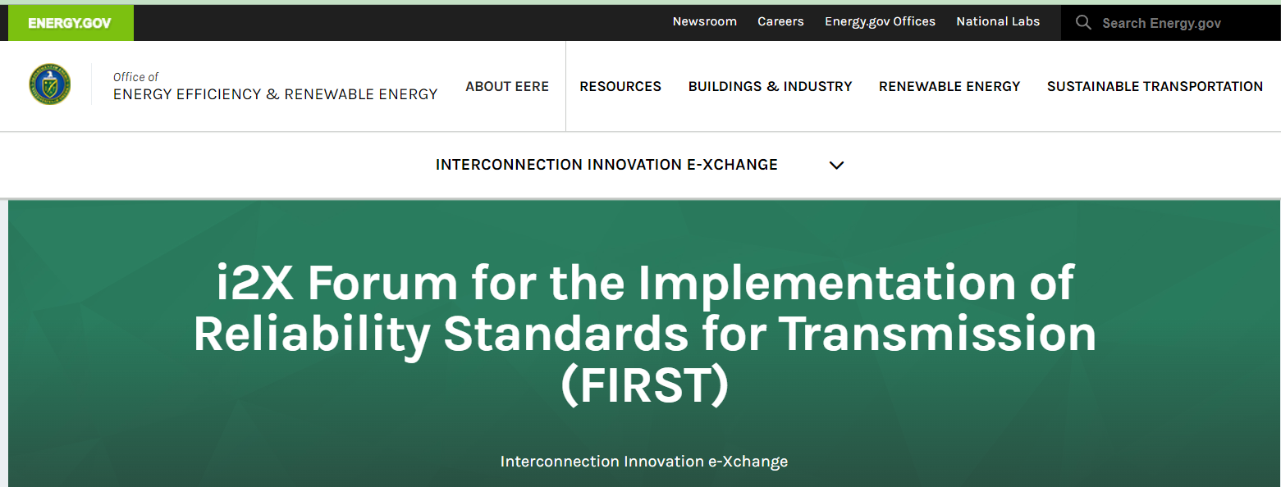
Thank you! Questions?
https://www.ercot.com/committees/ros/ibrwg
julia@esig.energy
https://www.energy.gov/eere/i2x/i2x-forum-implementation-reliability-standards-transmission-first

