Slide 1
TDTMS Update
RMS
May 7th, 2024

Slide 2
TDTMS
ERCOT Reporting
MIS API project update – Release to correct the issue of the missing key date in the GUI for initiating transactions if viewer is not the submitter was scheduled for April 25th.
MarkeTrak WSDL for SCR817 & TXSET 5.0 – repeated discussion from MCT where ERCOT was to host a technical meeting with MT API developers and market participant API users to review the changes to the MT API associated with SCR817. Any WSDLs are not expected until late July, however, the working session was to address high level changes for preparation.
Market Notice Archives – some market notices were not being archived due to character limit exceeded in the subject title. ERCOT is working on a fix.

Slide 3
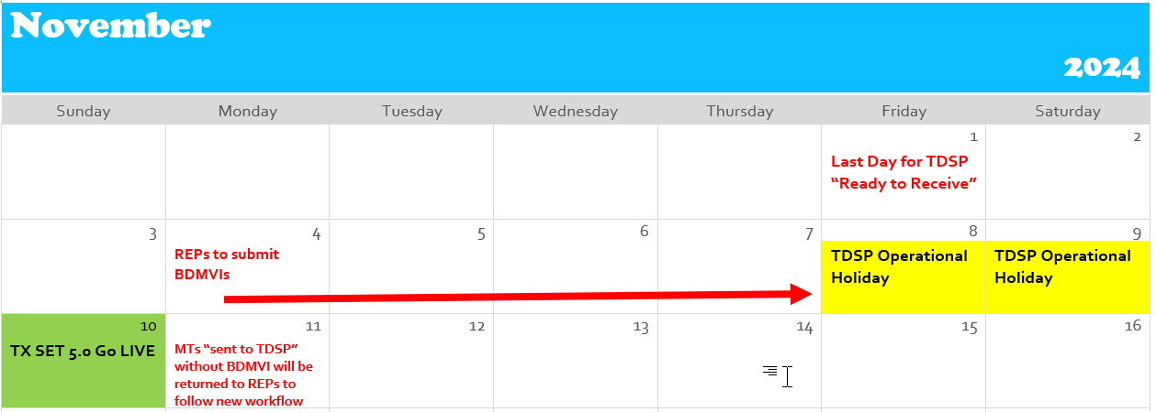
TDTMS
SCR 817
The group is working on approving the proposed User’s Guide revisions. ACTION item:
provide any comments/edits to Tammy Stewart for the Inadvertent Gain section
Next meeting, the group will review the minor edits to the User’s Guide for all other impacted subtypes.
Proposed Transition Plan:

Slide 4
TDTMS
TDTMS Other Topics
MarkeTrak Subtypes Volume for 2023 – ERCOT has provided “data dump” and smaller group will sort through data providing a deeper dive into Rescissions, Cancel w/ Approval, Service Orders, and DEVs
Data/Talking Points to Client Services on MT Analysis – Client Services is prepared to prepared to provide REP #s and direct REPs to the monthly IAG reports provided by ERCOT
TXSET 5.0 Related topics:
County Name attribute – sample flat files ERCOT requested via MarkeTrak to test the flat file process for adding to all ESIs. .txt files were requested by May
TDSP ESI Extract – when the new county name and optional meter service type will be added, where will the placement be in the extract?

Slide 5
TDTMS
Next Meeting – Tuesday, May 21st
DRAFT Agenda:
System Instances & MT Performance
Listserv
ERCOT Reports
MIS API update – follow up on ‘key dates’ populating
SCR817 Business Requirements Discussion
MarkeTrak Subtypes Volume Analysis 2023 – progress update
Review of User’s Guide drafts
Tuesday, May 21st - 1:30 AM WebEx only
Transition Plan for in flight MarkeTraks – IAGs
Market Notice Archives
IAG comments/edits
Other subtypes impacted
RMGRR revision - 7.3.5 Customer Rescission after Completion of a Switch Transaction (2)

