Slide 1

Current Limiting Reactor Losses
Presented by: Schneider Electric

Slide 2
Causes of Current Limiting Reactor Losses

Slide 3
CLR Losses cont.
Current limiting reactor (CLR) losses are the result of current passing through the CLR which are also in series with the line losses, increasing the overall impedance of the line. This is commonly done to reduce the short circuit current for the line. The conducting material has characteristic impedance that produce a voltage drop along the line proportional to the current flow. The total impedance and inductance are provided from the manufacturer, and the line resistance and reactance can be determine from these elements.

Slide 4
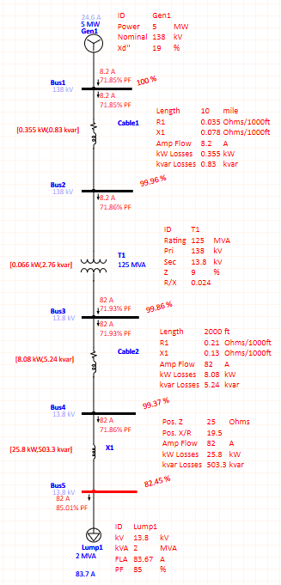
CLR Losses cont.
Utilizing ETAP I was able to build a test simulation of line losses, transformer losses, and current limiting reactor losses in series.
Used ETAP to model the impedance and calculate load losses in comparison to calculations in ION meter.
*Values are all test parameters to simulate I^2*Z losses to validate calculations within the meter.

Slide 5
CLR Losses cont.
The resistive component (R) of the impedance (Z) contributes to the active power losses (kWloss), while the reactive component (X) contributes to the reactive power losses (kVARloss).
The CLR nameplate typically provides the rated impedance and rated inductance. The reactive and resistance components can be calculated with the following equations:

Slide 6
CLR Losses cont.
The CLR-losses can be calculated based on the measured current load as:
For a 3-phase system, the losses for each phase are calculated separately according to the measured current as :

Slide 7
CLR Losses cont.
If we assume that the per-phase impedance is similar and use the average impedance, the equation simplifies to:
As current limiting reactors are an impedance in series the line conductor impedance, we can add the resistive and reactive elements together to get a total line resistance and reactance.

Slide 8
CLR Losses cont.
We can substitute the Rtotal and Xtotal values into the line-loss calculations to calculate the losses for the conductor and current-limiting reactor together. The line-loss equation simplifies to:

Slide 9
Loss Compensation Input Parameters

Slide 10
CLR Input Parameters cont.
Current limiting reactor losses are combined with the line losses and applied together, but are calculated separately from the transformer losses. Then applied to the measured power, energy, and demand quantities based on the location of the meter with regards to the power transformer, supply-side line, and load-side line.
All parameters required can be obtained from the current limiting reactor manufacturer.
Line loss calculation parameters:

Slide 11
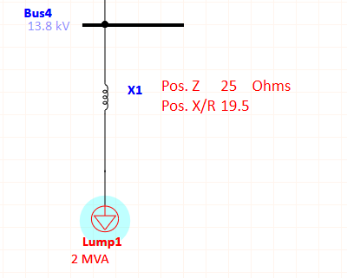
CLR Input Parameters cont.
For reactors on the supply side (SY) of the transformer:
For reactors on the load side (LD) of the transformer:

Slide 12
CLR Input Parameters cont.
ION Meters then calculate the reactor losses as:
When combined with line loss parameters the total line losses are:

Slide 13
CLR Input Parameters cont.
Converting Line Losses into Percent Loss Constants at 1/2 Class System Amps:

Slide 14
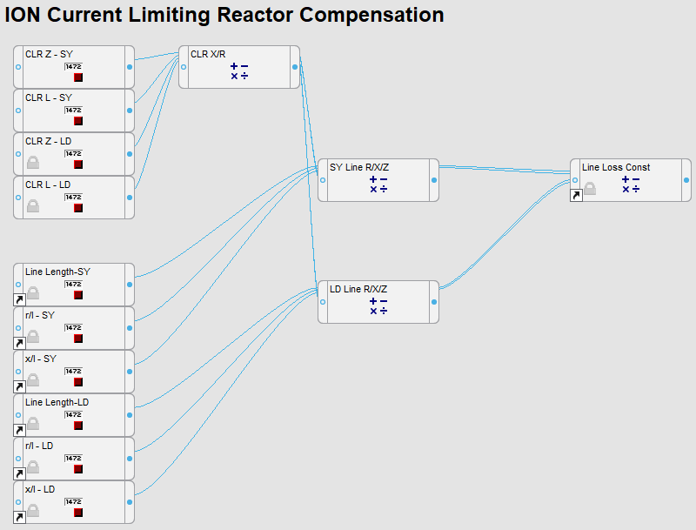
CLR Input Parameters cont.
Diagram of Framework
On the left are the External Numeric registers that are used to enter the CLR and Conductor impedance parameters. The control logic exists in the Loss compensation framework that has the Boolean modules the enable/disable and set line losses to be additive or subtractive.
NOTE: A division by "0" or a negative number in a square root would cause a "Not available" output on the Arithmetic modules.
The CLR arithmetic module calculates the R and X components for the current limiting reactor. As reactance is a function of frequency we're calculating X in real time, and then calculating R. Then the CLR R and X components are added with the conductor R and X components to get a total impedance for the line.

Slide 15
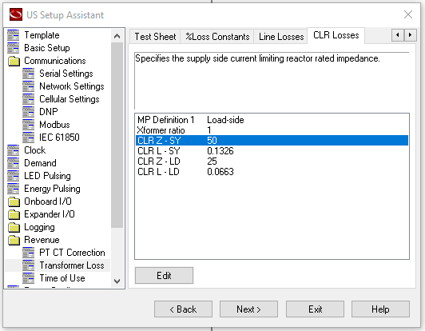
CLR Input Parameters cont.
Entering Current Limiting Reactor Losses in ION Setup
The following screen capture shows the data entry screen for CLR nameplate impedance and inductance to calculate losses within the meter.

Slide 16
Adding CLR Losses to ION Meters

Slide 17
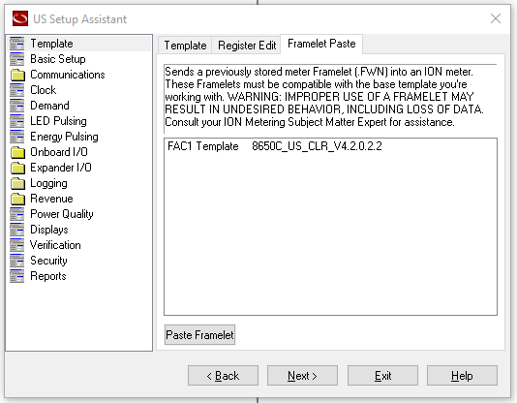
CLR Framelet
Use the framelet paste on any US template to add the CLR framework to the meter.
CLR framework is a part of the total loss compensation framework, and will still be enabled through the Comp Enable selection.

Slide 18
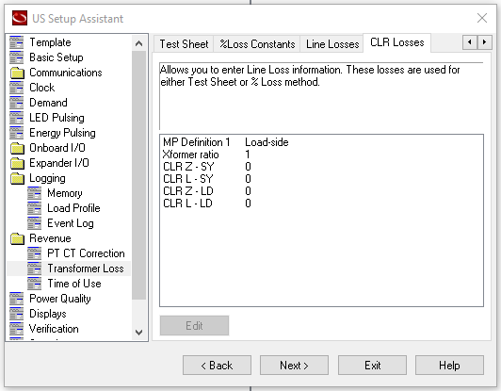
CLR Framelet cont.
A custom screen has been created for entering CLR loss parameters.
A packaged install can be created that includes framelet and GUI updates for the framework

Slide 19






Closing slide
se.com

