Slide 1
NPRR1224
Sensitivity Analysis for Power Balance Penalty based ECRS manual deployment trigger
Nitika Mago
Balancing Operations Planning Staff
April 26, 2024

Slide 2
Introduction
During discussion on NPRR1224, ECRS Manual Deployment Triggers at the April 05th 2024, Protocol Revision Subcommittee meeting, there was request to conduct a sensitivity analysis for the proposed Power Balance Penalty based manual deployment trigger.
Following is a recap of the proposed trigger in Nodal Protocol Section 6.5.7.6.2.4, Deployment and Recall of ERCOT Contingency Reserve Service in the version of NPRR1224 that was published on March 27, 2024.
  ERCOT may manually release up to 500 MW of ECRS capacity from SCED-dispatchable Resources when the power balance constraint is violated and the MW amount of power balance constraint violation is at or above 30 MW for at least ten consecutive minutes. Following such an ECRS release, if the power balance constraint violation remains at or above 30 MW, ERCOT may release additional MW of ECRS from SCED-dispatchable Resources.
ERCOT has conducted an analysis to test how often would this trigger could recommend release of ECRS if different combinations of power balance constraint violation (X, a negative value) and consecutive time duration (Y) for all SCED executions in June 1, 2023 – April 1, 2024.
This slide deck shares results from this analysis.
*For reference past ERCOT presentations on this topic include:
  March 19, 2024 Workshop Link
  April 03, 2024 WMS Link
  April 04, 2024 ROS Link
  April 15, 2024 TAC Link
  April 22, 2024 BoD R&M Link

Slide 3
Analysis Methodology
Results from all SCED executions between June 1, 2023 and April 1, 2024 were analyzed in this analysis.
  Note that ECRS was released on 29 days in this time frame.
The following values of X and Y were tested.
  X: -5, -10, -20, -30, -40, -50, -100 MWs
  Y: 0, 5, 10, 15, 20, 25, 30 minutes
The analysis reviewed the historic power balance penalty violations in every SCED execution and flagged the instances when the violation was greater than or equal to X for Y consecutive minutes.
When reporting results, only the first time in every Operating Day when the combination of X and Y were met is reported.
  This means if there are multiple times in an Operating Day when the X & Y combination are met, the earliest triggering time is reported.
Next two slides share a summary of the results from this analysis. The complete set of results are included in this workbook.*
*Note for the combination of X=-30 and Y =10, the triggering time results in this workbook and analysis in some cases are slightly different from the ones previously posted on https://www.ercot.com/calendar/03192024-2024-Ancillary-Services-Methodology. This is primarily attributed to the approach that the previous analysis used to track the consecutive minutes Power Balance Penalty violation was greater than or equal to 30 MW. The results from current analysis supersede the previous posting and are more accurate in tracking this.

Slide 4
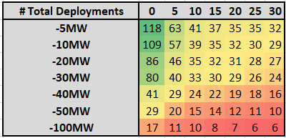
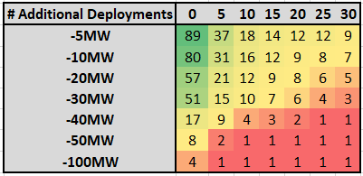
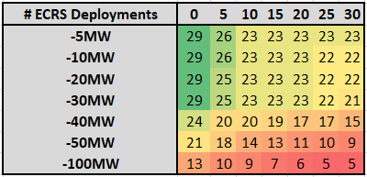
Summary of Results
Total Deployments: Total number of occurrences when the parameter pair were met indicating the potential for releasing SCED dispatchable ECRS.
New/Additional Deployments: Number of occurrences when the parameter pair were met on a day when ECRS was not historically released.
Same Day as historical ECRS Deployments: Total number of occurrences when the parameter pair were met on days when ECRS was historically released in Real-Time. (Continued on next slide)

Slide 5
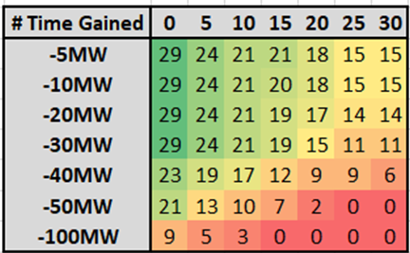
Summary of Results Same Day as Historical Deeper Dive
Same Day as historical ECRS Deployments: Total number of occurrences when the parameter pair were met on days when ECRS was historically released in Real-Time. (From previous Slide)
Time Gained: Number of occurrences when the parameter pair was met at or before the time ECRS was historically released.*
Time with No Gain: Number of occurrences when the parameter pair were met at a time after ECRS was historically released.*
*If ECRS was historically released multiple times on an Operating Day, the triggering time is compared to the earliest ECRS release of the day.

Slide 6
Summary
ERCOT appreciates the discussion and feedback received thus far on NPRR1224.
As noted previously, ERCOT has proposed using a power balance violation (X) value of 30 MW and duration (Y) of ten consecutive minutes based on analysis. ERCOT is open to stakeholder comments regarding alternative values of power balance violation and duration.
Please direct any questions and feedback specific to this analysis to OperationsAnalysis@ercot.com.

