Slide 1
Demand Side Working Group (DSWG)
April 26, 2024
ERCOT staff

Slide 2
NPRR Changes for Load Resources and ERS Deployments
NPRR1217 Removes requirement for VDI for LR and ERS deployments
Clarifies start and end time for ERS and LR deployments
Simplifies Control Room communications to market participants
Small change to the IA and implementation schedule
NPRR1131 CLR Participation in Non-Spin
Project underway in April
Latest Schedule from PMO office shows release in R7 – July
RTC+B Workshops underway
Significant changes coming that will affect LR participation in Ancillary Services (see schedule on next slide)

Slide 3
RTC+B Program Update (excerpt from April Board T&S RTC Update)

Slide 4
NPRR1090 (July 2021)
This Protocol change will not only eliminate the maximum number of deployment events during an ERS STC and the three-hour deployment limit, but will also eliminate the requirement for the ERCOT Operator to issue new deployment instructions for subsequent obligations during extended events.
This treats the Weather-Sensitive and Non-Weather Sensitive ERS Resource consistently as pertaining to the deployment rules.
Target Date for implementation is June 27 (JunSep24 SCT)

Slide 5
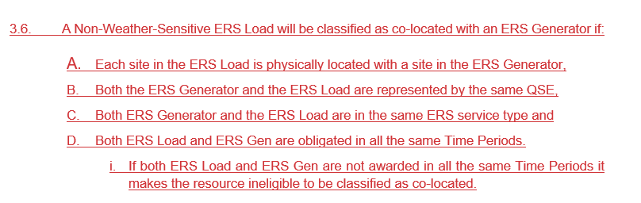
TRSOW Changes
Co-located resources
A Non-Weather-Sensitive ERS Load will be classified as co-located with an ERS Generator if each site in the ERS Load is physically located with a site in the ERS Generator, and if both the ERS Generator and the ERS Load are represented by the same QSE and are participating in the same ERS service type and Time Periods.

Slide 6
TRSOW Changes
Limits on aggregation sizes

Slide 7
09/06/2023 ERS Event
While performing the annual review of ERS, ERCOT discovered an error in calculating event performance
Initial performance analysis was done using the XML timestamp
ERCOT Nodal Protocol § 6.5.9.4.1(2) establishes that ERS ramp periods are considered to begin at the completion of a Verbal Dispatch Instruction (VDI)
ERCOT re-evaluated the event performance using the VDI timestamp
Market Notice was posted on April 22, 2024

