Slide 1
Firm Fuel Supply Service (FFSS) Deployment Report for 2023/24 Obligation Period
ERCOT
Wholesale Markets Subcommittee (WMS)
April 3, 2024

Slide 2
Background
This presentation is in response to the requirement under Protocol 3.14.5(11):
  “If FFSS is deployed, then ERCOT will provide a report to the TAC or its designated subcommittee within 30 days of the end of the FFSS obligation period. The report must include the Resources deployed and the reason for any deployments.”
There are additional reports that will be provided later in the year, specifically a report required under 3.14.5(13):
  “On an annual basis after the FFSS season, ERCOT will provide a report separately for the total amounts from Section 6.6.14.1, Firm Fuel Supply Service Fuel Replacement Costs Recovery, and Section 6.6.14.2, Firm Fuel Supply Service Hourly Standby Fee Payment and Fuel Replacement Cost Recovery, to the TAC or its designated subcommittee.”

Slide 3
Event Timeline
During the 2023/24 FFSS obligation period, there was one event that resulted in the deployment of FFSS from 01/13 23:00 to 01/17 09:00.
Leading up to this cold weather event, ERCOT began receiving information about gas supply restrictions impacting generating resources.
  This resulted in the determination to deploy FFSS resources
12:00 - Watch issued for forecasted cold weather event from 01/14 through 01/17
09:00 - Last FFSS deployments end. Watch and public notice cancelled
16:33- Public notification of First FFSS deployment instructions
23:00 - First FFSS deployment begins
01/13
01/14
01/15
01/16
01/17
01/18

Slide 4
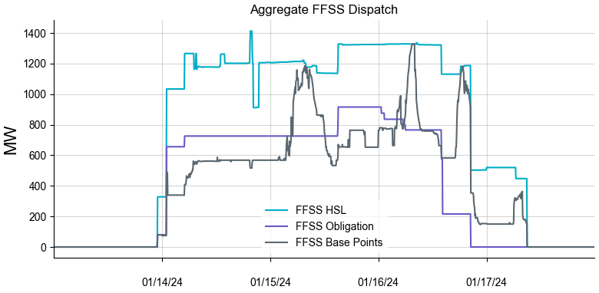
Summary of FFSS Deployments
10 Resources received an FFSS deployment
  Obligated to provide a maximum of 915.9 MW of aggregate capacity, based on awards from the FFSS procurement process.
  Telemetered a maximum aggregate HSL of 1,413.0 MW
  Given maximum aggregate base points of 1,330.0 MW

Slide 5
Deployment Details
Initial Notification Time for Deployment | Resource Name | Deployment Start | Deployment End | Reason
2024-01-15 14:27:58 | BRAUNIG_VHB6CT5 | 2024-01-15 15:00:04 | 2024-01-16 14:00:00 | Capacity
2024-01-15 14:29:03 | BRAUNIG_VHB6CT6 | 2024-01-15 15:00:59 | 2024-01-16 14:00:00 | Capacity
2024-01-15 14:30:10 | BRAUNIG_VHB6CT7 | 2024-01-15 15:00:57 | 2024-01-16 14:00:00 | Capacity
2024-01-15 14:31:52 | BRAUNIG_VHB6CT8 | 2024-01-15 15:00:37 | 2024-01-16 14:00:00 | Capacity
2024-01-13 17:37:31 | LHSES_UNIT1 | 2024-01-14 01:00:00 | 2024-01-16 20:30:00 | Capacity
2024-01-13 17:39:34 | LHSES_UNIT2A | 2024-01-14 01:00:00 | 2024-01-16 20:30:00 | Capacity
2024-01-13 16:33:15 | MIL_MILLERG2 | 2024-01-13 23:00:00 | 2024-01-17 09:00:00 | Capacity
2024-01-13 16:36:41 | MIL_MILLERG3 | 2024-01-13 23:00:00 | 2024-01-17 09:00:00 | Capacity
2024-01-13 16:52:19 | MIL_MILLERG4 | 2024-01-14 05:00:00 | 2024-01-17 09:00:00 | Capacity
2024-01-13 16:55:00 | MIL_MILLERG5 | 2024-01-14 05:00:00 | 2024-01-17 09:00:00 | Capacity
These deployments were issued through Verbal Dispatch Instruction (VDI) and occurred across multiple VDIs, particularly when they spanned across multiple Operating Days.

Slide 6
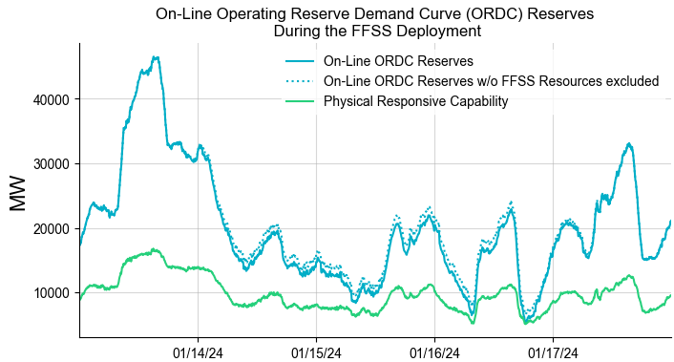
Real-Time Reserves and Pricing during the FFSS Deployment
The High Sustained Limit (HSL) of Resources deployed for FFSS is excluded from the on-line ORDC reserves.

Slide 7
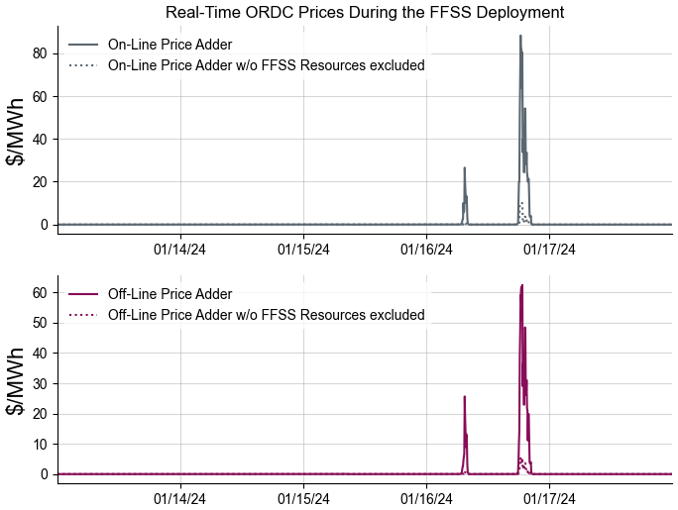
Real-Time Reserves and Pricing during the FFSS Deployment

Slide 8
Issues Identified During the Watch
Issues with FFSSR’s during the Watch for winter weather were identified by ERCOT staff. These issues will result in financial penalties.
  2 FFSSRs failed to come online or stay online.
    Both failures occurred during FFSSR deployments and involved unplanned mechanical issues that were not fuel-related nor caused by the cold weather.
    One FFSSR tripped offline on 01/14 for about 4 hours.
    One FFSSR tripped offline on 01/15 for about 1 hour.
  1 FFSSR was unavailable for deployment
    The FFSSR tripped offline during the Watch on 01/15 and was unavailable for deployment for about 3 hours. The FFSSR was not being deployed for FFSS when it tripped offline.

Slide 9
Observations and Next Steps
Due to the timing of the FFSS deployment within the obligation period and the on-going potential for extreme cold weather and natural gas supply disruptions, QSEs who requested fuel restocking for FFSSRs that were deployed were given approval to restock fuel reserves for FFSS.
A report will be provided on FFSS fuel replacement costs in the future, as required by Protocol.
An NPRR is being drafted based on lessons learned from this FFSS season. Areas of improvement include:
  Adding a procedure to clarify the fuel restocking process.
  Modifying the method by which the QSE notifies ERCOT when an alternate replaces an FFSSR.
  Clarifying when a Resource is considered available.

