Slide 1
Unregistered Distributed Generation Report:
2023 Annual Report
2024 Q1 Update
Resource Adequacy
5/1/2024

Slide 2
2023 Annual Unregistered Distributed Generation Report
Totals may not match the sum of their columns/rows due to rounding
Notes:
Competitive and NOIE breakdown:
Competitive: 1,411 MW
NOIE: 1,161 MW

Slide 3
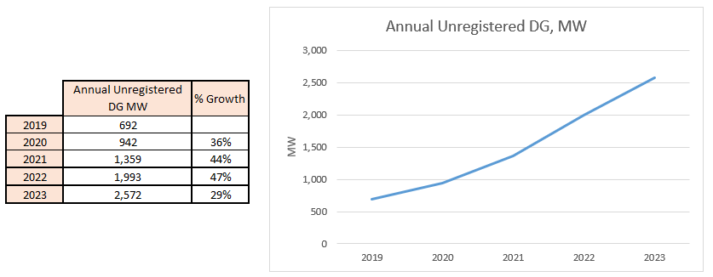
Annual Unregistered DG Growth Comparison
Competitive TDSP data: Same as 2023 Q4 quarterly report
NOIE data: All NOIEs required to report all capacity in annual report
Notes:
Competitive and NOIE breakdown:
Competitive: 1,411 MW
NOIE: 1,161 MW

Slide 4
2024 Q1 Unregistered Distributed Generation Report
Totals may not match the sum of their columns/rows due to rounding
Notes:
Competitive and NOIE breakdown:
Competitive: 1,474 MW
NOIE: 1,134 MW
For the quarterly report, NOIE capacity below 50 kW only includes information from NOIEs that have more than two MW of aggregate capacity from those sites.

Slide 5
2023 Q4 → 2024 Q1 Change
Totals may not match the sum of their columns/rows due to rounding

Slide 6
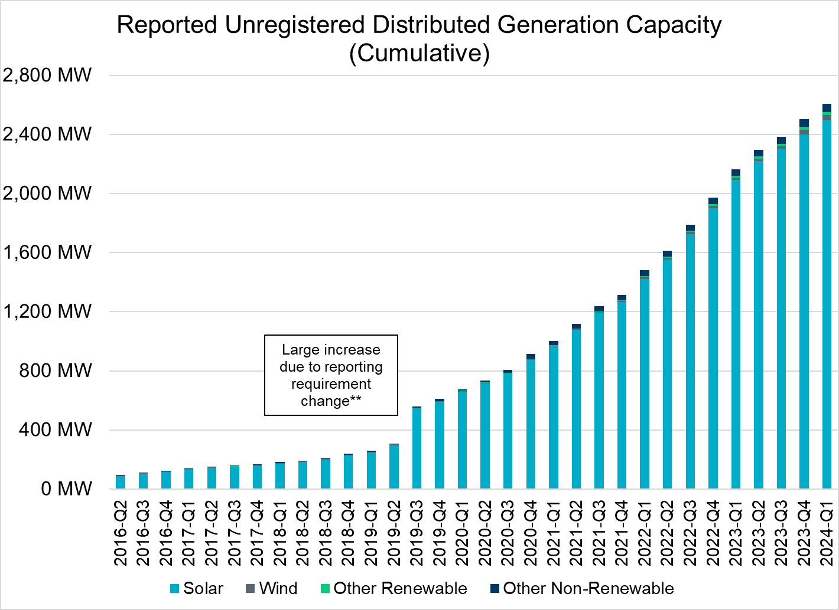
Unregistered DG Growth: 2016-Q2* to 2024-Q1
* 2016-Q2 was the first report published after implementation of report changes per NPRR794/COPMGR044
** 2019-Q3 was the first report published after implementation of report changes per NPRR891

