Slide 1
Project Update
April 5, 2024
Troy Anderson
ERCOT Portfolio Management

Slide 2
Project Update Agenda
Recent / Upcoming Project Highlights
2024 Release Targets
Major Projects
Additional Project Status Information
Priority/Rank Recommendations for Revision Requests with Impacts
None
Technology Working Group (TWG)
Items discussed at 3/28/2024 meeting
Aging Revision Request Project Review
Location of Revision Request Project Information: http://www.ercot.com/services/projects

Slide 3
Recent / Upcoming Project Highlights
2024 March Off-Cycle Release – 3/1/2024 Complete
NPRR1026(b) – Self-Limiting Facilities reporting
NPRR1172(a) – Fuel Adder Definition, Mitigated Offer Caps, and RUC Clawback
Section 5.5.2, Reliability Unit Commitment (RUC) Process
Section 5.7.2, RUC Clawback Charge
Section 6.6.12.1, Switchable Generation Make-Whole Payment
2024 March Off-Cycle Release – 3/11/2024 Complete
NOGRR247(a) – Change UFLS Stages and Load Relief Amounts
Increases the number of Load shed stages from three to five
Changes the Transmission Operator (TO) Load relief amounts to uniform increments of 5% for each stage
Adds a UFLS minimum time delay of six cycles (0.1 seconds)
2024 March Release – R3 – 3/28/2024 Complete
NPRR1040 – Compliance Metrics for Ancillary Service Supply Responsibility
2024 April Off-Cycle Release – 4/1/2024 Complete
NPRR1165 – Revisions to Requirements of Providing Audited Financial Statements and Providing Independent Amount
NPRR989(a) – BESTF-1 Energy Storage Resource (ESR) Technical Requirements
NOGRR204(a) – Related to NPRR989, BESTF-1 ESR Technical Requirements
NPRR1038 – BESTF-8 Limited Exemption from Reactive Power Requirements for Certain ESRs
Note: Projected Go-Live dates are subject to change. Please watch for market notices as the effective dates approach.

Slide 4
2024 Release Targets – Approved NPRRs / SCRs / xGRRs
R1
R3
R5
January 1/25 | February 2/22 | March 3/28 | April 4/25 | May 5/30 | June 6/27
NPRR1092(b) PGRR098(a) ESR Telemetry Public API Enhancements | NPRR1132(a) RRGRR032 NOGRR249(b) NPRR1184(a) NPRR1026(b) NPRR1172(a) | NPRR1040 NOGRR247(a) NPRR1165 NPRR989(a) NPRR1038 NOGRR204(a) |  | Forecast Presentation Platform NPRR1149 NPRR1186 NPRR1196 NPRR1121 NPRR1090 NPRR962 SCR819 NPRR1111
R2
R4
R6
ü
ü
ü
ü
ü
ü
ü
ü
ü
ü
NS
P
ü
ü
ü
ü
ü
ü
E
E
E
E
E
E
E
E
E
1/1
3/11
6/13
Various effective dates
2/1
2/26
4/1
2/16
3/1
R7
R9
July 7/25 | August 8/22 | September 9/26 | October 10/24 | TX SET 5.0 11/10 | December 12/11-12/12
NPRR1131 NPRR1002 RRGRR023 | NPRR1139 SCR813 | NPRR1183 | NPRR1183 | NPRR1095 SCR817 SCR823 RMGRR172 RMGRR168 | NPRR1023
R8
R10
R11
NS
E
E
NS
E
E
E
E
E
P
Go-live dates can differ from Protocol effective dates – Please refer to market notices for more details
APPENDIX
Red Text: New additions and target release changes
Strike-Through Text: Previous target release
(a), (b), etc.: Multiple phase release
Project Status Codes
NS = Not Started
I = Initiation
P = Planning
E = Execution
H = On Hold
NPRR989(a) – ESR tech. req.
NPRR1026(b) – SLF – Reporting
NPRR1092(b) – Limit RUC Opt-Out
NPRR1132(a) – RIOO portion
NPRR1172(a) – Phase 1 elements
NPRR1184(a) – Interest calcs
NOGRR204(a) – ESR tech req
NOGRR247(a) – UFLS changes
NOGRR249(b) – MIS posting
PGRR098(a) – Section 4.1.1.8
Release targets are subject to change

Slide 5
Major Projects
Other Project Highlights

Slide 6
Additional Project Status Information
RR | Description | Proj Phase | Additional Detail
NPRR1131 | Controllable Load Resource Participation in Non-Spin | Not Started | Approved for April 2024 start
NPRR1139 | Adjustments to Capacity Shortfall Ratio Share for IRRs | Not Started | Approved for April 2024 start
SCR799 | ERCOT Outage Study Cases in the System Operations Test Environment (SOTE) | Not Started | Approved for July 2024 start
NPRR1004 | Load Distribution Factor Process Update | Not Started | Assessing for start potential based on Market Participant feedback at March 2024 PRS meeting
NPRR1006 | Update RT On-Line Reliability Deployment Price Adder Inputs to Match Actual Data | On Hold
NPRR1058 | Resource Offer Modernization | Not Started
NPRR1091 | Changes to Address Market Impacts of Additional Non-Spin Procurement | Not Started
NPRR1128 | Allow FFR Procurement up to FFR Limit Without Proration | Not Started
NPRR1171 | Requirements for DGRs and DESRs on Circuits Subject to Load Shedding | Not Started
NPRR1213 | Allow DGRs and DESRs on Circuits Subject to Load Shed to Provide ECRS and Clarify Language Regarding DGRs and DESRs Providing Non-Spin | Not Started
Red Text: New additions and updates

Slide 7
Priority / Rank Recommendations for Revision Requests with Impacts
Recommendations for…
Revision Request | Description | Priority | Rank | Comments
None
PPL Rank Information
Next available 2024 Rank in Business Strategy = 4100
Next available 2025 Rank in Business Strategy = 4520
Next available 2026 Rank in Business Strategy = 4710
Next available Rank in Regulatory = 380

Slide 8
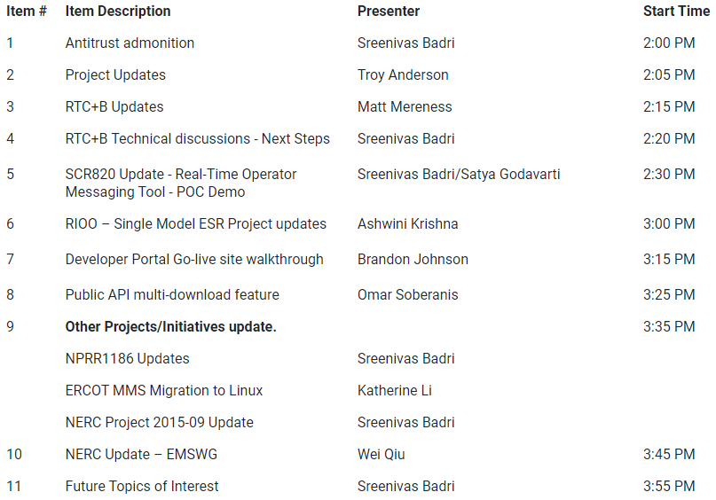
Technology Working Group (TWG)
3/28/2024 TWG discussion topics:

Slide 9
Aging Revision Request Project Review
Limited discussion on the “Aging Revision Request” list due to the quick turnaround between the March and April PRS meetings
Expect detailed discussion at May PRS
Updated draft Gantt on slides 11-13
TBD | NPRRs: 484,825(b),826,829,841,857,879,885,904,918,930,936,941,945,963,965,975,987,989,995,1004,1006,1007,1019,1020(b),1029,1030,1032,1034,1038, 1057,1058,1077,1091,1098,1105,1128,1131 SCRs: 799,805,810,818 PGRRs: 066,076,088,091,094,099,103 Other: OBDRR009,OBDRR017,RRGRR028

Slide 10
Aging Revision Request Project Review
Reminder: If PRS determines that one or more aging Revision Requests are candidates for removal, the process is to file a “new RR” to strike it
The “new RR” would go through the stakeholder process like any other RR
There are several historical examples of this from 2015:
NPRR721 – Removal of Language related to NPRR455
NPRR722 – Removal of Language related to NPRR181
NPRR724 – Removal of Language related to NPRR493
NPRR727 – Removal of Language related to NPRR327
NPRR728 – Removal of Language related to NPRR484 and NPRR554
TBD | NPRRs: 484,825(b),826,829,841,857,879,885,904,918,930,936,941,945,963,965,975,987,989,995,1004,1006,1007,1019,1020(b),1029,1030,1032,1034,1038, 1057,1058,1077,1091,1098,1105,1128,1131 SCRs: 799,805,810,818 PGRRs: 066,076,088,091,094,099,103 Other: OBDRR009,OBDRR017,RRGRR028

Slide 11
Aging Revision Request Project Review

Slide 12
Aging Revision Request Project Review

Slide 13
Aging Revision Request Project Review

